Slide 1
HL7 RIM
Exegesis and Critique
Regenstrief Institute, November 8, 2005
Barry Smith
Director
National Center for Ontological Research
http://ncor.us

Slide 2
“Health Level 7 Reference Information Model” (HL7 RIM)
– a standard for exchange of information between clinical information systems
The goal of the RIM is a laudable one, and its attempt to achieve it in a highly ambitious way is to be applauded

Slide 3
Reason for scepticism?
poor documentation
many logical and ontological problems
problematic treatment of definitions

Slide 4
Reason for scepticism?
HL7 v3 – a healthcare messaging system – as basis for a clinical record architecture extending as far as core genomic data
Compare: using air-traffic control messaging as a starting point for a science of airplane thermodynamics

Slide 5
Are definitions like this a good basis for biomedical science?
LivingSubject
Definition: A subtype of Entity representing an organism or complex animal, alive or not.

Slide 6
Person
Definition: A Living Subject representing single human being [sic] who is uniquely identifiable through one or more legal documents

Slide 7
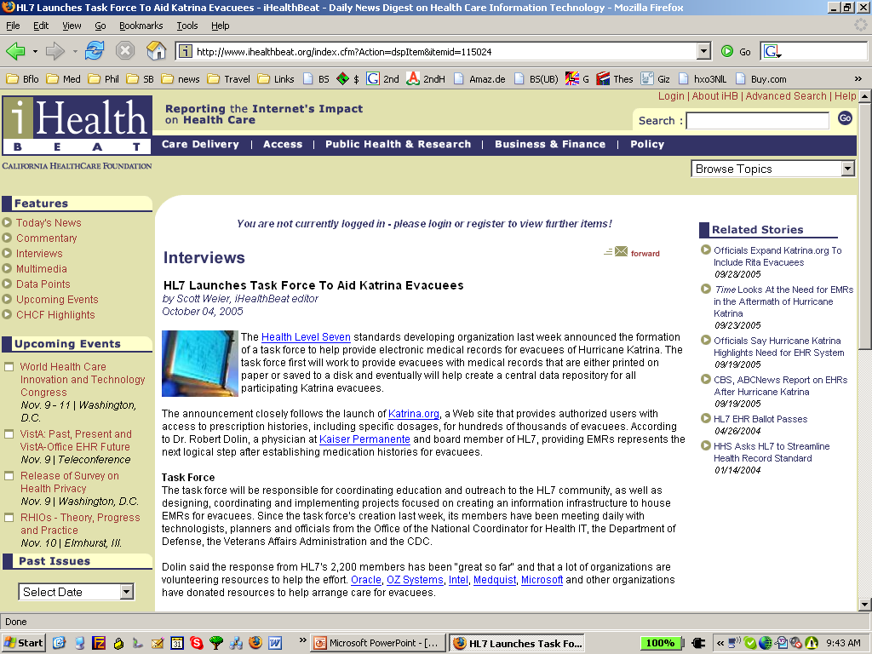
Katrina

Slide 8
Katrina

Slide 9
The Problem of Circularity
Person = Person with documents
‘An A is an A which is B’
– useless in practical terms, since neither we nor the machine can use it to find out what ‘A’ means
– incorporates a vicious infinite regress
– has the effect of making it impossible to refer to A’s which are not Bs, for example to undocumented persons

Slide 10
What is the RIM about?
blood pressure measurement = an information item
blood pressure = something in reality which exists independently of any recording of information, and which the measurement measures
Q: Is the RIM about information, or about the reality to which such information relates?
A: There is no difference

Slide 11
RIM Philosophy
“The truth about the real world is constructed through a combination and arbitration of attributed statements ...
“As such, there is no distinction between an activity and its documentation.”

Slide 12
Unfortunately
this very distinction raises its head at almost every turn in the RIM documentation
which means that two incompatible conceptions of what the RIM is all about are fighting to achieve dominance within it

Slide 13
The Information Model Conception of the RIM
the RIM ‘is a static model of health and health care information’
The scope of the RIM’s class hierarchy consists in packets of information:
the information content of invoices, statements of observations, lab reports, …

Slide 14
Yet:
the examples provided to illustrate these classes involve the familiar kinds of things and processes in reality (medication, patients, devices, paper documents, surgery, diet, supply of bedding) with which healthcare messages are concerned.
→ The Reference Ontology Conception of the RIM

Slide 15
A good, general constraint on a theory of meaning
For each linguistic expression ‘E’
‘E’ means E

Slide 16
From the perspective of the Information Model conception
  a RIM term such as ‘medication’ does not mean ‘medication’ in the RIM
  rather it means:
  ‘the record of medication in an information system’.
  Similarly ‘stopping a medication’ means not: ‘stopping a medication’ but rather:
  ‘change of state in the record of a Substance Administration Act from Active to Aborted’.

Slide 17
An A is the B of an A
Definition of Benefit Coverage: A description of the benefits provided by an individual’s benefit plan
benefit coverage = description of benefit coverage

Slide 18
Logically Contradictory Definitions
Definition of Act: An Act is an action of interest that has happened, can happen, is happening, is intended to happen, or is requested/demanded to happen.
Definition of Act: An Act is the record of something that is being done, has been done, can be done, or is intended or requested to be done.

Slide 19
An Act is the record of an act
Examples of Act under this heading:
(4) treatment services (such as medication, surgery, physical and psychological therapy), (5) assisting, monitoring or attending, (6) training and education services to patients and their next of kin, (7) notary services (such as advanced directives or living will) …
(The Reference Ontology conception)

Slide 20
The RIM’s Entity class
persons, places, organizations, material

Slide 21
States of Entity
• active: The state representing the fact that the Entity is currently active.
• inactive: The state representing the fact that an entity can no longer be an active participant in events.
• normal: The “typical” state. Excludes “nullified”, which represents the termination state of an Entity instance that was created in error
• nullified: The state representing the termination of an Entity instance that was created in error.
(The information Model conception)

Slide 22
Persons are Entities
What does ‘active’ and ‘inactive’ mean as applied to Person?
Is there a special kind of death-through-nullification in the case of these instances of Person who were created in error?
(The definitions of ‘active’ and ‘inactive’ provide no assistance in this regard.)

Slide 23
A Person is not a person
In fact however ‘Person’ refers not to persons, but to objects in information systems – entities created through processes of data entry.
They undergo not: processes such as being treated, falling ill, being born, dying, moving from place to place (the processes-of-interest in the domain of healthcare),
but: processes of being revised, reactivated, nullified
(The information Model conception)

Slide 24
But then what about: ‘Entity.name’
Definition: A non-unique textual identifier or moniker for the Entity.
Examples: Proper names, nicknames, legal names of persons, places or things.
(The Reference Ontology conception)

Slide 25
And what about the HL7 Glossary:
Instances of Person include: John Smith, RN, Mary Jones, MD, etc.
(The Reference Ontology conception)

Slide 26
An A is not an A
Definition of Animal: A subtype of Living Subject representing any animal-of-interest to the Personnel Management domain.
An Animal is not an animal. Rather (an) Animal represents an animal: it is an information item which represents a certain highly specific kind of animal-of-interest, namely an animal that is of interest to the Personnel Management domain.

Slide 27
Conclusion
The RIM should be divided into two separate artefacts:
an information model in the proper sense, including terms like ‘name of a person’, ‘record of an observation’, ‘social security number’, etc.
a reference ontology, including terms like ‘person’, ‘observation’, ‘medication’, ‘disease’, etc.

Slide 28
problems with syntactic regimentation
‘act’, ‘Act’, ‘Acts’, ‘Act’, ‘Acts’
an Act is …
Act is …
Acts is …
? an Acts is …

