Slide 1
A plant disease extension of the Infectious Disease Ontology
Ramona Walls¹, Barry Smith², Justin Elser³, Albert Goldfain⁴
Dennis W. Stevenson¹, Pankaj Jaiswal³
1. New York Botanical Garden, Bronx, NY, USA,
2. Department of Philosophy, University at Buffalo, Buffalo, NY, USA,
3. Department of Botany and Plant Pathology, Oregon State University, Corvallis, OR, USA,
4. Computer Science Department, Blue Highway, Inc., Syracuse, NY, USA
With thanks to Lindsay Cowell (IDO), Lol Cooper (PO), and Laura Mooray (PO)
Notes:
Also thank Lindsay and Lol!

Slide 2
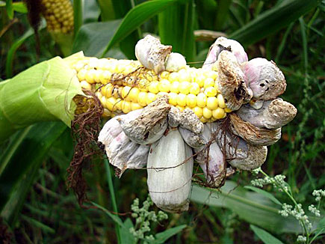
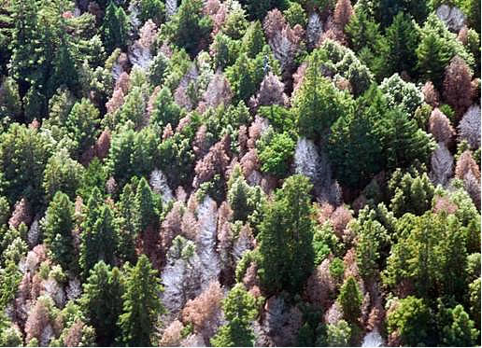
Corn smut
Ustilago maydis
Sudden oak death
Phytophthora ramorum
Notes:
Ontologies are essential tools for accessing and analysing the large quantities of data that come with these newer methods. As part of a larger project to develop ontologies that describe plant phenotypes and stresses, we are developing a plant disease extension of the Infectious Disease Ontology (IDOPlant).

Slide 3
Traditional definitions
Plant disease: A deviation from normal physiological functioning that is harmful to a plant.
Plant infectious disease: A plant disease caused by an infectious agent (bacteria, fungus, virus)
Abiotic (non-infectious) plant disease: A plant disease that results from some abiotic stress
such as heat, cold, nutrient deficiency, or drought

Slide 4
Ontologies for plant phenotypes and stress
GO Biological processes
PO Plant anatomical entities
Plant development stages
IDO Infectious diseases
OGMS Disorders and diseases
IDOPlant Plant infectious diseases
TO Plant traits
Plant stress and disease
GAZ Geography
PATO Phenotypic qualities
ENVO Habitats
NCBITaxon Plants Pathogens Vectors
Notes:
images of different OBO Foundry ontologies involved in describing plant phenotypes and diseases

Slide 5
IDO-
avian flu
IDOPlant-
rice bacterial leaf blight disease
IDOflu
Influenza
IDO-human flu
IDO Infectious diseases
IDOPlant
Plant infectious diseases
IDObru
Brucellosis
IDOPlant-
potato blight
IDOmal
Malaria
Notes:
Could either create more detailed sub-ontologies of IDOplant, or create community views for specific diseases using Ontodog.

Slide 6

Applicability to plant pathology:
Rooted in BFO – compatible with other OBO Foundry ontologies
imports from OGMS, GO, OBI, ENVO
Most term definitions are compatible with plant pathology without modification
disease, disorder, resistance to infectious agent

Slide 7
Example:
IDO:infectious disease : A disease whose physical basis is an infectious disorder.
OGMS:disease: A disposition (i) to undergo pathological processes that (ii) exists in an organism because of one or more disorders in that organism.
Notes:
Although the wording of definitions such as this may be unfamiliar to plant pathologists, the meaning is consistent with traditional treatments of plant disease.

Slide 8
More challenging:
IDO:subclinical infection: An infection that is part of an asymptomatic host.
IDO:transition to clinical abnormality or subclinical infection: A process by which a part of an organism or something contained in an organism becomes clinically abnormal.
clinical abnormality (as used by OGMS):(1) not part of the life plan for an organism of the relevant type … (2)causally linked to an elevated risk either of pain or other feelings of illness, or of death or dysfunction, and (3) is such that the elevated risk exceeds a certain threshold level (Scheuermann et al., 2009)
Notes:
The word “clinical” is not commonly used for plants, but the meaning of their definitions was appropriate for plants, despite the names

Slide 9
Even more challenging: OGMS/IDO terms that are defined with humans in mind
OGMS:symptom: A quality of a patient that is observed by the patient and is hypothesized by the patient to be a realization of a disease.
Requires a sentient host
Possible alternate term “sign” would be odd to many plant pathologists
Notes:
This same challenge applied to other IDO ontologies for animals, such as IDObru

Slide 10
Plant disease symptom: A feature of a plant that is of the type that can be hypothesized to be involved in the realization of a plant disease.
Comment: Features include phenotypes such as pale yellow leaf color, processes such as sudden wilting, and independent continuants such as leaf lesion.
Notes:
This term is not actually in the IDOplant, but we use the definition to define a relation that links symptoms to diseases. In BFO, quality is a specifically dependent continuant, but plant disease symptoms can also be processes or independent continuants.

Slide 11
New relations for the IDOPlant
has_plant disease_symptom (IDOPlant)
has_material_basis (BFO)
has_infectious_agent (IDO)

Slide 12
IDOplant:
plant bacterial disease
IDOplant:
X. orzyae infected Orzya sativa
SubClassOf
has_disposition
IDOplant:
rice bacterial blight disease
has_infectious_agent
has_plant_disease_symptom
IDOplant:
X. orzyae infectious agent
TO:
leaf color
inheres_in
has_value
PO:
vascular leaf
PATO:
pale yellow

Slide 13
has_plant_disease_symptom
Used to relate a plant disease to a phenotype, process, or independent continuant that is evaluated to diagnose the disease.
e.g.: rice bacterial leaf blight disease has_plant_disease _symptom leaf color pale yellow
Pale yellow leaf color is a plant disease symptom of rice bacterial leaf blight disease.
It does not mean that every instance of rice bacterial leaf blight disease has pale yellow leaves.
Notes:
Comment: Features include phenotypes such as pale yellow leaf color, processes such as sudden wilting, and independent continuants such as leaf lesion.

Slide 14
IDOplant cross product importer – x-disease_phenotype_importer.owl
<owl:Ontology rdf:about="http://purl.obolibrary.org/obo/go/extensions/x-idoplant-importer.owl">
<owl:imports rdf:resource="http://purl.obolibrary.org/obo/idoplant.owl"/>
<owl:imports rdf:resource="http://purl.obolibrary.org/obo/po.owl"/>
<owl:imports rdf:resource="http://purl.obolibrary.org/obo/to.owl"/>
<owl:imports rdf:resource="http://purl.obolibrary.org/obo/idoplant/extensions/x-idoplant.owl"/>
</owl:Ontology>
IDOplant cross products - x-idoplant.owl
<?xml version="1.0"?> <!DOCTYPE rdf:RDF [ <!ENTITY owl "http://www.w3.org/2002/07/owl#"
<!ENTITY x-plant-anatomy "http://purl.obolibrary.org/obo/extensions/x-idoplant#" > ]> ...
Phenotypic Quality Ontology - pato.owl
<?xml version="1.0"?> <!DOCTYPE rdf:RDF [ <!ENTITY owl "http://www.w3.org/2002/07/owl#" > <!ENTITY obo "http://purl.obolibrary.org/obo/" > <!ENTITY OBO_REL "http://purl.org/obo/owl/OBO_REL#" > <!ENTITY xsd "http://
...
IDOplant- idoplant.owl
<?xml version="1.0"?> <!DOCTYPE rdf:RDF [ <!ENTITY owl "http://www.w3.org/2002/07/owl#" > <!ENTITY obo "http://purl.obolibrary.org/obo/" > <!ENTITY OBO_REL "http://purl.org/obo/owl/
...
Plant Ontology - po.owl
<?xml version="1.0"?> <rdf:RDF xmlns="http://purl.obolibrary.org/obo/po.owl#" xml:base="http://purl.obolibrary.org/obo/po.owl”
...
Trait Ontllogy - to.owl
<?xml version="1.0"?> <!DOCTYPE rdf:RDF [ <!ENTITY owl "http://www.w3.org/2002/07/owl#" > <!ENTITY obo "http://purl.obolibrary.org/obo/" > <!ENTITY OBO_REL "http://purl.org/obo/owl/OBO_REL#" > <!ENTITY xsd "http://
...

Slide 15
Conclusions
Plant infectious diseases can be modeled using the general IDO format
creates potential for translational research
The Plant Phenotype and Stress Ontology framework allows for complex modeling of across ontologies
needs a user-friendly interfaces
Notes:
Human researchers benefit because using plants as models for disease is often cheaper and easier than using humans. Plant researchers benefit through access to extensive data on human health.
Talk about crop ontology meeting.

