Slide 1
Transition from BFO 1.1 to BFO 2.0 (OWL Format)
Jie Zheng
Department of Genetics
University of Pennsylvania
May 13th, 2013

Slide 2
Transition of BFO1.1 to BFO2.0
For consistent and widespread adoption of BFO 2.0, need (semi-)automatic conversion
Transition of BFO1.1 to BFO2.0
Ontology metadata update/clean up
Term’s IRI update
Notes:
Continuant, occurrent, at some time/at all time

Slide 3
Ontology Metadata Update/Clean Up
URI of Ontologies (used in OWL:imports and xmlns)
BFO1.1: http://www.ifomis.org/bfo/1.1
BFO2.0: http://purl.obolibrary.org/obo/bfo.owl
OBO-REL: http://purl.org/obo/owl/OBO_REL
merged to BFO2.0, need to be removed
RO old version: http://www.obofoundry.org/ro/ro.owl
RO current version: http://purl.obolibrary.org/obo/ro.owl
Old URI format: http://purl.org/obo/owl/GO#
Current URI format: http://purl.obolibrary.org/obo/go.owl

Slide 4
Term’s IRI Update
1 to 1 mapping
http://www.ifomis.org/bfo/1.1/snap#Continuant
http://purl.obolibrary.org/obo/BFO_0000002 continuant
Temporal relations
Term split
http://www.obofoundry.org/ro/ro.owl#part_of
part of continuant at some time, part of continuant at all times
part of occurrent …
Incorporate relations from OBI, such as concretized by
Need to deprecate the relations in original ontology
Old URI format: http://purl.org/obo/owl/GO#
Current URI format: http://purl.obolibrary.org/obo/go.owl

Slide 5
Automated Transition
http://bfoconvert.hegroup.org/
Developed by He group
Clean up ontology metadata
Using string replace to update BFO/RO URI (1 to 1 mapping)
Temporal relation: choose either at some time or at all time
Mapping file
https://obi.svn.sourceforge.net/svnroot/obi/trunk/src/ontology/obi-view/obi-bfo2/TermsMapping-BFO2.xls
BFO converter using OWL-API developed by Allen Xiang
Take care of continuant and occurrent part_of, has_part

Slide 6
Example 1 – OGMS (easy case)
Imports
BFO 1.1
IAO ontology metadata
The imported ontology should be BFO 2.0 Graz compatible too
Simple case, not use part_of/has_part in logical axioms
The BFO 2.0 Graz release compatible OGMS is available on:
https://bcgo-ontology.googlecode.com/svn/trunk/ogms/ogms_BFO2_v1.owl

Slide 7
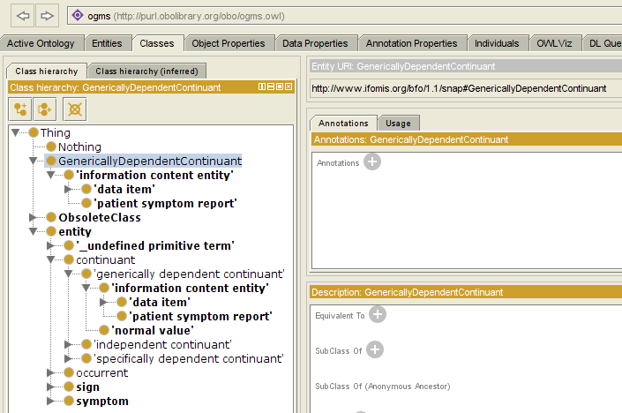
Imported IAO ontology metadata using BFO1.1

Slide 8
Example 2 – BCGO (hard case)
Beta Cell Genomics Ontology (BCGO)
http://code.google.com/p/bcgo-ontology/
An application ontology built for the Beta Cell Genomics database. The ontology is developed using Basic Formal Ontology (BFO) as upper ontology, Ontology for Biomedical Investigations (OBI) as ontology framework and integrated subsets of multiple OBO Foundry (candidate) ontologies.
Referencing to 24 various OBO Foundry ontologies (BFO, 20 reference ontologies, and 3 application ontologies).
Including logical axioms defined in OBI, CL, UBERON, PATO
OBI: contains complicated logical axioms

Slide 9
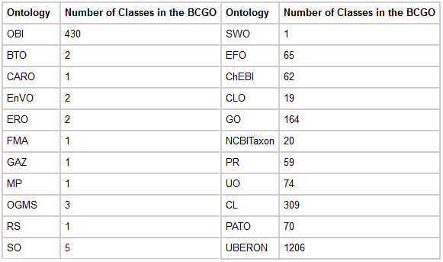
OBO Terms Reused in BCGO

Slide 10


Manual Intervention
Separate part_of/has_part based on continuant and occurrent
Converter does not work well since it walks through classes and check continuant/occurrent of left node of an axiom, cannot handle:
ChIP-seq assay,
has_specified_input some (specimen and ('has part' some 'deoxyribonucleic acid')
has_specified_input some (specimen and ('has occurrent part' some 'deoxyribonucleic acid')
has_specified_input some (specimen and (‘has continuant part at all times' some 'deoxyribonucleic acid')
subproperties of part_of/has_part defined in external ontologies
http://purl.obolibrary.org/obo/IAO_0000039 has measurement unit label (subproperty of has_part)
http://purl.obolibrary.org/obo/OBI_0000645 is grain of (subproperty of part_of)
Temporal relations: need to review case by case manually
Notes:
Planned process, same issue, assay terms
Histology:
'has occurrent part' some
('imaging assay' and 'histological sample preparation' and staining and 'collecting specimen from organism')
Does it correct? Some of these terms are disjoint. Intersection should be null.
investigation agent role
role and ('inheres in at all times' some
(('Homo sapiens' or organization) and ('bearer of at some time' some ('concretizes at some time' some
('objective specification' and (objective_achieved_by some
('planned process' and ('part of continuant at all times' some investigation))))))))
Should be ‘part of occurrent’

Slide 11
BFO 2.0 Graz release compatible BCGO
BFO 2.0 Graz release compatible BCGO is available on:
https://bcgo-ontology.googlecode.com/svn/trunk/release/20130214/bcgo_basis_bfo2.owl

Slide 12
Conclusion
Transition from BFO 1.1 to BFO 2.0 can be done semi-automatically

Slide 13
Future Work
Better converter
IRI replacement – using OWL-API/Jena rather than string replacement
Separate part_of/has_part based on continuant and occurrent – using Jena ?
Subproperties of part_of/has_part, with defined domain/range might be handled by script
Need ‘precedes/preceded by’ in BFO
Have been submitted to BFO-OWL issue tracker

Slide 14
Acknowledgement
Chris Stoeckert
Alan Ruttenburg
Allen (Zuoshuang) Xiang
Oliver (Yongqun) He
James Overton

