Slide 1
Moving Toward Common Logic (CLIF) and standard FOPL (quantificational logic) versions of BFO 2.0
Randall R. Dipert
University at Buffalo
"Interim Chair, Working Group for First Order Logic Versions of BFO 2.0"

Slide 2
CLIF/FOPL Version of BFO 2.0
At BFO 2.0 Specification (04/02/2013), 0.1:
"While we have attempted to produce OWL, FOL and CLIF files reflecting the current BFO2 specification document, there may be issues or bugs that will be fixed in subsequent releases."
Notes:
Notice that there is a mistake: CLIF files ARE FOL. The difference is their notation or "format." "WE have attempted to produce" FOL files in standard notation and in CLIF (Common Logic format) notation.

Slide 3
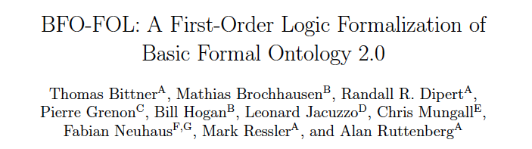
CLIF/FOPL Version of BFO 2.0
At end of summer 2012:
This group and others (but mainly Mark Ressler) produced:
Common Logic Interchange Format (CLIF) version of BFO 2.0
Source TeX file of FOPL version in standard logical notation
PDF version of FOPL version in standard logical notation (TeX output)
Notes:
RD wrote and ran a parser and grammar checker on the CLIF text.

Slide 4
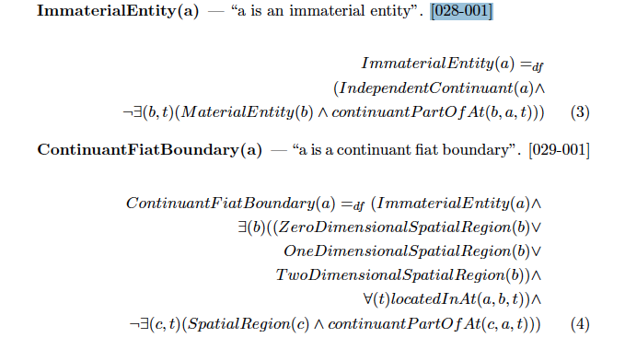
CLIF/FOPL Version of BFO 2.0
FOPL excerpt:
Notes:
RD wrote and ran a parser and grammar checker on the CLIF text.

Slide 5
CLIF/FOPL Version of BFO 2.0
CLIF excerpt (beginning of file):
/*
[...]
\section{Formalization}
BFO-FOL is an extension of classical first-order formal logic with identity. It can be represented using any standard axiomatization of the logical calculus. The formalization presented here uses the following symbols for negation, conjunction, disjunction, material implication, biconditional implication, universal and particular quantification, respectively: ${\neg,}\ {\wedge,}\ {\vee,}\ {\supset,}\ {\equiv,}\ {\forall,}\ {\exists}$.
\section{Predicates}
The predicates of BFO-FOL are divided into categorial predicates, which are intended to represent categories or universals, and relational predicates, which are intended to represent relations that hold between individuals within those categories.
[...]
\subsection{Primitive Categorial Predicates}
The following categorial predicates are taken as primitive:
\begin{description}
\item[Entity(a)] --- Intended interpretation: ``$a$ is an entity''. [001-001]
\item[Continuant(a)] --- ``$a$ is a continuant''. [008-002]
\item[MaterialEntity(a)] --- ``$a$ is a material entity''. [019-002]
\item[Object(a)] --- ``$a$ is an object''. [024-001]
[...]
\end{description}
Notes:
RD wrote and ran a parser and grammar checker on the CLIF text.

Slide 6
CLIF/FOPL Version of BFO 2.0
CLIF excerpt (beginning of file):
% NOTE: CLIF does not seem to have specific support for defined predicates, so
% for the defined predicates below, '\equiv' should be replaced by the
% defined '\DF' command for the final LaTeX compilation, but only in the
% defined predicates sections. Further, the letter arguments should be
% replaced by their Greek equivalents, e.g. 'a' replaced by '$\alpha$'
% to make clear that these arguments are used in definitional schemata,
% not as individual names in the system.
Notes:
RD wrote and ran a parser and grammar checker on the CLIF text.

Slide 7
CLIF/FOPL Version of BFO 2.0
CLIF excerpt (excerpt of CLIF content):
/*
\item[ImmaterialEntity(a)] --- ``$a$ is an immaterial entity''. [028-001]
[RD:] a is an Immaterial entity if and only if a is an independent continuant and
there does not exist a material entity b and a t
such that b is a continuant-part of a at [time] t. */
(iff (ImmaterialEntity a)
(and (IndependentContinuant a)
(not (exists (b t) (and (MaterialEntity b)
(continuantPartOfAt b a t)))))))
Notes:
RD wrote and ran a parser and grammar checker on the CLIF text.

Slide 8
CLIF/FOPL Version of BFO 2.0
CLIF (excerpt of CLIF content):
\subsection{Defined Categorial Predicates}
The following categorial predicates are defined as indicated:
\begin{description}
\item[IndependentContinuant(a)] --- ``$a$ is an independent continuant''. [017-002]
[RD: a is an independent continuant if and only if a is an independent continuant and
it is not the case that there exists a [continuant] b
such that a specifically depends on
b at [time] t. ] */
(iff (IndependentContinuant a)
(and (Continuant a)
(not (exists (b t) (specificallyDependsOnAt a b t)))))
Notes:
RD wrote and ran a parser and grammar checker on the CLIF text.

Slide 9
Issues and Tentative Proposals (RD)
Issue 1 Organizational Problems Proposal: Organization of Two Committees to revise/approve FOL/CLIF version of BFO 2.0 A. Voting Committee (3): R. Dipert F. Neuhaus C. Mungle B. Consulting Committee:
B. Andersen P. Grenon A. Ruttenberg T. Bittner B. Horgan ... M. Brochhausen L. Jacuzzo C. Hired graduate student help.
Notes:
Add "major experts": Michael Gruninger, Pat Hayes,

Slide 10
Issues and Tentative Proposals (RD)
Issue 2:
OWL FOL/CLIF differences E.g.
To: (iff (IndependentContinuant a)
(and (Continuant a)
(not (exists (b t) (specificallyDependsOnAt a b t)))))
Add: (the "range"—co-domain of third argument position--of specificallyDependsOnAt)
(forall (a b t) (if (specificallyDependsOnAt a b t)
(TemporalEntity t ) ) )
∀ a,b,t (specificallyDependsOnAt(a, b, t) ⊃ TemporalEntity(t) )
Where:
(iff (TemporalEntity t)
(or (TemporalInstant t)
(TemporalInterval t) ) )

Slide 11
Issues and Tentative Proposals (RD)
Issue 3 Comments Now: unread by CLIF processor
% ... Ignore rest of line /* ... */ Ignore multiline section
Proposal A: Use CLIF: (cl:comment ...)
Proposal B: Structure comments E.g.,
(cl: comment '(Definition [28-001] Vers.04/02/2013)'
<CLIF axiom>)

Slide 12
Issues and Tentative Proposals (RD)
Issue 4 Definitions
Now:
FOPL CLIF:
(iff (DefinedPred FreeVar1 FreeVar2) ( forall/exists (Var3 ... ) <DefiningExpression> FreeVar1 FreeVar2 Var3 ...> ]
Proposal: (def-iff ... ) + Parsing tool/translator to replace ‘def-iff’ with ‘iff’
Also: Leave Var1 Var2 ... [in Defined Expression] unquantified. Quantify them if pure FOPL desired. Problem: variable vs individual constant.

Slide 13
Issues and Tentative Proposals (RD)
Issue 5a: Lack of Theorem Provers or Reasoners
As of 5/1/2013:
No "native" CLIF logical tools.
Translate into notation for: Prover9 Isabelle SNARK (KIF) ...
HETS Project (University of Bremen)
Heterogeneous Tool Set
Chris Mungall's Prolog code

Slide 14
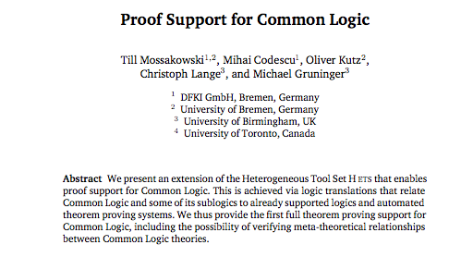
Issues and Tentative Proposals (RD)
Issue 5a (continued)

Slide 15
Issues and Tentative Proposals (RD)
Issue 5b
Grammar and consistency checking.

Slide 16
Issues and Tentative Proposals (RD)
Pause for Questions/Clarification
Issues:
1. Organization of effort. 2. OWL/CLIF-FOPL differences
3. Comments
4. Definitions
5. Logical tools: theorem provers, reasoning,
consistency and grammar checking, independence of axioms

Slide 17
Issues and Tentative Proposals (RD)
Issue 6
Develop Lemmon-style Natural Deduction Theorem Prover

Slide 18
Issues and Tentative Proposals (RD)
Issue 7
Move BFO 2.0 from a relatively trivial axiom/definition set to a robust one:
Add mereology in CLIF (Gruninger, Bittner)
Add a time calculus (Allen), agnostic about continuous vs dense/discrete

Slide 19
Issues and Tentative Proposals (RD)
Issue 8
Reduce or "bracket off" axiom that induce problems with computational tractability
(a) Decidability: Use only decidable fragments of FOPL
(b) Reduce computational Complexity
i. Use guarded/restricted quantifiers (or multi-sorted).
ii. More careful introduction of 2-place and 2+ place relations

Slide 20
Issues and Tentative Proposals (RD)
Issue 9
BFO 2.0 specification has changed since April 2012.
Revise CLIF and standard FOPL versions
Carefully examine specification for: a. ambiguities/lack of specificity b. "Gaps" (missing axioms)
Automate page number references

Slide 21
Issues and Tentative Proposals (RD)
Issue 10
Develop tools for manipulating a "higher order" language, e.g.
Prolog-CLIF
Generates FOPL (Done) Generates correctly formatted TeX FOPL Generates CLIF (Done)
Generates formulas for Prover9 etc.
[or use a tool like HETS]
Converts into variants with different features,
e.g. allows free variables in definitions,
'def-iff' becomes 'iff', etc.

Slide 22
Issues and Tentative Proposals (RD)
Pause for Questions/Clarification
Issues:
6. Natural Deduction Theorem Provers/reasoners 7. Add mereology, calculus of time
8. Issues of computational complexity
9. Update FOPL/CLIF versions to current specification of BFO 2.0
10. Develop wide array of tools.

