Slide 1
Temporally qualified continuants for BFO 2 OWL A bottom-up view
Stefan Schulz, Janna Hastings, Fabian Neuhaus
May 14, 2013

Slide 2
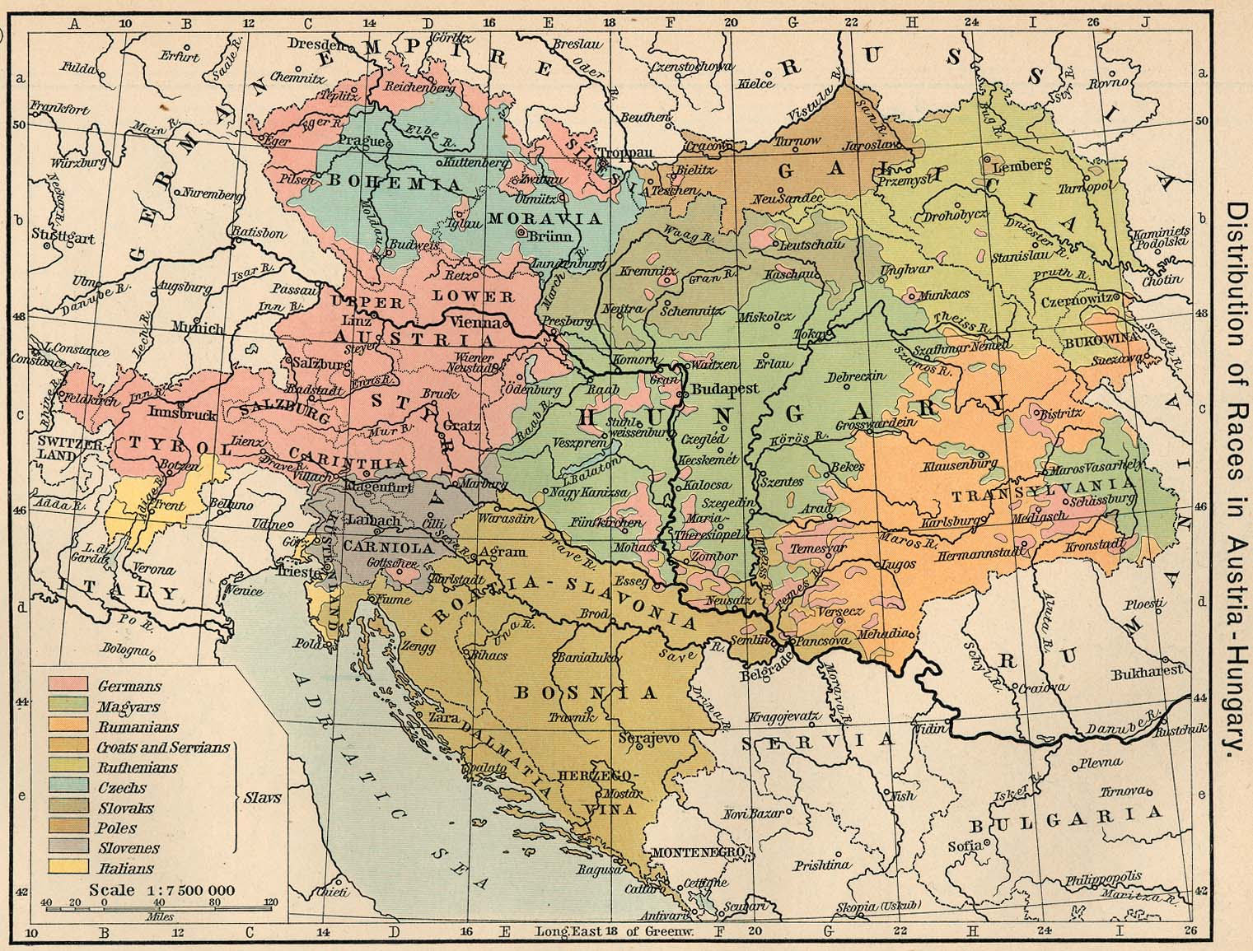
Львів, Lviv, L’viv, Lwów, לעמבערג
Lemberg
Львів
Lviv
L’viv,
Lwów
Lemberg

Slide 3
Relations between continuants
Binary relations between occurrents non-ambiguous:
partOf (Battle_of_Stalingrad, Second_World_War)
Binary relations between continuants ambiguous:
partOf (Lviv, Poland)
Ternary relations between continuants non-ambiguous:
partOf³ (Lviv, Austria, 1900)
partOf³ (Lviv, Poland, 1925)
partOf³ (Lviv, URSS, 1950)
partOf³ (Lviv, Ukraine, 2000)

Slide 4
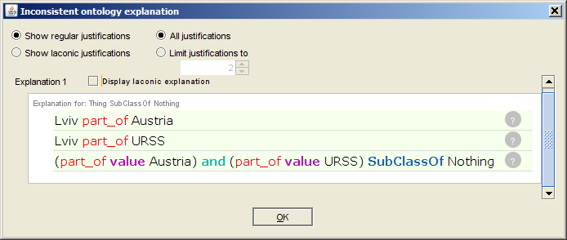
Problem: only binary relations in OWL
Instantiation:
Lviv rdf:type City
Ukraine rdf:type Country
Relations
Lviv partOf URSS
Lviv partOf Austria
Assertion that URSS and Austria don't overlap: Inconsistency →

Slide 5
Class level axioms
How to interpret
City subClassOf partOf some Country ?
Temporary relatedness: every city is part of some country at least at some time ∀a∀t₁ ∃ t₂: inst³ (a, A, t₁) ∧ inst³ (a, A, t₂) → ∃b: (inst³ (b, B, t₂) ∧ rel³ (a, b, t₁))
Permanent generic relatedness: at all times, every city is part of some country ∀a∀t: inst³ (a, A, t)→ ∃b: inst³ (b, B, t) ∧ rel³ (a, b, t)
Permanent specific relatedness: at all times, every city is part of the same country ∀a∀t₁: [inst³ (a, A, t) → ∃b: (inst³ (b, B, t) ∧ rel³ (a, b, t)
∀t: (inst³ (a, A, t) → (rel³ (a, b, t) ∧ inst³ (b, B, t))))]

Slide 6
Possible solutions
Use binary relations and interpret them as permanent generically related (as most of DL community has done for decades): may be acceptable as long no non-rigid classes and no instances are used (?)
Reify ternary relations: Overly complicated, user-unfriendly and difficult to get transitivity into it
Use temporalized relations (as in BFO 2 OWL Graz version): works only for temporary relatedness and permanent specific relatedness, but not for permanent generic relatedness.
Four-dimensionalism (?): represent histories instead of objects
Use temporally qualified continuants. See following slides

Slide 7
Temporally qualified continuants
Temporally qualified continuants (TQCs) are continuants which were referred to a some time
TQCs have no ontological commitment
Technical "façon de parler", no instance of universal
Examples:
Lviv@1913
Ukraine@1Feb1995
myLeftThumb@14May2013

Slide 8
TQC: additional entities
Classes:
TQC: continuants referred to in a temporal context
Relations:
hasTime: relates a temporally qualified continuant to the temporal region at which a temporally relevant assertion is made
hasCont: Relates a temporally qualified continuants to continuant (function); inverse hasTQC
Axioms:
certain relations require domains or ranges to be TQCs, e.g. partOf
optional relation chains if temporalized relations required: hasTQC o partOf subpropertyOf hasPartAtSomeTime

Slide 9
Examples, Instance level
partOf³ (Lviv, Austria, 1900)
partOf³ (Lviv, Poland, 1925)
instanceOf³ (Lviv, Settlement, 1100)
instanceOf³ (Lviv, City, 1925)
partOf (Lviv@1900, Austria@1900) hasTime (Lviv@1900, 1900) hasCont (Lviv@1900, Lviv) hasTime (Austria@1900, 1900) hasCont (Austria@1900, Austria)
partOf (Lviv@1925, Poland@1925) hasTime (Lviv@1925,1925) hasCont (Lviv@1925, Lviv) hasTime (Poland@1925,1925) hasCont (Poland@1925, Poland)
Lviv@1100 rdf:Type Settlement hasTime (Lviv@1100, 1100) hasCont (Lviv@1100, Lviv)
Lviv@1925 rdf:Type City hasTime (Lviv@1925, 1925) hasCont (Lviv@1925, Lviv)

Slide 10
Examples, Class level
"Each city is always part of some country" ∀a, t: inst³ (x, City, t)→ ∃b: inst³ (b, Country, t) ∧ part of³ (x, y, t)
"Each medieval city has had a city gate at some time" ∀a, t₁ ∃ t₂: inst³ (x, MCity, t₁) ∧ inst³ (x, MCity, t₂) → ∃b: (inst (y, CGate, t₂) ∧ hasPart³ (x, y, t₁))
City subClassOf partOf some Country
partOf Domain TQC
partOf Range TQC
City and Country are classified as TQC
MCity subClassOf hasTQC some (hasPart some CGate)
CGate are classified as TQC

Slide 11
Examples
City subClassOf partOf some Country
Country subClassOf partOf some Continent
City subClassOf subClassOf partOf some Continent
CityGate subClassOf hasTQC some (partOf some City)
CityGateDoor subClassOf partOf some CityGate
Does not entail that CityGateDoor is part of a city
CellNucleolus subClassOf partOf some CellNucleus
CellNucleus subClassOf partOf some Cell
CellNucleolus subClassOf partOf some Cell
Apple subClassOf hasTQC some (partOf some AppleTree)
AppleSeed subClassOf hasTQC some (partOf some Apple)
Does not entail that part Apple seeds are parts of apple trees
Permanent generic relatedness
Temporary relatedness
Permanent generic relatedness
Permanent generic relatedness
Permanent generic relatedness
Temporary relatedness
Temporary relatedness

Slide 12
Consistency of A-boxes
r0: partOf³ (Lviv, Austria, 1900)
One ternary relation rel (a, b, t) is translated into a set of five binary relations.
r1: partOf (Lviv@1900, Austria@1900) r2: hasTime (Lviv@1900, 1900) r3: hasCont (Lviv@1900, Lviv) r4: hasTime (Austria@1900, 1900) r5: hasCont (Austria@1900, Austria)
r1: rel (a @ t, b @ t) r2: hasTime (a @ t, t) r3: hasCont (a @ t, a) r4: hasTime (b @ t , t) r5: hasCont (b @ t, b)
OWL Rule for consistency checking: TemporallyQualifiedContinuant(?x), TemporallyQualifiedContinuant(?y), hasTime (?x,?t1), hasTime(?y,?t2), topObjectProperty(?x,?y) - > equal(?t1,?t2)

