Slide 1
The OBO Relation Ontology
Genome Biology 2005, 6:R46
based on the fundamental distinction between instances and universals
takes instances and time into account

Slide 2
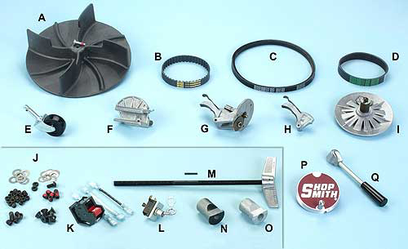
Catalog vs. inventory
A | 515287 | DC3300 Dust Collector Fan
B | 521683 | Gilmer Belt
C | 521682 | Motor Drive Belt

Slide 3
Part_of as a relation between universals is more problematic than is standardly supposed
heart part_of human being ?
human heart part_of human being ?
human being has_part human testis ?
testis part_of human being ?

Slide 4
two kinds of parthood
between instances:
Mary’s heart part_of Mary
this nucleus part_of this cell
between universals
human heart part_of human
cell nucleus part_of cell

Slide 5
Definition of part_of as a relation between universals
A part_of B =Def. all instances of A are instance-level parts of some instance of B
human testis part_of adult human being
but not
adult human being has_part human testis

Slide 6
Fundamental Dichotomy
Continuants (aka endurants)
  have continuous existence in time
  preserve their identity through change
  exist in toto whenever they exist at all
Occurrents (aka processes)
  have temporal parts
  unfold themselves in successive phases
  exist only in their phases

Slide 7
part_of for processes
A part_of B =def.
For all x, if x instance_of A then there is some y, y instance_of B and x part_of y
where ‘part_of’ is the instance-level part relation
EVERY A IS PART OF SOME B

Slide 8
part_of for continuants
A part_of B =def.
For all x, t if x instance_of A at t then there is some y, y instance_of B at t and x part_of y at t
where ‘part_of’ is the instance-level part relation
ALL-SOME STRUCTURE

Slide 9
is_a (for processes)
A is_a B =def
For all x, if x instance_of A then x instance_of B
cell division is_a biological process

Slide 10
is_a (for continuants)
A is_a B =def
For all x, t if x instance_of A at t then x instance_of B at t
abnormal cell is_a cell
adult human is_a human
but not: adult is_a child

Slide 11
These definitions make reasoning possible
Whichever A you choose, the instance of B of which it is a part will be included in some C, which will include as part also the A with which you began
The same principle applies to the other relations in the OBO-RO:
located_at, transformation_of, derived_from, adjacent_to, etc.

Slide 12
A part_of B, B part_of C ...
The all-some structure of the definitions in the OBO-RO allows
cascading of inferences
(i) within ontologies
(ii) between ontologies
(iii) between ontologies and EHR repositories of instance-data

Slide 13
OBO Relation Ontology
Foundational | is_a part_of
Spatial | located_in contained_in adjacent_to
Temporal | transformation_of derives_from preceded_by
Participation | has_participant has_agent

Slide 14
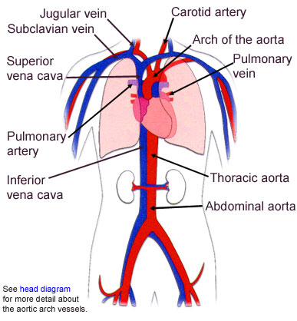
Fiat and bona fide boundaries

Slide 15
Continuity
Attachment
Adjacency
Containment

Slide 16
Containment involves relation to a hole or cavity
1: cavity
2: tunnel, conduit (artery)
3: mouth; a snail’s shell

Slide 17
Fiat vs. Bona Fide Boundaries
fiat
boundary
physical boundary

Slide 18
Connection
The body is a highly connected entity.
Exceptions: cells floating free in blood.

Slide 19
Modes of Connection
Modes of connection:
  attached_to (muscle to bone)
  synapsed_with (nerve to nerve, nerve to muscle)
  continuous_with (= share a fiat boundary)

Slide 20
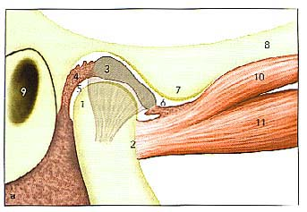
head of condyle
fossa
fiat boundary
neck of condyle
the temporomandibular joint

Slide 21
a continuous_with b
= a and b are continuant instances which share a fiat boundary
This relation is always symmetric:
if x continuous_with y , then y continuous_with x

Slide 22
continuous_with
(relation between types)
A continuous_with B =Def.
for all x, if x instance-of A then there is some y such that y instance_of B and x continuous_with y

Slide 23
continuous_with is not always symmetric
Consider lymph node and lymphatic vessel:
  Each lymph node is continuous with some lymphatic vessel, but there are lymphatic vessels (e.g. lymphs and lymphatic trunks) which are not continuous with any lymph nodes

Slide 24
Adjacent_to as a relation between types is not symmetric
Consider
seminal vesicle adjacent_to urinary bladder
Not: urinary bladder adjacent_to seminal vesicle

Slide 25
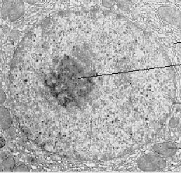
instance level
this nucleus is adjacent to this cytoplasm
implies:
this cytoplasm is adjacent to this nucleus
type level
nucleus adjacent_to cytoplasm
Not: cytoplasm adjacent_to nucleus

Slide 26
Applications
Expectations of symmetry e.g. for protein-protein interactions may hold only at the instance level
if A interacts with B, it does not follow that B interacts with A
if A is expressed simultaneously with B, it does not follow that B is expressed simultaneously with A

Slide 27
transformation_of
same instance
C
c at t
C₁
c at t₁
time
pre-RNA
mature RNA
child
adult

Slide 28
transformation_of
A transformation_of B =Def.
Every instance of A was at some earlier time an instance of B
  adult transformation_of child

Slide 29
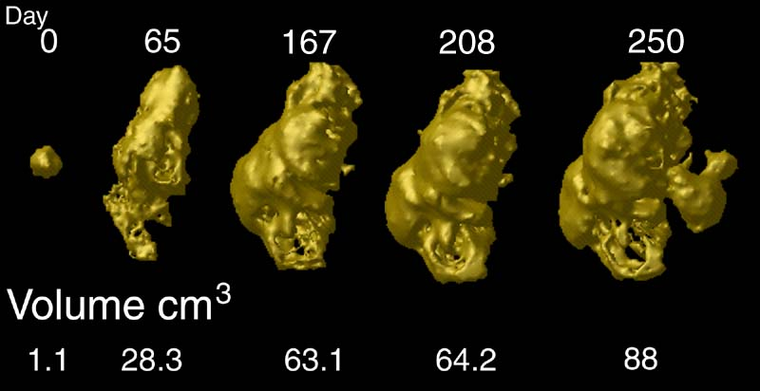
tumor development
C
c at t
C₁
c at t₁
Notes:
http://www.loni.ucla.edu/~thompson/HBM2000/tumor_volumes.jpg

Slide 30
derives_from
C
c at t
C₁
c₁ at t₁
time
C'
c' at t
instances
ovum
zygote derives_from
sperm

Slide 31
two continuants fuse to form a new continuant
C
c at t
C₁
c₁ at t₁
C'
c' at t
fusion

Slide 32
one initial continuant is replaced by two successor continuants
C
c at t
C₁
c₁ at t₁
C₂
c₁ at t₁
fission

Slide 33
one continuant detaches itself from an initial continuant, which itself continues to exist
C
c at t
c at t₁
C₁
c₁ at t
budding

Slide 34
one continuant absorbs a second continuant while itself continuing to exist
C
c at t
c at t₁
C'
c' at t
capture

Slide 35
To be added to the Relation Ontology
lacks (between an instance and a type, e.g. this fly lacks wings)
dependent_on (between a dependent entity and its carrier or bearer)
quality_of (between a dependent and an independent continuant)
functioning_of (between a process and an independent continuant)

Slide 36
instance to universal: lacks
continuant to continuant: connected_to
function to process: realized_by
process to function: functioning_of
function to continuant: function_of
continuant to function: has_function
quality to continuant: inheres_in (aka has_bearer)
continuant to quality: has_quality
? interacts_with, ...

