Slide 1
extracted from
“Lmo-2 interacts with Elf-2”
On the Meaning of Common Statements in Biomedical Literature
Stefan Schulz
Department of Medical Informatics, Freiburg University Hospital, Germany
Ludger Jansen
Department of Philosophy, University of Rostock, Germany
delivered at KR-MED 2006

Slide 2
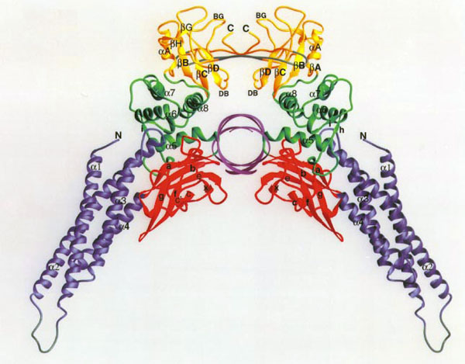
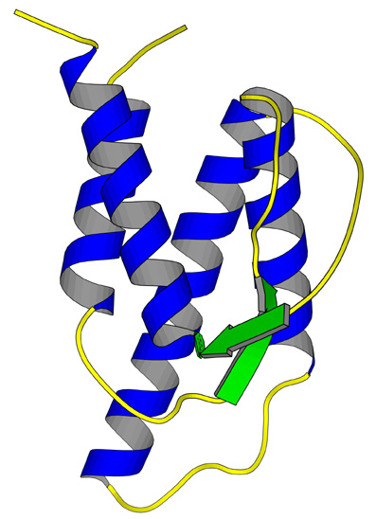
Protein-Protein Interactions
Interaction:
  Binding
  Upregulation
  Downregulation
  Activation
  Inhibition
  Phosphorylation
  …

Slide 3
“Lmo-2 interacts with Elf-2”

Slide 4
Referents of Protein names
“Lmo-2” may refer to
  One single Lmo-2 molecule
  Some amount of Lmo-2,
  e.g. in an experiment
  The collection of all Lmo-2
  molecules in the world
  The mental representation of
  “Lmo-2”
  The universal (type) “Lmo-2”

Slide 5
“Lmo-2 interacts with Elf-2”

Slide 6
“Lmo-2 interacts with Elf-2”:
Existential interpretation of single events
There is one interaction event which involves one single Lmo-2 molecule and one single Elf-2 molecule
There is one interaction event which involves an amount of Lmo-2 and an amount of Elf-2
There is one interaction event which involves one single Lmo-2 molecule and an amount of Elf-2
There is one interaction event which involves an amount of Lmo-2 and an single Elf-2 molecule

Slide 7
“Lmo-2 interacts with Elf-2”:
Existential interpretation of collective events
There are multiple interactions which pairwise involve single Lmo-2 molecules single Elf-2 molecules
There are multiple interactions which involve amounts of Lmo-2 and amounts of Elf-2
There are multiple interactions each of which involves one single Lmo-2 molecule and an amount of Elf-2
There are multiple interactions each of which involves an amount of Lmo-2 and one single Elf-2 molecule

Slide 8
Generic Interpretations

Slide 9
“Lmo-2 interacts with Elf-2”:
Generic interpretation of events
All Lmo-2 molecules interact with some Elf-2 molecule
All amounts of Lmo-2 interact with some amount of Elf-2
All Lmo-2 molecules interact with some amount of Elf-2
All amounts of Lmo-2 interact with some Elf-2 molecule

Slide 10
“Lmo-2 interacts with Elf-2”: Generic interpretations by introducing new event types
All instances of Lmo-2/Elf-2 Interaction have one Lmo-2 and one Elf-2 molecule as participants
All instances of Lmo-2/Elf-2 Interaction’ have one amount of Lmo-2 and one amount of Elf-2 as participants
(…)

Slide 11
… but this does not
further describe generic behaviour of the proteins involved either

Slide 12
So far…
Valid existential statements on
  instances of molecules
  instances of amounts of molecules
  instances of events
Valid universal statements on
  subtypes of events
Invalid universal statements on
  molecules
  amounts of molecules

Slide 13
Are there universally true properties of molecules or amounts of molecules regarding interaction ?

Slide 14
Dispositional Reading
Authors of “Lmo-2 interacts with Elf-2” possibly do not want to refer to accidental occurrences
They may want to express a disposition (the capability of an entity of doing sth.) “Lmo-2 molecules have the disposition to interact with Elf-2 molecules”

Slide 15
Canonical (wild type) interactions

Slide 16
Ambiguities dispositional readings
Which event is it exactly that the property in question is meant to cause?
A: Single events / Collective events
What is thought to be the bearer of this property
A: Single molecules / Collectives of molecules
Which kind of property is in fact intended to be ascribed? …

Slide 17
Surefire dispositions
(tendencies)
Dispositions to react invariably in a certain way under specific circumstances
Problem: Which are the circumstances for the realization of a disposition?
  Under “all” circumstances: already discarded
  Under “some” circumstances: considering extreme circumstances, (nearly) any interaction is possible
  How to define “normal circumstances” ?
  (range of normality wrt concentration, pressure, temperature, pH etc.)

Slide 18
Probabilistic Dispositions (propensities)
Dispositions which get realized with a certain probability under given circumstances
Two patterns
  Real stochastic behavior, e.g. low concentrations of one reagent
  Hidden distinguishing characteristics, e.g. different subtypes of molecules: wildtype interacts, mutant does not

Slide 19
“Lmo-2 interacts with Elf-2”:
Generic dispositions
All single Lmo-2 molecules have the disposition to react with some single Elf-2 molecule
All amounts of Lmo-2 have the disposition
to react with some amount of Elf-2
All single Lmo-2 molecules have the disposition to react with some amount of Elf-2 molecules
All amounts of Lmo-2 have the disposition to react with some single Elf-2 molecule

Slide 20
Finally…
Valid existential statements on
  instances of molecules
  instances of amounts of molecules
  instances of events
Valid universal statements on
  subtypes of events
Valid universal statements about dispositions of
  molecules
  amounts of molecules

Slide 21
Ontology in Practice
=
Biologists’ Nightmare ?

Slide 22
Simplifying matters and maintaining ontological correctness

Slide 23
Referents of Protein names
“Lmo-2” may refer to
  One single Lmo-2 molecule
  Some amount of Lmo-2 molecules,
  e.g. in an experiment
  The universal (type) “Lmo-2”

Slide 24
Referents of Protein names
Proposal:
“Lmo-2” refers to
  The universal (type) Lmo-2 molecule
  Or
  An undefined number (n>0) of instances of Lmo-2

Slide 25
Referents of Interaction Assertions
Proposal:
“Interacts” refers to
  A plurality of interaction events
Reason: Unique interaction events cannot be detected and are irrelevant

Slide 26
Introducing Dispositions
Disposition taxonomies:
Disposition
Disposition to Interact
Disposition to Interact with Elf-2
is-a
is-a

Slide 27
Conclusion:
“Lmo-2 interacts with Elf-2” has the following two readings:
There are a plurality of interaction events each of them has one or many Lmo-2 molecules and one or many Elf-2 molecules as participants
Every single Lmo-2 molecule or plurality thereof has the disposition to interact with one or many Elf-2 molecules

