Slide 1
Ontologies in Biomedicine:
The Good, The Bad and The Ugly
Barry Smith
http://ontology.buffalo.edu/smith

Slide 2
The Good
Foundational Model of Anatomy (FMA)
Pro
Very clear statement of scope: structural human anatomy, at all levels of granularity, from the whole organism to the biological macromolecule
Powerful treatment of definitions, from which the entire FMA hierarchy is generated – can serve as basis for formal reasoning
Con
Some unfortunate artifacts in the ontology deriving from its specific computer representation (Protégé)

Slide 3
FMA follows formal rules for Aristotelian definitions
When A is_a B, the definition of ‘A ’ takes the form:
an A =Def. a B which C s...
a human being =Def. an animal which is rational

Slide 4
Examples
Cell =Def. an anatomical structure which consists of cytoplasm surrounded by a plasma membrane

Slide 5
The FMA regimentation
brings the advantage that circular definitions are avoided
each definition reflects the position in the hierarchy to which a defined term belongs
the position of a term within the hierarchy enriches its own definition by incorporating automatically the definitions of all the terms above it.

Slide 6
Foundational Model of Anatomy
The entire information content of the FMA’s term hierarchy can be translated very cleanly into a computer representation
But the definitions encapsulate this information in a modular form which is of maximal advantage to human beings

Slide 7
The FMA regimentation ensures intelligibility of definitions
The terms used in a definition should be simpler (more intelligible) than the term to be defined; otherwise the definition provides no assistance
  to human understanding
  to machine processing

Slide 8
FMA
organized in a graph-theoretical structure involving two sorts of links or edges:
is-a (= is a subtype of )
(pleural sac is-a serous sac)
part-of
(cervical vertebra part-of vertebral column)

Slide 9
Anatomical Space
Anatomical
Structure
Organ Cavity
Subdivision
Organ
Cavity
Organ
Organ Part
Serous Sac
Cavity
Subdivision
Serous Sac
Cavity
Serous Sac
Organ
Component
Organ
Subdivision
Tissue
is_a
Pleural Sac
Pleura(Wall
of Sac)
Pleural
Cavity
part_of
Parietal
Pleura
Visceral
Pleura
Interlobar
recess
Mediastinal
Pleura
Mesothelium
of Pleura

Slide 10
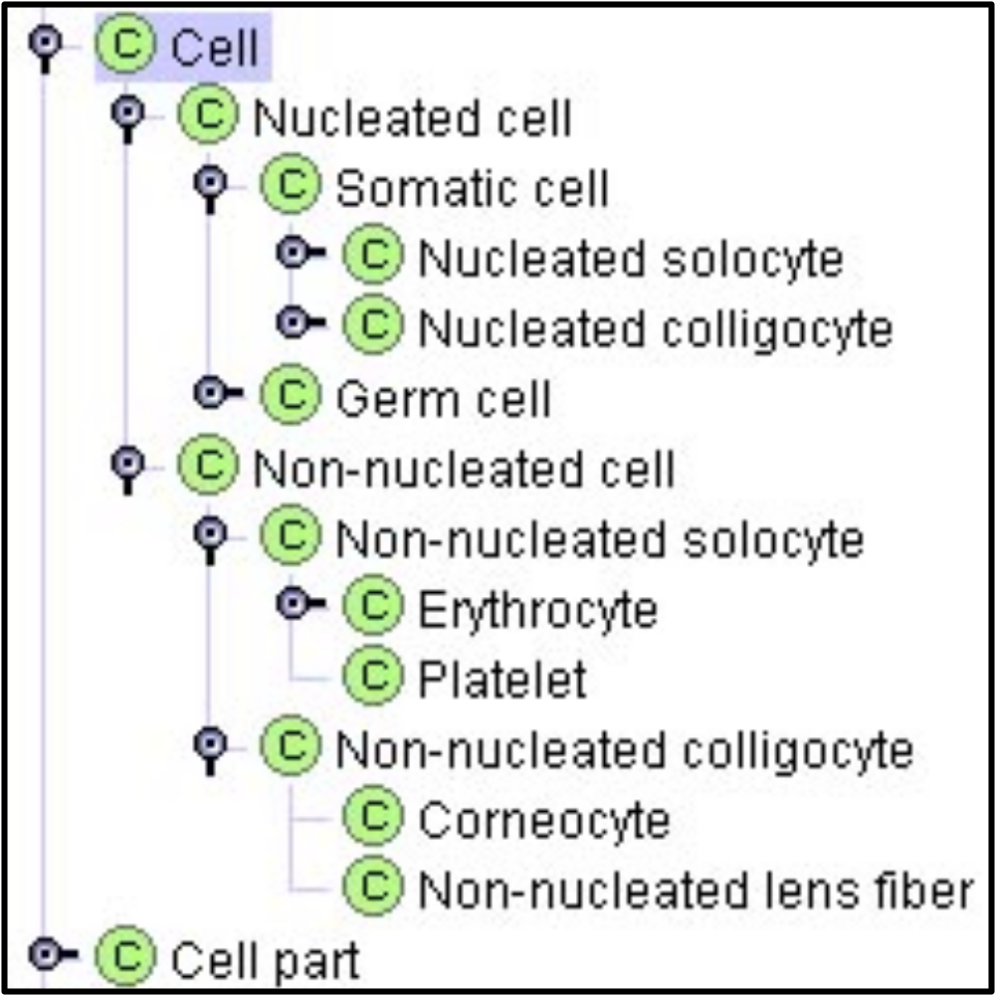
at every level of granularity

Slide 11
The FMA is a Structural Anatomy
Plasma membrane =Def. a cell part that surrounds the cytoplasm

Slide 12
The Gene Ontology
Pro
Open Source
Cross-Species
Impressive annotation resource
Impressive policies for maintenance
Has recognized the need for reform

Slide 13
Intermediate
The Gene Ontology
Con
Poor formal architecture
Full of errors
menopause part_of death
Poor support for automatic reasoning and error-checking
Poor treatment of definitions
Not trans-granular
No relation to time or instances

Slide 14
The Gene Ontology
Pro
Open Source
Cross-Species
... has recognized the need for reform, including explicit representation of granular levels

Slide 15
GO:0019836 hemolysis
Definition: The processes that cause hemolysis
X =def. the Y of X
this is worse than circular

Slide 16
Reactome
Pro
Rich catalogue of biological process
Con
Incoherent treatment of categories:
ReferentEntity (embracing e.g. small molecules) is a sibling of PhysicalEntity (embracing complexes, molecules, ions and particles).
Similarly CatalystActivity is a sibling of Event.

Slide 17
The Bad
National Cancer Institute Thesaurus
See http://ontology.buffalo.edu/medo/NCIT_Smith.html

Slide 18
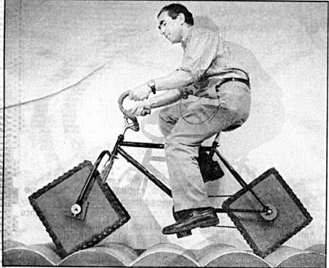

Slide 19
National Cancer Institute Thesaurus (NCIT)
Pro
NCIT is open source
NCIT has broad coverage
NCIT has some formal structure (OWL-DL)
NCIT has realized the errors of its ways
Con
Full of errors (many inherited from UMLS)
Bad realization of formal structure

Slide 20
Goals of NCIT
to make use of current terminology best practices to relate relevant concepts to one another in a formal structure, e.g. to support automatic reasoning;

Slide 21
Formal Definitions
of 37,261 nodes, 33,720 remain formally undefined
Thus only a small portion of the NCIT ontology can be used for purposes of automatic classification and error-checking

Slide 22
Verbal Definitions
About half the NCIT terms are assigned verbal definitions for human use
Unfortunately some are assigned more than one

Slide 23
Disease Progression
Definition1
Cancer that continues to grow or spread.
Definition2
Increase in the size of a tumor or spread of cancer in the body.
Definition3
The worsening of a disease over time.

Slide 24
Cancer
a process (of getting better or worse)
an object (which can grow and spread)
occurrent vs. continuant

Slide 25
Disease
Definition1
A disease is any abnormal condition of the body or mind that causes discomfort, dysfunction, or distress to the person affected or those in contact with the person. ...
Definition2
A definite pathologic process with a characteristic set of signs and symptoms. ...

Slide 26
Confuses definitions with descriptions
Tuberculosis =Def.
A chronic, recurrent infection caused by the bacterium Mycobacterium tuberculosis. Tuberculosis (TB) may affect almost any tissue or organ of the body with the lungs being the most common site of infection. The clinical stages of TB are primary or initial infection, latent or dormant infection, and recrudescent or adult-type TB. Ninety to 95% of primary TB infections may go unrecognized. Histopathologically, tissue lesions consist of granulomas which usually undergo central caseation necrosis. Local symptoms of TB vary according to the part affected; acute symptoms include hectic fever, sweats, and emaciation; serious complications include granulomatous erosion of pulmonary bronchi associated with hemoptysis. If untreated, progressive TB may be associated with a high degree of mortality. This infection is frequently observed in immunocompromised individuals with AIDS or a history of illicit IV drug use.

Slide 27
Confuses definitions with descriptions
Tuberculosis =Def.
A chronic, recurrent infection caused by the bacterium Mycobacterium tuberculosis. Tuberculosis (TB) may affect almost any tissue or organ of the body with the lungs being the most common site of infection. The clinical stages of TB are primary or initial infection, latent or dormant infection, and recrudescent or adult-type TB. Ninety to 95% of primary TB infections may go unrecognized. Histopathologically, tissue lesions consist of granulomas which usually undergo central caseation necrosis. Local symptoms of TB vary according to the part affected; acute symptoms include hectic fever, sweats, and emaciation; serious complications include granulomatous erosion of pulmonary bronchi associated with hemoptysis. If untreated, progressive TB may be associated with a high degree of mortality. This infection is frequently observed in immunocompromised individuals with AIDS or a history of illicit IV drug use.

Slide 28
A better definition
Tuberculosis
Definition:
A chronic, recurrent infection caused by the bacterium Mycobacterium tuberculosis.

Slide 29
Duratec, Lactobutyrin, Stilbene Aldehyde
are classified by the NCIT as Unclassified Drugs and Chemicals

Slide 30
NCIT recognizes three disjoint classes of plants
  Vascular Plant
  Non-vascular Plant
  Other Plant

Slide 31
and three kinds of cells
Abnormal Cell is a top-level class (thus not subsumed by Cell )
Normal Cell is a subclass of Microanatomy.
Cell is a subclass of Other Anatomic Concept (so that cells themselves are concepts)

Slide 32
NCIT as now constituted will block automatic reasoning
Neither Normal Cells nor Abnormal Cells are Cells within the context of the NCIT

Slide 33
The Ugly
UMLS Semantic Network
Pros
Broad coverage; no multiple inheritance
Cons
Incoherent use of ‘conceptual entities’
(e.g. the digestive system as a conceptual part of the organism)
Full of errors

Slide 34
UMLS Semantic Network
Edges in the graph represent merely “possible significant (= some-some) relations”:
  Bacterium causes Experimental Model of Disease
  Experimental Model of Disease affects Fungus
  Experimental model of disease is_a Pathologic Function

Slide 35
UMLS Semantic Network
Unclear what the nodes of the graph are:
Drug Delivery Device contains Clinical Drug
Drug Delivery Device narrower_in_meaning_than Manufactured Object
The use-mention confusion:
“Swimming is healthy and has 8 letters”

Slide 36
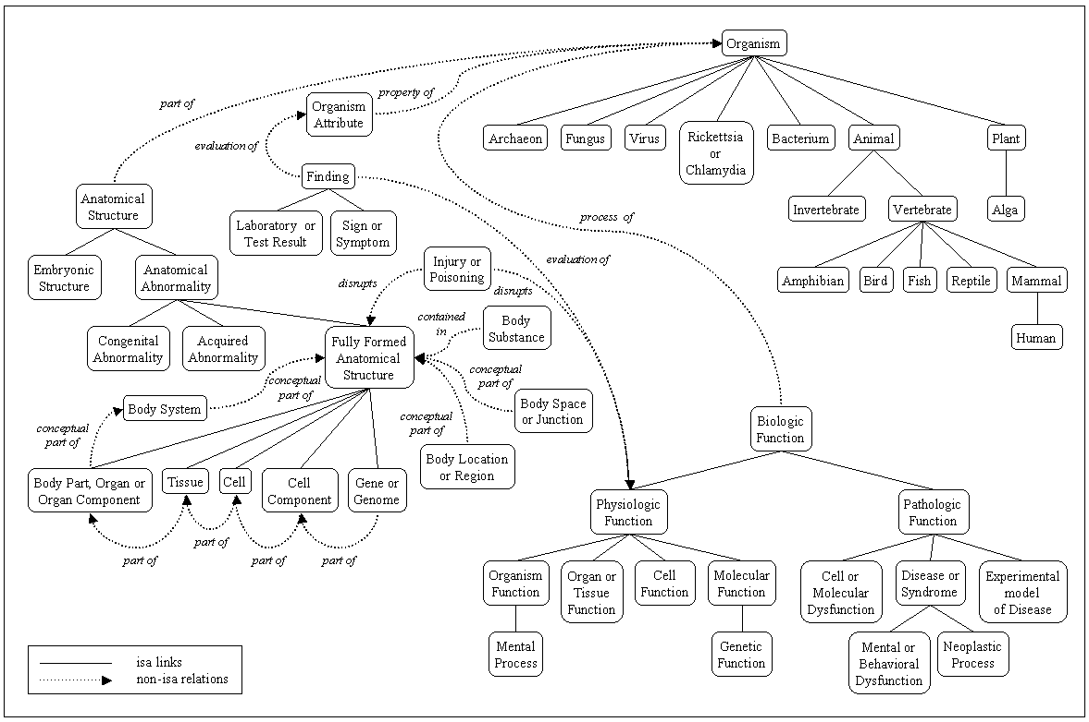
a hodgepodge of ‘concepts’

Slide 37
location_of
Tissue location_of Mental or Behavioral Dysfunction
Fungus location_of Vitamin

Slide 38
Fungus location_of Vitamin
Every instance of vitamin is located in some fungus?
Every instance of vitamin is located in every fungus?
Some instance of vitamin is located in some fungus?
Some instance of vitamin is located in every fungus?

Slide 39
what are the nodes in this graph?

Slide 40
UMLS Semantic Network
A is_a B =Def.
A is narrower in meaning than B
A disrupts B
A contained_in B

Slide 41
UMLS Semantic Network
Drug Delivery Device contains Clinical Drug
Drug Delivery Device narrower_in_meaning_than Manufactured Object

Slide 42
UMLS
Metathesaurus
Semantic Network
Specialist Lexicon

Slide 43
“Circular Hierarchical Relationships in the UMLS:
Etiology, Diagnosis, Treatment, Complications and Prevention”
Olivier Bodenreider
Topographic regions: General terms
Physical anatomical entity
Anatomical spatial entity
Anatomical surface
Body regions
Topographic regions
Notes:
from Bodenreider

Slide 44
Intermediate
GALEN
Pro
Allows formal representation of clinical information
Allows multiple views of relevant detail as needed
Uses powerful Description Logic (DL)-based formal structure
Con
Remains only partially developed
Contains errors: Vomitus contains carrot
– which DLs did not prevent

Slide 45
The Ugly
Clinical Terms Version 2 (The Read Codes)
Classifies chemicals into:
chemicals whose name begins with ‘A’,
chemicals whose name begins with ‘B’,
chemicals whose name begins with ‘C’, ...

Slide 46
GALEN: Vomitus contains carrot
All portions of vomit contain all portions of carrot
All portions of vomit contain some portion of carrot
Some portions of vomit contain some portion of carrot
Some portions of vomit contain all portions of carrot

Slide 47
MeSH
MeSH Descriptors
Index Medicus Descriptor
Anthropology, Education, Sociology and
Social Phenomena (MeSH Category)
Social Sciences
Political Systems
National Socialism
National Socialism is_a Political Systems
National Socialism is_a Anthropology ...

Slide 48
Principle
Use singular nouns
Terms in ontologies represent types
Every term ‘A’ in a well-constructed ontology is shorthand for ‘the type A’

Slide 49
UMLS Semantic Network
The use-mention confusion
Conceptual Entities =Def.
An organizational header for concepts representing mostly abstract entities.
swimming is healthy and has eight letters

Slide 50
Principle
Avoid confusing between words and things
Avoid confusing between concepts in our minds and entities in reality
Recommendation: avoid the word ‘concept’ entirely

Slide 51
Principle
Avoid circular definitions
(The term defined should not appear in its own definition)

Slide 52
ICD
V31.22 Occupant of three-wheeled motor vehicle injured in collision with pedal cycle, person on outside of vehicle, nontraffic accident, while working for income
W65.40 Drowning and submersion while in bath-tub, street and highway, while engaged in sports activity
X35.44 Victim of volcanic eruption, street and highway, while resting, sleeping, eating or engaging in other vital activities

Slide 53
Disease Ontology (early versions)
DOID:425 Other counselling
DOID:594 Gynecological examination
DOID:101 Other problems with special functions
DOID:128 Tuberculosis of unspecified bones and joints, tubercle bacilli not found by bacteriological or histological examination, but tuberculosis confirmed by other methods (inoculation of animals)

Slide 54
Disease Ontology (early versions)
DOID:130 Other mineral salts, not elsewhere classified, causing adverse effects in therapeutic use
DOID:148 Other suture of other tendon of hand
DOID:164 Other general medical examination for administrative purposes
DOID:288 Assault by other specified means

Slide 55
Disease Ontology (early versions)
DOID:431 Full-thickness skin loss due to burn (third degree not otherwise specified) of single digit (finger (nail)) other than thumb
DOID:807 Surgical or other procedure not carried out because of patient's decision DOID:13769 Other accidental submersion or drowning in water transport accident injuring other specified person

Slide 56
Principle
Don’t use ‘Other’

Slide 57
Principle
Every type in an ontology should have instances in reality
DOID:807 Surgical or other procedure not carried out because of patient's decision
SNOMED: Congenital absent nipple

Slide 58
Principle
An A which is B is an A
Don’t use ‘B’ expressions (cancelled, forged, missing, ...*) for which this rule does not hold
(* ‘modifying adjectives’)

Slide 59
CYC Ontology
CLASSIFICATION OF HUMAN-TYPE-BY-CUP-SIZE
cup size a = instance of human type by cup size
instance of partially tangible type by non-numeric size
subtype of homo sapiens
disjoint with cup size b

Slide 60
CYC Ontology
the collection of people with female breast cup size a
human type by cup size is an instance of collection with an event-like order
A collection of collections. Each instance of CollectionWithAnEventLikeOrder is a collection whose instances are conventionally regarded as being ordered by some relation RELN, where RELN orders the members of COL in the manner in which events are ordered in linear time.

Slide 61
Principle
a classification of cup sizes is a classification of cup sizes
red car, blue car, green car ... is not a good classification of cars

Slide 62
MGED Ontology
EnvironmentalFactorCategory: atmosphere
FamilyRelationship: aunt
PublicationType: book
MaterialType: cell
BiosourceType, DeprecatedTerms: blood
BioMaterialCharacteristicCategory: clinical treatment
InitialTimePoint: coitus
ComplexAction: pool

Slide 63
MGED Ontology
QuantityUnitOther: count
Sex: female
Result: inconclusive
MaterialType: molecular mixture
DeprecationReason: split term
ComplexAction: timepoint
NodeValueType: uncentered Pearson correlation

Slide 64
MGED Ontology
ConcentrationUnitOther: x times
MaterialType: whole organism
EnvironmentalFactorCategory: water
AtomicAction: wait
MGEDOntologyVersion: version 1.3.0
Scale: unscaled
Media: semisolid

Slide 65
Principle
An ontology should have a well-defined domain
An ontology should re-use available resources

Slide 66
Gramene Environment Ontology
virus is_a environment ontology
unknown environment is_a environment ontology
study type is_a environment ontology
unknown study type is_a study type
pest/pathogen/animal/plant environment is_a environment.

Slide 67
Principle
Use Aristotelian definitions
An A is_a B which C’s.
A human being is an animal which is rational

Slide 68
Universality
Ontologies are made of relational assertions
They should include only those which hold universally
pneumococcal virus causes pneumonia

Slide 69
Universality
Often, order will matter:
We can assert
adult transformation_of child
but not
child transforms_into adult

Slide 70
Universality
viral pneumonia caused by virus
but not
virus causes pneumonia
pneumococcal virus causes pneumonia

Slide 71
Positivity
Complements of types are not themselves types.
Terms such as
non-mammal
non-membrane
other metalworker in New Zealand
do not designate types in reality
Notes:
There is no species called ‘non-rabbit’

Slide 72
Ontology of types ≠ logic of terms
There are no conjunctive and disjunctive types:
anatomic structure, system, or substance
musculoskeletal and connective tissue disorder

Slide 73
Objectivity
Which types exist in reality is not a function of our knowledge.
Terms such as
unknown
unclassified
unlocalized
arthropathies not otherwise specified
do not designate types in reality.
Notes:
There is no biological species: unknown rabbit. See discussion below.

Slide 74
Keep Epistemology Separate from Ontology
If you want to say that
We do not know where A’s are located
do not invent a new class of
A’s with unknown locations
(A well-constructed ontology should grow linearly; it should not need to delete classes or relations because of increases in knowledge)

Slide 75
Keep Sentences Separate from Terms
If you want to say
I surmise that this is a case of pneumonia
do not invent a new class of surmised pneumonias
Confusion of ‘findings’ in medical terminologies

Slide 76
Concepts
Biomedical ontology integration will never be achieved through integration of meanings or concepts
The problem is precisely that different user communities use different concepts
Concepts are in your head and will change as your understanding changes

Slide 77
Concepts
Ontologies represent types: not concepts, meanings, ideas ...
Types exist, with their instances, in objective reality
– including types of image, of imaging process, of brain region, of clinical procedure, etc.

Slide 78
Rules on types
Don’t confuse types with words
Don’t confuse types with concepts
Don’t confuse types with ways of getting to know types
Don’t confuse types with ways of talking about types
Don’t confuses types with data about types

Slide 79
Univocity
Terms should have the same meanings on every occasion of use.
They should refer to the same kinds of entities in reality
Basic ontological relations such as is_a and part_of should be used in the same way by all ontologies
Notes:
Problem example: ‘chromosome’ in Sequence Ontology and in Cell Component Ontology means different things
Current solution: two distinct terms involved (qualified by respective namespace)

Slide 80
Ontology of types ≠ logic of terms
There are no conjunctive and disjunctive types:
anatomic structure, system, or substance
musculoskeletal and connective tissue disorder
rheumatism, excluding the back

Slide 81
Objectivity
Which types exist in reality is not a function of our knowledge.
Terms such as
unknown
unclassified
unlocalized
arthropathies not otherwise specified
do not designate types in reality.
Notes:
There is no biological species: unknown rabbit. See discussion below.

Slide 82
Keep Epistemology Separate from Ontology
If you want to say that
We do not know where A’s are located
do not invent a new class of
A’s with unknown locations
(A well-constructed ontology should grow linearly; it should not need to delete classes or relations because of increases in knowledge)

Slide 83
Syntactic Separateness
Do not confuse sentences with terms
If you want to say
I surmise that this is a case of pneumonia
do not invent a new class of surmised pneumonias

Slide 84
Single Inheritance
  No kind in a classificatory hierarchy should have more than one is_a parent on the immediate higher level

Slide 85
Multiple Inheritance
thing
blue thing
car
is_a
is_a
blue car

Slide 86
Multiple Inheritance
is a source of errors
encourages laziness
serves as obstacle to integration with neighboring ontologies
hampers use of Aristotelian methodology for defining terms
hampers modularity, division of labor

Slide 87
Multiple Inheritance
thing
blue thing
car
is_a₁
is_a₂
blue car

Slide 88
is_a Overloading
The success of ontology alignment demands that ontological relations (is_a, part_of, ...) have the same meanings in the different ontologies to be aligned.

Slide 89
Example: is_a is pressed into service by the GO to express location
is-located-at and similar relations are expressed by creating special compound terms using:
site of …
… within …
… in …
extrinsic to …
yielding associated errors

Slide 90
e.g. errors with ‘within’
lytic vacuole within a protein storage vacuole
lytic vacuole within a protein storage vacuole is-a protein storage vacuole
Compare:
embryo within a uterus is-a uterus

Slide 91
similar problems with part_of
GO: extrinsic to membrane part_of membrane

Slide 92
Compositionality
The meanings of compound terms should be determined
1. by the meanings of component terms
together with
2. the rules governing syntax

Slide 93
Why do we need rules/standards for good ontology?
Ontologies must be intelligible both to humans (for annotation and curation) and to machines (for reasoning and error-checking): the lack of rules for classification leads to human error and blocks automatic reasoning and error-checking
Intuitive rules facilitate training of curators and annotators
Common rules allow alignment with other ontologies
Notes:
e.g. menopause part-of aging, aging part-of death
Database searching is one of the important kinds of reasoning we want to enable

