Slide 1
HL7 RIM
Lessons for Semantic Interoperability

Slide 2
HL7 V2 as messaging standard
HL7 V3 claims to be:
“The foundation of healthcare interoperability”
“The data standard for biomedical informatics”
from blood banks to Electronic Health Records to clinical genomics

Slide 3
HL7 Incredibly Successful
adopted by Oracle as basis for its Electronic Health Record technology; supported by IBM, GE, Sun ...
embraced as US federal standard
central part of $35 billion program to integrate all UK hospital information systems

Slide 4
Semantic interoperability
The rationale of the HL7 messaging standard:
to ensure that health information systems can communicate their information in a form which will be understood in exactly the same way by both sender and recipient – no local dialects
HL7 is an ambitious effort to realize a laudable goal, involving dedicated user communities in many countries.

Slide 5
Problem
in HL7 V2 the realization of the messaging task allows ad hoc interpretations of the standard by each sending or receiving institution.
Result: vendor products never properly interoperable, and always require mapping software.

Slide 6
The solution to this problem (V3) is the HL7 RIM
or Reference Information Model
= a world standard for exchange of information between clinical information systems

Slide 7
The V3 solution
Remove optionality by having the RIM serve as a master model of all health information, from blood banks to Electronic Health Records to clinical genomics

Slide 8
The claim
“HL7 V3 is the standard of choice for countries and their initiatives to create national EHR and EHR data exchange standards as it provides a level of semantic interoperability unavailable with previous versions and other standards. Significant V3 national implementations exist in many countries, e.g. in the UK (e.g. the English NHS), the Netherlands, Canada, Mexico, Germany and Croatia.”

Slide 9
The reality (I asked them)
“None of the implementations have a national scope”

Slide 10
... and one can understand why
HL7 does not have an EHR architecture
The "HL7 EHR System Functional Model and Standard” is not a functional model for an EHR system at all; it is a specification of requirements – a profile of what would be needed to create such a functional model.

Slide 11
The claim
The RIM is “credible, clear, comprehensive, concise, and consistent”
It is “universally applicable” and “extremely stable”

Slide 12
The reality
HL7 V3 documentation is 542,458 KB, divided into 7,573 files
It remains subject to frequent revisions
It is very difficult to understand
The decision to adopt the RIM was made already in 1996, yet the promised benefits of interoperability still, after 10 years, remain elusive.
HL7 has bet the farm on the RIM – technology has advanced in these 10 years

Slide 13
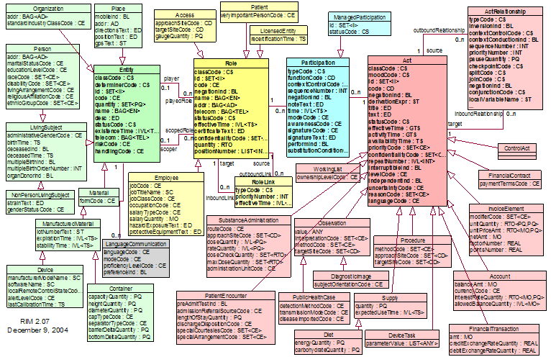
RIM NORMATIVE CONTENT

Slide 14
to design a message, choose from here

Slide 15
Too many combinations
as the traffic on HL7’s own vocabulary mailing list reveals, there is no adequate mechanism for ensuring that the vast number of combinations of coded terms within actual messages can be controlled in such a way that messages will be understood in the same way by designers, senders and receivers.

Slide 17
These pre-defined attributes
code, class_code, mood_code,
status_code, etc.
yield a combinatorial explosion:
class_code (61 values) x mood_code (13 values) x code (estimate 200) x status_code (10 codes) = 1.58 million combinations.
Adding in the other codes this becomes 810 billion.
Notes:
with thanks to Thomas Beale of Ocean Informatics

Slide 18
Why does the RIM embody so many combinations?
To ensure in advance that everything can be said in conformity to the standard

Slide 19
The RIM methodology
defines a set of ‘normative’ classes (Act, Role, and so on), with which are associated a rich stock of attributes from which one must make a selection when applying the RIM to each new domain (pharmacy, clinical genomics ...),
Compare: attempting to create manufacturing software by drawing from a store containing pre-established parts (so that the store would need to have the bits needed for making every conceivable manufacturable thing, be it a lawnmower, a refrigerator, a hunting bow, and so on).

Slide 20
The RIM methodology
Is there even one example where a methodology of this sort has been made to work?

Slide 21
This methodology does not impede the formation of local dialects
Different teams produce different message designs for the very same topic.
In the UK, the $ 35 bn. NHS National Program “Connecting for Health” has applied the RIM rigorously, using all the normative elements, and it discovered that it needed to create dialects of its own to make the V3-based system work for its purposes (it still does not work)

Slide 22
The RIM documentation
is subject to multiple and systematic internal inconsistencies and unclarities:
is marked by sloppy and unexplained use of terms such as ‘act’, ‘Act’, ‘Acts’, ‘action’, ‘ActClass’ ‘Act-instance’, ‘Act-object’
and uncertain cross-referencing to other HL7 documents
no publicly available teaching materials (no HL7 for Dummies)

Slide 23
Problems of scope
Only two main classes in the RIM
Act = roughly: intentional action
Entity = persons, places, organizations, material
How can the RIM deal transparently with information about, say, disease processes, drug interactions, wounds, accidents, bodily organs, documents?

Slide 24
Diseases in the RIM
... are not Acts
... are not Entities
... are not Roles, Participations ...
So what are they?
At best: a case of pneumonia is identified as the Act of Observation of a case of pneumonia

Slide 25
HL7 Clinical Document Architecture
defines a document as an Act
HL7’s Clinical Genomics Standard Specifications
defines an individual allele as an Act of Observation

Slide 26
Why the centrality of ‘Act’
because of HL7’s roots in US hospital messaging – and thus in US hospital billing:
intentional actions are what can be billed

Slide 27
Mayo RIM discussion of the meaning of ‘Act’ as “intentional action”
Is a snake bite or bee sting an "intentional action"?
Is a knife stabbing an intentional action?
Is a car accident an intentional action?
When a child swallows the contents of a bottle of poison is that an intentional action?
Notes:
http://informatics.mayo.edu/wiki/index.php/Intentionality_of_Act_and_the_Future_of_Observations

Slide 28
The RIM has no coherent criteria for deciding
If basic categories cannot be agreed upon for common phenomena like snakebites, then the RIM is in serious trouble.

Slide 29
Are definitions like this a good basis for achieving semantic interoperability in the biomedical domain?:
LivingSubject
Definition: A subtype of Entity representing an organism or complex animal, alive or not.

Slide 30
Person (from HL7 Glossary)
Definition: A Living Subject representing single human being [sic] who is uniquely identifiable through one or more legal documents

Slide 31
The Problem of Circularity
A Person =def. A person with documents
‘An A is an A which is B’
– useless in practical terms, since neither we nor the machine can use it to find out what ‘A’ means
– incorporates a vicious infinite regress
– has the effect of making it impossible to refer to A’s which are not Bs, for example to undocumented persons

Slide 32
What is the RIM about?
blood pressure measurement = an information item
blood pressure = something in reality which exists independently of any recording of information, and which the measurement measures
Q: Is the RIM about information, or about the reality to which such information relates?
A: There is no difference between the two

Slide 33
RIM Philosophy
“The truth about the real world is constructed through a combination and arbitration of attributed statements ...
“As such, there is no distinction between an activity and its documentation.”

Slide 34
The RIM as an Information Model
‘a static (UML) model of health and health care information’
The scope of the RIM’s class hierarchy consists in packets of information:
the information content of invoices, statements of observations, lab reports, …

Slide 35
From the perspective of the RIM on the Information Model conception
  ‘medication’ does not mean: medication
  rather it means:
  the record of medication in an information system
  ‘stopping a medication’ does not mean: stopping a medication
  rather it means:
  change of state in the record of a Substance Administration Act from Active to Aborted

Slide 36
HL7 Glossary
Definition of Animal: A subtype of Living Subject representing any animal-of-interest to the Personnel Management domain.
An Animal is not an animal. Rather (an) Animal represents an animal: it is an information item which represents a certain highly specific kind of animal-of-interest, namely an animal that is of interest to the Personnel Management domain.

Slide 37
Double Standards
The RIM is a confusion of two separate artifacts:
1. an “information model”, relating to names of persons, records of observations, social security numbers, etc.
2. a reference ontology, relating to persons, observations, documents, acts, etc.

Slide 38
HL7’s backbone ‘Act’ class
Definition of Act:
A record of something that is being done, has been done, can be done, or is intended or requested to be done
An Act is the record of an Act
“There is no difference between an activity and its documentation”

Slide 39
Acts are records: but the examples of Act given by the RIM are as follows:
“The kinds of acts that are common in health care are (1) a clinical observation, (2) an assessment of health condition (such as problems and diagnoses), (3) healthcare goals, (4) treatment services (such as medication, surgery, physical and psychological therapy), ...

Slide 40
The class Procedure
(a subclass of Act)
Definition of Procedure: An Act whose immediate and primary outcome (post-condition) is the alteration of the physical condition of the subject
Examples:
chiropractic treatment, acupuncture, straightening rivers, draining swamps.

Slide 41
What’s gone wrong?
People of good will are making mistakes because of insufficient concern for clarity and consistency
Even large ontologies are built in the spirit of the amateur hobbyist
Money is wasted on megasystems that cannot be used

Slide 42
What is an information model ?
Is it a model of entities in reality (an ontology)?
Or of information about entities in reality (an ontology)?
The RIM is an incoherent mixture of the two

