Slide 1
Wrap-Up
Barry Smith

Slide 2
Principles of Ontology Development

Slide 3
Principle of singular nouns
Terms in ontologies represent types
Goal: Each term in an ontology should represent exactly one type
Thus every term should be a singular noun

Slide 4
Dublin Core
Term Name: available
URI: | http://purl.org/dc/terms/available
Label: | Date Available
Term Name: alternative
URI: | http://purl.org/dc/terms/alternative
Label: | Alternative Title

Slide 5
Count vs. mass nouns
Count
suitcase
cow
datum
Mass
luggage
beef
information

Slide 6
Principle: Avoid mass nouns
Brenda Tissue Ontology
blood is_a hematopoietic system
hematopoietic system is_a whole body
whole_body is_a animal

Slide 7
Principle: Supply definitions
Supply definitions for every term
human-understandable natural language definition
an equivalent formal definition

Slide 8
Principle: definitions must be unique
Each term should have exactly one definition
it may have both natural-language and formal versions
(issue with ontologies which exist with different levels of expressivity)

Slide 9
Principle of secondary use
Every ontology should be built on the basis of the assumption that it will have unanticipated secondary uses
Thus general terms (‘cell’, ‘water’, ‘part of’) should not be defined with more specific or local meanings
Do not focus your ontology on just your local use-case

Slide 10
Dublin Core
Term Name: dateCopyrighted
URI: | http://purl.org/dc/terms/dateCopyrighted
Label: | Date Copyrighted
Term Name: date
URI: | http://purl.org/dc/terms/date
Label: | Date
Definition: | A point or period of time associated with an event in the lifecycle of the resource.

Slide 11
The Problem of Circularity
A Person =def. A person with an identity document
Hemolysis =def. The causes of hemolysis
Allergy event = def. Allergy event recorded in Microsoft Healthvault

Slide 12
Principle of non-circularity
The term defined should not appear in its own definition

Slide 13
Principle of increase in understandability
A definition should use only terms which are easier to understand than the term defined
Definitions should not make simple things more difficult than they are

Slide 14
Principle of acknowledging primitives
In every ontology some terms and some relations are primitive = they cannot be defined (on pain of infinite regress)
Examples of primitive relations:
identity
instance_of

Slide 15
Principle of Aristotelian ( two-part) definitions
Use two-part definitions
An A is a B which C’s.
A human being is an animal which is rational
Here A is the child term, B is its immediate parent in the ontology is_a hierarchy

Slide 16
Principle of positivity
Complements of types are not themselves types.
Terms such as
non-mammal
non-membrane
other metalworker in New Zealand
do not designate types in reality
Notes:
There is no species called ‘non-rabbit’

Slide 17
Generalized Anti-Boolean Principle
There are no conjunctive and disjunctive types:
anatomic structure, system, or substance
musculoskeletal and connective tissue disorder

Slide 18
Objectivity
Which types exist in reality is not a function of our knowledge.
Terms such as
unknown
unclassified
unlocalized
arthropathies not otherwise specified
do not designate types in reality.
Notes:
There is no biological species: unknown rabbit. See discussion below.

Slide 19
Keep Epistemology Separate from Ontology
If you want to say that
We do not know where A’s are located
do not invent a new class of
A’s with unknown locations
(A well-constructed ontology should grow linearly; it should not need to delete classes or relations because of increases in knowledge)

Slide 20
Keep Sentences Separate from Terms
If you want to say
I surmise that this is a case of pneumonia
do not invent a new class of surmised pneumonias

Slide 21
Principle: avoid the use-mention confusion
Avoid confusing between words and things
Avoid confusing between concepts in our minds and entities in reality
Recommendation: avoid the word ‘concept’ entirely

Slide 22
Do not confuse data (words, information artifacts) with entities in reality
Use-mention confusion Swimming is healthy and has two vowels.

Slide 23
Do not confuse thing with information about a thing
DARWIN CORE
Term Name: Occurrence
Identifier: | http://rs.tdwg.org/dwc/terms/Occurrence
Class:
Definition: | The category of information pertaining to evidence of an occurrence in nature, in a collection, or in a dataset (specimen, observation, etc.).
Comment: | For discussion see http://code.google.com/p/darwincore/wiki/Occurrence
Details: | Occurrence

Slide 24
Characteristic: Name in OBOE-sbc (OBOE Santa Barbara Coastal Extension)
oboe:Name
oboe-sbc:SBCSiteName
oboe-sbc:TaggedFish
oboe-sbc:TaggedKelpFrond

Slide 25
X vs. Information about X
Term Name: behavior
Identifier: | http://rs.tdwg.org/dwc/terms/behavior
Class: | http://rs.tdwg.org/dwc/terms/Occurrence
Definition: | A description of the behavior shown by the subject at the time the Occurrence was recorded. Recommended best practice is to use a controlled vocabulary.
Comment: | Examples: "roosting", "foraging", "running". For discussion see http://code.google.com/p/darwincore/wiki/Occurrence
Details: | behavior
Term Name: establishmentMeans
Identifier: | http://rs.tdwg.org/dwc/terms/establishmentMeans
Class: | http://rs.tdwg.org/dwc/terms/Occurrence
Definition: | The process by which the biological individual(s) represented in the Occurrence became established at the location. Recommended best practice is to use a controlled vocabulary.

Slide 26
Category: Taxon
Term Name: class
Identifier: | http://rs.tdwg.org/dwc/terms/class
Class: | http://rs.tdwg.org/dwc/terms/Taxon
Definition: | The full scientific name of the class in which the taxon is classified.
Comment: | Example: "Mammalia", "Hepaticopsida". For discussion see http://code.google.com/p/darwincore/wiki/Taxon
Details: | class

Slide 27
Darwin Core
The categories correspond to Darwin Core terms that are classes
Classes = terms that have other terms to describe them.
The terms that describe a given class (the class properties) appear in the list immediately below the name of the category in the index.

Slide 28
Category: Record-level terms
Term Name: dcterms:type
Identifier: | http://purl.org/dc/terms/type
Class: | all
Definition: | The nature or genre of the resource. For Darwin Core, recommended best practice is to use the name of the class that defines the root of the record.

Slide 29
Category: Occurrence
Term Name: individualCount
Identifier: | http://rs.tdwg.org/dwc/terms/individualCount
Class: | http://rs.tdwg.org/dwc/terms/Occurrence
Definition: | The number of individuals represented present at the time of the Occurrence.
Comment: | Examples: "1", "25". For discussion see http://code.google.com/p/darwincore/wiki/Occurrence
Details: | individualCount

Slide 30
Category: Event
Term Name: Event
Identifier: | http://rs.tdwg.org/dwc/terms/Event
Class:
Definition: | The category of information pertaining to an event (an action that occurs at a place and during a period of time).
Comment: | For discussion see http://code.google.com/p/darwincore/wiki/Event
Details: | Event

Slide 31
Category: Identification
Term Name: Identification
Identifier: | http://rs.tdwg.org/dwc/terms/Identification
Class:
Definition: | The category of information pertaining to taxonomic determinations (the assignment of a scientific name).
Comment: | For discussion see http://code.google.com/p/darwincore/wiki/Identification
Details: | Identification

Slide 32
The strategy
Form a community of those who agree on the principle of reusing ontology modules
Homesteading principle
Create a consortium (Environment, Collection, Germplasm, ...)
Create a Coordinating Board, one representative from each ontology, plus ontology expert(s)
Reuse as far as possible existing ontologies, e.g. from OBO Foundry, e.g. in definitions

Slide 33
Darwin Core Semantic Layer
Create 2-part definitions of all Darwin Core terms via downward population from BFO
Use a reasoner to classify the result and to identify classification errors
Redefine problematic terms and repeat as necessary

Slide 34
Ontologies of relevance for potential reuse
BFO
EnvO (GSC) + GAZ
IDO
Plant Ontology
Uberon (cross-species anatomy ontology)
Ontology for Biomedical Investigations
Information Artifact Ontology

Slide 35
Ontologies of Relevance
IDO
establishment
invasiveness
harmful
introduced

Slide 36
Plant Ontology
Crop Ontology → Plant Ontology
Plant Trait Ontology,
Plant Disease Ontology
Resistance
Needed
Plant EnvO

Slide 37
Information Artifact Ontology
Scientific name

Slide 38
OBO Governance
http://obofoundry.org/
See especially under ‘Participate’

Slide 39
Education
OBI (Ontology for Biomedical Investigations)
Protégé
BFO

Slide 40
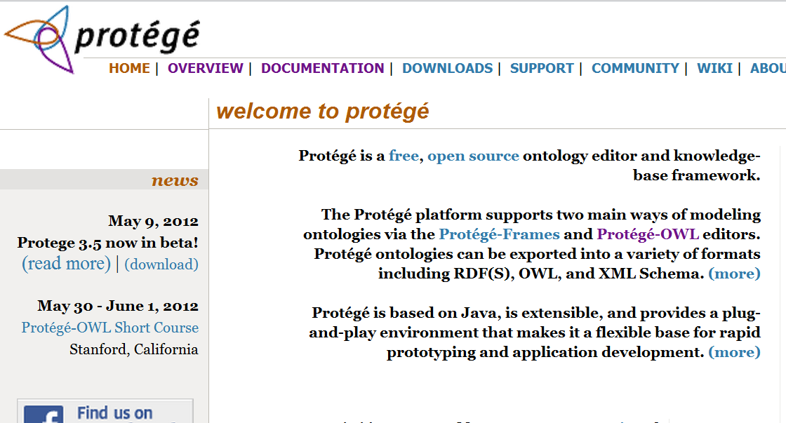
Protégé website

Slide 41
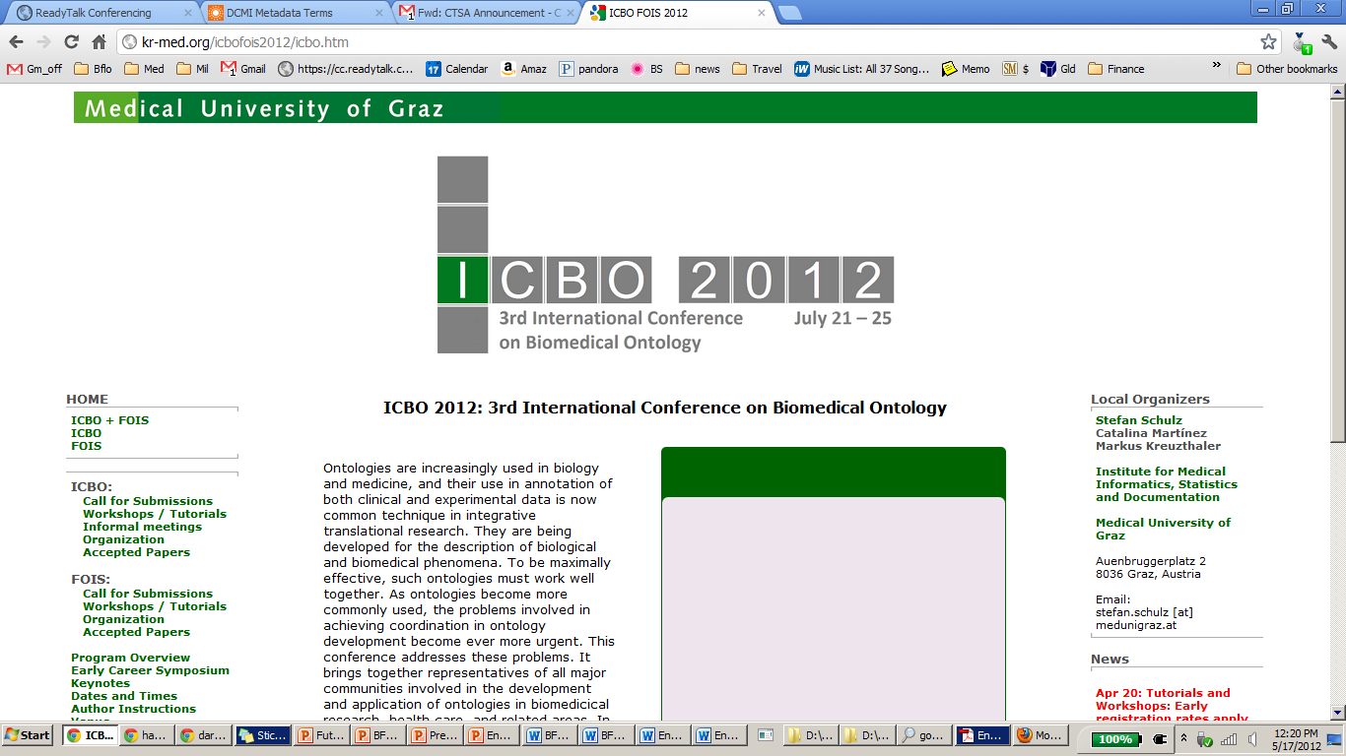

Slide 42
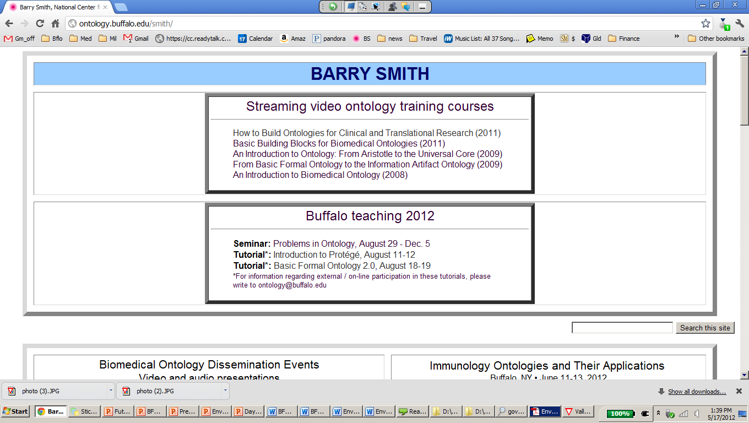
http://ontology.buffalo.edu/smith

