Slide 1
Enabling semantic integration of biobank administrative data using OMIABIS
M Brochhausen
Orlando Feb 11, 2013

Slide 2

1.1 Starting point: BBMRI
European Biobanking and Biomolecular Resources Research Infrastructure (BBMRI)
Preparation of the construction of a pan-European research infrastructure
Integrating technical, ethical, social and financial aspects of the endeavor
Increasing scientific excellence and efficacy

Slide 3
1.2 Starting point: MIABIS
Minimum Information About Biobank data Sharing
52 attributes
Based on existing standards ( etc. SPREC, ICD 10, etc.)
Used in a Scandinavian survey to gather data on biobanks
L Norlin, MN Fransson, M Eriksson, R Merino-Martinez, M Anderberg, S Kurtovic, JE Litton. Biopreservation and Biobanking. August 2012, 10(4): 343-348. doi:10.1089/bio.2012.0003.

Slide 4
2.1 Aims
Provide better semantic Integration for BBMRI
shift from minimum data set to OWL 2.0 ontology
Provide a semantically rich ontology to enter biobanking data into i2b2

Slide 5
2.2 BBMRI developmental use-cases
Search for tissue samples from donors diagnosed with nemaline myopathy to determine:
Age group
Sample storage conditions
Possible detailed information about the biopsies
Whether myoblast cell cultures have been grown from these samples
Search for sample collections that have:
At least 10 cases with tissue from thoracic aorta
Blood, serum, or plasma from the same donor.
Biopsies performed +/- one week in relation to the blood sampling
Possible registered clinical data of the donors
Possible detailed information of the biopsies

Slide 6
2.3 Arkansas use-case
Multiple biobanks (UAMS, ACHRI)
Integrate data for research purposes, while keeping the facilities independent
Integration with EHR data
Data is stored in EDW, access via i2b2
For integrating data from heterogeneous resources an ontology for the i2b2 Ontology Cell

Slide 7
2.3 Arkansas use-case
Currently caTissue is used
Does not guarantee integration, due to user-created specimen annotation forms with different data
Incorporation of OMIABIS into annotation forms for all UAMS/ACHRI biobanks and biobank data model elements

Slide 8
3.1 Status report
OMIABIS is written in OWL 2.0.
It contains 249 classes and 64 object properties (total of 35 new entities).
Initial release can be downloaded from http://purl.obolibrary.org/obo/omiabis.owl

Slide 9
3.2 Status Report: Re-used ontologies
Basic Formal Ontology (BFO)
Information Artifact Ontology (IAO)
Proper Name Ontology (PNO)
Ontology of Biomedical Investigations (OBI)
Ontology of Medically Relevant Social Entities (OMRSE)

Slide 10
Biobank Information
Biobank ID
Biobank Name
Biobank Organization
Biobank URL
Biobank Country Code
Biobank Contact Person
Biobank Contact Phone
Biobank Contact Email
Biobank Contact Department
…
Study Information
Study ID
Study Name
Study Description
Principal Investigator
Study Contact Person
Study Contact Phone
Study Contact Email
Study Contact Department
Study Contact Address
…
Study Participant
Participant Sex
Participant Name
Participant’s Main Diagnosis
Participant’s Comorbidity
Categories Of Data Collected
Register Or Survey Data
Specimen
Material Type
Omics Experiments
Storage Temperature
Hosting Biobank
done!
to do…

Slide 11
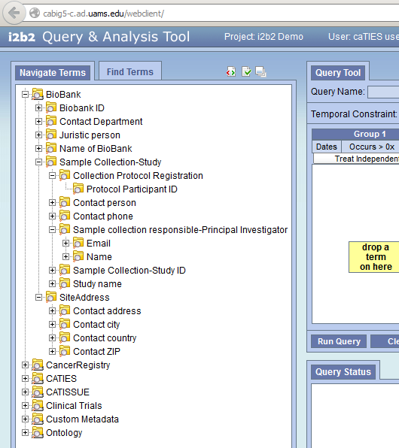

Slide 12
4. Next steps
Complete representation of MIABIS
Putting data into i2b2 using the completed OMIABIS
Set up cooperation with Tissue Bank project at Medical School, University Mainz
Look for more use-cases, collaborators, etc.!!!

Slide 13



5. Collaborators:
M. Brochhausen, N. Kanaskar, U. Topaloglu, W.R. Hogan
M.N. Fransson, M. Eriksson, R. Merino-Martinez, L. Norlin, S. Kjellqvist, M. Hortlund, J.E. Litton
C. Brochhausen

Slide 14
6. Other ontology projects at UAMS:
Drug Ontology
National Children's Study MDES Improvement (collaboration with Northwestern University)
Social Ontology for Biomedicine (collaboration with Cornell University, Oregon Health Science University, University at Buffalo)
Epidemic Simulation Ontology (collaboration with University of Pittsburgh)

