Slide 1
Formal Ontology and Biomedical Informatics
Barry Smith http://ontologist.com

Slide 2
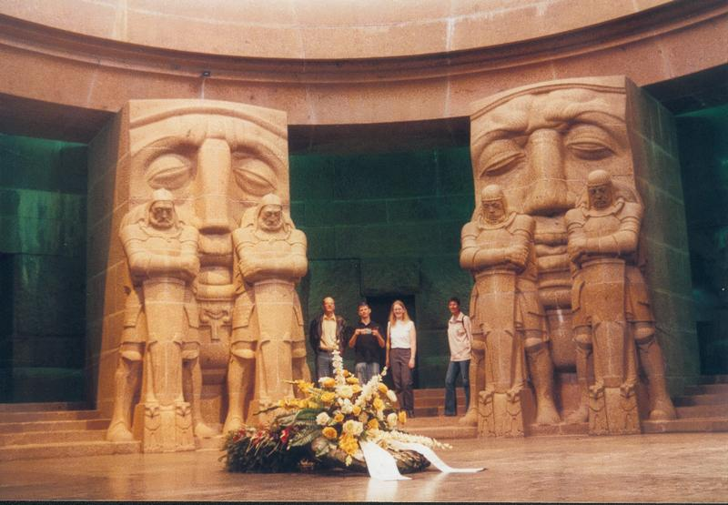
Part One
Formal Ontology

Slide 3
Formal Ontology
Logical Investigations (1900-01, 1913-21)
Prolegomena to Pure Logic
III: On the Theory of Wholes and Parts

Slide 4
Logical Investigations¸1900/01
  theory of part and whole
  theory of dependence / unity
  theory of boundary, continuity and contact
  theory of species, instances and lowest specific differences

Slide 5
Formal Ontology
the theory of those ontological structures
(such as part-whole, universal-particular)
which apply to all domains whatsoever

Slide 6
Formal Ontology vs. Formal Logic
Formal ontology deals with the interconnections of things
with objects and properties, parts and wholes, relations and collectives
Formal logic deals with the interconnections of truths
with consistency and validity, or and not

Slide 7
Formal Ontology vs. Formal Logic
Formal ontology deals with formal ontological structures
Formal logic deals with formal logical structures

Slide 8
Ontological Structure
relation
A
B
C
D
E

Slide 9
Ontological Structure
one-sided dependence
A
B
C
two-sided mutual dependence
D
E

Slide 10
Ontological Structure
part-whole
relations
A
B
F
C
D
E

Slide 11
Formal-Ontological Laws
Necessitation
Compatibility
Exclusion

Slide 12
Necessitation
if instances of species S exist, then as a matter of necessity there exist also instances of the species S′, S′′, etc.
S′
S

Slide 13
Compatibility
if instances of species S, S′, etc., exist in association with each other, then it is possible that there exist also associated instances of species T, T′ , etc.

Slide 14
Exclusion
if instances of species S, S′, etc., exist in association with each other, then it is necessarily excluded that they should be associated also with instances of the species U, U′, etc.

Slide 15
Formal-Ontological Categories
object
state of affairs
unity
plurality
dependent part
independent part
relation
are able to form complex structures in non-arbitrary, law-governed ways

Slide 16
In formal ontology
as in formal logic, we can grasp the properties of given structures in such a way as to establish in one go the properties of all formally similar structures

Slide 17
Compare the applicability of ‘pure’ mathematics
‘If the relevant formal theory has actually been worked out …, then all deductive theoretical work in the building up of all actual theories of the same form has been done.’ (LU, I A249f./242)

Slide 18
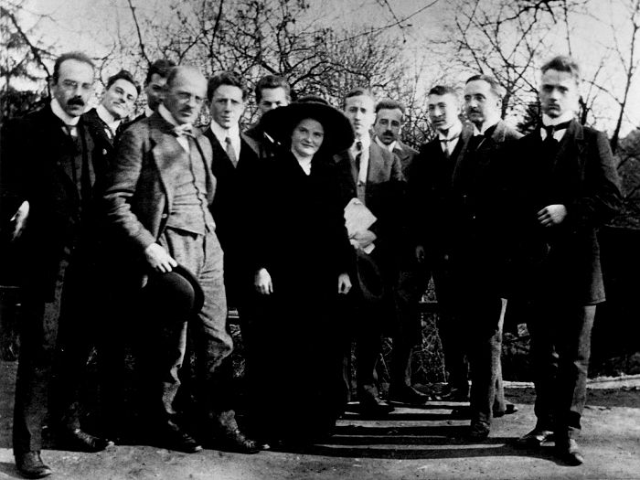
The Munich School of Phenomenology

Slide 20
Munich School of Phenomenology
Alexander Pfänder
Max Scheler
Adolf Reinach
Edith Stein
…
Roman Ingarden
(Karol Wojtyła)

Slide 21
The Munich School
applied the realist ontological method sketched by Husserl in the Logical Investigations to different material domains:
Husserl: Logic, Language, Perception …
Ingarden: Art and Aesthetics
Stein: The State and the Individual
Scheler: Ethics
Reinach: Law

Slide 22
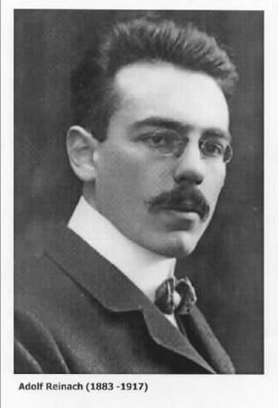

Slide 23
Reinach and Speech Act Theory
The A Priori Foundations of the Civil Law 1913
uses Husserl’s theory of dependence and part-whole relations to develop the foundations of a ‘general ontology of social interaction’

Slide 24
The Structure of the Promise
act of speaking
promiser
act of registering
promisee
content
two-sided mutual dependence
oblig-ation
claim

Slide 25
A Window on Reality
act of speaking
promiser
act of registering
promisee
content
two-sided mutual dependence
oblig-ation
claim

Slide 26
A Window on Reality speech act
assertion warning promise

Slide 27
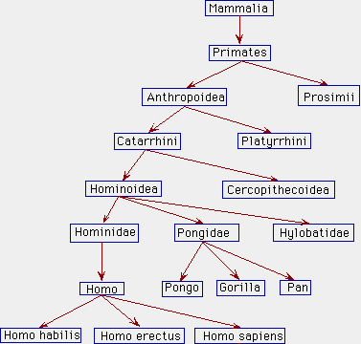
A Window on Reality
Notes:
http://www.kheper.auz.com/gaia/biosphere/systematics/Linnean.htm

Slide 28
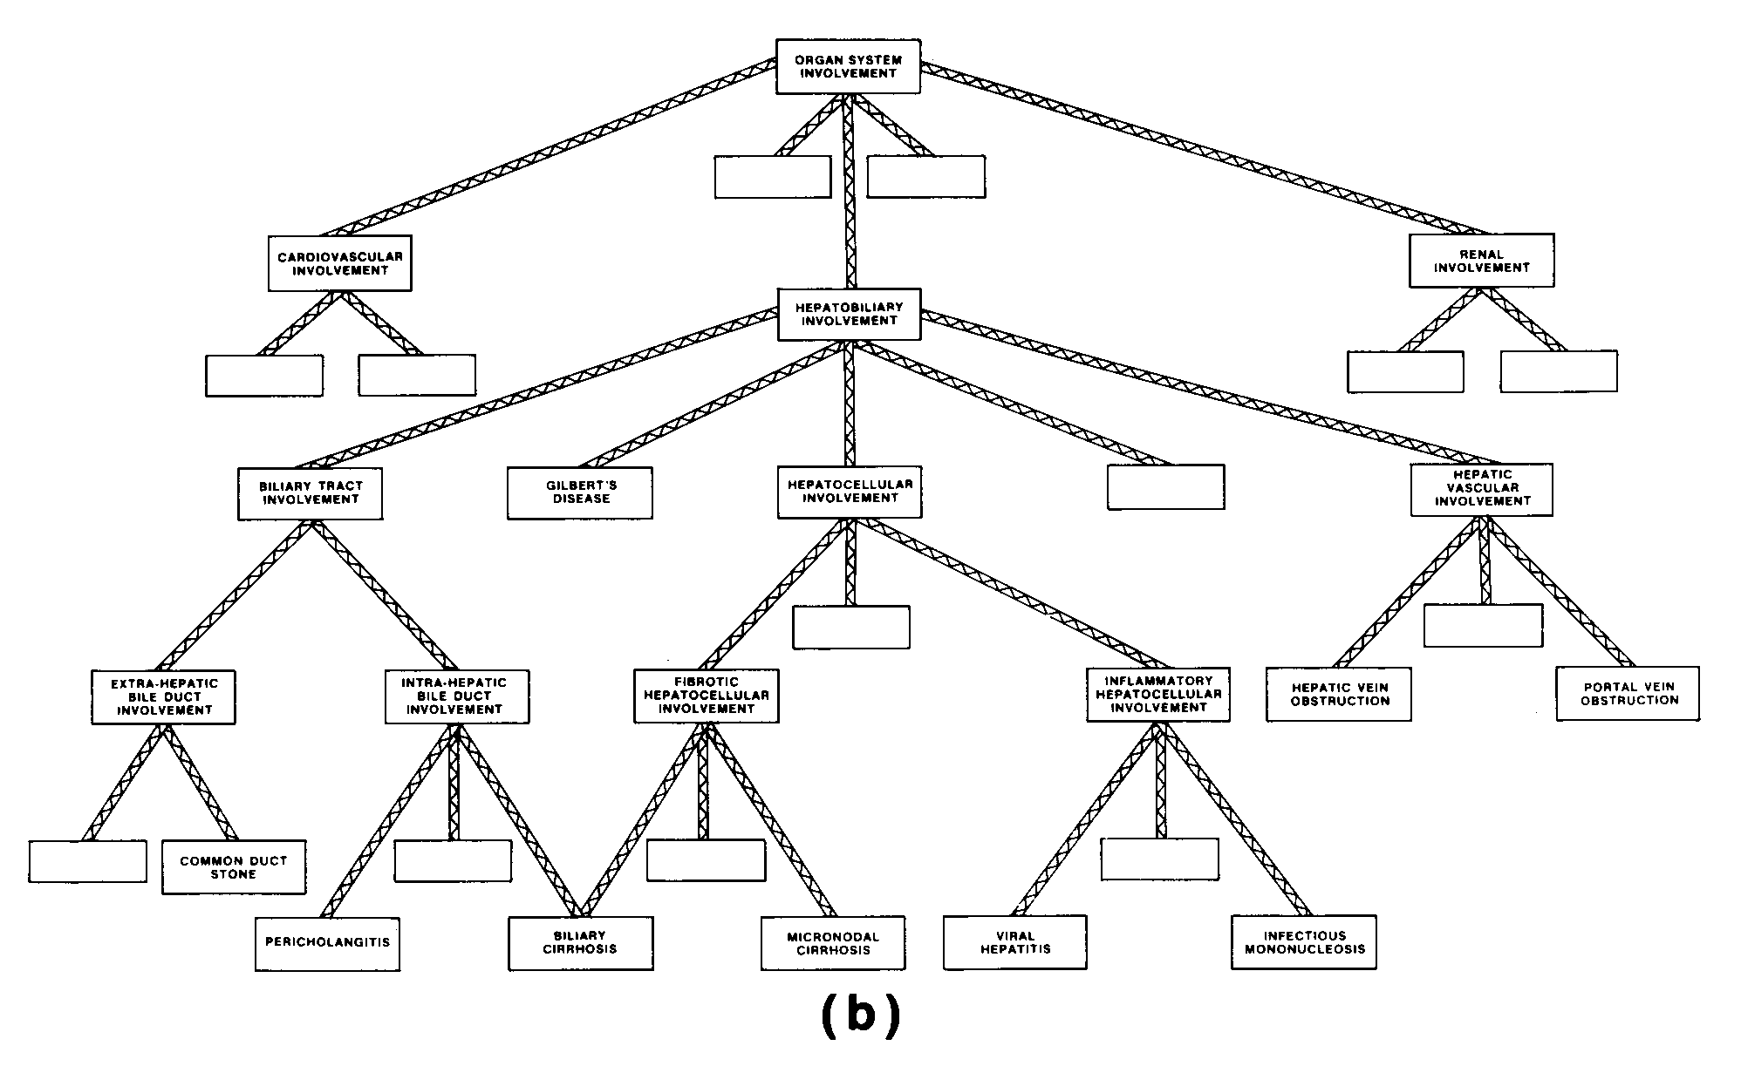
Medical Diagnostic Hierarchy
a hierarchy in the realm of diseases
Notes:
http://medg.lcs.mit.edu/ftp/psz/AIM82/wpe51.gif

Slide 29
Dependence Relations
Organisms
Diseases
Notes:
http://www.kheper.auz.com/gaia/biosphere/systematics/Linnean.htm

Slide 30
A Window on Reality
Organisms
Diseases
Notes:
http://www.kheper.auz.com/gaia/biosphere/systematics/Linnean.htm

Slide 31
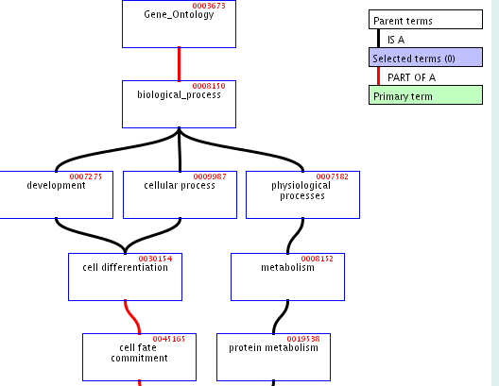
A Window on Reality
Notes:
http://www.kheper.auz.com/gaia/biosphere/systematics/Linnean.htm

Slide 32
Formal-Ontological Laws
Universal and necessary relations obtaining among universals
in law
in language
in logic
in biology?

Slide 33
Part Two
Biomedical Informatics

Slide 34
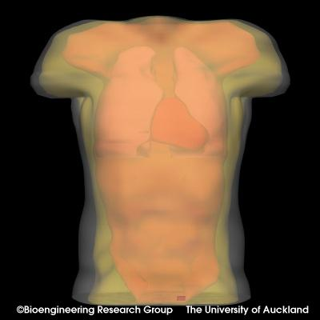
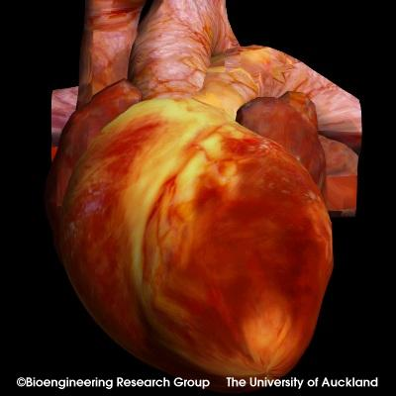
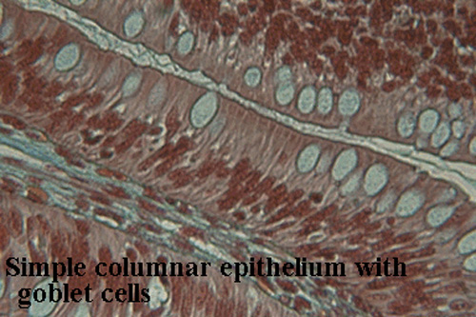
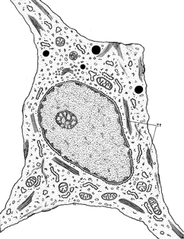
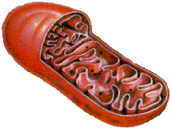
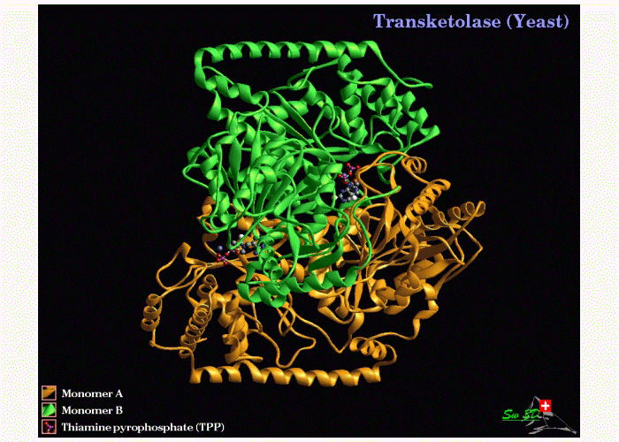
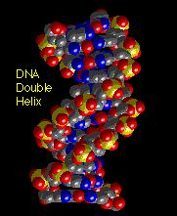
Scales of anatomy
Organism
Organ
Tissue
10⁻¹ m
Cell
Organelle
10⁻⁵ m
Protein
DNA
10⁻⁹ m

Slide 35
Complexity of biological structures
30,000 genes in human
200,000 proteins
100s of cell types
100,000s of disease types
1,000,000s of biochemical pathways (including disease pathways)

Slide 36
New Golden Age of Classification
importance of chemistry
molecules
molecular structures
molecular processes

Slide 37
But:
each (clinical, pathological, genetic, proteomic, pharmacological …) information system uses its own classification system
How can we overcome the incompatibilities which become apparent when data from distinct sources is combined?

Slide 38
Answer:
“Ontology”

Slide 39
The problem of the unity of science
The logical positivist solution to this problem addressed a world in which sciences are identified with
printed texts
What if sciences are identified with
information systems ?

Slide 40
Different scientific cultures/terminologies
immunology
genetics
cell biology

Slide 41
Anatomy Reference Ontology
theoretical framework surrounding the Digital Anatomist Foundational Model of Anatomy
Department of Biological Structure, University of Washington, Seattle

Slide 42
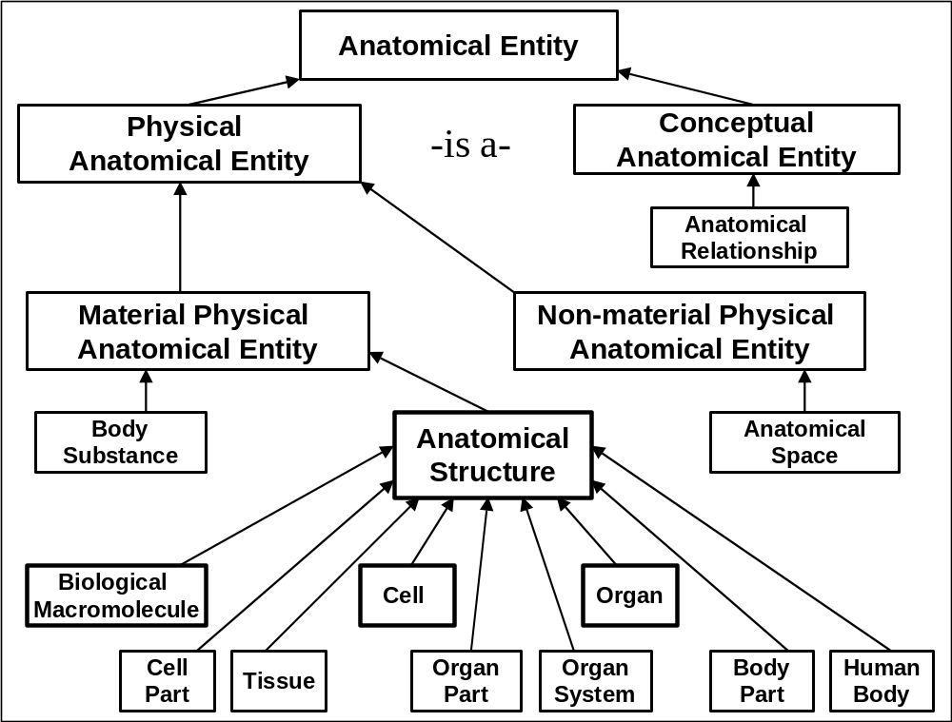

Slide 43
The Anatomy Reference Ontology
is organized in a graph-theoretical structure involving two sorts of links or edges:
is-a (= is a subtype of )
(pleural sac is-a serous sac)
part-of
(cervical vertebra part-of vertebral column)

Slide 44
Anatomical Space
Anatomical
Structure
Organ Cavity
Subdivision
Organ
Cavity
Organ
Organ Part
Serous Sac
Cavity
Subdivision
Serous Sac
Cavity
Serous Sac
Organ
Component
Organ
Subdivision
Tissue
Pleural Sac
Pleura(Wall
of Sac)
Pleural
Cavity
Parietal
Pleura
Visceral
Pleura
Interlobar
recess
Mediastinal
Pleura
Mesothelium
of Pleura

Slide 45
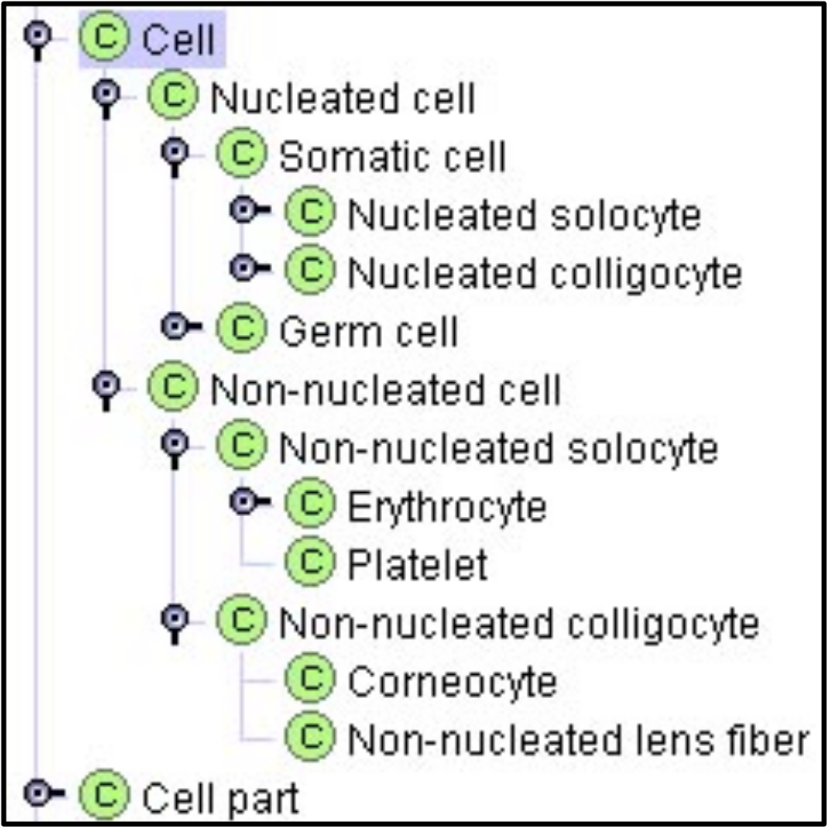
at every level of granularity

Slide 46
Anatomy Reference Ontology
“Rather than stating the meanings of terms, definitions should state the essence of anatomical entities in terms of their characteristics ... Paraphrasing Aristotle, the essence of an entity is constituted by … the genus, necessary to assign an entity to a class and … the differentiae, necessary to distinguish the entity from other entities also assigned to the class.”

Slide 47
Part Three
GO:
The Gene Ontology

Slide 48
GO is three ontologies
cellular components
molecular functions
biological processes
December 16, 2003:
1372 component terms
7271 function terms
8069 process terms

Slide 49
GO product of Open Biological Ontologies consortium
Fungal Ontology
Plant Ontology
Yeast Ontology
Disease Ontology
...

Slide 50
When a gene is identified
three important types of questions need to be addressed:
1. Where is it located in the cell?
2. What functions does it have on the molecular level?
3. To what biological processes do these functions contribute?

Slide 51
GO’s three ontologies
molecular functions
biological processes
cellular components

Slide 52
The Cellular Component Ontology (counterpart of anatomy)
flagellum
chromosome
membrane
cell wall
nucleus

Slide 53
The Molecular Function Ontology
ice nucleation
protein stabilization
kinase activity
binding
The Molecular Function ontology is (roughly) an ontology of actions on the molecular level of granularity

Slide 54
Biological Process Ontology
Examples:
glycolysis
death
adult walking behavior
response to blue light
= occurrents on the level of granularity of cells, organs and whole organisms

Slide 55
Each of GO’s ontologies
is organized in a graph-theoretical structure involving two sorts of links or edges:
is-a (= is a subtype of )
(copulation is-a biological process)
part-of
(cell wall part-of cell)

Slide 57
the universals of GO are species-independent
an ontology of the unchanging universal building blocks of life
(substances and processes)
and of the structures they form

Slide 58
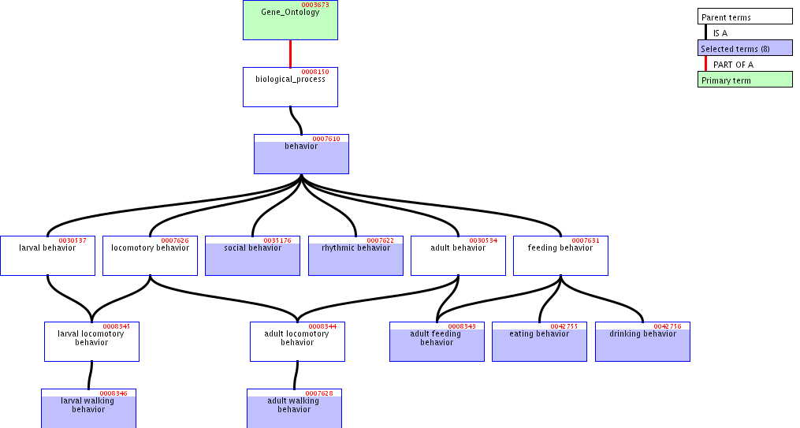
Problems

Slide 60
cars
red cars Cadillacs cars with radios

Slide 62
The Gene Ontology
error prone
in part because of its sloppy treatment of relations
menopause part_of death

Slide 63
Ontological Relations
one-sided dependence
A
B
C
two-sided mutual dependence
D
E

Slide 64
Easier to maintain an ontology like GO if you understand what your relational terms mean

Slide 65
Open Biological Ontologies
http://obo.sourceforge.net/
OBO library of controlled vocabularies developed for shared use across different biological domains.
Gene Ontology plus: Cell Ontology, Sequence Ontology, etc.

Slide 66
To support integration of ontologies
relational expressions such as
is_a
part_of
...
should be used in the same way by the ontologies to be integrated
should be coherently defined

Slide 67
To define bio-ontological relations we need to take account of both components and processes
(= continuants and occurrents)
Components are that which changes; they are the bearers of processes.
cell division has_participant cell

Slide 68
OBO Relations Ontology:
is_a
part_of
develops_ from
derives_ from
located_at
participates_in
adjacent_to
contained_in
precedes
has_function

Slide 69
to define these relations properly
we need to take account of both universals* and instances
*what Olivier called ‘classes’

Slide 70
Kinds of relations
<universal, universal>: is_a, part_of, ...
<instance, universal>: this mitosis instance_of the universal mitosis
<instance, instance>: Mary’s heart part_of Mary

Slide 71
Instance-level relations
part_of
is_located_at
has_participant
has_agent
earlier
. . .

Slide 72
Taking the instance-level part_of as primitive
we can define:
C₁ part_of C₂ means: any instance of C₁ is part_of some instance of C₂
nucleus part_of cell
but not:
testis part_of human

Slide 73
from C₁ part_of C₂ we cannot infer that C₂ has_part C₁
human_testis part_of human
but not
human has_part human testis
running has_part breathing
but not
breathing part_of running

Slide 74
transformation_of
fetus transformation_of embryo
adult transformation_of child
C₂ transformation_of C₁ =def. any instance of C₂ was at some earlier time an instance of C₁

Slide 75
transformation_of
C
c at t
C₁
c at t₁

Slide 76
child transformation_of fetus
adult transformation_of child
mature RNA transformation_of pre-RNA

Slide 77
Derives_from
c derives_from c₁ =def c and c₁ are non-identical
and exist in continuous succession

Slide 78
the initial component ceases to exist with the formation of the new component
C
c at t
C₁
c₁ at t₁
the new component detaches itself from the initial component, which itself continues to exist
C
c at t
c at t₁
C₁
c₁ at t

Slide 79
two initial components fuse to form a new component
C
c at t
C₁
c₁ at t₁
C'
c' at t

Slide 80
neuron derives_from neuroblast
muscle cell derives_from myoblast
child derives_from adult
embryo derives_from ovum
embryo derives_from sperm
corpse derives_from human

Slide 81
is_functioning_of
your heart has the function: to pump blood
= your heart is predisposed (has the potential or casual power) to realize a process of the type pumping blood.
has_agent (instance-level relation)
C is_functioning_of P → any instance of C is an agent_of some instance of P

Slide 82
Compare:
pure mathematics (theories of structures such as order, set, function, mapping) employed in every domain
applied mathematics, applications of these theories = re-using the same definitions, theorems, proofs in new application domains
physical chemistry, biophysics, etc. = adding detail

Slide 83
Three levels of ontology
?????
formal (top-level) ontology =
biomedical ontology has thus far had nothing like the technology of definitions, theorems and proofs provided by pure mathematics
2) domain ontology
= UMLS Semantic Network, GO
3) terminology-based ontology
= UMLS, SNOMED-CT, GALEN, FMA

Slide 84
OBO Relations Ontology
is_a
part_of
develops_ from
derives_ from
located_at
has_participant
has_agent
adjacent_to
contained_in
precedes
is_functioning_of

Slide 85
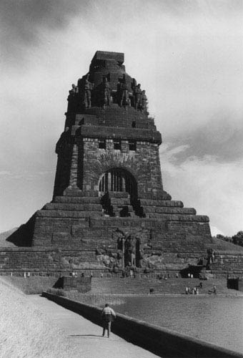

The End
http://ontologist.com

