Slide 1
Ontology of Disease and the OBO Foundry
Chris Mungall
NCBO
GO
Nov 2006
Notes:
NCORB
s/core4/core1

Slide 2
Outline
OBO Foundry introduction
  Organisational principles
  Phenotypes in OBO
Ontology of Disease (and disease-related entities) in the OBO Foundry
  What needs to be done?

Slide 3
OBO Foundry goals
Data integration & reasoning
  High quality interoperable gold standard reference ontologies
  Coverage of all of biomedical reality
Subset of OBO
    All OBO principles are inherited; eg open
    OBO Foundry is a reformulation of the original OBO goals
      Offshoot of GO

Slide 4
Organisation and principles of the OBO Foundry
Divided by partitions:
  Kind of entity
  Granularity
  Canonical, variant and pathological
  Species-specificity
Strives for orthogonality
Normalized design
      Rector et al
Definitions

Slide 5
Division by kind: upper level categories
Entity
  Occurrent (broadly: 4D entity)
    Process (e.g. GO biological_process)
      Organismal process, cellular process, subatomic process (REX)
  Continuant (broadly: 3D entity)
    Independent Continuant
      Cell (CL), Organ (FMA,CARO), Organism (NCBITax), Tumor (eVOC)
    Dependent Continuant
      Function (GO-MF), quality (PATO), phenotype (MP), trait (TO), disease / condition, disposition
Example terms/root nodes (current OBO ontology)
Notes:
Doesn’t have kent’s C0 or C1
Comes from philosophers and fits well with natural self-organisation of ontologies by scientists

Slide 6
Division by granularity
Example of a granular partitioning:
  Biological
    Population (multi-organism)
    Multi-cellular organismal
    Cellular
  Molecular/chemical
Notes:
Cross-cutting partitions?

Slide 7
Canonical, variant and pathological
Drawing boundaries is difficult
Examples
  Pathological
    Pathological condition or quality (disease or mutant phenotype)
    Pathological independent continuants (eg tumor)
    Pathological processes (oncogenesis)
  Canonical
    GO (molecular function, biological process, cellular component)
    FMA (canonical human anatomy)
Notes:
Drawing boundaries nec at least practically; consider developing fly_anat s.t. mutants are accounted for
GO does have processes that are pathological from the context of the host; eg viral genome transport within host. Canonical viral process

Slide 8
Organism and stage specificity
Ontologies may be specific to an organism type or stage
Examples
  Anatomy
    FMA: Human adult
    Zebrafish_anatomy: Danio rerio/Cypriniformes?
    CARO: multi-species/Metazoan
  Process
    GO-BP: pan-kingdom pan-stage

Slide 9
Populating the OBO Foundry
Each ontology (partially or fully) occupies one or more slots/cells in the matrix defined by these divisions
Example:
  GO Cellular component
    Canonical Independent continuants: subcellular (cross-species)
  PATO
    Dependent Continuant (quality): all (cross-species)
Foundry strives for orthogonality

Slide 10
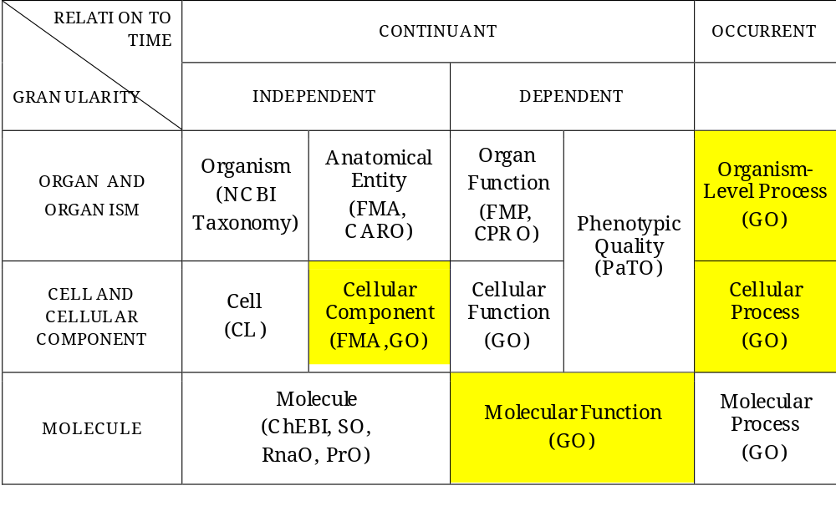
Notes:
GO occupies multiple slots - DO can too

Slide 11
OBO Foundry Definitions
Necessary and sufficient conditions
OBO Foundry terms should have Aristotelian definitions
  An <S> is a <G> which <D>
Example (from FMA)
  A plasma membrane is a cardinal cell part which surrounds the cytoplasm
Each term should have a single definition
  Thus single primary is a parent
  Full subsumption DAG can be derived automatically

Slide 12
The OBO Foundry should be connected
Connections required for inference
Types connected via formally defined relations
  OBO Relation ontology
Some relations can connect:
  different kinds of entities
  across granular levels
Connections obtained through
  Definitions (N+S conditions)
  Relationships (N conditions)

Slide 13
Connectivity & GO Bio Process
GO-BP represents biological processes
  Process has_participant continuant
  Processes realized_by functions
  Processes can be part_of other processes
    Intra-ontology
Examples:
  Chemical entity participant
    Cysteine biosynthesis
  Cell or gross anatomical entity participant
    Oocyte differentiation
    Neural crest cell migration
Notes:
These are still orthogonal; controlled DAGs

Slide 14
Connectivity and phenotypes
We care because we want to use computers to help understand the relationships between genes and phenotypes across species
Phenotypes are dependent continuants
  They require a bearer
    The bearer is an independent continuant
    A phenotype is a quality inhering in a bearer
  Phenotypes may be directed towards other entities
  PATO ‘EQ’ methodology
    Successful for MOD annotation

Slide 15
Phenotype (MP) | Computable Definition
 | Genus | Differentia
Big ears MP:0000017 | Large size PATO | Inheres_in ears MA
Sensitivity to nicotine MP:0003386 | sensitivity PATO:0000085 | Towards nicotine CHEBI:17688
Susceptibility to viral infection MP | susceptibility PATO:0001043 | Towards viral infection GO
holoprosencephaly MP | Having_single_part PATO | Cerebral hemisphere FMA
Hypoglycemia MP:0000189 | Low_quantity PATO | Glucose CHEBI:17234
 |  | Inheres_in blood FMA

Slide 16
Diseases and the OBO Foundry
The OBO Foundry has a vacant space for disease & related entities (DO)
How do we proceed?
  What are the kinds of entities within the scope of the DO?
  How do these entities connect to entities defined in other OBO-Foundry ontologies?
  How does the DO address granularity?
  Should the DO cover other mammals/vertebrates?
  How do we define disease (general) and specific diseases?

Slide 17
Scope of the DO
Diseases are dependent continuants
The OBO Foundry also has space for:
  Pathological independent continuants
    Tumors
    Viruses (NCBITax?)
  Pathological processes
    Caveat: pathogenic organismal processes (GO)
  Should the DO manage or import these?
Phenotypes (signs, symptoms)
  Covered
  Overlap?
Notes:
‘path’ process in GO

Slide 18
Connections to other ontologies
What entities should be related
  Infected (condition) & spread of virus & virus
  Cancer disease & carcinoma
  Clinical procedures & diseases
  Disease and diagnosis (meta-observation??)
  Disease and symptoms/phenotypes/manifestations
  Gene and disease
  Diseases and dispositions
  Diseases and anatomical entities
  Disease and process
Which of these are in scope of the DO?
  Application ontologies
  Annotations, Databases/knowledge bases (e.g. OBD)
What relations need added to RO to support these?
Notes:
Syndromes vs diseases: purely epistemological
Stefan: disease of: colitis - whole colon; nephite - some part of kidney
DO should be good enough for clinical medicine; but diagnoses etc can be a separate ontology

Slide 19
Organism specificity
We are focused on translational medicine
  Human health
Animal diseases that can cross to human
  Eg Avian flu
Animal models of human disease
What is the scope of the DO?
  Human is priority
  What is the migration path?
Notes:
Translational science has no specific use for eg plant diseases, but others might.
Phages or things that infect disease vectors?

Slide 20
Defining diseases
Can we always apply the Aristotelian definition methodology?
  Eligibility criteria
Can we import definitions from Snomed & openGALEN?
Should there be a single axis?
  What is it?
Many definitions will be hard
  Use cases on wiki?

Slide 21
Proposal
Pick low hanging fruit
  Define in terms of disruption of process/functioning (GO + ?)
    As granular/specific as possible
  Tag as ‘foundry subset’ as appropriate
For all disease terms
  Link to aetiological agent(s) (if there is one)
  Link to manifestations (phenotypes)
  Link to independent continuants (eg FMA)
  Link to pathological formations
  These links can be used to automatically build DAGs for use in applications

Slide 22
Further discussion
Mailing lists
  Diseasesontology-discuss
  Obo-relations
  Obo-discuss
  Obo-phenotype

Slide 24
Annotations, genes
Need a place for statistical knowledge
  7% of breast cancer cases are correlated with a mutation in BRCA1
OBO Foundry
OBD Foundry

Slide 25
Genes and the OBO Foundry
Difference between gene instance and gene type
OBD Foundry

Slide 26
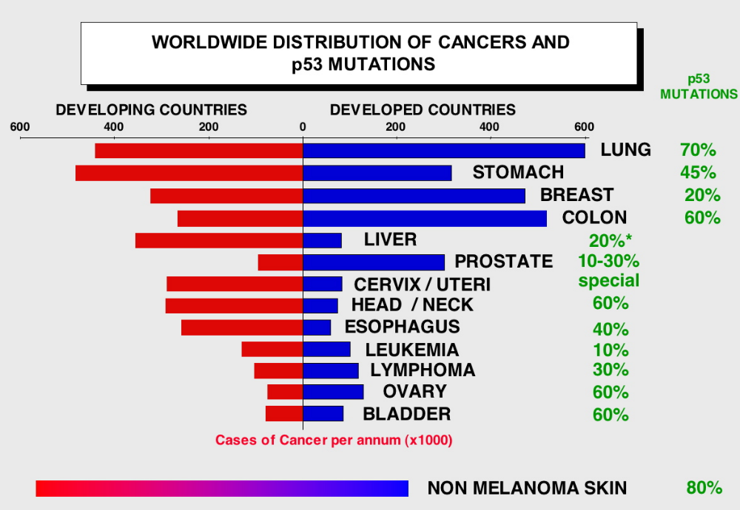
http://p53.free.fr/Database/p53_mutation.html

Slide 27
Axes
Topog
Morphology
Etiology
Function

