Slide 1
Tutorial on Ontology Design
Barry Smith and Werner Ceusters

Slide 2
Who we are
Werner Ceusters
Executive Director, European Centre for Ontological Research (Saarbrücken)
Formerly Director R&D and VP Research, Language & Computing nv (Belgium)

Slide 3
Who we are
Barry Smith
Director of IFOMIS: The Institute for Formal Ontology and Medical Information Science (Saarbrücken)
Professor of Philosophy, University at Buffalo, NY

Slide 4
IFOMIS
Institute for Formal Ontology and Medical Information Science
Mission: to develop formal ontologies to support empirical research in biomedical informatics and in the life sciences

Slide 5
Four Parts
Smith
Realist Principles of Ontology Design
Ceusters
Practical Implementation of Realism-Based Ontologies: Referent Tracking in the EHR
Smith
Coda: Instances and Universals as Benchmark for Ontologies and Terminologies

Slide 6
Part I:
Realist Principles of Ontology Design

Slide 7
In computer science, there is an information handling problem
Different groups of data-gatherers develop their own idiosyncratic terms in which to represent information.
To put this information together, methods must be found to resolve terminological incompatibilities.

Slide 8
The Solution to this Tower of Babel problem
A shared, common, backbone taxonomy of relevant entities, and the relationships between them
This is referred to by information scientists as an Ontology.
= a collection of general classes (‘universals’) and of general truths about the relations between such classes
Notes:
Provide significant advantages over the case-by-case resolution of incompatibilities.

Slide 9
Time-indexed facts about instances are not included !
It is the generalizations that are captured in an ontology
But instances and times are nonetheless important
– and will become even more important when ontologies are applied to reasoning with EHR data

Slide 10
Motivation of ontology: to capture general biomedical truths
Inferences and decisions we make are based upon what we know of biomedical reality.
An ontology is a computable representation of general laws governing the universals and relations in biomedical reality.
to enable a computer to reason over different bodies of data in (some of) the ways that we do
Notes:
Presumably

Slide 11
top-down methodology, based on relations between concepts; largely ignores the world of flesh-and-blood individuals existing in time
bottom-up methodology, starts not from concepts but from individuals as they are related together in reality, and from the universals which they instantiate

Slide 12
Ontologies ≈ Structured Terminologies ≈ Coding Systems ≈ Controlled Vocabularies
expressing discoveries in the life sciences in a uniform way – discoveries about universals
providing a uniform framework for managing instance-based data deriving from different sources

Slide 13
Examples of individuals
me
my cardiologist
my heart
my blood pressure
the measurement of my blood pressure
– all of these are entities referred to in my medical record when I consult my cardiologist.

Slide 14
Examples of universals
human being
patient role
physician role
human heart
human blood pressure
act of blood pressure measurement

Slide 15
Importance of Rules/Principles for Building Ontologies
Following common basic rules helps make ontologies more robust, more intuitive, more error free, more interoperable

Slide 16
Why do we need rules for good ontology?
Ontologies must be intelligible both to humans (who construct them) and to machines (for reasoning and error-checking)
Unintuitive rules for classification lead to entry errors (problematic links)
Facilitate training of curators
Overcome obstacles to alignment with other ontology and terminology systems
Enhance harvesting of content through automatic reasoning systems
Notes:
e.g. menopause part-of aging, aging part-of death
Database searching is one of the important kinds of reasoning we want to enable

Slide 17
First Rule: Univocity
Terms (including those describing relations) should have the same meanings on every occasion of use.
In other words, they should refer to the same universals (the same kinds of entities in reality) or to the same relations between universals on every occasion of use
Notes:
Problem example: ‘chromosome’ in Sequence Ontology and in Cell Component Ontology means different things
Current solution: two distinct terms involved (qualified by respective namespace)

Slide 18
Example of univocity problem in case of part_of relation
(Old) Gene Ontology:
‘part_of’ = ‘may be part of’
  flagellum part_of cell
‘part_of’ = ‘is at times part of’
  replication fork part_of the nucleoplasm
‘part_of’ = ‘is included as a sub-list in’
IFOMIS currently working with GO Consortium on formal revisions of GO

Slide 19
Second Rule: Positivity
Complements of universals are not themselves universals.
Terms such as ‘non-mammal’ or ‘non-membrane’ do not designate genuine universals.
Notes:
There is no species called ‘non-rabbit’

Slide 20
Third Rule: Objectivity
Which universals exist is not a function of our biological knowledge.
Terms such as ‘unknown’ or ‘unclassified’ or ‘unlocalized’ do not designate biological natural kinds.
Notes:
There is no biological species: unknown rabbit. See discussion below.

Slide 21
Fourth Rule: Single Inheritance
  No universal in a classificatory hierarchy should have more than one is_a parent on the immediate higher level

Slide 22
No diamonds
B
is_a₁
C
is_a₂
A

Slide 23
Confusion of partitions
cars
red cars
Buicks
red Buicks

Slide 24
Problems with multiple inheritance
B C
is_a₁ is_a₂
A
‘is_a’ no longer univocal
Notes:
‘is_a’ has two meanings – breaks the rule of univocity
the multiple meanings are a reflection of a design choice (to keep GO simple by having multiple sorts of partitions brought together within the same framework)

Slide 25
‘is_a’ is pressed into service to mean a variety of different things
shortfalls from single inheritance are often clues to incorrect entry of terms and relations because different partitions are used simultaneously
the resulting ambiguities make the rules for correct entry difficult to communicate to human curators

Slide 26
is_a Overloading
serves as obstacle to integration with neighboring ontologies
The success of ontology alignment depends crucially on the degree to which basic ontological relations such as is_a and part_of can be relied on as having the same meanings in the different ontologies to be aligned.
Notes:
See “Relations in Biomedical Ontologys”, Genome Biology May 2005.

Slide 27
Fifth Rule: Intelligibility of Definitions
The terms used in a definition should be simpler (more intelligible) than the term to be defined
otherwise the definition provides no assistance
  to human understanding
  for machine processing

Slide 28
Terms and relations should have clear definitions
These tell us how the ontology relates to the world of biological universals, and thereby also to the instances, the actual particulars in reality:
  actual cells, actual portions of cytoplasm, actual hearts, and so on…

Slide 29
Sixth Rule: Basis in Reality
When building or maintaining an ontology, always think carefully about how universals (types, kinds, species) relate to instances and to the associated time-indexed facts in reality

Slide 30
Axioms governing instances
Every universal has at least one instance
Each species (child universal) has a smaller class of instances than its genus (parent universal)
‘Class’ here signifies the extension of a universal
Notes:
To be presupposed when building, curating and using ontologies.

Slide 31

species, genera
substance
organism
animal
mammal
cat
leaf class
frog
siamese
instances

Slide 32
Axioms governing Instances
Distinct universals on the same level never share instances
Distinct leaf universals within a classification never share instances

Slide 33
Main obstacle to integration
Current ontologies do not deal well with instances (particulars) and time
Our definitions should link the terms in the ontology to instances in spatio-temporal reality
We can achieve this via clear definitions of relations
Smith, et al. “Relations in Biomedical Ontologies”, Genome Biology, April 2005.

Slide 34
The problem of ontology alignment
Still remain too much at the level of TERMINOLOGY
Not based on a common set of rules
Not based on a common set of relations
No clear connection to instances
SNOMED
MeSH
UMLS
NCIT
HL7-RIM …
None of these have clearly defined relations
Notes:
There are some 100 different biomedical source vocabularies in the Unified Medical Language System (UMLS) prepared by the US National Library of Medicine. See: http://www.nlm.nih.gov/research/umls/

Slide 35
An example of an unclear definition of: A is_a B
‘A’ is more specific in meaning than ‘B’
Examples:
disease prevention is_a disease
cancer documentation is_a cancer
vomitus has_part carrot

Slide 36
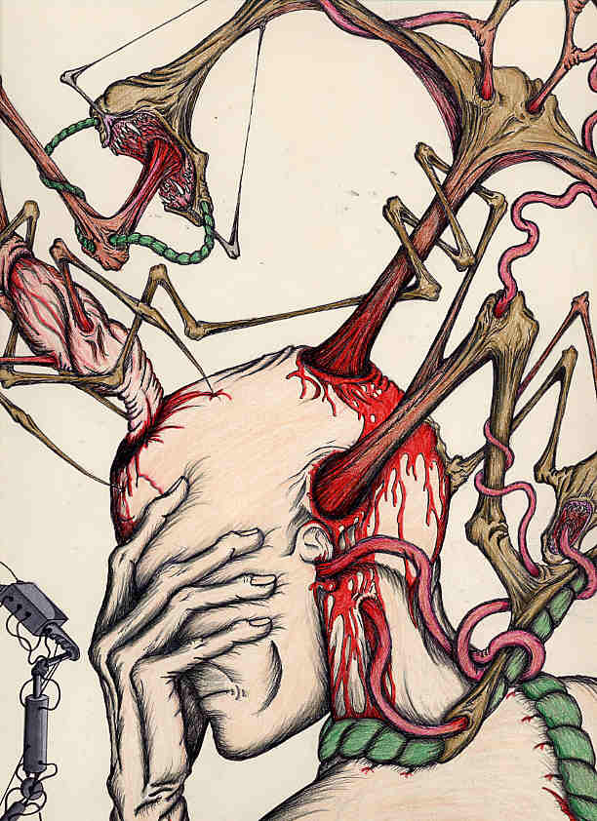
HL7-RIM: dead person is_a LivingSubject
HL7 Reference Information Model (RIM) Version V 02-07:
Definition of LivingSubject: A subtype of Entity representing an organism or complex animal, alive or not. (3.2.5)

Slide 37
An example of an unclear definition of: A part_of B
A part_of B =def
  A composes (with one or more other physical units) some larger whole
  Here A and B are concepts (!)
  This definition confuses relations between concepts with relations between entities in reality
  It confuses relations between what is general with relations between individual cases
Notes:
From the UMLS Semantic Network

Slide 38
How to define A is_a B
A is_a B =def.
A and B are names of universals (natural kinds, types) in reality
all instances of A are as a matter of biological science also instances of B
for all times t, all instances of A at t are as a matter of biological science also instances of B at t

Slide 39
Key idea in defining ontological relations
Not enough to look just at universals or types (or ‘concepts’).
We need also to take account of instances and time
This will yield an automatic bridge to the instance data in the EHR

Slide 40
Don’t forget instances when defining relations
part_of as a relation between universals versus part_of as a relation between instances
nucleus part_of cell – general truth
your heart part_of you – description of a particular fact

Slide 41
Three kinds of relations
Between universals:
  is_a, part_of, ...
Between an instance and a universal
  this explosion instance_of the universal explosion
Between instances:
  Mary’s heart part_of Mary

Slide 42
Syntax
Universals are in upper case
  ‘A’ is a universal
Instances are in lower case
  ‘a’ is a particular instance
part_of is a relation between universals
part_of is a relation between instances

Slide 43
Part_of as a relation between universals is more problematic than is standardly supposed
testis part_of human being ?
heart part_of human being ?
human being has_part human testis ?

Slide 44
Features of relations on the level of instances may not hold on the level of universals
nucleus adjacent_to cytoplasm
Not: cytoplasm adjacent_to nucleus
seminal vesicle adjacent_to urinary bladder
Not: urinary bladder adjacent_to seminal vesicle
Adjacency as a relation between universals is not symmetric

Slide 45
part_of
organisms and other continuant entities may lose and gain parts over time
part_of must be time-indexed for spatial universals
A part_of B is defined as:
  Given any instance a and any time t,
  If a is an instance of the universal A at t,
  then there is some instance b of the universal B
  such that
  a is an instance-level part_of b at t

Slide 46
derives_from
C
c at t
C₁
c₁ at t₁
time
C'
c' at t
instances
ovum
zygote derives_from
sperm

Slide 47
transformation_of
same instance
C
c at t
C₁
c at t₁
time
adult transformation_of child

Slide 48
transformation_of
A transformation_of B =def.
  Any instance of A
  was at some earlier time an instance of B

Slide 49
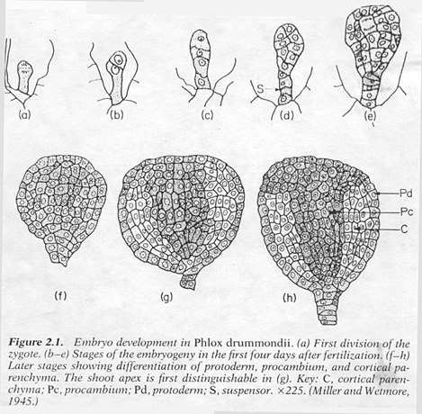
embryological development
C
c at t
C₁
c at t₁

Slide 50
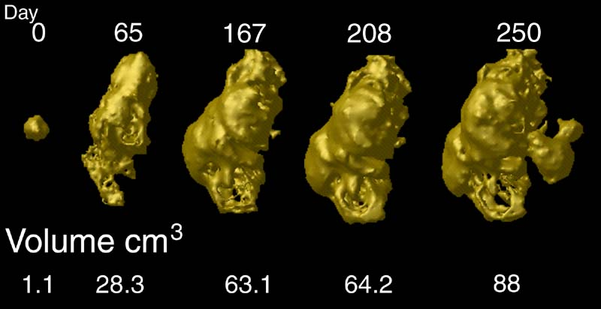
tumor development
C
c at t
C₁
c at t₁
Notes:
http://www.loni.ucla.edu/~thompson/HBM2000/tumor_volumes.jpg

Slide 51
the all-some form
A part_of B =def.
  for all instances a and times t,
  If a is an instance of the universal A at t,
  then there is some instance b of the universal B
  such that
  a is an instance-level part_of b at t

Slide 52
Use of the quantifiers ‘all’ and ‘some’
enable us to refer in definitions to instances in general even in those areas (such as molecular biology) where we have no information about instances in particular

Slide 53
Definitions of the all-some form allow cascading inferences
If A R₁ B and B R₂ C, then we know that
every A stands in R₁ to some B, but we know also that, whichever B this is, it can be plugged into the R₂ relation, because R₂ is defined for every B.

Slide 54
What we have argued for
A methodology which enforces clear, coherent definitions
Meaning of relationships is defined, not inferred
Guarantees automatic reasoning across ontologies and across data at different granularities

Slide 55
Part Two: From Biomedical Ontologies to the Electronic Health Record
bottom-up methodology, starts not from concepts but from individuals as they are related together in reality, and of the universals which they instantiate

Slide 56
Cimino, “Desiderata for Controlled Medical Vocabularies in the Twenty-First Century”
– a defense of the concept orientation
Q: How do medical vocabularies relate to patients, to patient care, and to patient records ?

Slide 57

A: The concept diabetes mellitus becomes ‘associated with a diabetic patient’
concept patient concept diabetes
what it is on the
side of the patient
?
?

Slide 58
The concept diabetes mellitus becomes ‘associated with a diabetic patient’
concept patient concept diabetes
what it is on the
side of the patient
?
what is the relation here?

Slide 59
Make this our starting point
what it is on the
side of the patient
both belong to the realm of particulars
both instantiate universals
+

Slide 60
Make this our starting point
what it is on the
side of the patient
in this way we can abandon the detour through concepts altogether
+

Slide 61
Current EHRs
have very poor treatment of particulars
They record not: what is happening on the side of the patient, but rather: what is said about what is happening.
They refer not to particulars directly (via unique IDs) but rather indirectly (via general codes)

Slide 62
Instances and Universals as Benchmark for Ontologies and Terminologies

Slide 63
Main problems of EHRs
Statements refer only implicitly to the concrete entities about which they give information.
Codes are general: they tell us only that some instance of the universal the codes refer to, is referred to in the statement, but not what instance precisely.

Slide 64
Proposed solution:
Referent Tracking
Purpose:
  explicit reference to the concrete individual entities relevant to the accurate description of each patient’s condition, therapies, outcomes, ...
Method:
  Introduce an Instance Unique Identifier (IUI) for each relevant particular / instance as it becomes salien to the clinical record of a given patient

Slide 65
A bottom-up approach
begin with what confronts the physician at the point of care
instances in reality (patients, disorders, pains, fractures, ...)
= the what it is on the side of the patient
and build up to terminologies from there

Slide 66
What happens when a new disorder first begins to make itself manifest?
physicians delineate a certain family of cases manifesting a new pattern of symptoms
... hypothesis: they are instances of a single universal or kind
(this universal still hardly understood)
but already we need for a new term (e.g. ‘AIDS’)

Slide 67
‘SARS’
not: severe acute respiratory syndrome
but: this particular severe acute respiratory syndrome, instances of which were first identified in Guangdong in 2002 and caused by instances of this particular coronavirus whose genome was first sequenced in Canada in 2003

Slide 68
Users can point to instances in the lab or clinic – but not yet to universals
The terminologist plugs the gap by postulating concepts

Slide 69
New idea: terminology building should start from the instances that we apprehend in the lab or clinic
Assertions in scientific texts pertain to universals in reality
Assertions in the EHR pertain to instances of these universals

Slide 70
Universals are those invariants in reality
which make possible the use of general terms in scientific inquiry and the use of standardized tests and standardized therapies in clinical care

Slide 71
Universals have instances
SNOMED CT comprehends universals in the realms of disorders, symptoms, anatomical structures, ...
In each case we have corresponding instances
= the what it is on the side of the patient
but such instances are poorly recorded in EHRs so far

Slide 72
The Great Task of Terminology Building in an Age of Evidence-Based Medicine
Terminology work should start with instances in reality, and seek to build up from there to align our terms with the corresponding universals

Slide 73
Terminologies should be aligned not with concepts but with universals in reality
including the universals instantiated by therapies, acts of measurement, portions of bodily substance, etc.

Slide 74
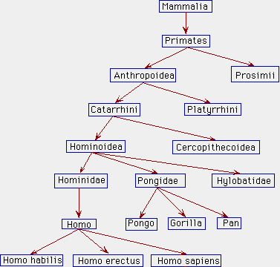
An Ontology is a Map of the Universals in a Given Domain
Notes:
http://www.kheper.auz.com/gaia/biosphere/systematics/Linnean.htm

Slide 75
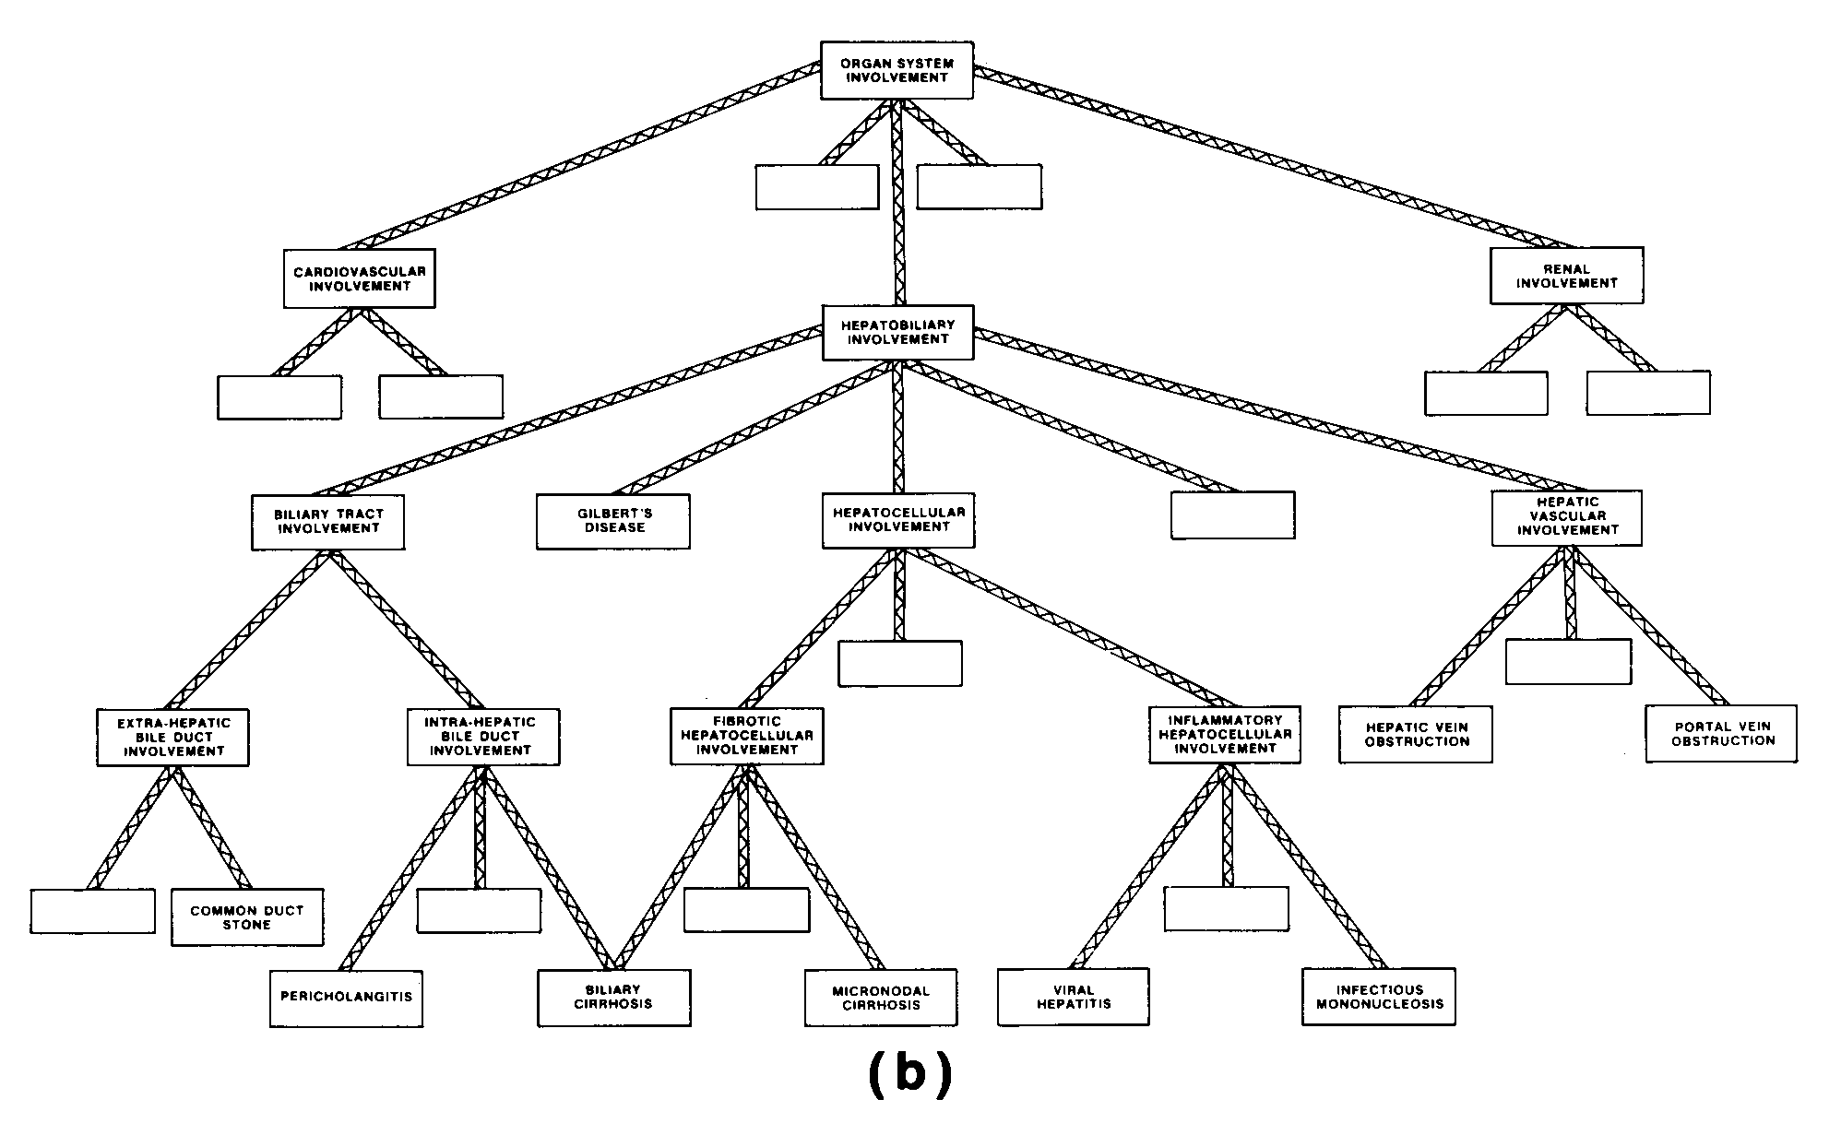
Combining hierarchies
Diseases
Organisms
Notes:
http://www.kheper.auz.com/gaia/biosphere/systematics/Linnean.htm

Slide 76
via Dependence Relations
Organisms
Diseases
Notes:
http://www.kheper.auz.com/gaia/biosphere/systematics/Linnean.htm

Slide 77
A Window on Reality
Notes:
http://www.kheper.auz.com/gaia/biosphere/systematics/Linnean.htm

Slide 78
A Window on Reality
Diseases
Organisms
Notes:
http://www.kheper.auz.com/gaia/biosphere/systematics/Linnean.htm

Slide 79
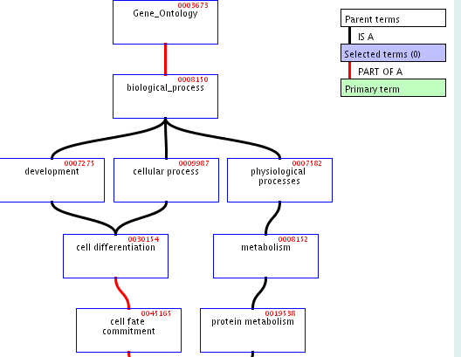
A Window on Reality
Notes:
http://www.kheper.auz.com/gaia/biosphere/systematics/Linnean.htm

Slide 80
Define a node of a terminology:
<p, S_{p}>
with p a label (alphanumeric string, preferred term)
S_{p} a set of synonyms
Define a terminology as a graph:
T = <N, L, v>
N a set of nodes
L a set of links (edges in the graph)
v a version number

Slide 81
The problem of mismatch
Notes:
http://www.kheper.auz.com/gaia/biosphere/systematics/Linnean.htm

Slide 82
The ideal: one-to-one correspond between nodes and universals in reality
Problem: bad terms (‘phlogiston’, ‘diabetes’)
At any given stage we will have:
N = N1 ∪ N> ∪ N<
where
N1 = terms which correspond to exactly one universal
N> = terms which correspond to more than one universal
N< = terms which correspond to less than one universal (normally to no universal at all)

Slide 83
The belief in scientific progress
with the passage of time, N> and N< will become ever smaller, so that N1 will approximate ever more closely to N *
Assumption: the vast bulk of the beliefs expressed / presupposed in biomedical texts are true.
Hence N1 already constitutes a very large portion of N (the collection of terms already in general use).
*modulo the fact that the totality of universals will itself change with the passage of time

Slide 84
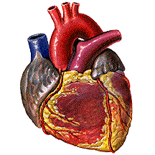
There are hearts
Notes:
I think there are mountains in a mind-independent nature.

Slide 85
But science is an asymptotic process
At all stages prior to the ideal end of our labors, we will not know where the boundaries between N1, N<, and N> are to be drawn

Slide 86
We do not know how the terms are presently distributed between N1, N< and N>,
So: is the distinction of purely theoretical interest – a matter of abstract (philosophical) housekeeping ?

Slide 87
Not if it can allow us to carry out a sort of experimentation with terminologies
Clinicians consider alternative local assignments of clinical terms to the patterns of instances revealed by given symptoms
Can we generalize this idea?

Slide 88
How to make instances visible to reasoning systems?
First, create an EHR regime in which explicit alphanumerical IUIs (instance unique identifiers) are automatically assigned to each instance, to each what it is on the side of the patient, when it first becomes relevant to the treatment of the patient

Slide 89
How medical terms are introduced
we have a pool of cases (instances) manifesting a certain hitherto undocumented pattern of irregularities (deviations from the norm)
the universal kind which they instantiate is unknown – and the challenge is to solve for this unknown
(cf. the discovery of Pluto)

Slide 90
Instance vector
an ordered triple
<i, p, t>
i is a IUI, p a term label, and t a time
instance #5001 is associated with
the SNOMED-CT code glomus tumour
at 4/28/2005 11:57:41 AM

Slide 91
Instantiation of a terminology
Let D be a set of instance-vectors (e.g. collected by a given hospital)
For a term p in a terminology T= <N,L,v>
define the D,t-extension of p as the set of all IUIs i for which <i, p, t> is in D

Slide 92
Referent tracking can help improve terminologies
For each p we subject its D,t-extensions to statistically based factor-analysis in order to determine whether
1. p is in N1(it designates a single universal): the instances in this extension manifest a common invariant pattern
2. p is in N>
3. p is in N<

Slide 93
Referent tracking can help to create mappings between ontologies and coding systems
  We can statistically compare vectors involving the same particular using different systems e.g. in different hospitals

Slide 94
Referent tracking can help diagnostic decision support
We can consider the results of assignment of different clinical codes to one and the same collection of IUIs assembled over a given time period (and thereby uncover new patterns of symptom development)

Slide 95
Referent tracking can help diagnostic decision support
we can teach a system to recognize at early phases the characteristic patterns of correction which arise in the early phases of diagnosis of degenerative diseases such as multiple sclerosis.

Slide 96
Referent tracking can help diagnostic decision support
e.g. in relation to a given patient, we can compare the patterns for different diagnoses, e.g. p vs. q + r
to see which gives a better match

Slide 97
Referent tracking provides a benchmark for correctness of a terminology

Slide 98
How to achieve terminology standardization
How to translate one terminology into another?
By some benchmark, some tertium quid (biomedical reality) which is not itself a system of terms or concepts
(Ontology)

Slide 99
Current benchmark (“Wüsteria”)
A terminology is correct if its concepts correspong to the way people use terms

Slide 100
Universals
are not creatures of cognition or of computation
they are invariants existing in the totality of particulars out there in reality
= ontological realism
http://ontologist.com

