Slide 1
Review of Existing PRO Coverage of AD-related entities
Darren A. Natale, PhD
Protein Information Resource
Georgetown University Medical Center

Slide 2

Our Efforts: Scratched the surface
APP: isoforms, sequence variants, cleavage products
Tau: isoforms, phosphorylation PTMs
Secretases: components only, no complexes yet
Nearly all information on isoforms and sequence variants have come from UniProtKB, as have leads on PTM combinations (need to re-read the literature)
Need a more comprehensive source

Slide 3
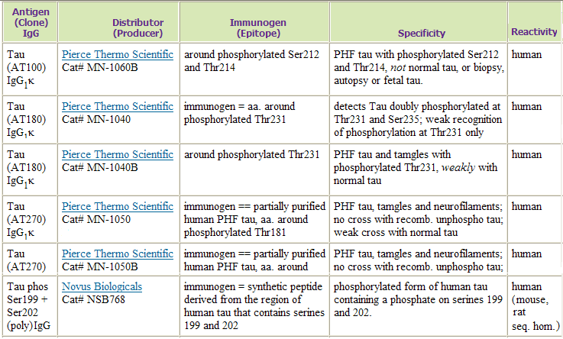



AlzForum Antibodies

Slide 4
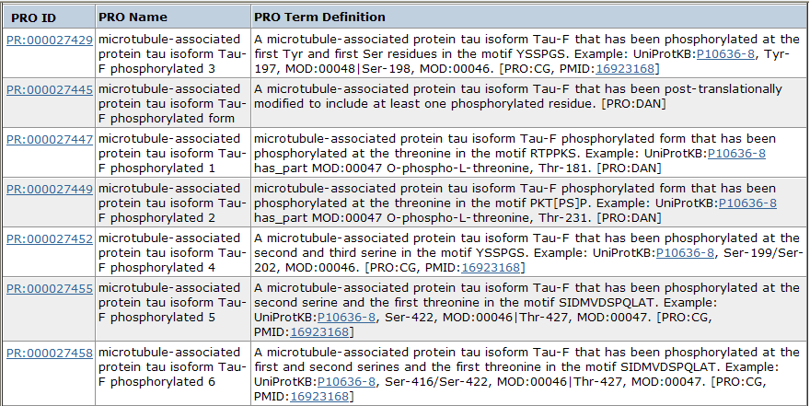

Slide 5
Challenges
Numbering for PTMs in AD community differs from that used by PRO (AD=Tau-F; UniProtKB=PNS-Tau)
AlzForum resource (Antibodies) indicates PTM sites in free text that varies in form
PRO currently lacks structured way to indicate positions of PTMs
Have to take into account cross-reactants

Slide 6
