Slide 1
Realism with respect to Universals
Ingvar Johansson,
Institute for Formal Ontology and Medical Information Science, Saarbrücken
2004-09-08
Notes:
Does the language-independent part of our spatiotemporal world consist only of particulars, or does it contain universals as well?

Slide 2
One in Many
Six colored surfaces
How many colors?
Six particulars?
(six instances of red?)
One universal?
(one redness?)
How can One entity be in Many places simultaneously?
Notes:
On the distinction between universals and particulars. Can there be universals? In perception there seems to be an immediate revelation of the existence of universals. The Problem of Universals. Perceived colors for pedagogical purposes.
The existence of speakers, speech acts, and language is taken for granted.

Slide 3
Extreme Nominalism
There are particulars independently of language.
Particulars can be named.
There are no universals (such as redness).
There are general terms (such as “red”).
A general term denotes an aggregate or a set of particulars.
Notes:
To denote an aggregate or a set is to name it (and its elements collectively).

Slide 4
Some Peculiarities of
Extreme Nominalism
All classifications become completely arbitrary.
Communication becomes a mystery.
Bare particulars are incredible.
General terms have to be universals.
red
red
red
………….
...……..……………
Notes:
If there are no universals, the ordinary particulars/things become “bare”.

Slide 5
Extreme Conceptualism
There are universals in language.
Outside language there are only particulars.
Universals are constructions made by means of the operations of comparison and abstraction.
Notes:
This view implies that language structures the world.

Slide 6
Some Peculiarities of
Extreme Conceptualism
Abstraction has nothing to take its departure from.
Why are universals in language not a problem?
red
red
red
………….
………….….………

Slide 7
Moderate (trope) Nominalism and Conceptualism
There are no language independent universals.
There are non-repeatable property instances (tropes).
A general term denotes an aggregate or a set of property instances with resemblance relations.
Abstraction takes its departure from property instances with resemblance relations.
Notes:
This covers both traditional empiricist nominalism and conceptualism, as well as modern “trope thinking”.

Slide 8
The Outstanding Peculiarity of the Moderate Position
The resemblance relation has to be a language independent universal.
The classical “one-in-many” problem afflicts resemblance just as much as it afflicts monadic universals.
red
red
red
….
………….…………
Notes:
Bertrand Russell and Edmund Husserl; about a hundred years ago.
If one has to except “one in many” for resemblance, why not accept it for monadic universals.

Slide 9
The Proof of the Necessary Existence of one Universal (o)
Edmund Husserl,
Logische Untersuchungen vol. 2 (1901),
section II, §4 (last paragraph).
Bertrand Russell,
The Problems of Philosophy (1912),
chapter 9 (11th paragraph).

Slide 10
The Proof of the Necessary Existence of one Universal (i)
Rab
Ga
Gb
Rac
Rbc
Gc
Notes:
The problem is how to get the monadic property G from the relation of exact resemblance R.
‘One’ means of course at least one.

Slide 11
The Proof of the Necessary Existence of one Universal (ii)
Rab R(Rab Rbc) Rbc
R(Rab Rac) R(Rac Rbc)
Rac
Notes:
In order to connect Rab with Rbc (or Rac), the relation of exact resemblance is needed once again

Slide 12
The Proof of the Necessary Existence of one Universal (iii)
R(Rab Rbc) R(…) (Rac Rbc)
R(…) R(…)
R(Rab Rac)
Notes:
Ad infinitum

Slide 13
Resemblance Nominalism
There are particulars.
There are property instances (tropes).
There is at least one universal, exact resemblance.
(There are several universals of degrees of resemblance.)
Notes:
Comment on the parenthesis.

Slide 14
The Outstanding Peculiarity of
Resemblance Nominalism (i)
Are they red because they resemble each other?
Do they resemble each other because they are red?
Why not both monadic universals and resemblance relations?
Notes:
Compare “top-down” and “bottom-up” approaches. Relations without properties. Compare larger-than, etc.

Slide 15
The Outstanding Peculiarity of
Resemblance Nominalism (ii)
A world with only one red thing is logically possible.
Therefore: the monadic universal “redness” is logically prior to “exact resemblance” between two red particulars.
Notes:
Ontology has to contain a notion of “logical” or “ontological” priority.
Husserl, Logische Untersuchungen vol. 2, section II, §3, seems to make the same point.

Slide 16
Transcendent (Platonist) Realism
There are particulars
There are monadic universals
There are no universals in the spatiotemporal world.
Particulars can “instantiate” or “participate in” universals.

Slide 17
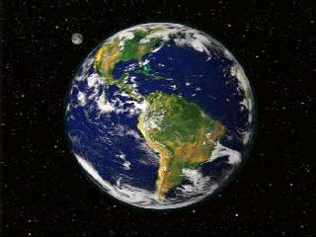
The Peculiarities of
Transcendent Realism
Where is this transcendent realm?
What kind of relation is the instantiation relation?
How can this relation come into being and pass out of being?
Notes:
Transcendence means transcendence in relation to the whole universe.

Slide 18
Immanent Realism (i):
Basic Views
There are particulars.
There are both monadic and relational universals.
No particularity without universality, no universality without particularity.
There are no universals outside the spatiotemporal world.
Universals are parts of their instances.
A universal is wholly present in each of its instances.
Notes:
Aristotle did not say part!

Slide 19
Immanent Realism (ii):
Three Peculiarities
One and the same universal can be wholly present in many places.
What kind of parthood relation is it?
A universal that lacks an instance in a given interval of time does not exist in that interval of time.
Notes:
Nonetheless the best alternative.

Slide 20
Immanent Realism (iii):
More Views
There are both universals and instances of universals (tropes).
There are both monadic universals and relations of exact resemblance.
There are universals both in mind-independent things and in mind-dependent perceptions and speech acts.
Universals structure both the mind-independent world and our mind-dependent perceptions and speech acts.
Notes:
Compare “top-down” and “bottom-up” approaches. Relations without properties. Compare larger-than, etc.

Slide 21
Immanent Realism (iv):
Concepts and Extensions
Concepts (universals in language) can be used to talk about language-independent universals.
By using a concept, we can denote something that is distinct from the concept.
In abstraction from its use, a concept can be said to represent an extension.
Seldom is there a one-to-one relation between a concept and a universal.
Notes:
Mention the color terms as examples.
The extension can consist of universals as well as of instances of universals.

Slide 22
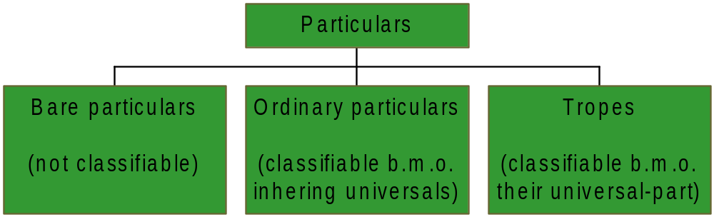
Immanent Realism (v):
How to Classify Particulars
Notes:
Bare particulars cannot be classified even if they exist. Ordinary particulars (kinds of property bearers) are classified by means of inhering universals.
A realist can classify tropes by means of universals, but a trope nominalist has to use primitive resemblance relations.

Slide 23
Immanent Realism (vi): first peculiarity
Can one and the same universal be wholly present in many places?
No contradiction. Don’t confuse qualitative and numerical identity.
What can be wholly present in several spatiotemporal locations cannot in itself have a definite spatiotemporal location.
Traditionally, universals are conceived of as entities that lack spatiotemporal location.

Slide 24
Immanent Realism (vii): second peculiarity
What kind of parthood relation is it?
There are different kinds of parthood relations: spatial, temporal, and functional. Why not “instantiative”? That is, the universal participates in its instances.
David Armstrong has recently claimed that universals are parts of their instances.

Slide 25
Immanent Realism (viii): third peculiarity
A universal that lacks an instance in a given interval of time does not exist in that interval of time. How is this possible?
Entities that are capable of having scattered existence in space ought to be capable of having intermittent existence in time.
We are able to think of non-actual entities;
both of entities that have existed in the past and entities that may exist in the future.
Notes:
There is then “resurrection”, but not for particulars as many religions teach.

Slide 26
The End
Today, no position on universals is completely free from problems.
Immanent realism is by far the least problematic position.

