Slide 1
Immanent Realism, Orderings and Quantities
Ingvar Johansson,
Institute for Formal Ontology and Medical Information Science, Saarbrücken
2004-09-15

Slide 2
Summary of last week’s lecture
First four slides

Slide 3
Immanent Realism (i):
Basic Views
There are particulars.
There are both monadic and relational universals.
No particularity without universality, no universality without particularity.
There are no universals outside the spatiotemporal world.
Universals are parts of their instances.
A universal is wholly present in each of its instances.
Notes:
Aristotle did not say part!

Slide 4
Immanent Realism (ii):
Three Peculiarities
One and the same universal can be wholly present in many places.
What kind of parthood relation is it?
A universal that lacks an instance in a given interval of time does not exist in that interval of time.
Notes:
Nonetheless the best alternative.

Slide 5
Immanent Realism (iii):
More Views
There are both universals and instances of universals (tropes).
There are both monadic universals and relations of exact resemblance.
There are universals both in mind-independent things and in mind-dependent perceptions and speech acts.
Universals structure both the mind-independent world and our mind-dependent perceptions and speech acts.
Notes:
Compare “top-down” and “bottom-up” approaches. Relations without properties. Compare larger-than, etc.

Slide 6
Immanent Realism (iv):
Concepts and Extensions
Concepts (universals in language) can be used to talk about language-independent universals.
By using a concept, we can denote something that is distinct from the concept.
In abstraction from its use, a concept can be said to represent an extension.
Seldom is there a one-to-one relation between a concept and a universal.
Notes:
Mention the color terms as examples.
The extension can consist of universals as well as of instances of universals.

Slide 7
Today’s Question
How is it possible in such a “qualitative” immanent realism to make sense of orderings and quantities (magnitudes)?
Answer: Because there are in the world internal relations, even though they are mere epiphenomena.

Slide 8
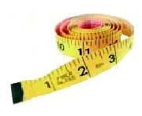

Basic Measurement
A lot of things can be equally long; a lot of things can have the same mass.
One thing may be longer than another; one thing may have a greater mass than another.
Notes:
On the distinction between basic (length) and derived (area) measurement.

Slide 9
Exact Resemblance
When two things are equally long (or have the same mass) there is a relation of exact resemblance between the two instances in question.
But there is only one universal.
When two particulars are qualitatively identical there is necessarily a relation of exact resemblance between them.

Slide 10
Non-Exact Resemblance
When two things have different lengths there is nonetheless a relation of (non-exact) resemblance between the two length instances in question.
There are then two universals.
Between these universals there is an internal relation, a determinate kind of resemblance.
When the universals are instantiated there is also an internal relation between the corresponding instances.

Slide 11
Areas (derived measurement)
A
We measure
areas
We talk about areas: “A is smaller than B.”
B
We perceive areas
Notes:
The predicates ‘is small’ and ‘is large’ are implicitly relational predicates.
Converse relation predicates have the same extension. I’ll come back to this.

Slide 12
Internal Relations (i)
A is smaller than B.
B is larger than A.
(A is small.)
(B is large.)
The first two assertions describe the same fact, the instantiation of an internal relation.
A
B
Notes:
The predicates ‘is small’ and ‘is large’ are implicitly relational predicates.
Converse relation predicates have the same extension. I’ll come back to this.

Slide 13
Internal Relations (ii)
In the thing A inheres an instance of the universal u₁ (a determinate area-size), and in B inheres an instance of the universal u₂ (a different determinate area-size).
A is smaller than B because of the two instantiated universals, u₁ and u₂, and their resemblance relation.
A: u₁
B: u₂
Notes:
About primary and secondary relata of relations; ‘u’ is meant to indicate that I believe in universals; a “trope” is for me an instance of a universal.

Slide 14
Internal Relations (iii)
u₁ can be instantiated independently of u₂, and vice versa.
Necessarily: if both u₁ and u₂ are instantiated, then the relation of “being smaller than” is instantiated.
A: u₁
B: u₂
Notes:
About primary and secondary relata of relations; ‘u’ is meant to indicate that I believe in universals; a “trope” is for me an instance of a universal.

Slide 15
Internal Relations (iv)
Every instance of u₁ is smaller than every instance of u₂.
In order to know that A is smaller than B, we have to compare their area sizes.
Nonetheless, we discover the size relation between their areas.
This relation is instantiated independently of our knowledge.
A: u₁
B: u₂

Slide 16
Internal Relations (v)
A is smaller than B.
This fact is mind-independent.
There are epiphenomenal natural facts.
Epiphenomena add to being.
A: u₁
B: u₂
Notes:
Naturalism and materialism have to accept the existence of epiphenomena with their ephemeral kind of existence. They come into being and pass out of being all the time. And there are an incredible lot of them!

Slide 17
Internal Relations (vi)
Statements describing internal relations:
“A is smaller than B”, “A is heavier than B”,
“A is more electrically charged than B”, “A has greater intensity than B”, etc.
These internal relations have different relata of the same kind.
Non-exact resemblance is always resemblance in a certain respect.
A determinate-determinable distinction
(W.E. Johnson) has to be made explicit.
(Armstrong tries to reduce determinables to relations of partial identity between determinates.)
Notes:
In his truthmaker book, Armstrong does not even mention the determinable-determinate distinction

Slide 18
Orderings (i)
A
B
C
D
Length A resembles B more than C
B resembles C more than D
Transitivity: A is more like C than D

Slide 19
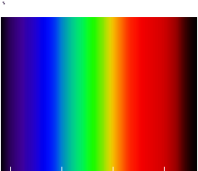
Orderings (ii)
Hue A resembles B more than C.
B resembles C more than D.
Non-Transitivity:
A does not resembles C more than D.
A B C D
Notes:
Note: perceived color not physical color.

Slide 20
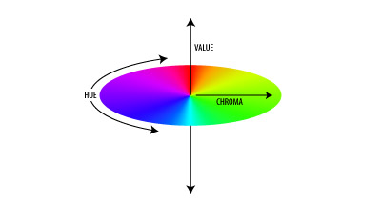
Orderings (iii)
One abstract space with three quality dimensions: hue,
chroma (saturation),
value (intensity).
Hue gives rise to a circular ordering
D
C
A
B
Notes:
About physical color: Wavelength corresponds to hue, amplitude roughly to saturation, and enrgey flux (the Poynting vector) to intensity.

Slide 21
Orderings (iv)
There are:
mind-independent internal relations
between
mind-dependent phenomena such as perceptions and pains.

Slide 22
Orderings (v)
It is the natures of the determinable length, its determinates, and their internal relations that give rise to a linear ordering.
The same is true of mass, electric charge, and a lot of other physical determinables.
It is the natures of the determinable perceived color, its determinates, and their internal relations that give rise to a circular ordering.

Slide 23
Orderings and Scales
0 1 2 3 4 5 6 7 8 9 10 cm (kg)
(a) All orderings and scales presuppose a distinction between a determinable
(a conceptual space) and its determinates
(the points in the space).
Notes:
Scales may just as well be called quality dimensions; Peter G:s term.

Slide 24
Orderings and Ordinal Scales
A B C
The line A resembles B in length more than C.
(b) An ordinal scale represents a transitive (internal) resemblance relation between the determinates of a determinable.
Notes:
Apart from the relations of coincidence and precedence, there are 3-term resemblances.
Resemblance relations are internal relations. Resemblance is always resemblance in a certain respect (the d-able).

Slide 25
Orderings and Metric Scales (i)
(Quantities)
0 1 2 3 4 5 6 7 8 9 10 cm (kg)
7 cm (kg) differs from 4 cm (kg) just as much as 4 cm (kg) differs from 1 cm (kg) .
(c) A metric scale represents resemblance- distance relations between determinates, too.
Notes:
Distance is distance of resemblance in a certain respect (the d-able).

Slide 26
Orderings and Metric Scales (ii)
0 1 2 3 4 5 6 7 8 9 10 feet (lb)
(d) A metric scale has a fiat standard unit,
i.e., a metricizable determinable has many possible scales.

Slide 27
Orderings and Metric Scales (iii)
0 1 2 3 4 5 6 7 8 9 10 cm (kg)
(e) Some metric scales have an absolute zero point (ratio scales), some have a fiat zero point (interval scales), e.g. º C and º F.

Slide 28
Orderings – A Summary
(a) All orderings presuppose (i) a distinction between a determinable and its determinates, and (ii) an internal ternary resemblance relation between the determinates in question (x resembles y more than z).
(b) An ordinal scale also presupposes that his resemblance relation is transitive.
(c) A metric scale, furthermore, presupposes (internal) relations of resemblance-distances.
(d) All metric scales have a fiat standard unit, i.e., a metricizable determinable has many possible metric scales.
(e) Some metric scales have an absolute zero point (ratio scales), some have a fiat zero point (interval scales), e.g. º C and º F.

Slide 29
Speech Acts Using Quantities
Every true statement such as “This thing has a length of 7 cm” uses explicitly one conceptual determinate of a conceptual determinable, but it refers to a language- and mind-independent non-conceptual determinate and a non-conceptual determinable.
However, such a statement also connotes:
(i) all the determinates;
(ii) all the corresponding (internal) resemblance relations and resemblance-distance relations.
Notes:
The number indicates the determinate, and the dimension indicates the determinable.

Slide 30
Scales and Realism (i)
Metric scales should be regarded as maps over resemblance-distance relations between non-conceptual determinates (universals).
Measurements might be said to be mappings into a scale (an abstract conceptual space), but it is non-conceptual determinates that are being measured and mapped.

Slide 31
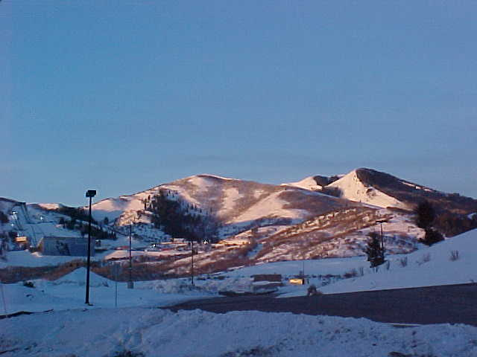
There are mountains
Notes:
I think there are mountains in a mind-independent nature.

Slide 32
Complications for Naïve Realism
When, by means of a concept such as “mountain”, we are talking about something in the world, then this concept may:
(a) select an aspect (e.g., geographical),
(b) select a granularity level (e.g., mesoscopic),
(c) create boundaries (ends of the mountains),
without thereby
(d) create this aspect, the granularity level,
and what is bounded (the mountain).
Notes:
The concept of “mountain” selects a geographical aspect of the world, it focuses at a certain granularity level, and it is connected with a vague conventionally drawn boundary line that tells us where mountains end. Nonetheless, it is preposterous to say that the concept “mountain” creates the mountains. Substitute “heart” for “mountain”.

Slide 33
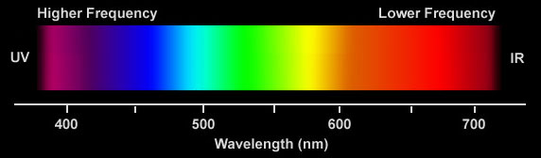
Color Words
blue green y red
The boundaries of our ordinary color terms are fiat.
To create a boundary is not to create what is bounded.
Note: Neither homogeneities nor continuities have bona fide boundaries.
Notes:
Fiat and bona fide; homogeneous and continuous; compare maps.

Slide 34
Scales and Realism (ii)
When, by means of a length scale, we are talking about a certain determinate objective length, then this scale:
(a) selects an aspect (spatial extension),
(b) selects a granularity range (mesoscopic),
(c) creates links (to the other determinates),
but it does not thereby
(d) create this aspect, this granularity range,
and what is directly talked about
(the determinate length in question).

Slide 35
Scales and Realism (iii)
There are universals in the spatiotemporal world.
There are determinables, determinates and internal relations between determinates.
All objective orderings and scales presuppose pre-existing internal relations.
Without such internal relations all measurements would be subjective.

Slide 36
Some Immanent-Realistic Views
Because of their nature, lengths and masses can be metrically represented by means of a single dimension with an absolute zero point.
Because of the nature of perceived color, its abstract space requires three dimensions.
(Next Week) Because of the nature of shapes, it seems to be impossible to construe a single overarching abstract space for shapes.
Notes:
Quality spaces are constituted by internal relations.

Slide 37
The End
No position on universals is completely free from problems, but
immanent realism is by far the least problematic position.
If immanent realism accepts the existence of internal relations, it can give a realist account of orderings and quantities.

