Slide 1
Ordinary Shapes and
Four-Dimensional Shapes
Ingvar Johansson,
Institute for Formal Ontology and Medical Information Science, Saarbrücken
2003-09-21

Slide 2
Summary of last week’s lecture
There are universals in the spatiotemporal world.
There are determinables, determinates and internal relations between determinates.
All objective orderings and scales presuppose pre-existing internal relations.
Because of their nature, some qualities can be ordered on a single line, whereas others require more dimensions.

Slide 3
Orderings (i)
A
B
C
D
Length A resembles B more than C
B resembles C more than D
Transitivity: A is more like C than D

Slide 4
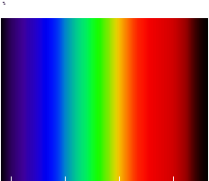
Orderings (ii)
Hue A resembles B more than C.
B resembles C more than D.
Non-Transitivity:
A does not resembles C more than D.
A B C D
Notes:
Note: perceived color not physical color.

Slide 5
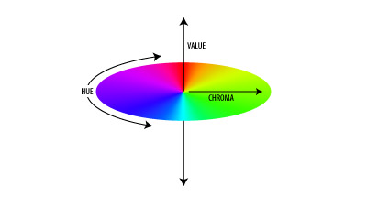
Orderings (iii)
One abstract space with three quality dimensions: hue,
chroma (saturation),
value (intensity).
Hue gives rise to a circular ordering
D
C
A
B
Notes:
About physical color: Wavelength corresponds to hue, amplitude roughly to saturation, and enrgey flux (the Poynting vector) to intensity.

Slide 6
Main Ideas to be Explained Today
Some features of functions and functionings can be better understood if some features of ordinary shapes (2D-shapes and 3D-shapes) are better understood.
Functions involve both teleology and causality, but they involve process shapes
(4D-shapes, SPAN-shapes), too. This feature of functions has so far been neglected.

Slide 7
Some Views to be Defended
The determinates of some determinables can because of their nature not be ordered or scaled.
What the use of scale units are to metricized determinables, the use of prototypical concepts can be to non-scaled determinables.
There is no general necessary connection between being a quantity (magnitude) and being additive.
Notes:
About Aristotle and modern science. “Scaled” means linearly ordered.
3. Addition understood “bottom up”.

Slide 8
PART I
SCALES AND PROTOTYPES

Slide 9
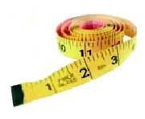
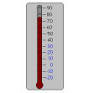
Scales and Monadic Qualities
A lot of things can be 7 cm long.
A lot of rooms can be 75°F.
A certain scale magnitude (quantity) represents a determinate universal (and a corresponding set of instances or tropes).

Slide 10
Scales and Resemblance Relations
0 1 2 3 4 5 6 7 8 9 10 cm
7 cm is more like 4 cm in length than 1 cm.
40°F is more like 39° than 38°.
A scale represents resemblance relations, too.
Notes:
Scales may just as well be called quality dimensions.

Slide 11
Speech Acts Using Quantities
Every true statement such as “This thing has a length of 7 cm” uses explicitly one conceptual determinate of a conceptual determinable, but it refers to a language- and mind-independent non-conceptual determinate and a non-conceptual determinable.
However, such a statement also connotes:
(i) all the determinates;
(ii) all the corresponding (internal) resemblance relations and resemblance-distance relations.
Notes:
The number indicates the determinate, and the dimension indicates the determinable.

Slide 12
Orderings – A Summary
(a) All orderings presuppose (i) a distinction between a determinable and its determinates, and (ii) an internal ternary resemblance relation between the determinates in question (x resembles y more than z).
(b) An ordinal scale also presupposes that his resemblance relation is transitive.
(c) A metric scale, furthermore, presupposes (internal) relations of resemblance-distances.
(d) All metric scales have a fiat standard unit, i.e., a metricizable determinable has many possible metric scales.
(e) Some metric scales have an absolute zero point (ratio scales), some have a fiat zero point (interval scales), e.g. º C and º F.

Slide 13
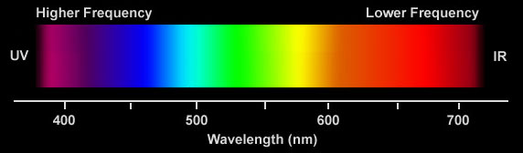
Color Hue Ordering
blue green y red
The boundaries of our ordinary color terms are fiat.
To create a boundary is not to create what is bounded.
Note: Neither homogeneities nor continuities have bona fide boundaries.
Notes:
Fiat and bona fide; homogeneous and continuous; compare maps.

Slide 14
Orderings and Prototypes: Color
Color hues can be represented both by means of scales
(E. Rosch: “logical classification”) and prototypical classification.
Typical:
blue green y red
Notes:
Comment on Plato’s forms/ideas and Weber’s ideal types. Think of gender and ethnicity.

Slide 15
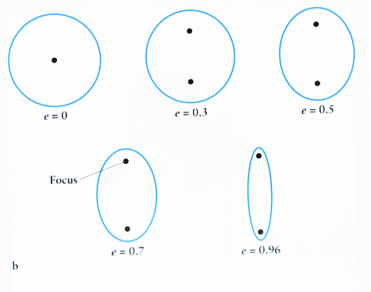
Orderings and Prototypes: Shape (i)
There is a scale for all ellipses that have one axis in common.
Each determinate represents a certain “eccentricity”.
Notes:
From Greek elleipsis, a falling short. It falls short of being a circle.

Slide 16
Orderings and Prototypes: Shape (ii)
There simply seems to be no scale or conceptual space for all two-dimensional shapes.
Some determinables can because of their nature not be ordered or scaled.
But there are nonetheless internal relations even between all two-dimensional shapes.
Notes:
The resemblance relations do not seem to allow it. There is neither a conceptual space for all three-dimensional shapes.

Slide 17
Orderings and Prototypes: Shape (iii)
Prototypical representation is possible for a larger collection of shapes.
Prototypes require a determinable.
Resemblance is always resemblance in a certain respect.
Notes:
The Ancients and the circle. The internal relations in sloped prototypical relations do not have to be as “well-behaved” as in flat logical representation.

Slide 18
Orderings and Prototypes: Shape (iv)
There are resemblance relations between shapes along an infinite number of dimensions.
An abstract space with an infinite number of dimensions is meaningless.
Three-dimensional shapes are even more complex than two-dimensional.

Slide 19
Orderings and Prototypes: General (i)
Metric Scales have a conventional standard unit.
A prototype functions like a standard unit.
Question: Is a prototype just as conventional as a standard unit in a scale?
What the use of scale units are to metricized determinables, the use of prototypical concepts can be to non-metricized and non-scaled determinables.

Slide 20
Orderings and Prototypes: General (ii)
Prototypical conceptualizations can be just as scientific as scale constructions are.

Slide 21
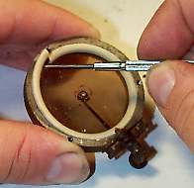
Functions and Prototypes (i)
There is a human teleology –
a social fact.
There is a causal process –
a natural fact.
But there is more.
Teleology and causality will now be bracketed.

Slide 22
Functions and Prototypes (ii)
A screwdriver has a function. When we use it, we put it into a state of functioning; when we are not using it, the screwdriver has its states of functioning only as the dispositional property to be able to be in these states. In (its state of) function(ing), the screwdriver participates in a process, namely a certain characteristic movement. In other words, it is in a state of being involved in a process.
Notes:
Motion and state of motion, functioning and state of functioning. Both states and processes. Non-reducibility. IFOMIS: SNAP and SPAN.

Slide 23
Functions and Prototypes (iii)
In its functioning, a screwdriver creates a process shape (4D-shape,
SPAN-shape).
Perfect screw-drivers create other shapes than bad screwdrivers do.

Slide 24
Functions and Prototypes (iv)
There are internal relations between process shapes (4D-shapes, SPAN-shapes).
It is impossible to create abstract spaces for the process shapes of functionings.
We can (and do!) construct prototypical concepts which we can use to denote the process shapes of functioning material entities.

Slide 25
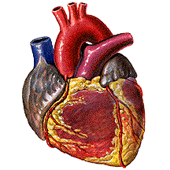
Functions and Prototypes (v)
In its functioning, a heart creates a process shape
(4D-shape,
SPAN-shape).
Good hearts create other shapes than sick hearts do.

Slide 26
Functions and Prototypes (vi)
Like this ???:
Notes:
A lot of different functionings are normal and healthy (green area).
2. Malfunctioning takes degrees.
3. A functional unit can malfunction in a lot of different ways.

Slide 27
Functions and Prototypes (vii)
There are process shapes that are necessary to the functioning of, for example, many tools, mechanisms, and bodily organs.
Between process shapes there are internal relations.
Process shapes can be related to prototypical process shapes.
A prototypical process shape (or a collection of such shapes) can but need not be regarded as a functional norm.

Slide 28
PART II
ADDITION

Slide 29
Everyday Addition (i)
SAUCE
6 bacon slices, cut in half
6 cups canned low-salt chicken broth
1 1/2 cups dry white wine
1/2 cup red currant jelly
1 1/4 teaspoons minced fresh rosemary
3 tablespoons unsalted butter
Cook bacon in heavy large saucepan over medium heat until crisp. Using tongs, transfer bacon to paper towels. Discard drippings from pan. Add broth, wine, jelly, and rosemary to pan. Boil until reduced to 2 1/2 cups, about 35 minutes. Return bacon to sauce. Boil until liquid is reduced to 1 1/3 cups, about 10 minutes longer. Strain sauce into small saucepan. Add butter. Whisk over low heat until sauce is smooth, about 2 minutes. Season with salt and pepper.

Slide 30
Everyday Addition (ii)
Ramos Fizz #2
Ingredients:
  1 oz Gin
  1/2 oz sweet Cream
  1 1/2 oz Lemon juice
  1 Egg white
  1 tsp Powdered sugar
  2 dashes Orange juice
  Club soda
Mixing instructions:
Fill glass with cracked ice and add gin, cream, lemon juice, egg white, sugar and orange juice. Shake and strain into a chilled Collins glass, then add Club soda.

Slide 31
Physical Addition (i)
2 cm² +
1,5 kg +
1,8 cm² = 3,8 cm²
3 kg = 4,5 kg

Slide 32
Physical Addition (ii)
2 cm² +
1,5 kg +
Aggregate or
1,8 cm² = 3,8 cm²
3 kg = 4,5 kg
Unity?

Slide 33
Physical Addition (iii)
Distinguish between:
addition of pure numbers
(1,5 + 3 = 4,5);
addition of quantities (pure magnitudes)
(1,5 kg + 3 kg = 4,5 kg);
addition of substances
(put them together in space and take away the boundary between them).

Slide 34
Shape Addition (i)
shape determinate 1 +
shape determinate 2 =
shape determinate 3
Aggregate or Unity?

Slide 35
Shape Addition (ii)
Shapes are additive without being quantities.
Such addition is not univocally defined.
There is no general necessary connection between being a metricized determinable and being an additive determinable.

Slide 36

Process Shape Addition (i)

Slide 37

Process Shape Addition (ii)

Slide 38
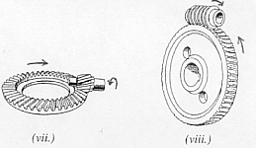
Process Shape Addition (iii)
Arrows that represent time can turn an addition of ordinary shapes into an addition of process shapes.

Slide 39
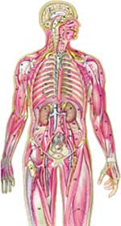
Process Shape Addition (iv)
Try to visualize all the process shapes!

Slide 40
Process Shape Addition (v)
Connected (added) process shapes can constitute mechanisms.
Connected (added) mechanisms can constitute mechanical systems.
Connected (added) process shapes can constitute bodily systems.
Connected (added) bodily systems can constitute organisms.

Slide 41
Process Shape Addition (vi)
The difference between mechanisms and organisms is a difference in kind between the bearers of the process shapes in question.
Schematically:
Mechanical parts can endure outside the mechanical system.
Organs cannot endure outside the body system.
Notes:
Comment upon the distinction between organic and inorganic chemistry.

Slide 42
Systems Theory (i)
Musculoskeletal
Digestive
Respiratory
Circulatory

Slide 43
Systems Theory (ii)
Single arrows represent control.
Double arrows do not represent mutual control.
Double arrows represent continuous connection between process shapes.

Slide 44
PART III
FITNESS
BETWEEN ORDINARY SHAPES AND
BETWEEN PROCESS SHAPES
Notes:
Reference to OI and some papers.

Slide 45
The End
No position on universals is completely free from problems, but immanent realism is by far the least problematic position.
If immanent realism accepts the existence of internal relations, it can give a realist account of orderings and quantities.
Immanent realism can accept the existence of process shapes, and it is compatible with the use of prototypical concepts.

