Slide 1
How should BFO classify films?
By Uriah Burke

Slide 2
Agenda
Motivations for Project
A basic understanding of Film
Why/How Smith misclassifies Film in BFO
Ontological issues
Some Legal implications for Copyrights
Fixing the problem
Other Legal implications for Copyrights

Slide 3
Motivations
Film Ontology has generally been the domain of Phenomenological ontology.
Grounds ontology of objects in experience.
Useful for art criticism and discussion of aesthetic value.
NOT useful for many legal discussions.
E.g., whether anyone can own “The Dark Knight” shouldn’t be informed by how the object made us feel.

Slide 4
BFO is an alternative.
Analytic ontological classification of objects can speak great deals about legal issues, such as:
Who owns, or has rights to, an object.
Whether the object can be owned.
Examples:
Can a role be owned?
Can generically dependent continuants be owned?

Slide 5
Basics of Film
Phi Phenomenon
Human artifact
Film is a predominately visual medium
Uses Phi Phenomenon
We see motion with rapid succession of slightly different frames.

Slide 6
Note
This is an intentionally vague, and wide description of film.
I don’t wish to dismiss:
Short films
Films with minimal editing
Films without sound
I also make no assumptions about medium (8mm, VHS, DVD, Bluray)

Slide 7
U.S. Copyright law definition of motion picture
‘Motion pictures’ are audiovisual works consisting of a series of related images which, when shown in succession, impart an impression of motion, together with accompanying sounds, if any.
Essentially the same concept I am attempting to capture with film.

Slide 8

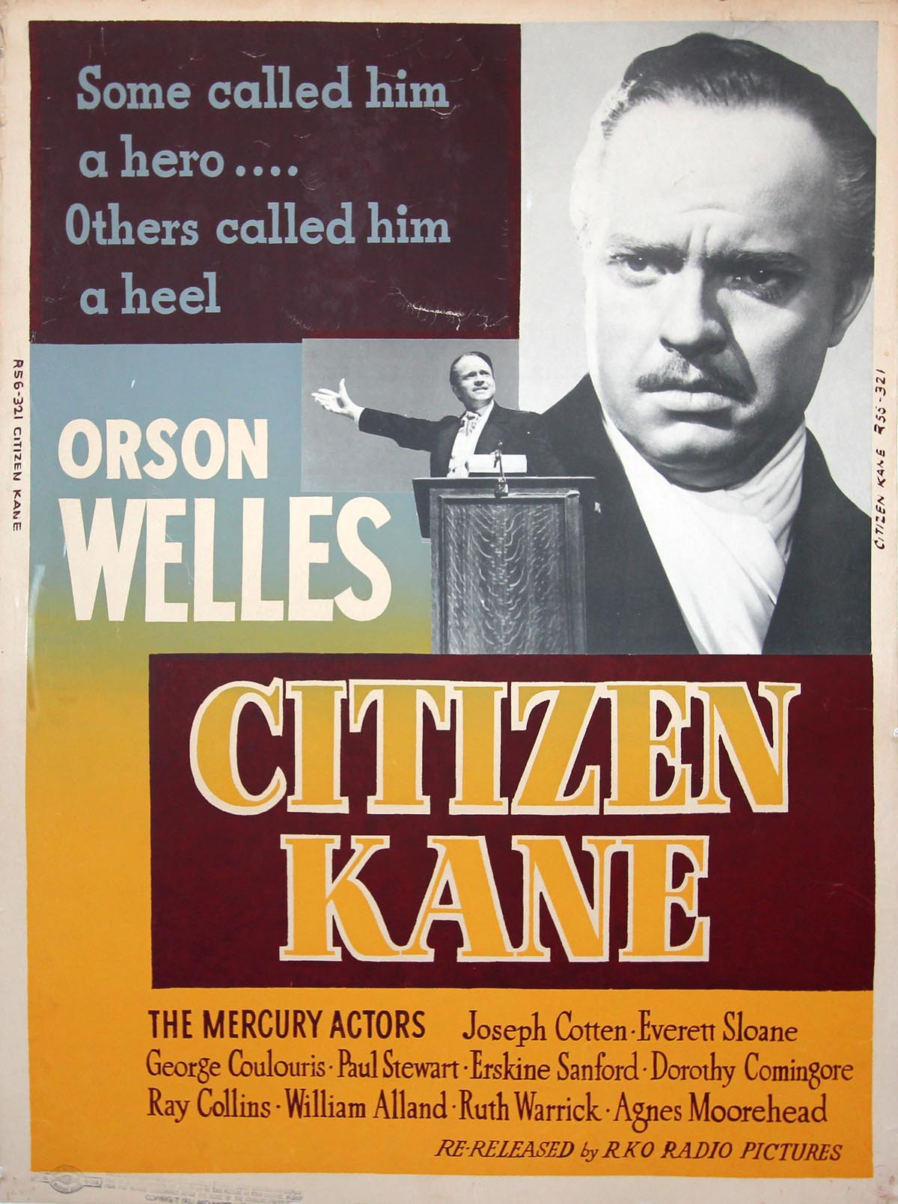
Examples

Slide 9
BFO classification: Is film a continuant or an Occurent?

Slide 10
Reminder of the different options
Continuant
Occurrent
process, event
Independent
Continuant
thing
Dependent
Continuant
quality,
role,…
Generically
Dependent
Continuant
Information entity, Sequence
Realization
.... ..... .......

Slide 11
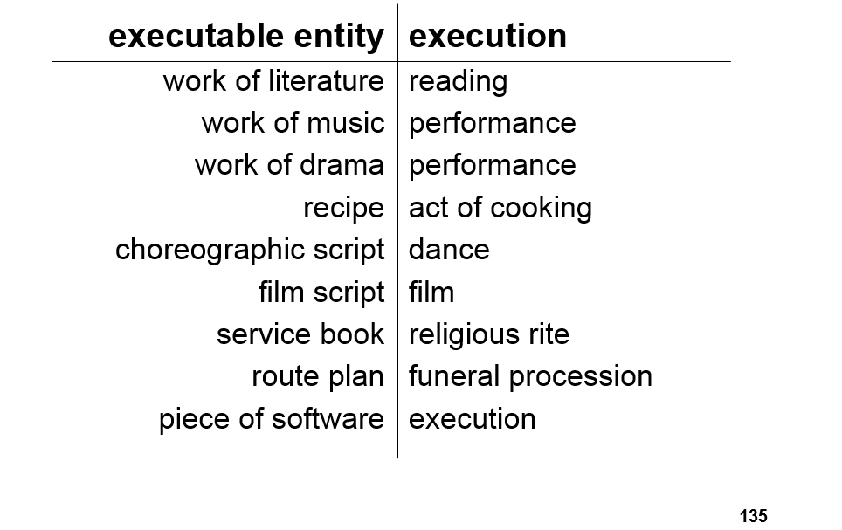
Smith’s BFO classification of film (Lecture 7)

Slide 12
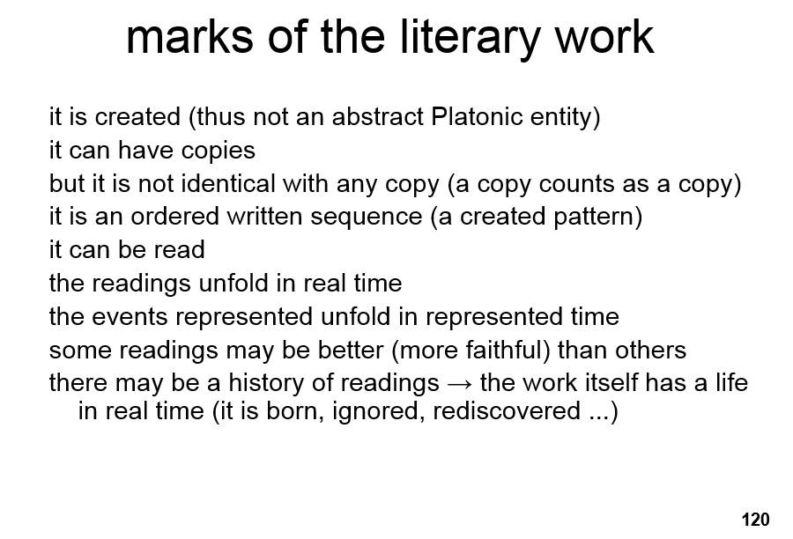
More from Smith (Lecture 7)

Slide 13
What this means
Smith is maintaining that that Film is an execution of a film script; like a reading is an execution of a literary work.
Performances are realizations, i.e. Processes or events.
Thus, Films are processes or events for Smith
Further for Smith, Films cannot be continuants like literary works (which are not identical to their readings).

Slide 14
Films as Occurents?
Films would be processes
Processes are dependent on occurents (whatever medium is the particular entities).
Processes unfold over time.
Films involve rapid display of slightly different pictures to create a motion illusion over time.
First blush, very plausible.

Slide 15
Ontological Problems with Occurent Films
This would mean that every screening would be a particular film.
But then what do we mean when was talk about a film, like “The Dark Knight” ?
Surely we don’t mean an individual screening of “The Dark Knight.” We mean to point to something more universal.

Slide 16
Legal problems with Films as Occurents 1
§102 · Subject matter of copyright: In general28
(b) In no case does copyright protection for an original work of authorship extend to any idea, procedure, process, system, method of operation, concept, principle, or discovery, regardless of the form in which it is described, explained, illustrated, or embodied in such work.
“process” is one now known or later developed. (This is a bad definition in the law).

Slide 17
Legal problems with Film occurents 2
Tricky conclusion if films are identified with showings and thus are processes…
They would be both protected and unprotected under the law.
Fixable with a better definition of process.

Slide 18
Deeper ontological problem turned Legal
Lets say “The Dark Knight” is identified with individual screenings (processes).
The copy right would then only apply to some individual screenings, and not others.
This is partially why we tend toward using universals when talking about authors works.

Slide 19
Other classification options in BFO

Slide 20
What we are left with
Independent Continuant
Dependent continuant
Generically dependent continuant

Slide 21
Independent Continuant, why not?
Independent continuants are individuals
We run into the same issues of universality and particulars that we did with processes.

Slide 22
Dependent continuants, why not?
These qualities or roles adhere in particular individuals.
Thus the ontological problems with processes would raise their head again.
E.g. If “The Dark Knight” is a quality of a particular individual, it is an individual quality.
Also seems odd to suggest we could copyright things of the same kind as Red, or Boss.

Slide 23
Generically Dependent Continuants are just right.
They are dependent on bearers (copies), but not on particular individual bearers.
Thus allows for universality of entity.
If all copies are gone it is gone
Includes ordered sequences/patterns
Sequences/patters can be enacted

Slide 24
Marks of Film
It is created (So non platonic)
Can be copied
Should not be seen as identical to any copy, but if all copies ceased to exist we would say it ceases to exist
It can be screened
Screenings unfold over time. (They are still certainly processes if not the films themselves).
Some screenings are closer to the universal than others (Bad sound or other such issues).

Slide 25
First Conclusion
Films are like Literary works they are Generically dependent continuants.
This makes them a sequence/pattern and possibly an information entity/artifact.
Perhaps best to classify it as a Information artifact made from a sequence of patters.

Slide 26
New ontological puzzle
What instantiates the film?
Screening?
Screening isn’t an independent continuant
Media copy?
It is a set of instructions for a machine to produce a screening
Film script?
It is a set of instructions to produce the film; how can picture patterns be instantiated in words?

Slide 27
Possible solution to instantiation problem
A film could instantiated in the same independent continuant pictures that the screening process is instantiated in.
But what if the film is never being played?
Like a fist never being made.

Slide 28
New legal difficulties arise
Does the law recognize patterns?

Slide 29
Recall…
§102 · Subject matter of copyright: In general28
(b) In no case does copyright protection for an original work of authorship extend to any idea, procedure, process, system, method of operation, concept, principle, or discovery, regardless of the form in which it is described, explained, illustrated, or embodied in such work.
Patterns are never directly discussed as a copyrightable entity in the law.

Slide 30
Precedent
Judge Learned Hand: Nichols v. Universal Pictures Corp
Created “Pattern test”
Patterns of ever increasing generality can be applied to a story and technically fit.
Eventually one such abstraction cannot apply, since
“otherwise the playwright could prevent the use of his ‘ideas,’ to which, apart from their expression, his property is never extended. . . . Nobody has ever been able to fix that boundary, and nobody ever can”

Slide 31
What could this mean?
Patterns are abstractions, used to measure ideas?
This keeps patterns in a grey legal area
Patterns are ideas?
If patterns are ideas then they are not copyrightable
So films would be both explicitly copyrightable and not again.
Could be solved with a clarification the legal definition of pattern.

Slide 32
Final Conclusions
Regardless of whether films are processes or generically dependent continuants Copyright law needs clarifications.
Still favor Generically dependent continuant as the proper classification
It avoids issues surrounding the universality of a film object.

Slide 33
Fin

