Slide 1
Ontologies and Relational Databases (RDB) Federico Borsotti

Slide 2
Program:
Some background info about relational databases.
In what way they are similar to, in what way different from ontologies?
Why/when we need both?

Slide 3
How is Data Stored in a Relational Database?
Table Name = PATIENT
Attributes
PATIENT ID  | AGE | GENDER
1 | 45 | M
2 | 45 | F
3 | 82 | F
Primary
Key
(a non-empty set of attributes)

Slide 4
PATIENT ID  | GENDER | SSN
1 | F | 928938029
2 | F | 002938293
3 | M | 390239203

CONTRAINTS
{
PRIMARY KEY
NOT NULL
UNIQUE
{
DATATYPE

INT
CHAR(1)
INT

Slide 5
Foreign Key
PAYMENT ID  | PATIENT ID  | PAYMENT DATE
PAY01 | 2 | 02/07/1997
PAY02 | 2 | 03/11/1999
PAY03 | 3 | 05/13/2003
PAYMENT
PATIENT ID  | AGE | GENDER
1 | 45 | M
2 | 45 | F
3 | 82 | F
Primary Key
Of table PATIENT
PATIENT

Slide 6
PART 2 – SIMILARITIES & DIFFERENCES

Slide 7
First: Similarities
Organize data in a machine-readable way.
Division between schema and data.
Use of relationships in data organization.
Relationship-cardinality and domain-constraints.
Define a sub-type (inheritance) relationship.

Slide 8
Differences: REPRESENTING vs STORING
ONTOLOGIES
RELATIONAL DATABASES
Semantic expressivity
Accuracy of representation
Query flexibility
Interoperability
Performance in handling data
Security

Slide 9
SEMANTIC EXPRESSIVITY
RDB do not use URIs to identify ‘entities’.
In RDB relationships are not given names.
Only an ontology comprises a taxonomy.
Is a relation symmetric, transitive? Universal or defined class?
Cardinality-relations between classes? (ex. complementOf)
What is the data about?

Slide 10
QUERY FLEXIBILITY
With RDB: a-priori knowledge of RDB-schema is required.
Semantic queries.
SPARQL: good performance with multiple-join queries.
Disambiguate/refine queries.
That is why ontologies are so popular in IPA and NLP.

Slide 11
PART 3 – WHY/WHEN DO WE NEED BOTH?

Slide 12
Do I Need a RDB?
Handle a big quantity of data in a timely way.
Perform specific (pre-definable) tasks.
Interested only in certain aspects of POR.

Slide 13
Do I Need an Ontology?
Acquire new information.
Merge or use data from semantically heterogeneous sources.
Need for query flexibility.
Aim is interoperability/reusability.

Slide 14
How to Do Things with Data
Expanding the semantic web.
Make inferences from big data (ex: SIOR project)
Share scientific resources (ex: Neuroscience Information Framework).

Slide 15
1: Expanding the Semantic Web
The Deep Web contains most of the data accessible from the web.
This information is not easily retrievable for semantic tagging.
A (partial) solution: finding correspondences between the RDB schema itself and domain ontologies.
OR: Generating ontology-based databases.

Slide 16
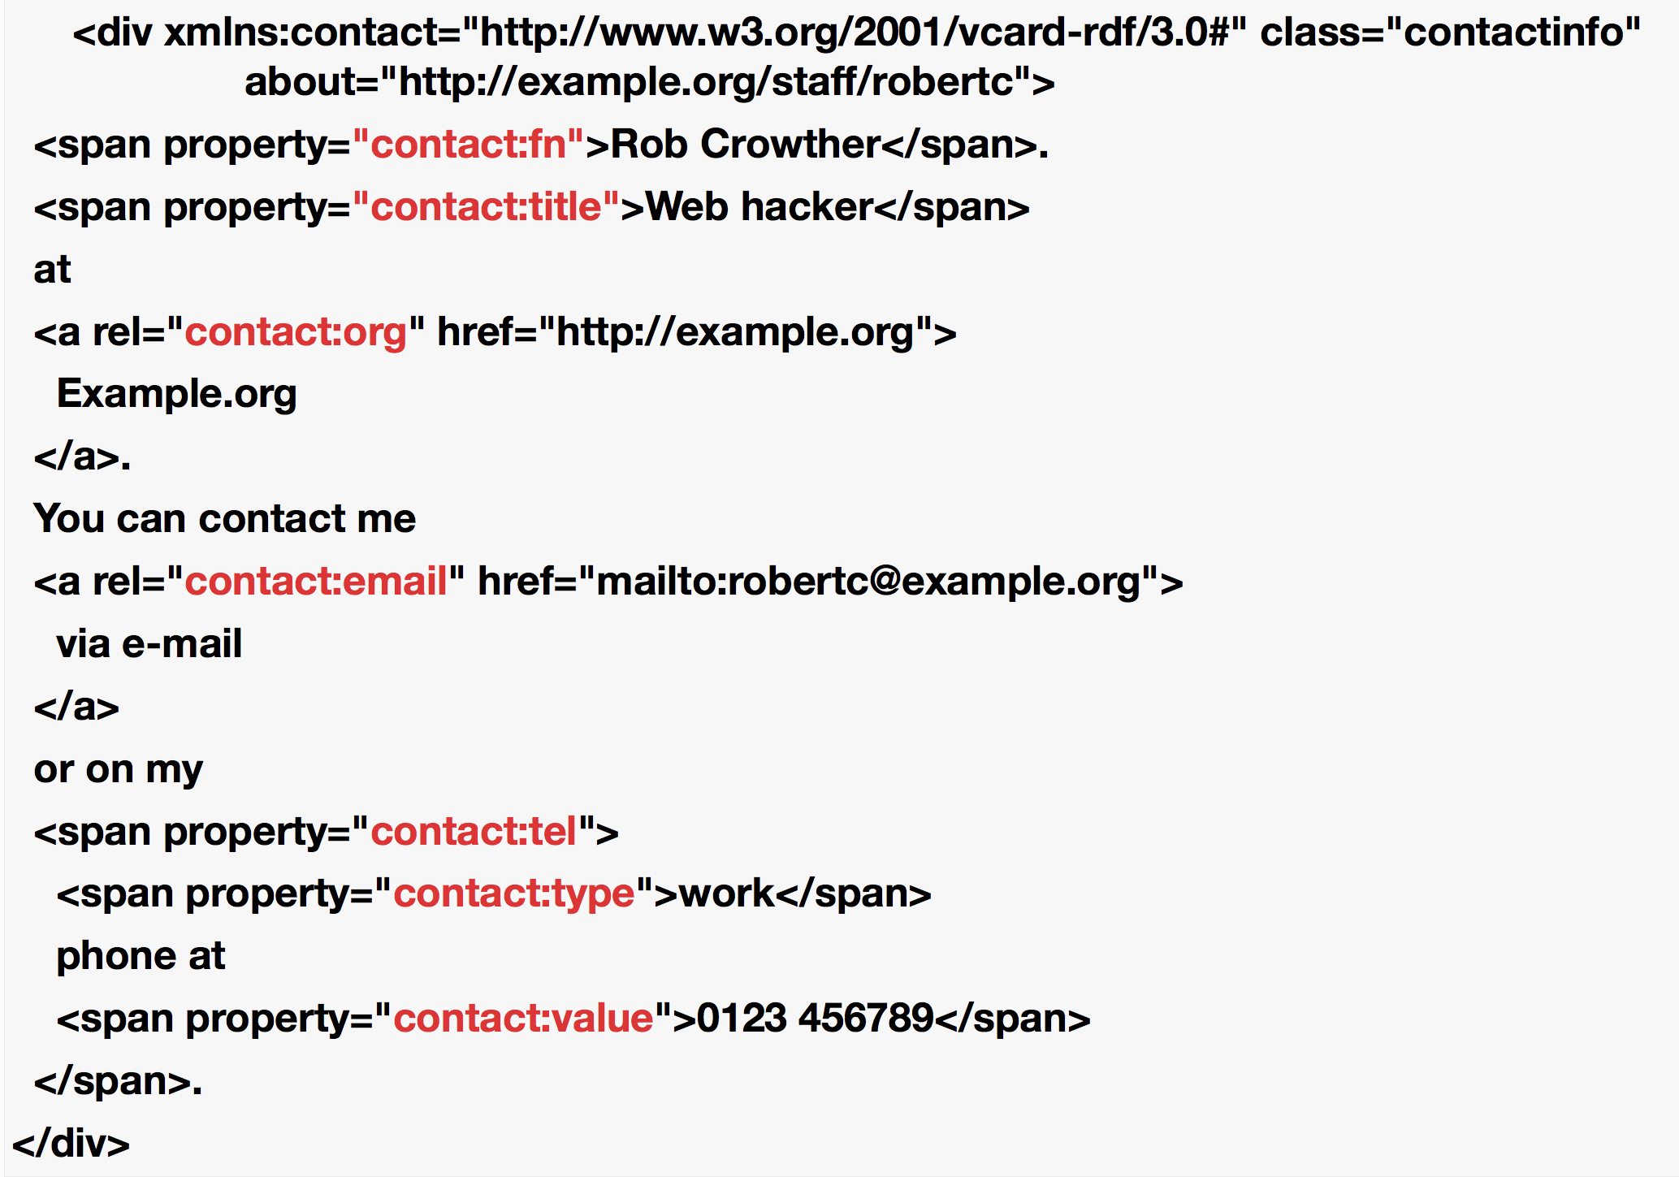

Slide 17
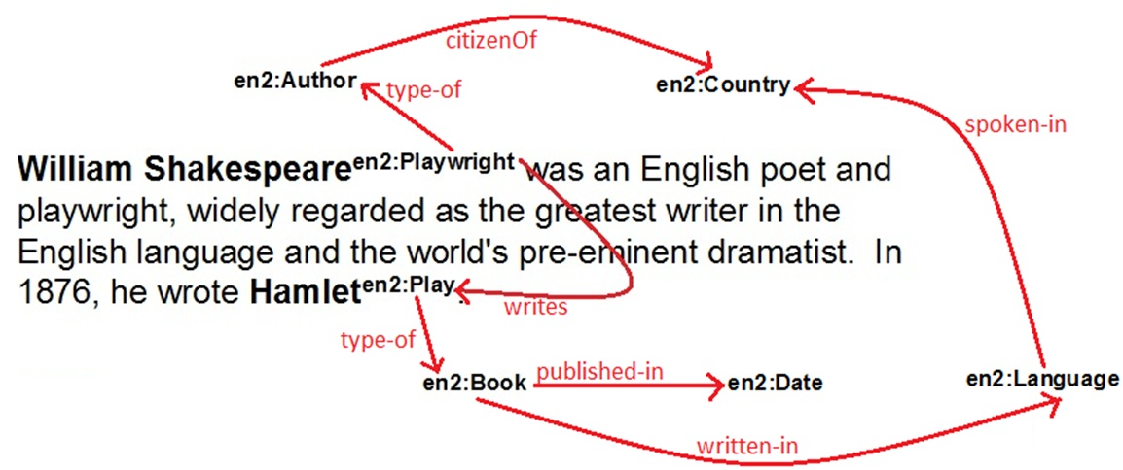
Img. source: www.ibm.com
+ Ontology:
 Ah! So Shakespeare was an author!
So he wrote a book!
Something is missing: When did he published the book?

Slide 18
Some Mapping Examples
ONE-TO-ONE IDENTIFYING RELATIONSHIP | IS_A relation (rdfs:subClassOf)
TABLES (EXCEPT BRIDGE TABLES) | Universal (Class)
SIMPLE COLUMN | Datatype Property
BRIDGE-TABLES | Two Mutually Inverse Object Properties

Slide 19
2: Find Complex Patterns: the SIOR project
Booz Allen Hamilton & the Sisters of Mercy Health System, launched the Sepsis Intervention Outcomes Research.
27,000 electronic health records from four hospitals over a two-year period.
SOME PROBLEMS:
Presence of unstructured documents.
Different database schemas employed.
Different vocabularies employed.
Electronic health records are often not organized by time.

Slide 20
Event-Centric Ontology (ECO)
SNOMED
Outcome:
Sepsis treatment protocols were followed in only the 16.9% of cases. Negative correlation between compliance and mortality of -0.82.

Slide 21
Conclusions
We are (entering) in the Big Data and Semantic Web era.
We need to store data in a secure, efficient and timely way.
But to transform data in knowledge we need ontologies…
…and to make it easier for RDB and ONTOLOGIES to work together.
WHAT WE CAN DO:
New Standards and Languages (ex: OWL2 ql)
RDB designers should be aware of ontology-related issues and vice versa.

