Slide 1
Zika Ontology
Uriah Burke

Slide 2
Motivations and goals
Disease ontology (DO) is terrible
OGMS and Infectious disease ontology (IDO) are much better.
Develop a zika ontology which correctly Identifies pertinent entities in accordance with IDO and OGMS

Slide 3
Problems with OD and the Zika Fever definition
“A viral infectious disease that has_material_basis in Zika virus, which is transmitted_by Aedes aegypti mosquitoes. ”
OD has no entry for the Zika Virus.
OD is only uses OGMS’s definition of Disease.
Mosquitoes are not the only vector/ vectors don’t matter to the definition.
Thus OD seems to recognize need to distinguish between virus and disease, but doesn’t follow through with it.

Slide 4
Distinguishing zika entities.
Three primary entities to distinguish:
Zika Fever
Zika Virus
Zika Disease course
These are the pivotal entities to get right; by correctly classifying and defining these we should clear lots of confusion, and show other entities which need to be documented

Slide 5
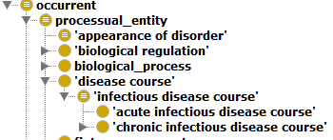
Zika Disease Course Definition.
Def
Disease courses in IDO
An acute infectious disease course which is the totality of all processes through which the disease zika fever is realized.

Slide 6
IDO disease definition
"A disposition (i) to undergo pathological processes that (ii) exists in an organism because of one or more disorders in that organism."

Slide 7
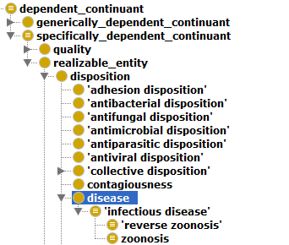
Zika Fever
Disease classification in IDO
My Tentative definition
an infectious disease that has its physical basis in an Zika infectious disorder, which has as an agent the Zika Virion.
One issue becomes clear, we have a 4th entity to classify the zika infectious disorder. More later.

Slide 8
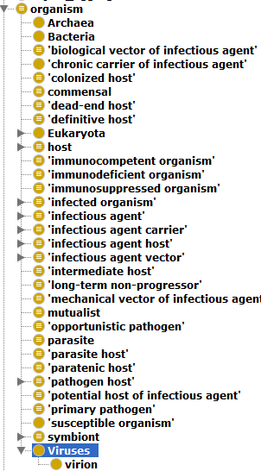
Zika virus Problems
IDO Virus hierarchy
The zika virus would be better talked about as a virion
Note the viruses are not listed as infectious agents, something I needed to change in my ontology
The zika virus is a virion, which…?

Slide 9
Looking to the Influenza Ontology For help and finding none.
Influenza Virion definition "A complete virus particle of influenza virus with its DNA or RNA core and protein coat as it exists outside the cell.“
Bad definition because its only truly differentiating factor is its reference to the influenza virus.
Also has Influenza Virus A, B, and C, categorized as organisms (not viruses), with no definitions.

Slide 10
Possible zika virion definition
Perhaps the best differentiator of the zika virion is its genomic sequences.
Definition: Definition: The zika virion is a virion whose genomic sequence matches the zika genome sequence

Slide 11
Notes on Zika genomic sequence
Thus far I have been dealing only in types/universals.
However the Zika genomic sequence is a particular information content entity.
Genomic sequences don’t deal with particular virus strains.
Zika genomic sequence definition: A genome sequence which follows the particular pattern of genomic information which can be found at the following NCBI link.
NCBI link to zika virus complete genome: https://www.ncbi.nlm.nih.gov/nucleotide/NC_012532

Slide 12
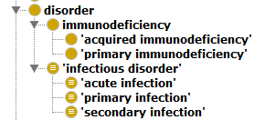
Zika infectious disorder definition.
IDO Disorder
Not the virion/virus
Not the disease
Not the disease course
As a disorder it is a material entity
Def: An acute infectious disorder that is the physical basis for Zika Fever

Slide 13
Possible problems with IDO disorder definitions?
Disorder: "A material entity which is clinically abnormal and part of an extended organism. Disorders are the physical basis of disease.“
Infectious disorder: "An infection that is clinically abnormal.“
Acute Infection: "An infectious disorder that is the physical basis for an unfolding acute infectious disease course.“

Slide 14
Possible problems with IDO disorders continued.
Problem 1: Infectious disorder should probably be a disorder rather than an infection, and abnormality is already part of the disorder definition.
Problem 2: Acute infection refers to disease course while disorder refers to the disease.

Slide 15
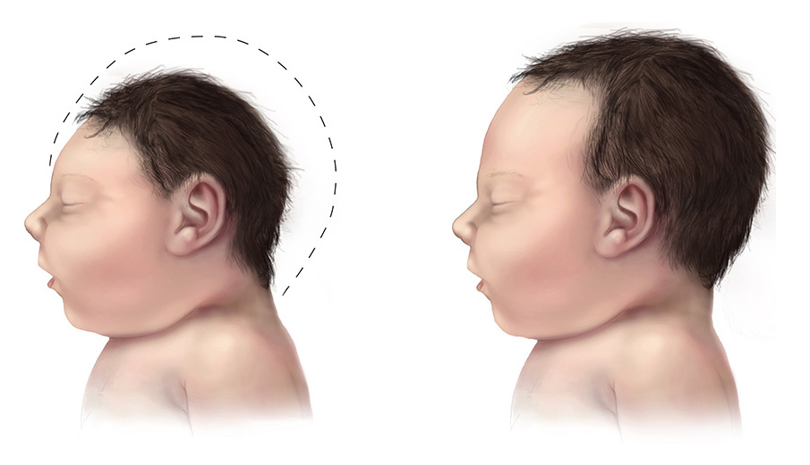
What is Microcephaly?
The phenomena we are trying to capture here is when infants develop with undersized heads.

Slide 16
Microcephaly connection
One question is whether Microcephaly should get the same treatment as zika
I.e. distinguishing between disease, disease course, and disorder.
However it is not linked to a specific organism like zika is.

Slide 17
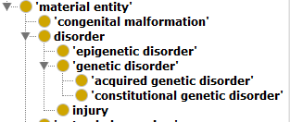
Pulling from OGMS
OGMS congenital malformation
IDO doesn’t have the resources to deal with Microcephaly, but OGMS does.
Microcephaly is best described as a congenital malformation

Slide 18
Malformation a disorder?
Note that congenital malformation are not listed as disorders, just as material entities.
This is because there is debate on whether they constitute a disorder.
If these malformations are disorders, then microcephaly will have associated diseases and disease courses.
Likely won’t be an associated infectious agent, however.

Slide 19
Affiliating microcephaly with zika
I opted to create a subtype of microcephaly which has differentiated by it’s a production in the zika disease course.
I opted to maintain that this was a universal since this processes involved seem important.
Concievably could have been a defined class.

Slide 20
Concluding questions
Am I really capturing two different kinds of phenomena with my different kinds of Microcephaly?
Have I lost generalizability by making use of the particular information content entity that is the Zika genomic sequence.

