Slide 1
Organizations: an Ontological Approach
Francesco Franda
Department of Philosophy

Slide 2
Goals of this presentation
Give a definition of ‘organization’ that would capture what is commonly considered to be an organization.
Provide an ontology of organization.
Use BFO as the upper level ontology.
Notes:
I will use other ontologies too (Information Artifact Ontology, etc.)

Slide 3
Some examples of types of organizations
Hospital
School
University
Corporation
Government
Non-governmental organization
Inter-governmental organization
Orchestra
Rock band
Criminal organization
Army

Slide 4
What do all these organizations have in common?
They have members, which can be people or other organizations.

Slide 5
What do all these organizations have in common?
They have members, which can be people or other organizations.
They have a, more or less precise, structure.

Slide 6
Organizations “as one” vs. organizations “as many”
“Russell drew a distinction between a class as one and a class as many. In the same vein, we might think there is a distinction between a group as one and as many.”
Katherine Ritchie, What are groups? (2013), p. 258

Slide 7
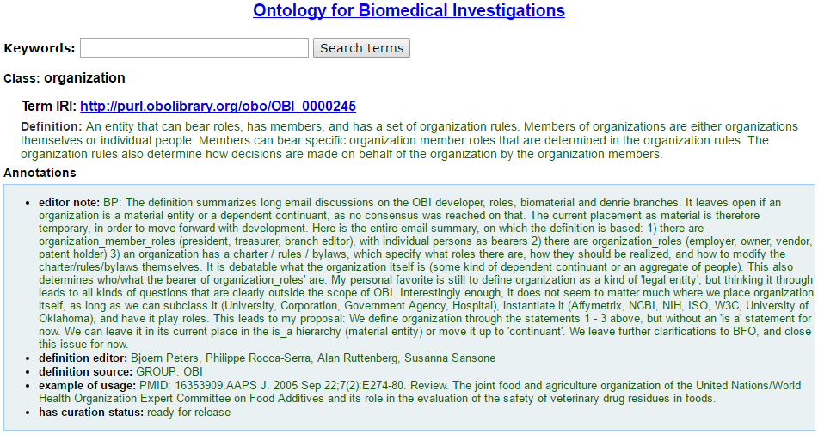
A material entity or a dependent continuant?

Slide 8
Organization as object aggregate
‘An object aggregate is a material entity that is made up of a collection of objects and whose parts are exactly exhausted by the objects that form this collection. In addition the objects forming an object aggregate are separate from each other in the sense that they share no parts in common.’
Arp-Smith-Spear, Building Ontologies with Basic Formal Ontology, p. 93

Slide 9
Object aggregate and persistence over time
‘[…] as it is true for many material entities, object aggregates may gain and lose parts while remaining numerically identical (one and the same individual) over time. This holds both for aggregates whose membership is determined naturally (the aggregates of cells in your body) and aggregates determined by fiat (a baseball team, a congressional committee).’
BFO 2.0 Specification and User’s Guide

Slide 10
member_part_of vs. continuant_part_of
‘if b member_part_of c at t then b continuant_part_of c at t.’
BFO 2.0 Specification and User’s Guide
This means that the axioms of the continuant_part_of are also the axioms of the member_part_of.

Slide 11
Transitivity
If x part_of y, and y part_of z, then x part_of z.
“The membership relation is non-transitive, because I might be a member of a trades union, and the trades union might be a member of the Trades Union Congress, but it might be that no individual can be a member of the TUC.”
David-Hillel Ruben, The Metaphysics of the Social World, p. 69

Slide 12
Weak Supplementation
If x part_of y & not x = y, then there is some z such that (z part_of y and z has no part in common with x).
“Suppose that the United States in turmoil. One senator resigns from office, then another and another until finally all but one senator has resigned. The Senate, if it exists at all, is a group made up of one member. A bit later, new elections are held and new senators are elected. The Senate grows and is, seemingly again, a many-membered group. While one could argue that the Senate before the mass exodus is a distinct entity from the Senate after it is quite natural to say that the Senate shrunk and then grew.”
Katherine Ritchie, What are groups? (2013), p. 259

Slide 13
The member_part_of relation is not a mereological relation
The member part relation, a relation holding between aggregate objects and continuants, is not a subkind of the continuant part relation.

Slide 14
Organizations and organigrams
“Organizational structure requires that every member has at most one superordinate.”
Thus, organizations display a hierarchical structure: the main relation is that of authority, which holds between roles. This structure is represented by the organigram, which is a graph representing the roles of the members of the organization and their links.
Barry Smith, The Ontology of the Organigram,
https://www.youtube.com/watch?v=bp3B2GkgaB8

Slide 15
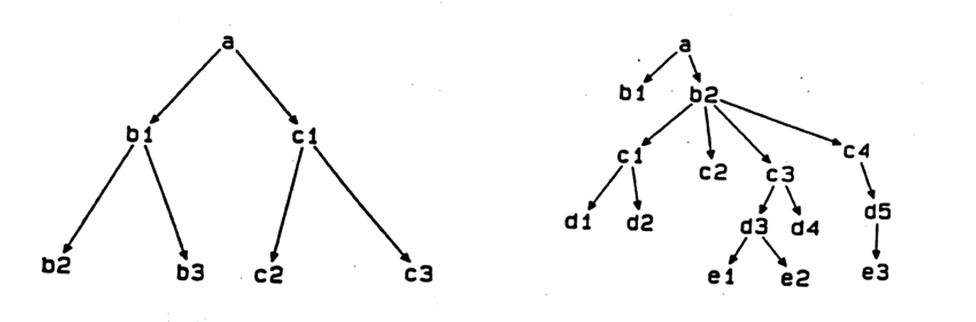
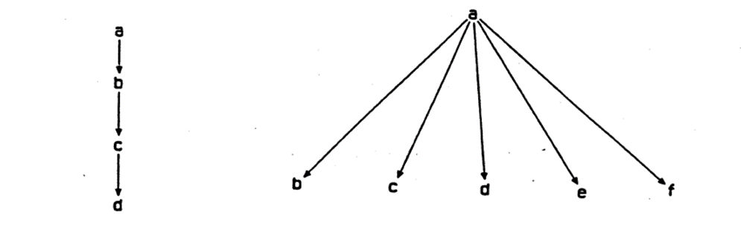
Organizations and organigrams
David Krackhardt, Graph Theoretical Dimensions of Informal Organizations

Slide 16
Problems with the organigram
The authority relation is only a way to capture the structure of an organization. Hierarchy, although fundamental, is only one dimension of the relation between roles.

Slide 17
Problems with the organigram
The authority relation is only a way to capture the structure of an organization. Hierarchy, although fundamental, is only one dimension of the relation between roles.
2) It does not capture important types of organizations such as governments that maintain the separation of powers (Executive, Legislative and Judicial branches).

Slide 18
Structure as role aggregate
The structure of the organization can be represented by nodes and edges, as in the case of the organigram, but the relations holding between the roles are not only of authority. They are in general relations concerning the functions of the different roles.
An organizational structure is then a role aggregate, which is the output of a speech act.
(“’aggregate’ should be understood as being generalizable to all continuant BFO categories. Thus for each BFO category X, the user BFO has at his disposal also the category aggregate of X”)
BFO 2.0 Specification and User’s Guide

Slide 19
Definition of ‘organization’
An organization is an object aggregate that bears some organizational structure.
The member parts are persons or other organizations and the organizational structure defines the roles of its members and the overall role of the organization.

Slide 20
Object aggregate
Person
has member part
is a
bears some
Organization
Role
bears some
Organization
Speech act
has member part
bears some
has member part
has output
Role Aggregate
is a
OrganizationalStructure

Slide 21
Entity
Continuant
is a
is a
Occurrent
is a
Independent Continuant
is a
is a
is a
Specifically dependent continuant
Material entity
Object aggregate
Object
is a
Process
is a
is a
is a
is a
is a
Person
has member part
Organization
Speech act
Realizable entity
has member part
bears some
Organization
bears some
is a
has output
bears some
Organizational Structure
Role aggregate
is a
Role
has member part

Slide 22
Some issues
We still have to precisely characterize some of the classes and relations, in particular of the member_part_of relation.

Slide 23
Some issues
We still have to precisely characterize some of the classes and relations, in particular of the member_part_of relation.
Vagueness (identity through time, speech acts, etc.)

Slide 24
Some issues
We still have to precisely characterize some of the classes and relations, in particular of the member_part_of relation.
Vagueness (identity through time, speech acts, etc.)
Can robots be members of organizations?

Slide 25
Some issues
We still have to precisely characterize some of the classes and relations, in particular of the member_part_of relation.
Vagueness (identity through time, speech acts, etc.)
Can robots be members of organizations?
Are suborganizations continuant parts or member parts?

