Slide 1
Proposals for the Information Artifact Ontology (IAO)
Ta-Yuan Luan
Dept. of Philosophy
University at Buffalo

Slide 2
Principle of Ontology Design
“Realism: the goal of an ontology is to describe reality.”
Arp, Smith, & Spear,
Building Ontologies with Basic Formal Ontology, 50

Slide 3
The Art of Definitions
“ … the framing of definitions which are useful and fruitful may well be regarded as a creative act.”
A. J. Ayer, Language, Truth, and Logic.

Slide 4
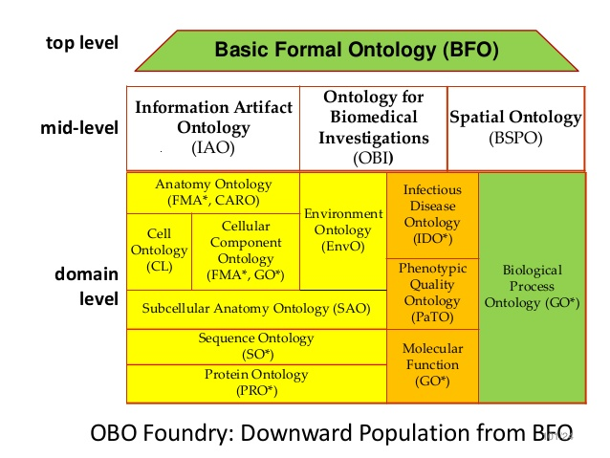
Information Artifact Ontology (IAO)
“An information artifact is, loosely, a dependent continuant or its bearer that is created as the result of one or more intentional processes.”

Slide 5
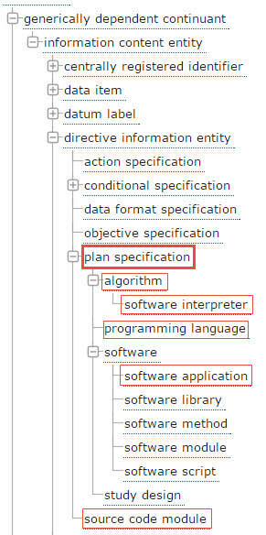
plan specification
Definition: A directive information entity with action specifications and objective specifications as parts that, when concretized, is realized in a process in which the bearer tries to achieve the objectives by taking the actions specified.
Notes:
.

Slide 6
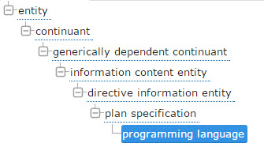
plan specification / programming language
Definition: A language in which source code is written that is intended to be executed/run by a software interpreter. Programming languages are ways to write instructions that specify what to do, and sometimes, how to do it.

Slide 7
Proposal symbol / programming language
Definition: A language in which source code is written that is intended to be executed. or run by a software interpreter. Programming languages are ways to write instructions that specify what to do, and sometimes, how to do it

Slide 8
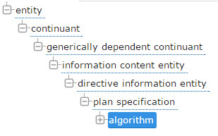
plan specification / algorithm
Definition: A plan specification which describes the inputs and output of mathematical functions as well as workflow of execution for achieving an predefined objective. Algorithms are realized usually by means of implementation as computer programs for execution by automata.

Slide 9
Proposal plan specification / algorithm
Definition: A plan specification which describes the inputs and and/or output of mathematical functions as well as workflow of execution provides a set of discrete instructions for achieving an predefined objective. Algorithms are realized usually by means of implementation as computer programs for execution by automata.

Slide 10
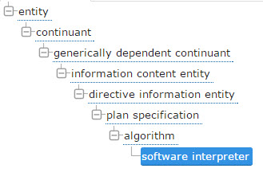
plan specification / algorithm / software interpreter
Definition: A software interpreter is a software application that executes some specified input software.
example of usage: R program, Perl interpreter, Java virtual machine

Slide 11
Proposal plan specification / algorithm software application / software interpreter
Definition: A software interpreter is a software application that executes source code that not compiled into machine code some specified input software.

Slide 12
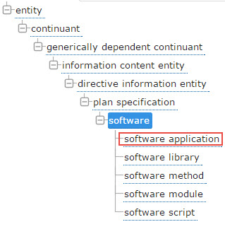
plan specification / software / software application
software application
Definition: A software application is software that can be directly executed by some processing unit.
software library
Definition: A software library is software composed of a collection of software modules and/or software methods in a form that can be statically or dynamically linked to some software application.

Slide 13
Proposal plan specification / software / software application
Definition: A software application is software that can be directly executed by some computer operating system processing unit.

