Slide 1
Christopher Boorse and the Mental Disease Ontology
By Evan Murphy

Slide 2
Contents
Background to 1975 paper
Boorse’s definition of ‘disease’
Boorse’s definition of ‘illness’
Boorse’s implicit philosophy of mind
Consequences for MFOMD

Slide 3
Background: American Psychiatry c. 1970
Paper published in 1975; Melvin Sabshin, president of the APA, gives speech in 1977 about need to ‘remedicalize’ psychiatry and free it from restrictive ‘ideologies’
Homosexuality had been removed from the DSM two years earlier, in 1973
The term ‘Neurosis’ was still used as a general category of mental disease

Slide 4
Boorse’s Definition of Disease
Normativism: Strong and Weak
Strong Normativism is wrong because it’s stupid
Weak Normativism can’t be established or refuted ‘definitively’
Boorse’s Functionalism:
The natural is the normal
Species-typical goals and functions to be determined empirically
No issues w/ cut-off
Example: intoxication
We don’t treat all diseases

Slide 5
Boorse’s Definition of Illness
Undesirability for the bearer
Title to special treatment or to a special societal role
Excuse for normally criticizable behavior
Division between our actions and our body’s

Slide 6
Boorse contra ‘Mental Illness’
Undesirability for the bearer
Talks about the vacuity of ‘social adjustment’; doesn’t mention subjective distress
Title to special treatment or to a special societal role
Quotes a psychiatrist to the effect that 99% of the populace has ‘neurosis’
Excuse for normally criticizable behavior
Implicit philosophy of mind

Slide 7
Boorse’s Philosophy of Mind
Mentalism, dualism
Or maybe not?

Slide 8
Boorse’s Theory + the MDO
Boorse’s philosophy of mind probably not an immediate sticking point between his theory and MDO

Slide 9
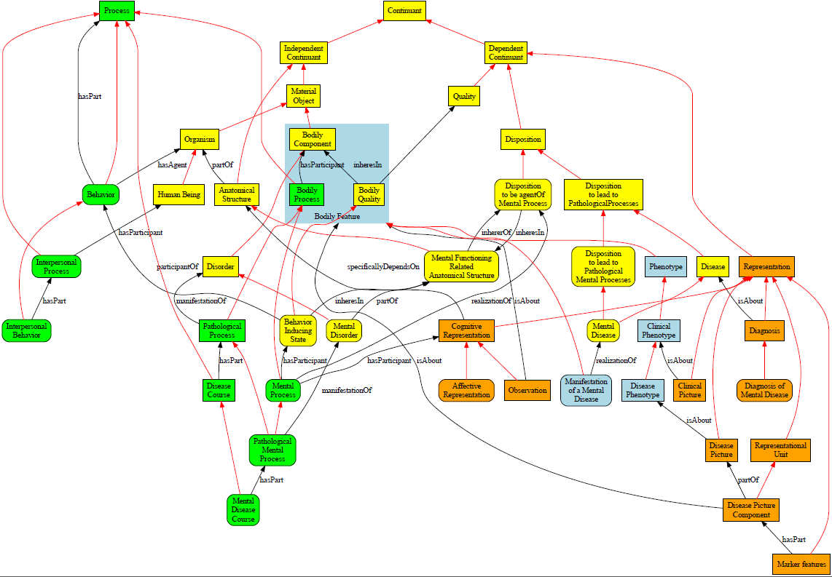

Slide 10
Boorse’s Theory + The MDO cont.
So long as the MDO sticks to the research side of psychotherapy shouldn’t encounter any obstacles from Boorse’s theory
Things that would cause it to run into problems:
Assigning patient roles to people diagnosed with mental diseases
Describing recommended treatments for different diseases
Basically anything that would have to do with clinical practice, because practice = illnesses and mental diseases =/= illnesses

Slide 11
Possible Counterarguments (For When the Time Comes)
If Boorse is a dualist of some kind, then he and the MDO are just speaking different languages
If he’s a physicalist of some sort, runs into difficulty explaining how the neurological underpinnings of something like a personality disorder don’t benefit from the same separation of responsibility that he says come along with bodily processes
Already admits some mental diseases might be deserving of illness status, e.g. psychosis – slippery slope
General problems with his own critiques: not very substantiated, dependent on serious outmoded research findings

