Slide 1
Understanding accessibility of healthcare facilities to older adults
Qiuyi Zhang
Department of Geography
University at Buffalo

Slide 2
Content:
Challenges for the aging population access to healthcare facility
The BFO framework
Application in agent-based modeling (ABM)
1
Notes:
Understanding accessibility to healthcare facilities for older adults in the Ontology
modeling: from problem to model (qualitative to quantitive)

Slide 3
Challenges for the aging population access to healthcare facility
Middle-aged and older minority individuals with disabilities have been shown to lack sufficient access to health care (Miller, Kirk, Kaiser, & Glos, 2014).
Among older adults, disparities in access to physician services have diminished for African Americans but have grown worse for Hispanics (Mahmoudi & Jensen, 2013).
The uneven distribution of healthcare facilities also causes differences spatial accessibility (Ngamini Ngui & Vanasse, 2012).
2

Slide 4
Access to healthcare facility
spatial/geographic factors:
uneven distributions of healthcare facilities
non-spatial/social factors:
socioeconomic resources and demographic characteristics
3

Slide 5
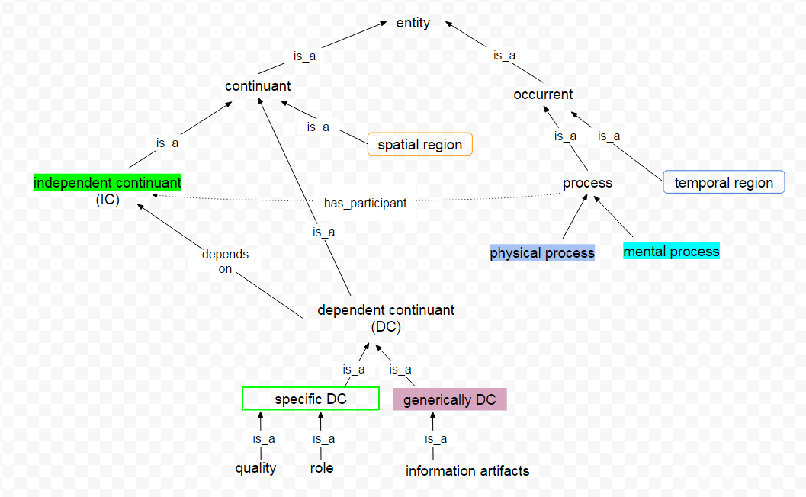
The BFO framework:
4

Slide 6
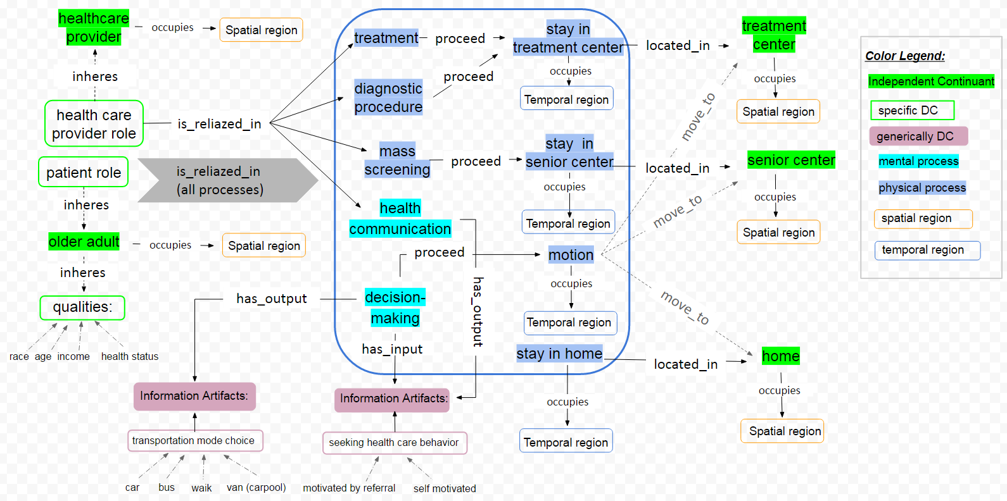
understanding accessibility of healthcare facilities to older adults
5

Slide 7
On July 3, 2016, John, who is 70 years old, decided to go to Upaca Senior Center to meet friends. He went to there by bus and costed 15 mins. At there, he participated an oral health screening event holded by ElderSmile program. After screening, healthcare provider Mary suggested him to go Mount Sinai Ruttenberg Treatment Center for following treatment.
On July 20, John went to Mount Sinai Ruttenberg Treatment Center by car which costed 20 mins. After health provider Jack’s examination, he received a pulp treatment. At end of day, he went back home.
6

Slide 8
Application in agent-based modeling (ABM)
ABM is one of a class of computational models for simulating the actions and interactions of autonomous agents(both individual or collective entities such as organizations or groups) with a view to assessing their effects on the system as a whole.
7
https://en.wikipedia.org/wiki/Agent-based_model

Slide 9
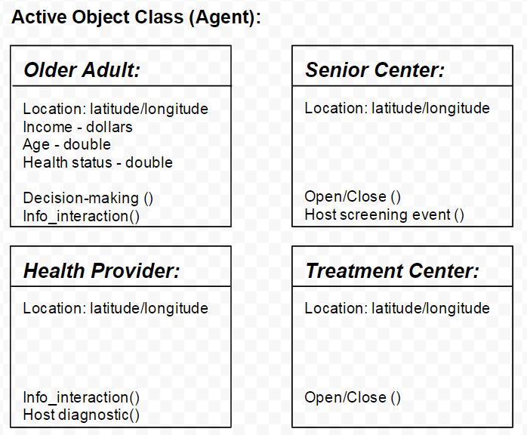
Application in agent-based modeling (ABM)
8
Notes:
see Independent Continuants (BFO) could be seen as agents in ABM. For agents, their Dependent Continuants (BFO) could be treated as attributes. All the processes (BFO) could be seen as events. And interaction occurs between agents, such as communication between patient and healthcare provider, could be seen as information artifacts (BFO) exchange through specific input and output.

Slide 10
Application in agent-based modeling (ABM)
Independent Continuants (BFO)
9
Notes:
see Independent Continuants (BFO) could be seen as agents in ABM. For agents, their Dependent Continuants (BFO) could be treated as attributes. All the processes (BFO) could be seen as events. And interaction occurs between agents, such as communication between patient and healthcare provider, could be seen as information artifacts (BFO) exchange through specific input and output.

Slide 11
Application in agent-based modeling (ABM)
Independent Continuants (BFO)
Dependent Continuants (BFO)
10
Notes:
see Independent Continuants (BFO) could be seen as agents in ABM. For agents, their Dependent Continuants (BFO) could be treated as attributes. All the processes (BFO) could be seen as events. And interaction occurs between agents, such as communication between patient and healthcare provider, could be seen as information artifacts (BFO) exchange through specific input and output.

Slide 12
Application in agent-based modeling (ABM)
Independent Continuants (BFO)
Dependent Continuants (BFO)
Process (BFO)
11
Notes:
see Independent Continuants (BFO) could be seen as agents in ABM. For agents, their Dependent Continuants (BFO) could be treated as attributes. All the processes (BFO) could be seen as events. And interaction occurs between agents, such as communication between patient and healthcare provider, could be seen as information artifacts (BFO) exchange through specific input and output.

Slide 13
Application in agent-based modeling (ABM)
Independent Continuants (BFO)
Dependent Continuants (BFO)
Process (BFO)
Spatial region (BFO)
12
Notes:
see Independent Continuants (BFO) could be seen as agents in ABM. For agents, their Dependent Continuants (BFO) could be treated as attributes. All the processes (BFO) could be seen as events. And interaction occurs between agents, such as communication between patient and healthcare provider, could be seen as information artifacts (BFO) exchange through specific input and output.

Slide 14
Application in agent-based modeling (ABM)
Independent Continuants (BFO)
Dependent Continuants (BFO)
Process (BFO)
Spatial region (BFO)
Temporal region (BFO)
Model time unit: minutes
Simulation time period: one year
13
Notes:
see Independent Continuants (BFO) could be seen as agents in ABM. For agents, their Dependent Continuants (BFO) could be treated as attributes. All the processes (BFO) could be seen as events. And interaction occurs between agents, such as communication between patient and healthcare provider, could be seen as information artifacts (BFO) exchange through specific input and output.

Slide 15
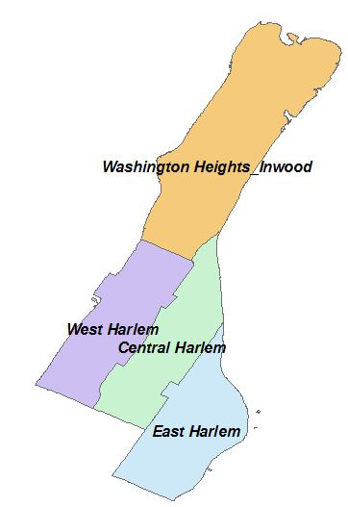
Case study:
The purpose of this case study is to employ the BFO framework to guide an agent-based model to examine the potential accessibility of oral healthcare facilities for older adults living in northern Manhattan, so as to maximize ways of providing access to people wherever they live.
14

Slide 16
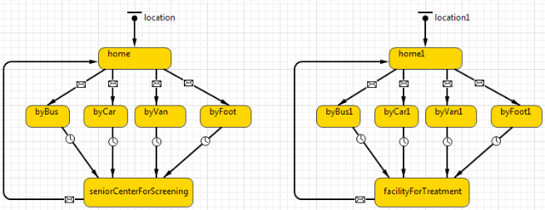
Application in agent-based modeling (ABM)
Simulate 100 older adults as mobile agents living in a GIS-based environment :
15

Slide 17
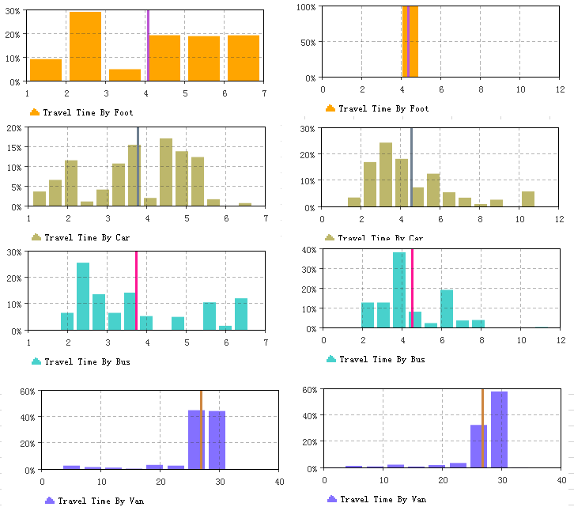
Application in agent-based modeling (ABM)
Travel Time Distribution:
By foot
By car
By bus
By van (carpool)
16
East Harlem
West Harlem

Slide 18
Conclusions:
This research used an ontology framework to help us understanding the spatial and social factors for older adults’ accessibility.
Also, this ontology framework could be a guideline to build an agent-based model which used to simulate the potential accessibility of healthcare facilities to older adults.
17

Slide 19
Reference:
Arp, R., Smith, B., & Spear, A. D. (2015). Building ontologies with basic formal ontology: Mit Press.
Cvitkovich, Y., & Wister, A. (2001). The importance of transportation and prioritization of environmental needs to sustain well-being among older adults. Environment and Behavior, 33(6), 809-829.
Mahmoudi, E., & Jensen, G. A. (2013). Exploring disparities in access to physician services among older adults: 2000–2007. The Journals of Gerontology Series B: Psychological Sciences and Social Sciences, 68(1), 128-138.
Miller, N. A., Kirk, A., Kaiser, M. J., & Glos, L. (2014). Disparities in access to health care among middle-aged and older adults with disabilities. Journal of aging & social policy, 26(4), 324-346. doi:http://dx.doi.org/10.1080/08959420.2014.939851
Ngamini Ngui, A., & Vanasse, A. (2012). Assessing spatial accessibility to mental health facilities in an urban environment. Spatial and Spatio-temporal Epidemiology, 3(3), 195-203. doi:http://dx.doi.org/10.1016/j.sste.2011.11.001
18

Slide 20
Thank you !
19

