Slide 1
The Ontology of Diabetes Camp
James Schuler
BMI 508
11/28/2016

Slide 2
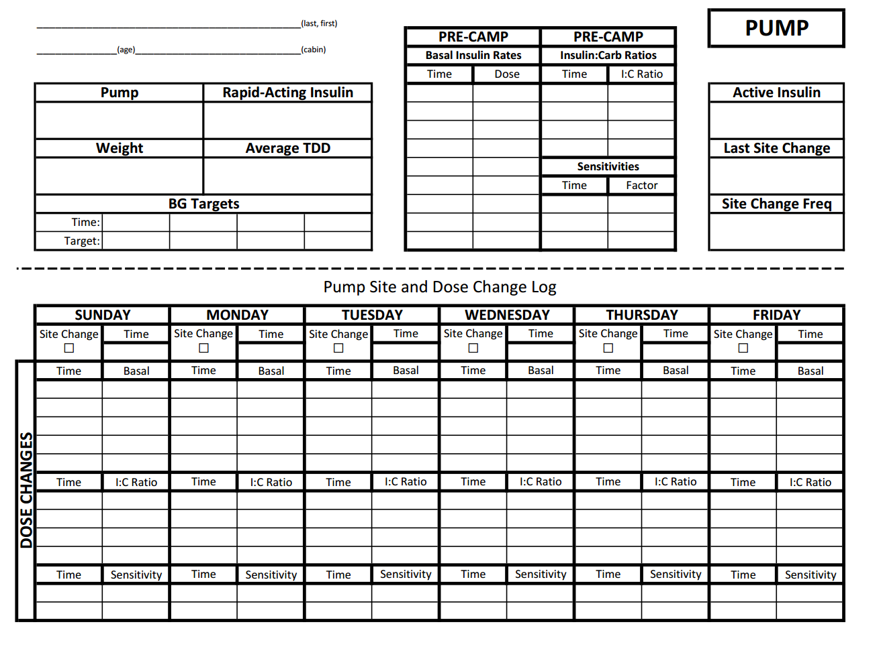

Slide 3
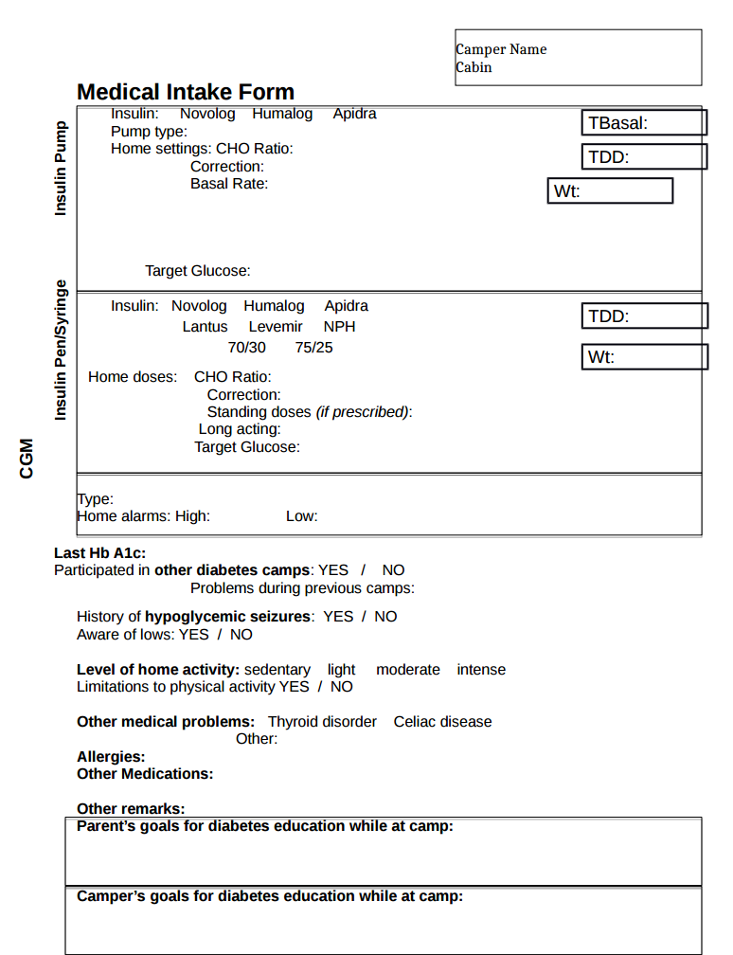

Slide 4
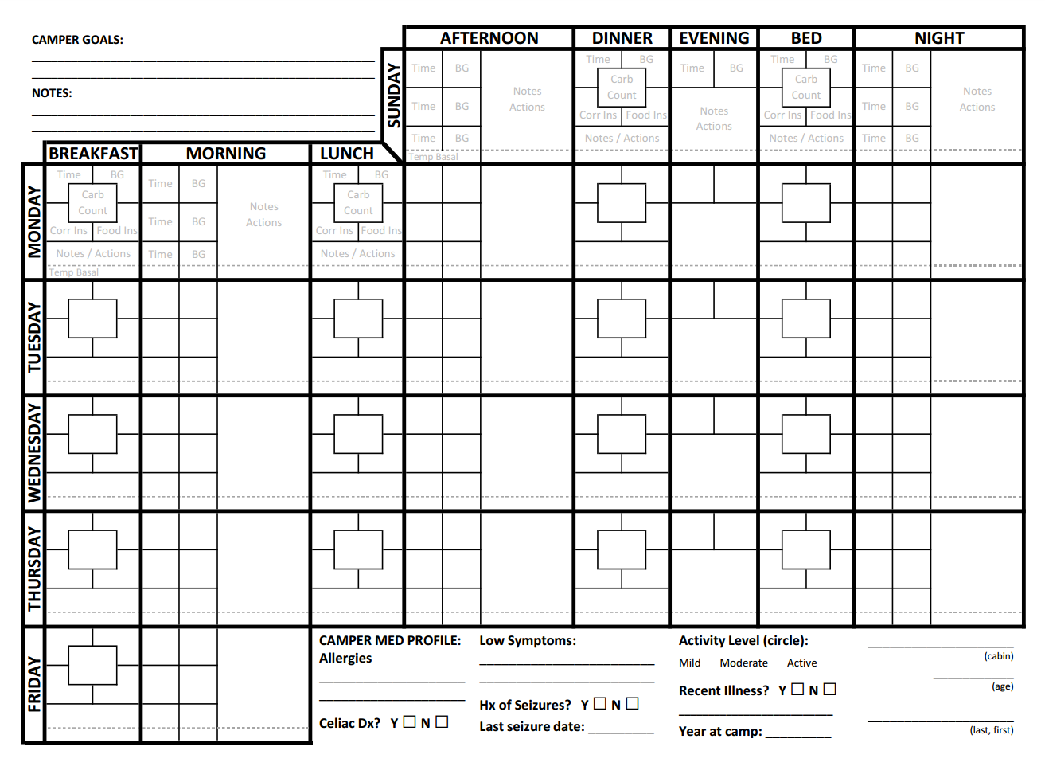

Slide 5
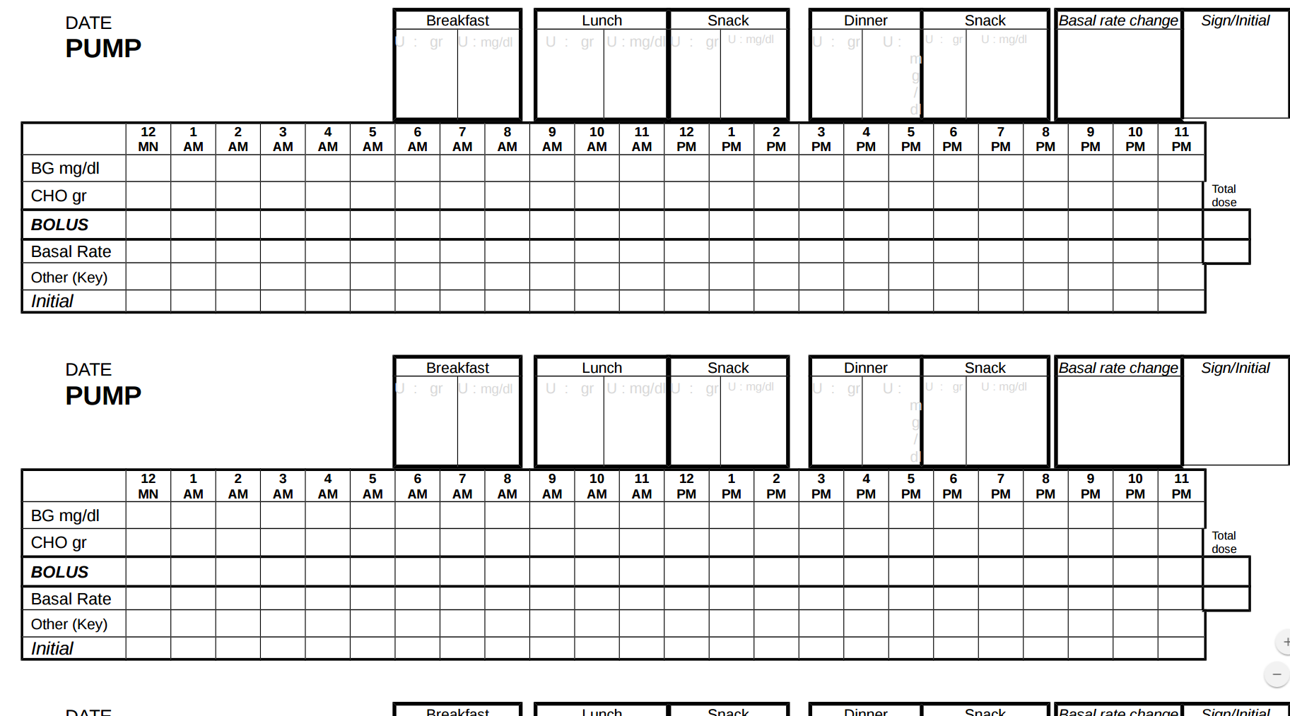

Slide 6
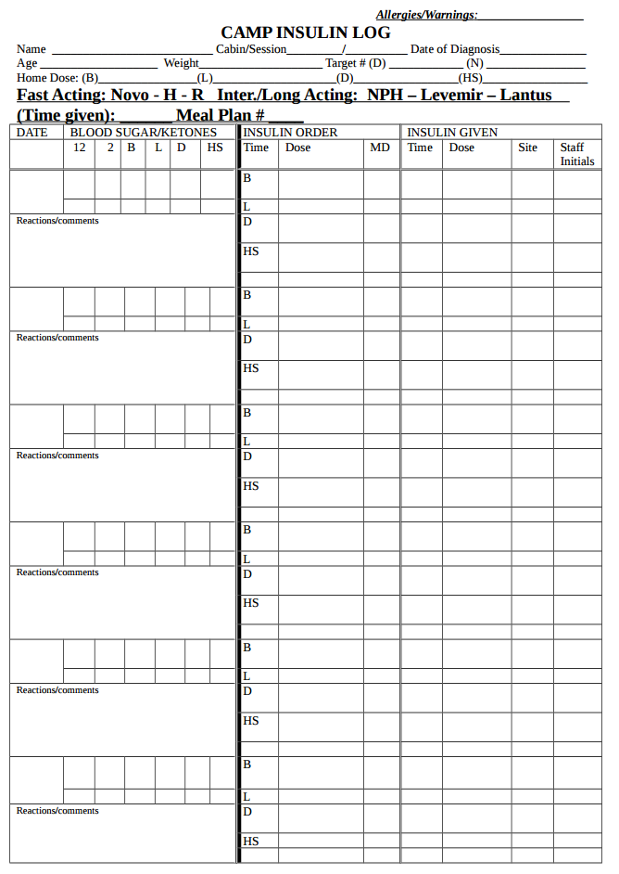

Slide 7
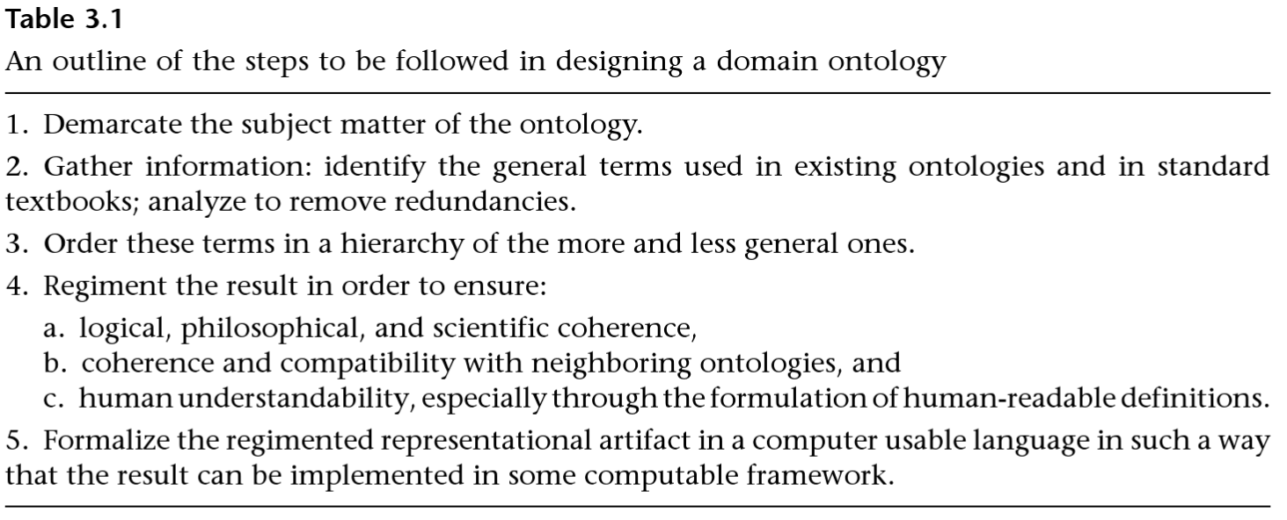
Guidelines from “Building Ontologies With BFO”

Slide 8
Subject matter of the ontology.

Slide 9
The Ontology of Diabetes Camp
James Schuler
BMI 508
11/28/2016

Slide 10
The Ontology of Medical Care at Diabetes Camp
James Schuler
BMI 508
11/28/2016

Slide 11
The Ontology of Diabetes Care at Diabetes Camp
James Schuler
BMI 508
11/28/2016

Slide 12
2. Gather Information, Terms
Diabetes, diabetes camp
People: Camper,Medical staff, lead medical staff, medical coordinator, medical director
Cabin, relationship between medical staff and dcamper
Blood sugar vs. Blood sugar reading
Test kit: glucometer, test strip, lancet (lancing device?)
Insulin: Short acting (bolus) insulin, Long acting (basal) insulin
Dose of insulin, administration of insulin
Bolus (dose): correction (dose), food (dose)
Bolus dose calculated vs bolus dose delivered
Insulin pump (Medtronic...530,530G,630,670G), Animas (Ping), OmniPod, T-Slim
Insulin pump setting:
Basal rate, basal rate setting, carb ratio, insulin sensitivity factor (correction factor), frequency of site change, active insulin
MDI/Pens: basal insulin amount and time
Pump warnings, pump errors
Pump site change
Ketones -- blood vs. urine, Diabetic Ketoacidosis
Carbohydrate count, “corrected” carbohydrate count
Multiple daily injections (MDI)
Humalog, Novolog, Apidra, … , U500?
Lantus, Lente, Ultralente, Trujeo, Levemir
Total Daily Dose
BG Targets
Low treatment: glucose tab, juice (box?), crackers, frosting, glucagon
Overtreatment
Temporary basal rate
Medical error: wrong insulin delivery, wrong amount of insulin delivery
Insulin pen, insulin pump: supplies (reservoir, tubing)
Processes: checking for ketones (urine & blood), checking blood glucose, filling pump, taking insulin

Slide 13
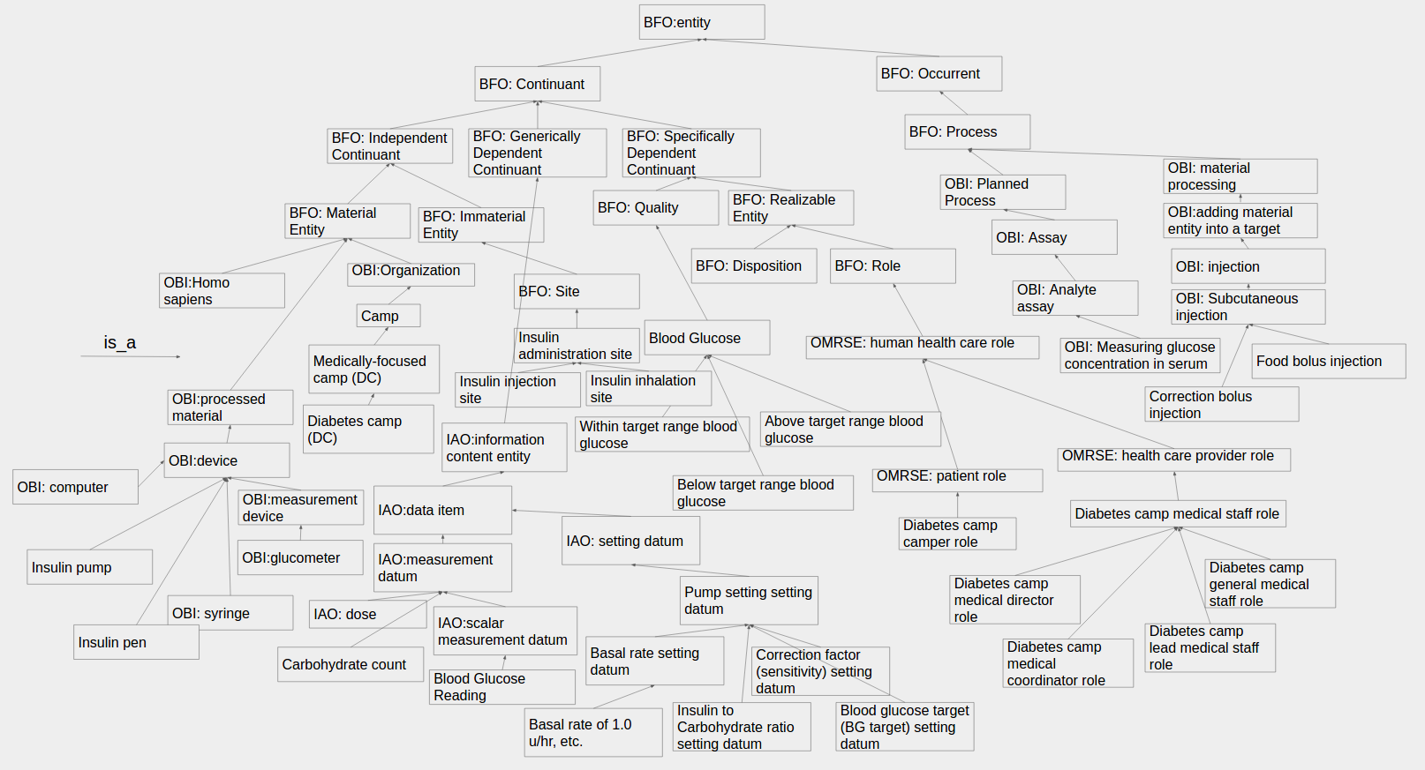
3. is_a hierarchy

Slide 14
4. Regiment the hierarchy and give definitions and human readability.

Slide 15
OBI:Organization
U
Camp
U
Medically-focused camp
DC
Diabetes camp
DC
Instance of at time t_{x}
Camp Aspire

Slide 16
Using the Vaccine Ontology as a model
BFO: Site
Insulin administration site
Insulin injection site
Insulin inhalation site

Slide 17
Using OMRSE as a model
OMRSE: health care provider role
Diabetes camp medical staff role
Diabetes camp medical director role
Diabetes camp general medical staff role
Diabetes camp medical coordinator role
Diabetes camp lead medical staff role

Slide 18
OMRSE: health care provider role
Diabetes camp medical staff role
Diabetes camp medical director role
Diabetes camp general medical staff role
Diabetes camp medical coordinator role
Diabetes camp lead medical staff role
OBI:homo sapiens
Universals
Instances
Lead medical staff role #1
Medical coordinator role #1
Diana
Jim
inheres_in
Instance_of at time t_{x}

Slide 19
BFO: Quality
Blood Glucose

Slide 20
BFO: Quality
Blood Glucose = def. A physical quality that inheres in blood by virtue of the concentration of glucose in serum
Blood Glucose Reading = def. An IAO: scalar measurement datum (is_a ICE) which is the specitifed_output of an OBI:measuring glucose concentration in serum
Blood Glucose

Slide 21
BFO: Quality
Blood Glucose = def. A physical quality that inheres in blood by virtue of the concentration of glucose in serum
Blood Glucose Reading = def. An IAO: scalar measurement datum (is_a ICE) which is the specitifed_output of an OBI:measuring glucose concentration in serum
Blood Glucose
Above target range blood glucose (hyperglycemia)
Blood glucose of 208 mg/dL
Instance at time t_{1 = 7:30 am}
Rob Smith’s blood glucose

Slide 22
BFO: Quality
Blood Glucose
Above target range blood glucose (hyperglycemia)
Within target range blood glucose (euglycemia)
Blood glucose of 208 mg/dL
Blood glucose of 120 mg/dL
Instance at time t_{1 = 7:30 am}
Instance at time t_{2 = 10:30 am}
Rob Smith’s blood glucose

Slide 23
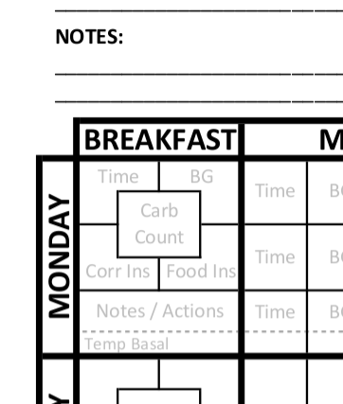
Standard
7:30 am
208
2.8
*Note units for BG (mg/dl) and units for insulin dose (u = units) are implicit

Slide 24
Ontologic Understanding
Rob Smith (camper 1) RO:participates in correction bolus injection (is_a OBI: subcutaneous injection) of OBI: dose of 2.8 units of insulin
7:30 am
208
2.8

Slide 25
Standard
7:30 am
208
65
2.8
4.3

Slide 26
Standard
Ontologic Understanding
Rob Smith (camper 1) RO:participates in food bolus injection (is_a OBI: subcutaneous injection) of OBI: dose of 4.3 units of insulin
7:30 am
208
65
2.8
4.3

Slide 27
Future
Step 5: Formalize the ontology in a computer language (OWL, Protege)
Better understanding of “relational qualities”
E.g., between a camper and his/her medical staff
Incorporate MORE of diabetes camp which I have excluded
E.g., insulin pens, DKA, counseling staff, specific treatments
Build EMR and incorporate this knowledge

Slide 28
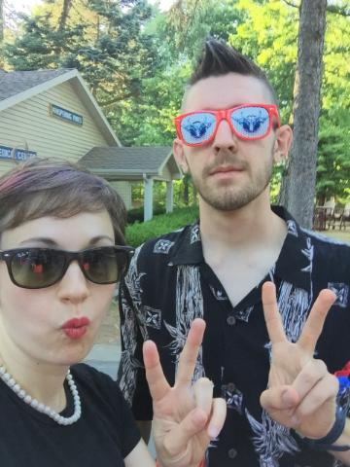
Thank you.
Questions?
Comments?
Acknowledgements
Dr. Smith
Dr. Ceusters
Matt Hudson
Izzy Schember
Dr. Miller
(picture of) domain expert
Dr. Diana Miller

