Slide 1
The OBO Relation Ontology: Preliminaries
Barry Smith
http://ontology.buffalo.edu/smith

Slide 2
3 kinds of binary relations
Between types:
  human is_a mammal
  cell nucleus part_of cell
Between an instance and a type
  this human instance_of the type human
  this human allergic_to the type penicillin
Between instances:
  Mary’s heart part_of Mary
  Mary’s aorta connected_to Mary’s heart
Notes:
In the following discussion:
Classes are in upper case
‘A’ is the class
Instances are in lower case
‘a’ is a particular instance

Slide 3
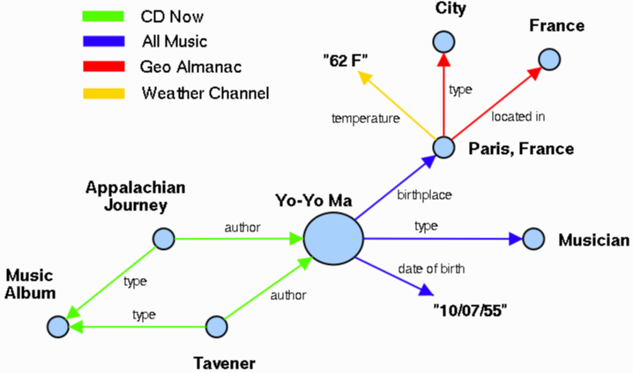
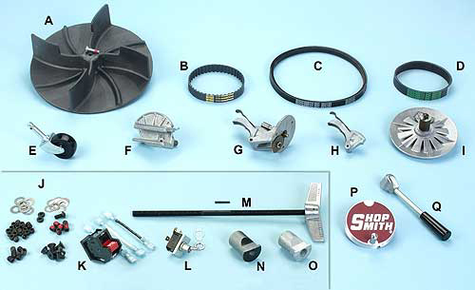
Catalog vs. inventory
A | 515287 | DC3300 Dust Collector Fan
B | 521683 | Gilmer Belt
C | 521682 | Motor Drive Belt
Notes:
www2003.org/cdrom/papers/refereed/p779/ess.html

Slide 4
Ontologies
are representations of types (of what is general)
The prime goal is to create a limited repertoire of relations linking types
A is_a B
A part_of B

Slide 5
Only something that holds of all As will be an assertion that holds of the type A
Hence the All-Some rule
Or analogous rules for n-ary relations
(where n > 2)

Slide 6
Definitions of type-level relations presuppose underlying instance-level relations
A is_a B presupposes instance_of
All instances of A are instances of B
A part_of B presupposes instance-level-part-of
Every instance of A are instance-level-parts-of some instance of B

Slide 7
Rules for including relations in RO
Keep RO as small as possible
Some are going to use these relations in sloppy ways – constraints are good, to keep this to a minimum
Paris has_temperature 62º
Currency has_unit $

Slide 8
Rules for including relations in RO
Keep RO as small as possible
If we have a relation, say, adjacent_to in RO, then we should not add lists of easily defined relations of the form
adjacent_to_organ:
adjacent_to_cytoplasm:
adjacent_to_neuron:
In general: include a relation only if it is lexicalized

Slide 9
Rules for including relations in RO
In every case we need to check, before we add a relation A R B, that, for some set of A and B terms we have data about the As and data about the Bs which is such that
all the instances of A stand in R to some B
e.g. all the instances of cell membrane stand in part_of to cell

Slide 10
Rules for including relations in RO
Include type-level relations in RO only if you have provided them with All-Some definitions in terms of instance-level relations of broad applicability

Slide 11
Rules for including relations in RO
Some_some relations are important not to ontology but to the treatment of empirical data e.g. relating to exceptions to proposed general hypotheses
However, in developing RO, we will need to keep track of instance-level relations in any case, and then corresponding some-some relations (and also various kinds of probabilistic relations) come for free

Slide 12
Thus for example
Instead of:
results_in_reception_of_stimulus_and_
conversion_into_molecular_signal_of
use:
results_in, together with: is_a,
reception_of_stimulus, and
conversion_into_molecular_signal

Slide 13
Or in other words:
A results_in_reception_of_stimulus_and_
conversion_into_molecular_signal_of B
=Def.
A results_in B
& B is_a reception_of_stimulus
& B is_a conversion_into_molecular_signal

Slide 14
Hypothesis
While RO should contain broad applicability relations such as part_of
ontologists should be free to develop suites of narrow-applicability relations for their own purpose
part_of_tumor:
part_of_nose:
part_of_earlobe:
I think this is wrong – the repertoire of relations should be small to support cross-ontology reasoning

Slide 15
Rules for including relations in RO
Before including a type-level relation in RO ask yourself whether the relation can be easily defined in terms of existing RO relations plus domain-specific terms
(e.g. define ‘synaptic connection’ in terms of is_connected_to, is_a and synapse)

Slide 16
Consequences of including only all-some relations in RO
All relations will be evaluable as
  Transitive
  Symmetric
  Reflexive
  Anti-Symmetric
All relations will support reasoning
is_somehow_related_to
is the worst kind of relation to create

Slide 17
Benefits of well-defined relationships
By maintaining its status as a small suite of well-defined relations with wide applicability the RO provides guidelines for those new to ontology development of a sort which goes far towards ensuring that their work will be compatible with the work of other ontology-development groups

Slide 18
Benefits of well-defined relationships
Reasoning should be able cascade from one relational assertion (A R₁ B) to the next (B R₂ C).
Find all DNA binding proteins should also find all transcription factor proteins because
  Transcription factor is_a DNA binding protein
  Only the All-Some structure guarantees such cascading of relational assertions

Slide 19
The crucial role of the all-some structure
If you know A part_of B, and B part_of C then whichever A you choose, the instance of B of which it is a part will be included in some C, which will include as part also the A with which you began
The same principle applies to the other relations in the OBO-RO:
located_at, transformation_of, derived_from, adjacent_to, etc.

Slide 20
A part_of B, B part_of C ...
The all-some structure of the definitions in the OBO-RO allows
cascading of inferences
(i) within ontologies
(ii) between ontologies
(iii) between ontologies and EHR repositories of instance-data

Slide 21
True Path Rule
the pathway from a child term all the way up to its top-level parent(s) must always be true
(Gene Ontology Consortium, 2001)

Slide 22
Definition of part_of as a relation between types
A part_of B =Def. all instances of A are instance-level parts of some instance of B
human testis part_of adult human being
but not
adult human being has_part human testis

Slide 23
Fundamental Dichotomy
Continuants (aka endurants)
  have continuous existence in time
  preserve their identity through change
  exist in toto whenever they exist at all
Occurrents (aka processes)
  have temporal parts
  unfold themselves in successive phases
  exist only in their phases

Slide 24
Fundamental Dichotomy
Continuants (aka endurants)
  have continuous existence in time
  preserve their identity through change
  exist in toto whenever they exist at all
Occurrents (aka processes)
  have temporal parts
  unfold themselves in successive phases
  exist only in their phases

Slide 25
Functions are continuants
Functionings are occurrents

Slide 26
part_of for process types
A part_of B =def.
For all x, if x instance_of A then there is some y, y instance_of B and x part_of y
where ‘part_of’ is the instance-level part relation
EVERY A IS PART OF SOME B

Slide 27
part_of for continuant types
A part_of B =def.
For all x, t if x instance_of A at t then there is some y, y instance_of B at t and x part_of y at t
where ‘part_of’ is the instance-level part relation
EVERY A AT A TIME IS PART OF SOME B AT THAT TIME

Slide 28
is_a (for processes)
A is_a B =def
For all x, if x instance_of A then x instance_of B
cell division is_a biological process

Slide 29
is_a (for continuants)
A is_a B =def
For all x, t if x instance_of A at t then x instance_of B at t
abnormal cell is_a cell
adult human is_a human
but not: adult is_a child

Slide 30
Lacks
Instance-type level
p lacks U with respect to r at time t =def. there is no instance u of U such that p stands in r to u at t.
Type-type level
C1 lacks C2 with respect to r =def. for all c,t, if c instance of C1 at t then c lacks C2 with respect to r at time t.
Need a way to state on top of this: that C1s normally stand in r to some C2

Slide 31
What is symmetric on the level of instances need not be symmetric on the level of types
  Always, on the level of instances, if
  nucleus adjacent_to cytoplasm,
  then
  cytoplasm adjacent_to nucleus
  and vice versa
But while:
  nucleus adjacent_to cytoplasm
  Not: cytoplasm adjacent_to nucleus
  And similarly while
  seminal vesicle adjacent_to urinary bladder
  Not: urinary bladder adjacent_to seminal vesicle

Slide 32
a continuous_with b on the instance level is always symmetric
if a continuous_with b, then b continuous_with a
and vice versa

Slide 33
continuous_with as a relation between types
A continuous_with B =Def.
for all x, if x instance-of A then there is some y such that y instance_of B and x continuous_with y

Slide 34
continuous_with is not always symmetric
Consider lymph node and lymphatic vessel:
  Each lymph node is continuous with some lymphatic vessel, but there are lymphatic vessels (e.g. lymphs and lymphatic trunks) which are not continuous with any lymph nodes

Slide 35
transformation_of
same instance
C
c at t
C₁
c at t₁
time
pre-RNA
mature RNA
child
adult
presupposes the primitive instance-level
relation of (transtemporal) identity

Slide 36
transformation_of
A transformation_of B =Def.
Every instance of A was at some earlier time an instance of B
  adult transformation_of child

Slide 37
derives_from
C
c at t
C₁
c₁ at t₁
time
C'
c' at t
instances
ovum
zygote derives_from
sperm
correction to original Genome Biology paper: derivation is never one-to-one

Slide 38
derives_from
two continuants fuse to form a new continuant
C
c at t
C₁
c₁ at t₁
C'
c' at t
fusion

Slide 39
derives_from
one initial continuant is replaced by two successor continuants
C
c at t
C₁
c₁ at t₁
C₂
c₁ at t₁
fission

Slide 40
derives_from combined with transformation_of
one continuant detaches itself from an initial continuant, which itself continues to exist
C
c at t
c at t₁
C₁
c₁ at t
budding

Slide 41
derives_from combined with transformation_of
one continuant absorbs a second continuant while itself continuing to exist
C
c at t
c at t₁
C'
c' at t
capture

Slide 42
To be added to the Relation Ontology
lacks (between an instance and a type, e.g. this fly lacks wings)
dependent_on (between a dependent entity and its carrier or bearer)
quality_of (between a dependent and an independent continuant)
functioning_of (between a process and an independent continuant)

Slide 43
instance to universal: lacks
continuant to continuant: connected_to
function to process: realized_by
function to continuant: function_of
continuant to function: has_function
continuant to quality: has_quality
various has_product terms

Slide 44
Conclusions
Follow a methodology which enforces clear, coherent definitions for a restricted set of relations
This promotes quality assurance
  relations are not black boxes to software
  meaning of relations is defined, not inferred
  arbitrariness is reduced in defining cross-product terms
Enables automated reasoning across ontologies and across data at different granularities

