Slide 1
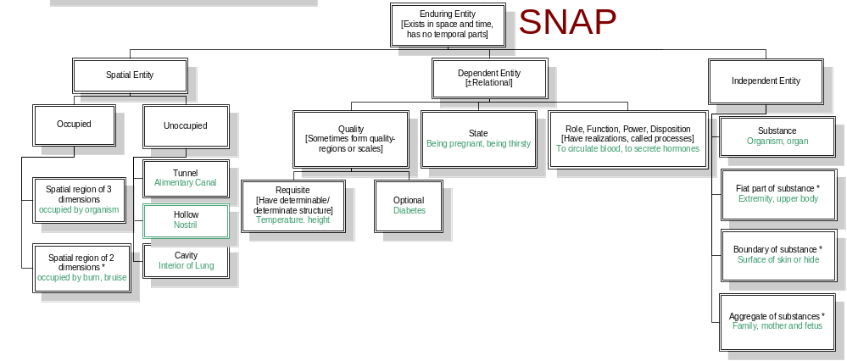
SNAP: Entities existing in toto at a time
http://ontology.buffalo.edu/bfo

Slide 2
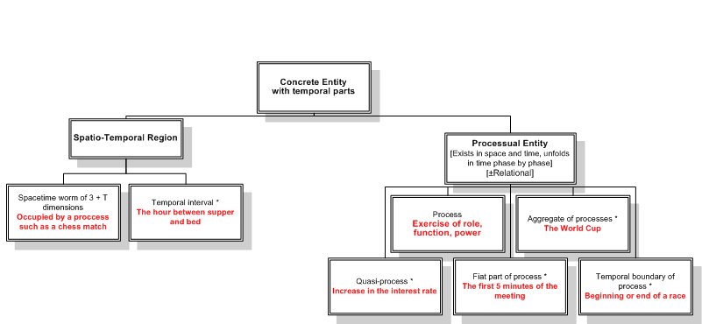
SPAN: Entities extended in time

Slide 3
SNAP-SPAN
Participation
Perpetration (+agentive)
Influence
Patiency
(-agentive)
Initiation
Termination
Facilitation
Perpetuation
Hindrance
Mediation

Slide 4
SPAN-SNAP
Qualitative projection
Creation
Involvement
Continuation
Destruction
Degradation
Creation
Sustenance
Degradation
Destruction
Blurring
Demarcation

