Slide 1







CTSAconnect
Melissa Haendel
Jon Corson-Rikert
Carlo Torniai
CTSAconnect.org
NCBO CTSA workshop, Baltimore
April 24th, 2012

Slide 2
CTSAconnect
Ontology project funded by NCATS via Booz Allen Hamilton
Collaboration between OHSU, UF, and Harvard CTSAs, and Cornell, Stony Brook and University at Buffalo
These sites will be piloting data integration leveraging the CTSAconnect ontologies
Advisory Group consisting of CTSA consortium members

Slide 3

Research resource discovery project (eagle-i.net) developed for past 2+ years
Large reuse and contribution to OBO Foundry ontologies
Coordinated development with NIF and Biositemaps
Ontology used to drive the search and data collection application UIs
Publishes Linked Open data about research resources

Slide 4
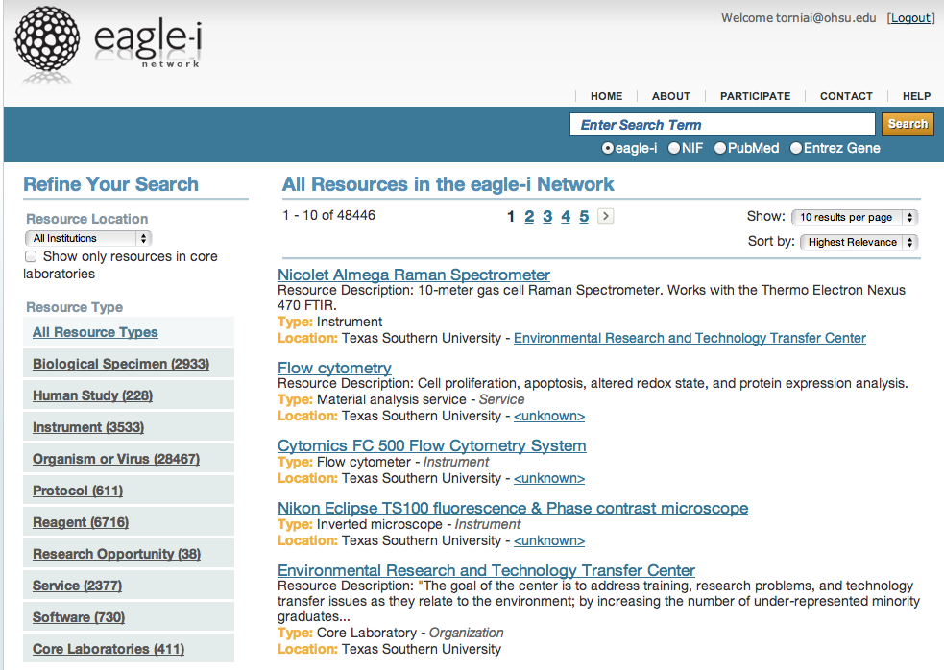

Slide 5

Primarily focused on people, activities, and outcomes typically associated with research networking (vivoweb.org)
Reuses common ontologies (FOAF, Bibo) but not OBO Foundry ontologies
Ontology Driven Application
Publishes Linked Open data about people and expertise

Slide 6
What is expertise?
Information About People
Researchers
Team Members
Clinicians
Teaching, Mentoring, etc.
Publications
Research Resources
Clinical Expertise
Information About What People Have and Do
Expertise is found in all the things that people do and produce.
The goal of CTSAconnect is to build ontologies that will enable inference of expertise across these disparate data sources

Slide 7
Building an integrated semantic framework for people and expertise
Align under a common upper ontology (BFO)
Provides basic principles for organization
Discuss compatibility of classes and properties before specific label choices
Agree on what each ontology is trying to model
OK to be interested in different granularity
Develop better representation of persons and their activities
Develop best practices to reference commonly used medical terminologies

