Slide 1
Resurrecting SOWG
BS, Baltimore, CTS Ontology Workshop
April 26 2012

Slide 2
NCBC Scientific Ontologies Working Group
Challenge: to identify a set of scientific ontologies and ontology-related resources which can be recommended for purposes of supporting data quality and data consistency in translational science
http://na-mic.org/Wiki/index.php/
SDIWG:_NCBC_Scientific_Ontologies

Slide 3
http://na-mic.org/Wiki/index.php/ PrelimResultsSOWG1
I – All NCBC's endorse
II – All NCBC's will use under protest
(or more often, with a wish for some additions/corrections)
III – promising but under construction
IV – will not use
V – no clear standard
VI – mapping from one ontology to the other.
VII – to be determined

Slide 4
Class I: All NCBC's endorse
Gene Names and Symbols Human – HGNC Mouse – JAXMGI Drosophila – FlyBase C. elegans – WormBase Yeast – SGD Zebrafish – ZFIN Protein names UNIPROT Primary molecular sequence data IUPAC single letter Genomic sequence coordinates NCBI genome builds Protein Sequences UNIPROT Attributes of Gene Products Gene Ontology | Taxonomy NCBI taxonomy minus virii Human Anatomy FMA (note that FMA's license is now open, unlike what is on their website) Clinical laboratory observations LOINC Sequence Features SO Protein Sequence Domains InterPro RNA Sequence domains RNAFam Macromolecular Structure Identifiers RCSB Medications used in US RxNorm

Slide 5
Class I: All NCBC's endorse
Gene Names and Symbols Human – HGNC Mouse – JAXMGI Drosophila – FlyBase C. elegans – WormBase Yeast – SGD Zebrafish – ZFIN Protein names UNIPROT Primary molecular sequence data IUPAC single letter Genomic sequence coordinates NCBI genome builds Protein Sequences UNIPROT Attributes of Gene Products Gene Ontology | Taxonomy NCBI taxonomy minus virii Human Anatomy FMA (note that FMA's license is now open, unlike what is on their website) Clinical laboratory observations LOINC Sequence Features SO Protein Sequence Domains InterPro RNA Sequence domains RNAFam Macromolecular Structure Identifiers RCSB Medications used in US RxNorm

Slide 6
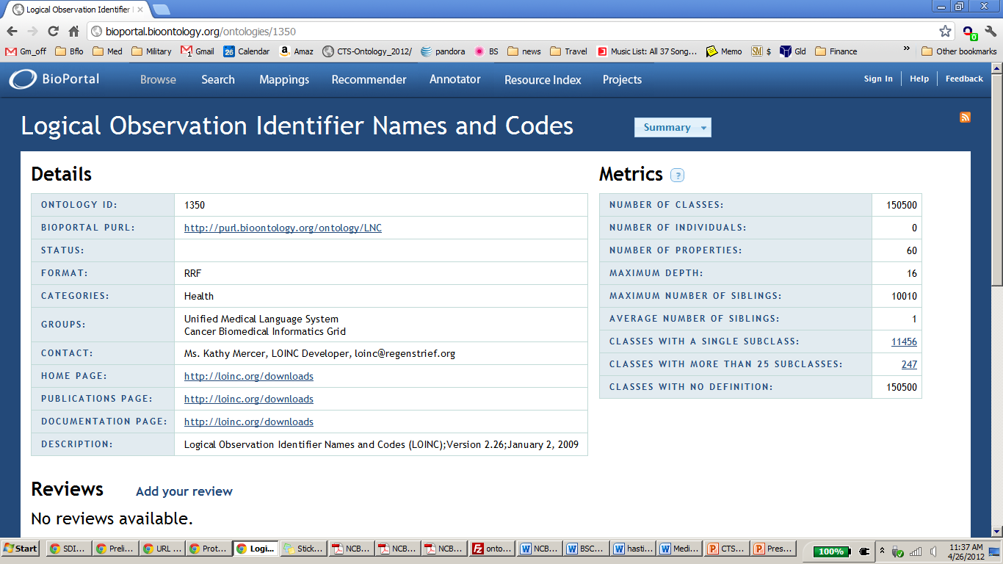

Slide 7
Class II: All NCBC's will use under protest
Literature headings for literature indexing MeSH Virus taxonomy ICTVdb Disease Classification ICD9-CM ICD10 Disease Nomenclature SNOMED CT (longish discussion about international efforts for a "free" SNOMED* Medical Procedures CPT4

Slide 8
Class III: Promising but under construction
Chemical Nomenclature CHEBI Mammalian Phenotype Mammalian Phenotype Ontology Cell types Cell Ontology Functional Genomics Investigation Ontology FuGO Post Translational Modification no standardization RNA Structure Domains RNA Ontology

Slide 9
Class I: All COnTRA-G's endorse
Gene Names and Symbols Human – HGNC Mouse – JAXMGI Drosophila – FlyBase C. elegans – WormBase Yeast – SGD Zebrafish – ZFIN Protein names UNIPROT Primary molecular sequence data IUPAC single letter Genomic sequence coordinates NCBI genome builds Protein Sequences UNIPROT Attributes of Gene Products Gene Ontology Protein Forms, Isoforms and Complexes Protein Ontology (PRO) Cell types Cell Ontology (CL) Chemical Entities of Biomedical Interest CheBI | Taxonomy NCBI taxonomy minus virii Human Anatomy FMA (note that FMA's license is now open, unlike what is on their website) Clinical laboratory observations LOINC Sequence Features SO Protein Sequence Domains InterPro RNA Sequence domains RNAFam Macromolecular Structure Identifiers RCSB Medications used in US RxNorm Protocols, instrumentation, experimental materials, data and analytics Ontology for Biomedical Investigations (OBI) Infectious diseases Infectious Disease

Slide 10
Class II: All COnTRA-G's will use under protest
Literature headings for literature indexing MeSH Virus taxonomy ICTVdb Disease Classification ICD9-CM ICD10 Upper Medical Ontology Ontology for General Medical Science (OGMS) Phenotypic Qualities PATO Adverse Events Adverse Event Reporting Ontology (AERO) | Disease Nomenclature SNOMED CT (longish discussion about international efforts for a "free" SNOMED*) Medical Procedures CPT4 Monogenic Diseases Human Phenotype Ontology Resource Registry eagle-i / Vivo Vaccine Research Vaccine Ontology (VO)

Slide 11
Process: Step 1
All COnTRA-G interested persons list
ontologies they are involved in developing or using
ontologies they know other CTSA persons are developing or using
ontologies they need, or are planning to develop
A portal (Bioportal slice?) is created linking to the above, with a request, widely disseminated, that the contents be kept up to date

Slide 12
Process: Step 2
A candidate set of reference ontologies from this list is identified, which COnTRA-G persons commit to using and improving
Gaps are identified, and the need is announced

