Slide 1
L&C’s LinkBase: a multi-lingual Hub to medical terminologies
Dr. W. Ceusters
Dir R&D
Language & Computing nv

Slide 2
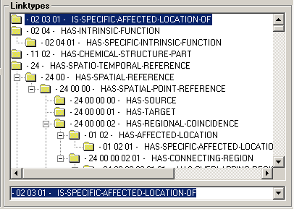
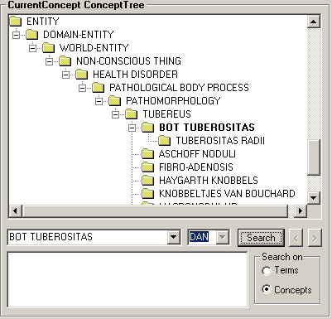
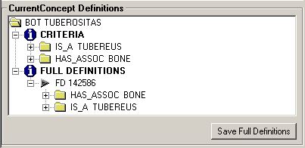
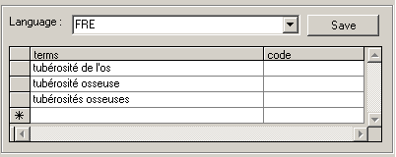
Client Graphical Objects

Slide 3
The L&C Linguistic Concept Database
Language A
Proprietary Terminologies
Language B
Lexicon
Lexicon
Others ...
Grammar
Grammar
ICPC
Formal Domain Ontology
SNOMED
ICD
Cassandra Linguistic Ontology
MEDRA
L
&
C
LinC Base

Slide 4
A formal terminology
Separation of terms and concepts
To be used by machines, not people
All information is explicit in the structure, not implicit in the terms
Clean subsumption hierarchies
Formal, “computable” definitions of concepts
Internal, automated quality control

Slide 5
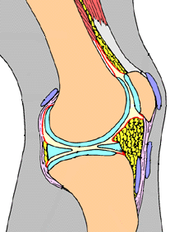
Expl: Joint anatomy
joint HAS-HOLE joint space
joint capsule IS-OUTER-LAYER-OF joint
meniscus
  IS-INCOMPLETE-FILLER-OF joint space
  IS-TOPO-INSIDE joint capsule
  IS-NON-TANGENTIAL-MATERIAL-PART-OF joint
joint
  IS-CONNECTOR-OF bone X
  IS-CONNECTOR-OF bone Y
synovia
  IS-INCOMPLETE-FILLER-OF joint space
synovial membrane IS-BONAFIDE-BOUNDARY-OF joint space

Slide 6
Expl: Relative spatial localisation
HAS-SPATIAL-POINT-REFERENCE
HAS-CONNECTING-REGION
HAS-OVERLAPPING-REGION
IS-SPATIAL-PART-OF
HAS-SPATIAL-PART
HAS-DISCRETED-REGION
HAS-PARTIAL-SPATIAL-OVERLAP
IS-PROPER-SPAT.-PART-OF
HAS-DISCONNECTED-REGION
HAS-PROPER-SPATIAL-PART
IS-PARTLY-IN-CONVEX-HULL-OF
IS-INSIDE-CONVEX-HULL-OF
IS-OUTSIDE-CONVEX-HULL-OF
HAS-EXTERNAL-CONNECTING-REGION
IS-NON-TANG.-SPAT.-PART-OF
IS-TANG.-SPAT.-PART-OF
IS-GEO-INSIDE-OF
IS-TOPO-INSIDE-OF
IS-SPAT.-EQUIV.-OF
HAS-NON-TANG.-SPAT.-PART
HAS-TANG.-SPAT.-PART

Slide 7
L&C’s strong position
Multi-lingual and multi-cultural approach
Modelling independent from specific languages but not from language as communication medium
Proven scalability of our approach
Support at all levels
  Services to migrate existing client dictionairies
  Large tool set for terminology development, maintenance, and/or use
Only company with in-house expertise in medicine, computational linguistics in many languages, formal ontologies and informatics

