Slide 1
Automated Clinical Guideline Systems: A Comparison
Gillian Hubble
MDI 207
6/7/00

Slide 2


Overview
Why clinical guideline systems?
Logic implementation
GLIF vs. EON
Future directions
Notes:
I used the more generic term CDS to introduce the topic, but the original and still central purpose of the systems I am covering was clinical guideline implementation.

Slide 3
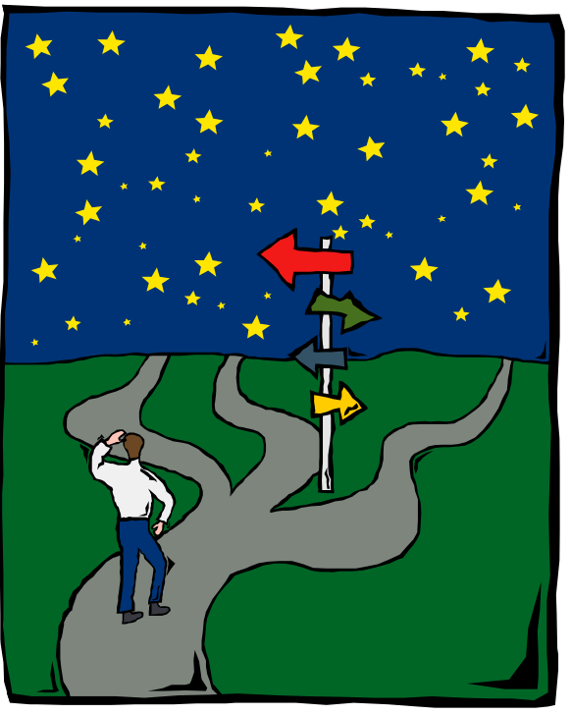
Why Clinical Guideline Systems?
A touchy topic!
Goal = guideline reuse (write once, use many)
New uses:
  “JIT” education
  prediction of performance
    Protocol
    Organization
  modeling for simulation
Notes:
Touchy topic: Reasons guidelines have a limited effect on physician behavior include:
lack of awareness (as high as 84%)
lack of familiarity (at least 10%)
lack of agreement (as high as 91%)
lack of self-efficacy (53-85%)
lack of outcome expectancy/ inertia
inability to recall the relevant portion of the guideline at the point of care [Cabana et al, 1999]
Guidelines authored once (in machine-readable format), meant for use in any number of computerized applications.
Examples: CDSS, workflow automation, referral management, medical education, conducting clinical trials, bioinformatics applications, user-specific documents
P-based care used for:
algorithms for mid-level practitioners
clinical practice guidelines
clinical trial protocols
clinical alerts and reminders
Prediction of performance for proposed guidelines in general or for a specific organization
Modeling of how changing the medical care process will affect the organization and potential problems that might be encountered.

Slide 4


QA in Healthcare
80’s: Measure product quality
  Quality out of control by the time problems are detected
  Example: hospital accreditation
90’s: Control variance in processes
  Manage quality problems as they arise
  Example: protocols and guidelines
2000→: Design work processes and organizations
  Anticipate and manage quality problems before they arise
  Example: reconfigure work processes and/or organization based on what-if scenarios
  Adapted from http://smi-web.stanford.edu/people/tu/talks/99LisbonTalk/
Notes:
Taken from a Stanford presentation, shows simulation use to determine how changing the medical care process will affect the organization and potential problems that might be encountered.

Slide 5

Example Academic Systems
PROforma (UK)
MBTA (MGH)
GEODE-CM (Harvard)
OzCare (Columbia)
GLIF (InterMed Collaboratory)
EON (Stanford)
Notes:
PROforma has been marketed, now sold as a commercial system throughout the UK.

Slide 6
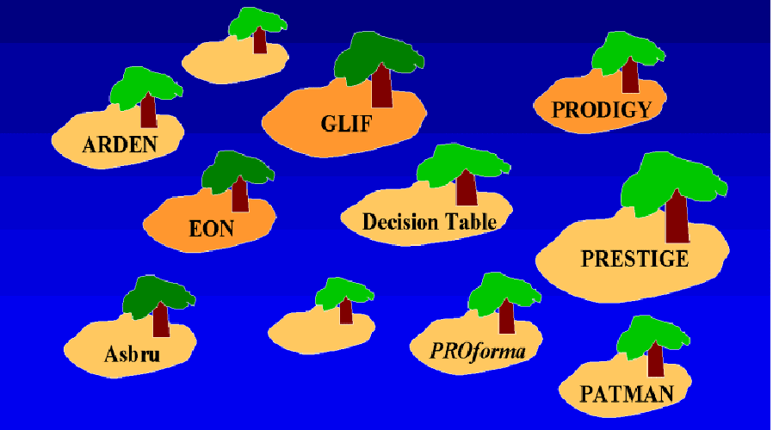
Many Knowledge Representations
From http://smi-web.stanford.edu/people/tu/Talks/99AMIAPanelSlides/sld003.htm

Slide 7
Logic Implementation: Two Camps
Rule-based systems
GLIF is (arguably) the best example
The “lowest common denominator”
ESPR
(Episodic Skeletal Plan Refinement)
Only one system: EON
Complex logic implementation scheme
Reusable systems using qualitative, not quantitative DS methods
Notes:
As scientific knowledge is inconsistent in its adequacy, systems intended for broad reuse must use qualitative methodology (data mining a sufficiently granular data repository for rule discovery would be interesting, as would trying an ANN)

Slide 8

GLIF
A rule-based system
Originally only a knowledge representation format
(meant for guideline interchange…hence the name!)
GLIF model
GLIF syntax
http://www.glif.org

Slide 9
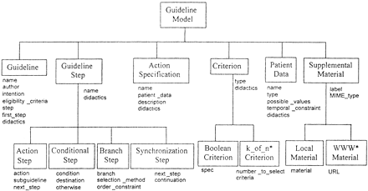
GLIF Model
Notes:
Intention was to create a machine-tractable guideline representation

Slide 10
GLIF Syntax
Guideline Example
{
name = ‘Guideline for vaccine X’;
authors = SEQUENCE 1 (‘Mary Doe, MD’;);
eligibility_criteria = NULL;
intention = ‘Decide whether to recommend the Generic vaccine and at what dosage’;
Steps = SEQUENCE 8 {
(Branch_Step 1); (Action_Step 1); (Action_Step 2); … };
first_step = (Branch_Step 1);
Didactics = SEQUENCE 1 {
(Supplemental_Material 1 {
material = ‘Published guideline does not contain explicit eligibility criteria.’); };
ETC…
From Ohno-Machado et al, 1999
Notes:
The guideline goes on from there to describe each step explicitly, with didactic material for every step.

Slide 11
An Executable System
Guideline authoring tool
Guideline viewing tool
Guideline server (imports, exports guidelines in XML markup)
Free downloads @ http://dsg.harvard.edu/public/software/guideline/
Guideline Engine (any rule-based engine)
Notes:
Now has been extended to a machine executable system
We are planning on using Jess (Java Expert System Shell) which is a Java version of CLIPS

Slide 12
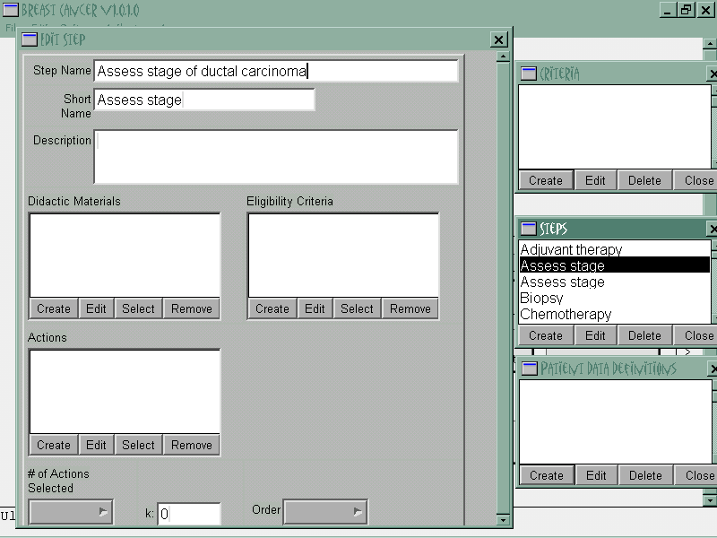
Authoring Tool
Notes:
Both high (GEODE, more familiar to clinicians) and low-level (GLIF, more familiar to knowledge engineers) authoring
Automatic translation from high to low level as much as possible

Slide 13
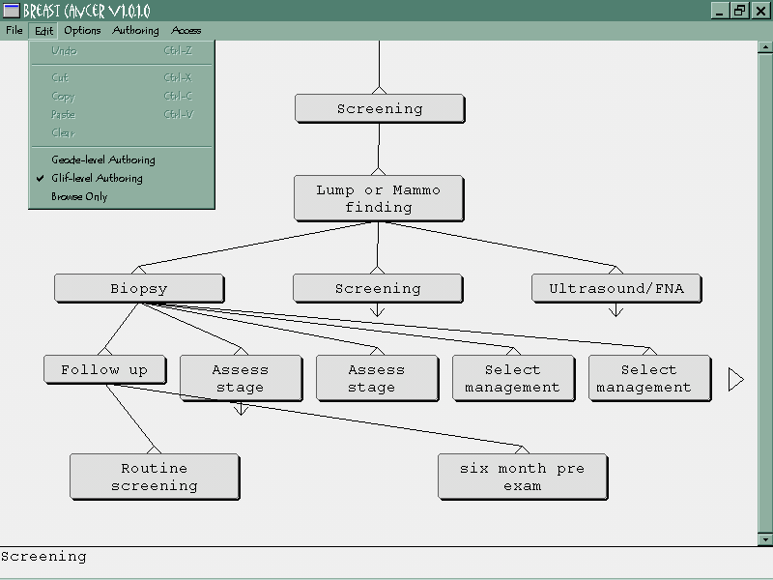
Viewing Tool

Slide 14

EON
Not as straightforward as GLIF!
Developed for protocol-based care
Logic implementation: ESPR
  Linear or non-linear? How does it work??
Used in:
  Breast cancer clinical trial protocols
  AIDS clinic
http://smi.stanford.edu
Notes:
Read many papers on EON, still don’t know how ESPR works

Slide 15
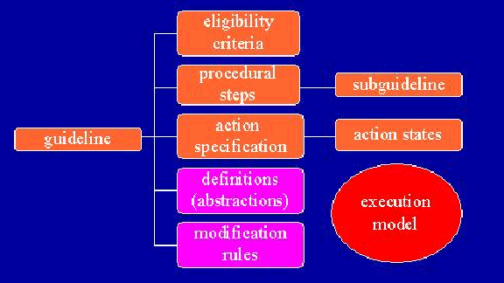
EON Guideline Model

Slide 16
System Architecture
Problem-solving systems
Domain-specific knowledge bases
Temporal abstraction system
Temporal query system

Slide 17
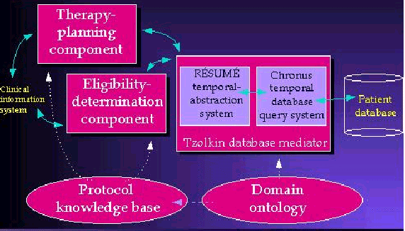
System Architecture

Slide 18
Problem-Solving Components
Problem solving methods
  Eligibility determination
  ESPR: propose plan, identify problem, revise plan
  Many more, and can develop new ones as needed
Protégé knowledge acquisition tool
  Develop domain ontologies
  Use the ontologies to construct domain-specific knowledge bases
Notes:
Problems solved through decomposition: protocol→plans→subtasks→methods etc.
ESPR success depends upon the ontology being represented in minute detail!
(Basically have to develop a SNOMED every time you want decision support)

Slide 19
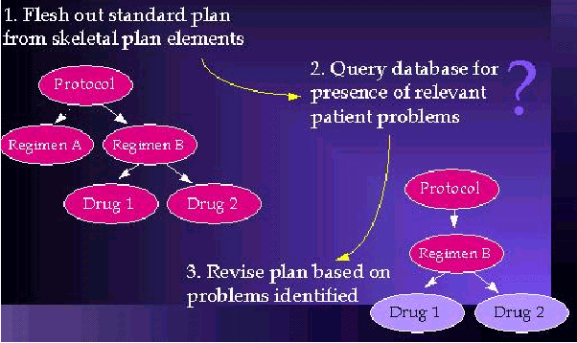
ESPR

Slide 20
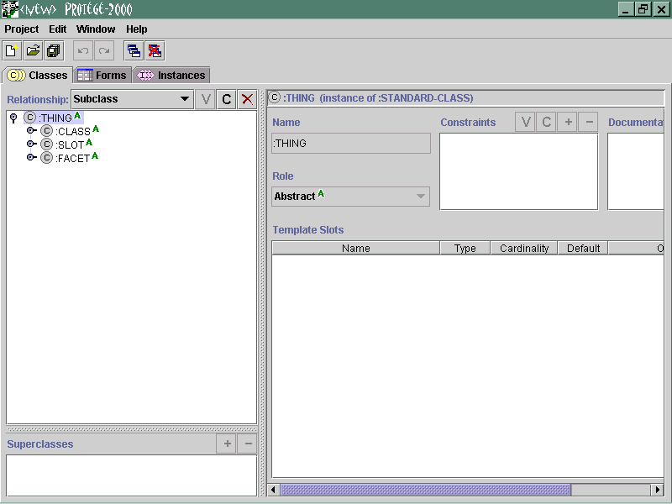
Ontology Editor: Protégé
http://smi-web.stanford.edu/projects/protege/backup/protege-2000/download.html
Notes:
Supposed to be one of the best available ontology editors for beginners.
However, I encourage you to try it and see for yourself…I’ll tell you why in a moment!

Slide 21
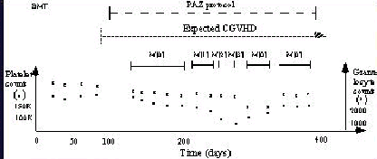
Temporal Abstraction System
Resume: abstracts clinical concepts from data
Abstraction of platelet and granulocyte values into myelotoxicity
Notes:
Myelotoxicity: destruction of the bone marrow
Another example: hemoglobin values→anemia
serum sodium values→hyponatremia

Slide 22

Temporal Query System
Chronus temporal query language
  TimeLine SQL (TLSQL)
  Allows temporal comparisons of time stamps
  Addresses SQL’s lack of expression for intervals (Start Time→Stop Time)
Tzolkin DBMS
  Handles the TLSQL “When” clause
  Allows queries of both primary data and abstractions of the data

Slide 23
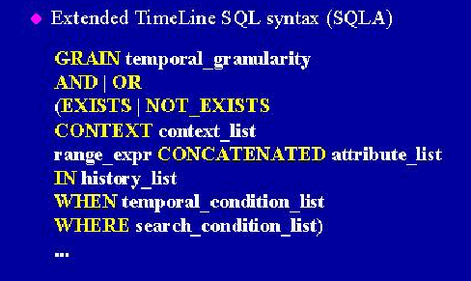
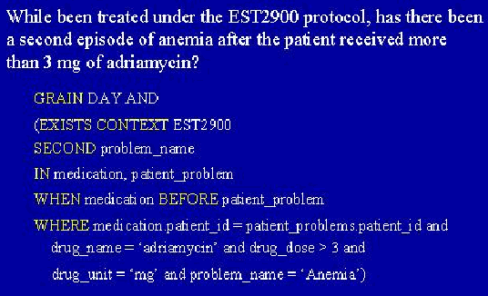
TLSQL Example

Slide 24
Knowledge Representation
Originally Asbru (now??)
  an intention-based language
  “The problem with the unsolicited model of CDSS is that clinician intentions are often misunderstood”
  --Van Bemmel, Handbook of Medical Informatics
Guideline decomposed into a set of plans with names, preferences, intentions, conditions, effects
Example: severe anemia for 2nd consecutive week on chemotherapy protocol
  Protocol: decrease drug dose
  Clinician action: blood transfusion
  No alert generated, as both actions increase the desired parameter by using different mechanisms
Notes:
Apparently it didn’t work very well, because it has been dropped

Slide 25

More Components Recently Added…
Dharma guideline model
Padda guideline execution interface
Yenta eligibility-determination interface
WOZ explanation system
…And it keeps on growing!
Notes:
Plus NeoResume, ChronusII, indecision whether to include Asbru + Dharma…

Slide 26
Assessment
EON
  Strengths
    High degree of functionality
    Expressive (if the author was)
    Responsive?
  Weaknesses
    Monolithic!
    Overly prescriptive for general medical care
    Reusability questionable; difficult to implement
    (The joy of ontology building…)
Notes:
Method of logic implementation a stumbling point as well as an advantage (only as good as the ontology that the author built)

Slide 27

Assessment
GLIF
  Strengths
    Few components, very practical
    Flexible implementation
  Weaknesses
    No domain ontology component
    No plan revision functionality
    Over-simplification of rule-based logic
Notes:
Terminology server may be all that’s necessary

Slide 28

Functionality vs. Practicality
Which system is better suited to rapid guideline development and reuse?
  GLIF
    Standard development began 1994
    Used in 4 projects so far
  EON
    Began development in 1988
    Used in 2 projects (not well described)
    Not “author friendly” by a long stretch
    May be better for modeling/simulation
Why haven’t any “biopsychosocial”aspects of these systems been published?
Notes:
GLIF: Guideline decision support applications (2)
Educational application testing knowledge of GL recommendations
Referral management

Slide 29

Current and Future Projects
Working with GLIF model
Proposal submitted
  Develop an automated A&R system for preventive care
Ongoing project
  Develop a potentially machine-tractable referral guideline DTD mapped to the GLIF DTD
  Web-based system with on-the-fly algorithm generation and XML-based documents for providers
Future: explore potential inclusion of AI method for conditions of uncertainty
Notes:
Of course, this being UCDHS, we’re pursuing goals from the 90’s! No HIS to work with.
System will include interface with a terminology server

Slide 30

The End

