Slide 1
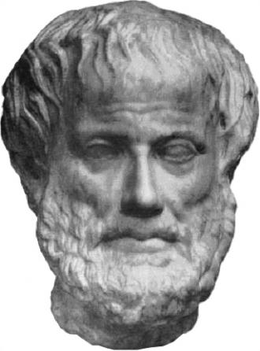
Development of the Field of Biomedical Ontology
Barry Smith
New York State Center of Excellence in Bioinformatics and Life Sciences
University at Buffalo

Slide 2
Biomedical Ontology Timeline
1990: Human Genome Project
1999: The Gene Ontology (GO)
2005: The Open Biomedical Ontologies
(OBO) Foundry
2010: Ontology for General Medical
Science
2011? an OBO Foundry for Dental and Oral
Biology Research

Slide 3
Goals of this ODR
to advance the quality and consistency of the data that is collected and used by the dental research community
to enhance the degree to which such data are integrated with data deriving from other fields of clinical and translational research.

Slide 4
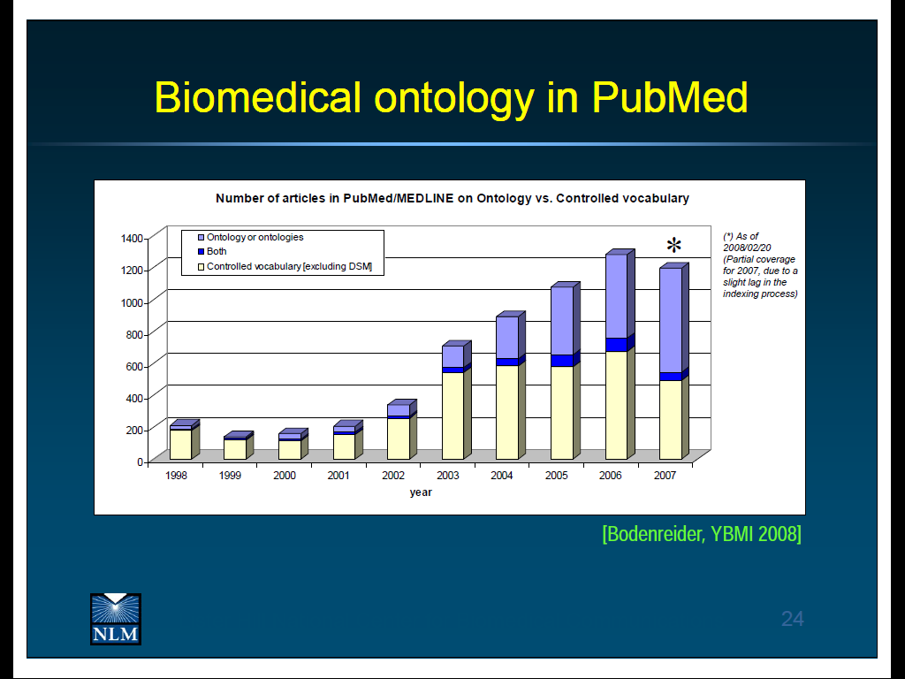
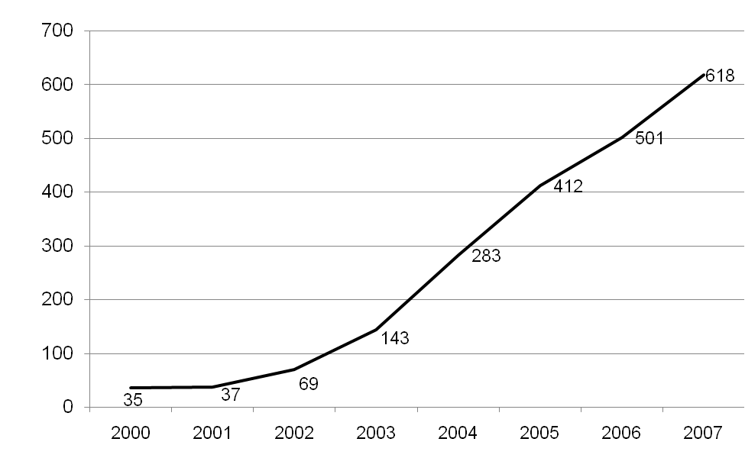
Uses of ‘ontology’ in PubMed abstracts

Slide 6
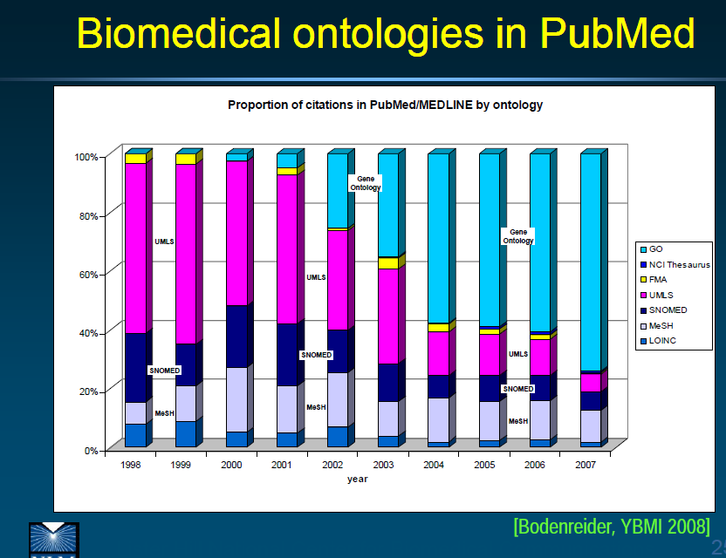
By far the most successful: GO (Gene Ontology)

Slide 7
The GO is a controlled vocabulary for use in annotating data
multi-species, multi-disciplinary, open source
contributing to the cumulativity of scientific results obtained by distinct research communities
compare use of kilograms, meters, seconds … in formulating experimental results

Slide 8
GO provides answers to three types of questions:
for each gene product (protein ...)
in what parts of the cell has it been identified?
exercising what types of molecular functions?
with what types of biological processes?

Slide 9
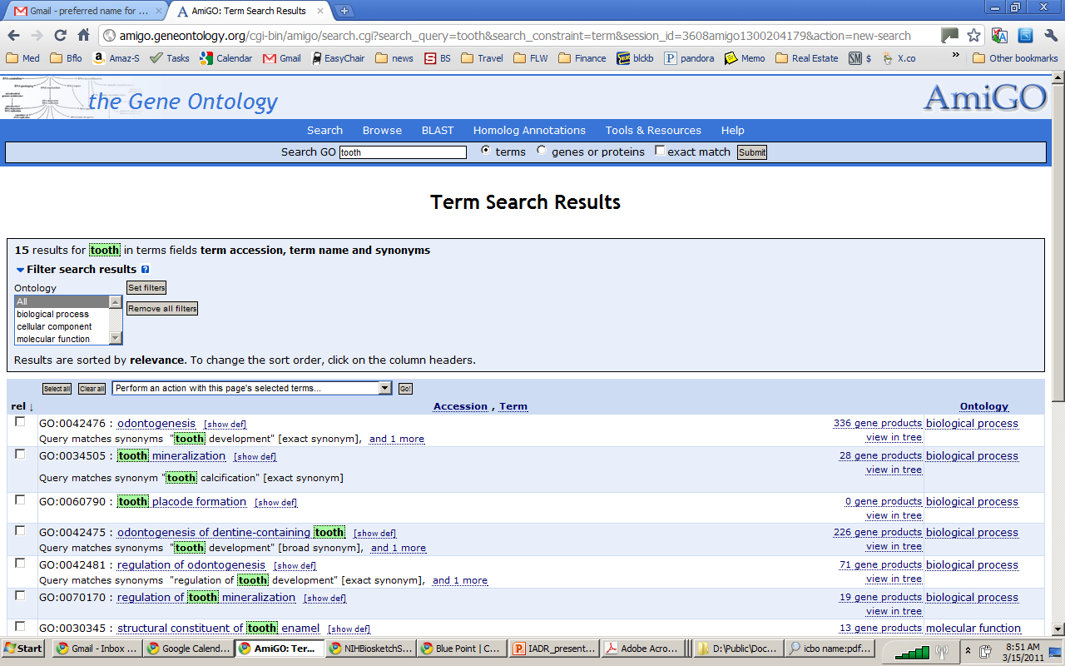

Slide 11
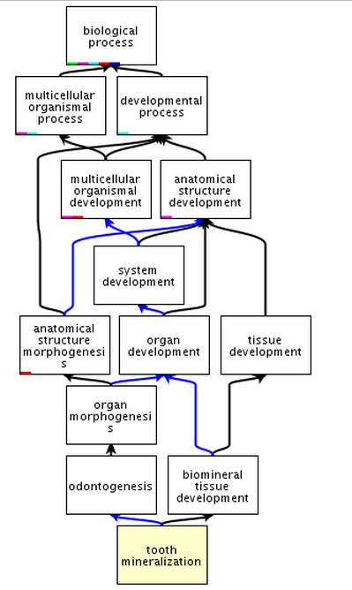
= part_of
= subtype_of
28 Gene Product
Associations

Slide 12
$100 mill. invested in literature curation using GO
over 11 million annotations relating gene products described in the UniProt, Ensembl and other databases to terms in the GO
ontologies provide the basis for capturing biological theories in computable form
in contrast to terminologies and thesauri

Slide 13
A new kind of biological research based on analysis and comparison of the massive quantities of annotations linking ontology terms to raw data, including genomic data, clinical data, public health data What 10 years ago took multiple groups of researchers months of data comparison effort, can now be performed in milliseconds

Slide 14
A new kind of Electronic Health Record resting on the use of the same (public domain) ontologies in mapping proprietary EHR vocabularies to yield patient data annotated in consistent ways that support
integrated care and continuity of care
comparison and integration for diagnosis and meta-analysis
secondary uses for research

Slide 15
The GO covers only generic (‘normal’) biological entities of three sorts:
cellular components
molecular functions
biological processes
It does not provide representations of diseases, symptoms, genetic abnormalities …
How to extend the GO methodology to other domains of biology and medicine?

Slide 16
RELATION TO TIME GRANULARITY | CONTINUANT |  |  |  | OCCURRENT
 | INDEPENDENT |  | DEPENDENT
ORGAN AND ORGANISM | Organism (NCBI Taxonomy) | Anatomical Entity (FMA, CARO) | Organ Function (FMP, CPRO) | Phenotypic Quality (PaTO) | Biological Process (GO)
CELL AND CELLULAR COMPONENT | Cell (CL) | Cellular Component (FMA, GO) | Cellular Function (GO)
MOLECULE | Molecule (ChEBI, SO, RnaO, PrO) |  | Molecular Function (GO) |  | Molecular Process (GO)
The Open Biomedical Ontologies (OBO) Foundry

Slide 17
OBO Foundry ontologies
all follow the same principles to ensure interoperability
GO Gene Ontology
ChEBI Chemical Ontology
PRO Protein Ontology
CL Cell Ontology
...
OGMS Ontology for General Medical Science

Slide 18
OGMS
Ontology for General Medical Science
http://code.google.com/p/ogms/

Slide 19
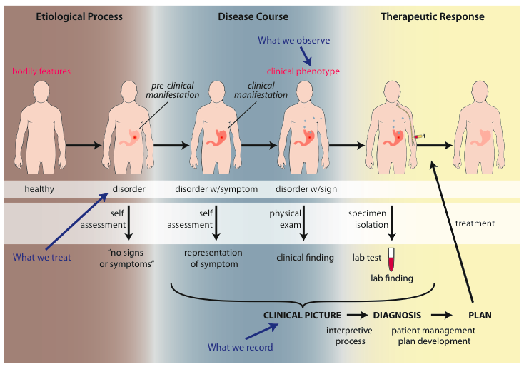
OGMS: The Big Picture

Slide 20
Influenza - infectious
Etiological process - infection of airway epithelial cells with influenza virus
produces
Disorder - viable cells with influenza virus
bears
Disposition (disease) - flu
realized_in
Pathological process - acute inflammation
produces
Abnormal bodily features
recognized_as
Symptoms - weakness, dizziness
Signs - fever
Symptoms & Signs
used_in
Interpretive process
produces
Hypothesis - rule out influenza
suggests
Laboratory tests
produces
Test results - elevated serum antibody titers
used_in
Interpretive process
produces
Result - diagnosis that patient X has a disorder that bears the disease flu

Slide 21
Huntington’s Disease - genetic
Etiological process - inheritance of >39 CAG repeats in the HTT gene
produces
Disorder - chromosome 4 with abnormal mHTT
bears
Disposition (disease) - Huntington’s disease
realized_in
Pathological process - accumulation of mHTT protein fragments, abnormal transcription regulation, neuronal cell death in striatum
produces
Abnormal bodily features
recognized_as
Symptoms - anxiety, depression
Signs - difficulties in speaking and swallowing
Symptoms & Signs
used_in
Interpretive process
produces
Hypothesis - rule out Huntington’s
suggests
Laboratory tests
produces
Test results - molecular detection of the HTT gene with >39CAG repeats
used_in
Interpretive process
produces
Result - diagnosis that patient X has a disorder that bears the disease Huntington’s disease

Slide 22
HNPCC - genetic pre-disposition
Etiological process - inheritance of a mutant mismatch repair gene
produces
Disorder - chromosome 3 with abnormal hMLH1
bears
Disposition (disease) - Lynch syndrome
realized_in
Pathological process - abnormal repair of DNA mismatches
produces
Disorder - mutations in proto-oncogenes and tumor suppressor genes with microsatellite repeats (e.g. TGF-beta R2)
bears
Disposition (disease) - non-polyposis colon cancer

Slide 23
Cirrhosis - environmental exposure
Etiological process - phenobarbitol-induced hepatic cell death
produces
Disorder - necrotic liver
bears
Disposition (disease) - cirrhosis
realized_in
Pathological process - abnormal tissue repair with cell proliferation and fibrosis that exceed a certain threshold; hypoxia-induced cell death
produces
Abnormal bodily features
recognized_as
Symptoms - fatigue, anorexia
Signs - jaundice, splenomegaly
Symptoms & Signs
used_in
Interpretive process
produces
Hypothesis - rule out cirrhosis
suggests
Laboratory tests
produces
Test results - elevated liver enzymes in serum
used_in
Interpretive process
produces
Result - diagnosis that patient X has a disorder that bears the disease cirrhosis

Slide 24
Systemic arterial hypertension
Etiological process – abnormal reabsorption of NaCl by the kidney
produces
Disorder – abnormally large scattered molecular aggregate of salt in the blood
bears
Disposition (disease) - hypertension
realized_in
Pathological process – exertion of abnormal pressure against arterial wall
produces
Abnormal bodily features
recognized_as
Symptoms -
Signs – elevated blood pressure
Symptoms & Signs
used_in
Interpretive process
produces
Hypothesis - rule out hypertension
suggests
Laboratory tests
produces
Test results -
used_in
Interpretive process
produces
Result - diagnosis that patient X has a disorder that bears the disease hypertension

Slide 25
Type 2 Diabetes Mellitus
Etiological process –
produces
Disorder – abnormal pancreatic beta cells and abnormal muscle/fat cells
bears
Disposition (disease) – diabetes mellitus
realized_in
Pathological processes – diminished insulin production , diminished muscle/fat uptake of glucose
produces
Abnormal bodily features
recognized_as
Symptoms – polydipsia, polyuria, polyphagia, blurred vision
Signs – elevated blood glucose and hemoglobin A1c
Symptoms & Signs
used_in
Interpretive process
produces
Hypothesis - rule out diabetes mellitus
suggests
Laboratory tests – fasting serum blood glucose, oral glucose challenge test, and/or blood hemoglobin A1c
produces
Test results -
used_in
Interpretive process
produces
Result - diagnosis that patient X has a disorder that bears the disease type 2 diabetes mellitus

Slide 26
Type 1 hypersensitivity to penicillin
Etiological process – sensitizing of mast cells and basophils during exposure to penicillin-class substance
produces
Disorder – mast cells and basophils with epitope-specific IgE bound to Fc epsilon receptor I
bears
Disposition (disease) – type I hypersensitivity
realized_in
Pathological process – type I hypersensitivity reaction
produces
Abnormal bodily features
recognized_as
Symptoms – pruritis, shortness of breath
Signs – rash, urticaria, anaphylaxis
Symptoms & Signs
used_in
Interpretive process
produces
Hypothesis -
suggests
Laboratory tests –
produces
Test results – occasionally, skin testing
used_in
Interpretive process
produces
Result - diagnosis that patient X has a disorder that bears the disease type 1 hypersensitivity to penicillin

Slide 27
ODR will draw on OGMS, PRO and other OBO Foundry ontologies relevant to oral health and disease. It will comprehend purpose-built ontologies such as Orofacial Pain Ontology Dental Anatomy Ontology Saliva Ontology (SALO) Oral Pathology Ontology and ontologies created by groups in Pittsburgh, Seoul, and elsewhere

Slide 28
Important features of ODR include: ▪▪ It will be built to work with the GO and with other high quality ontologies developed by the biomedical community, following best practices identified through 10 years of testing ▪ It will be built with terms used by dental researchers and it will be created and managed by the dental research community itself.

Slide 29
For an ontology to succeed,
potential users should be incentived to use it,
it should be populated using the terms that they need and using definitions that conform to their understanding of these terms
it should be easily correctable in light of new research discoveries
it should enable the data annotated in its terms to be easily integrated with legacy data from related fields
it should be easily extendable to new kinds of data.

Slide 30
The ODR will benefit the research community in a number of ways: It willl work well with existing ontologies in relevant areas of clinical and translational science, and thus allowsing dental research data to be easily integrated with other kinds of data. It provides a pre-tested and well-defined set of terms, selections from which can be used in the design of new databases in the future.

Slide 31
NIH Mandates for Data Sharing
Organizations such as the NIH now require use of common standards in a way that will ensure that the results obtained through funded research are more easily accessible to external groups.
ODR will be created in such a way that its use will address the new NIH mandates. It will designed also to allow information presented in its terms to be usable in satisfying other regulatory purposes—such as submissions to FDA.

Slide 32
Goals of Oral Health and Disease Ontology
Facilitate communication between and among Clinicians
Researchers
Policymakers (WHO, legislators, insurers)
Regulatory bodies
Industry
Informaticians and software developers
Educators
To support most effective use of
Research data
Clinical data, including electronic health records
Educational materials

Slide 33
Scope of Ontology in Oral health and disease
Practice
Diagnostics
Practices
Surgery, Pathology, Radiology, Reconstruction…
Instruments and Devices
Anesthesia and Medication
Mechanism
Saliva (disorders, functions, constitution)
Microbiome constitution and function
Bone and tissue development
Immunology
Correlates
Medical history
Bio samples
Vitals
Demographics

Slide 34
Scope of Ontology in Oral health and disease
Clinical and educational management
Treatment planning
Operatory organization
Patient visits
Roles, capabilities, responsibilities
Disease and disorder
Cancers
Pain disorders
Congenital anomalies
Infectious disease
Immune disfunction
Public health
Clinical trials, trial recruitment
General medical surveillance
Infectious disease monitoring
Epidemiology

Slide 35
Scope of Ontology in Oral health and disease
Research and discovery
Omics and assay development
Biomarker discovery
Materials research
Imaging
Sampling techniques
Translational research can be enabled by fluid use of information across these activities and perspectives, which despite different focus overlap in subject matter.
If we develop a suite of ontologies and use them to organize data across activities, we make it possible to reliably use information from each together.

Slide 36
The use of ODR to describe data will be entirely voluntary. However, we anticipate that over time more and more researchers will see the value of employing a common resource both in annotating their data and, progressively, in designing new databases in which to capture their research results.

Slide 37
Questions
What shall the thing be called?
Who should be invited to join/form the consortium?

