Slide 1
Why are ontologies needed to achieve EHR interoperability?
Barry Smith
http://ontology.buffalo.edu/smith

Slide 2
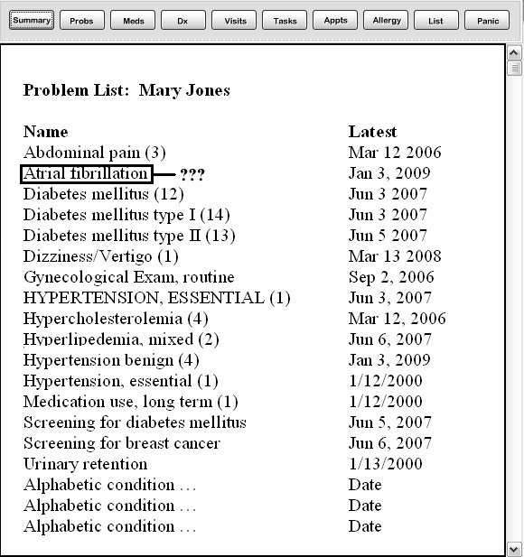

Sample problem presentation page generated via autopopulation in an EHR

Slide 3
from:
Are Health IT designers, testers and purchasers trying to kill people? by Scot M. Silverstein
http://tiny.cc/CKIW1

Slide 4
Problem List for Mary Jones

Slide 5
Problem List for Mary Jones
“This entry was auto-populated when a nurse ordered a blood clotting test and erroneously entered the reason for the test as ‘atrial fibrillation’ (a common reason, just not the case here) to expedite the order's completion. … I am told it takes going back to the vendor to have this erroneous entry permanently removed. …”

Slide 6
The Data Model That Nearly Killed Me by Joe Bugajski http://tiny.cc/S1HWo
“If data cannot be made reliably available across silos in a single EHR, then this data cannot be made reliably available to a huge, heterogeneous collection of networked systems.”

Slide 7
Redundant, Alphabetical Problem List for Mary Jones

Slide 8
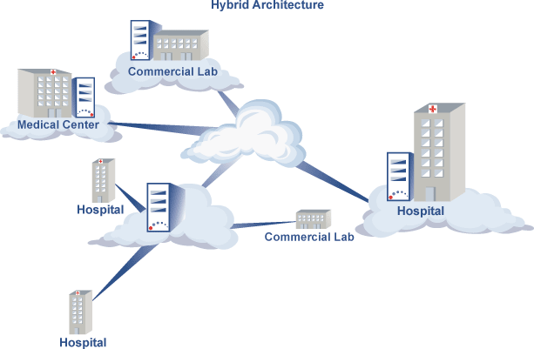
with thanks to http://dbmotion.com

Slide 9
f
f
f
f
f
f
synchronic and diachronic problems of
semantic interoperability
(across space and across time)

Slide 10
f
f
f
snapshot of patient’s condition
f
EHR 1
EHR 2
f
f
link EHR 1 to EHR 2 in a reliable, trustworthy,
useful way, through a snapshot of the patient’s
condition which both systems can understand

Slide 11
f
f
f
snapshot of patient’s condition
f
EHR 1
EHR 2
f
f
but how to formulate this snapshot?

Slide 12
UMLS (or any other bundle of overlapping terminologies) cannot solve the problem
UMLS
EHR 1
EHR 2

Slide 13
f
f
f
snapshot of patient’s condition
f
EHR 1
EHR 2
f
f
CCR/CDD is able to solve the problem on a case by case basis (e.g. with Microsoft Healthvault)

Slide 14
f
f
f
snapshot of patient’s condition
f
EHR 1
EHR 2
f
f
but what can serve as constraint to ensure generalizability?

Slide 15
f
f
f
snapshot of patient’s condition
f
EHR 1
EHR 2
f
f
in any case CDA/CDD will require content provided through (something like) SNOMED CT codes

Slide 16
f
f
f
snapshot of patient’s condition
f
EHR 1
EHR 2
f
fan
and SNOMED CT cannot solve the problem
because it has too much redundancy

Slide 17
SNCT 40613008: Open fracture of nasal bones (disorder)
is_a
Fractured nasal bones (disorder)
Open fracture of facial bones (disorder)
Open fracture of skull (disorder)
Open wound of nose (disorder)

Slide 18
How to remove the redundancy from SNOMED-CT
By using Basic Formal Ontology (BFO)
Ceusters W, Smith B et al. Ontology-based error detection in SNOMED-CT.
Proc. Medinfo 2004.

Slide 19
SNOMED CT has:
Open fracture of nasal bones (disorder)
is_a Fractured nasal bones (disorder)
But nasal bones are not a fracture
(A nasal bone is an independent continuant; a fracture is a dependent continuant)

Slide 20

European patients
Smart open services

Slide 21
Goal
to develop a practical eHealth framework and an ICT infrastructure that will enable secure access to patient health information, particularly with respect to basic patient summaries and ePrescriptions between different European healthcare systems.

Slide 22
To achieve this goal, the national entities cooperating within epSOS test basic patient summary and ePrescription services in pilot applications, which interconnect national solutions.

Slide 23
Issues
liability, audit trail, authentication, authority, access, workflow, billing, procedures, patient safety
translation: n² vs. 2n

Slide 24
n = 8
64 vs. 16 mappings

Slide 25
SNOMED-CT will not quite work here, yet, either
SNOMED
EN
DE

Slide 26
ICD, then?
Will ICD solve the n² mapping problem?
ICD
EN
DE

Slide 27
epSOS Demonstrator Project
Focusing on emergency dataset
Patient is unconscious, …
Urgent need for a small amount of information about the patient to be rapidly accessible to and reliably interpreted by the healthcare provider

Slide 28
Items needed
1. Term lists from each project country
2. Shared reference ontology to support automatic translation and evolution over time
3. Summary shapshots / screenshots, one for each country (a template, to be filled in using terms taken from the term lists)
Demonstrator: all three elements need to be tested

Slide 29
1. Creating a very small term list
consisting of the statistically most frequently used terms in all project languages
They are organized into classes and subclasses under major headings such as:
  allergies
      medications
      clinical problems

Slide 30
Coverage
The goal is to find terms which, in total, cover some 90% of all relevant cases in each of the dimensions distinguished – focusing on those terms relating to features likely to be of relevance to cross-border healthcare.
Thus, focus exclusively on those features on the side of the patient relevant to emergency care – not e.g. on healthcare transactions

Slide 31
Focus is on very simple terms
with precise, context-free meanings
no associations to tables, country-specific acronyms, tests, organizations, …

Slide 32
2. Shared reference ontology
language-neutral codes to which the terms in the term lists will be mapped
over time, its use will create a basis for statistical associations resting on the fact that information about single patients is gathered in multiple countries
these statistical associations can be used to validate translations

Slide 33
The system will provide support for cross-border health IT
  patient-centric basis for more comprehensive mappings between healthcare information systems in different countries, e.g. for:
  biodefense and biosurveillance ...
  interface to decision support tools (drug contraindications, ...)

Slide 34
Syntactic and semantic interoperability
Syntactic interoperability = systems can exchange messages (realized by XML).
Semantic interoperability = messages are interpreted in the same way by senders and receivers.
Round-trip mapping to the reference ontology can be based on published standards and on use of multi-lingual medical dictionaries
Meaning-preserving accuracy must be verified by human experts and by testing in use

Slide 35
3. Creating a snapshot
to create a snapshot of the health situation of the patient to be used while traveling, based on term list for language of the host country (A)
to translate this snapshot into a snapshot using terms from the term list in the language of the target country (B)
to evaluate the result in language B: can the healthcare provider read and make reliable use of the snapshot in speeding up provision of urgent care?

Slide 36
The proximate goal of the snapshot
to provide an emergency practitioner in country B with a quick overview of relevant features of the condition of the patient visiting from country A.

Slide 37
Snapshot elements
alerts
allergies
adverse events
current problems
implanted devices
vaccination
medication
diagnosis
recommendations

Slide 38
A strategy of self-learning
Creating the set of language-specific term lists and snapshot templates will be an iterative process
as translations are corrected and the summary enhanced in format and scope and take account of specific conditions in specific project countries
at every stage there will be a need for constant evaluation and update

Slide 39
Facility to ensure constant growth
Software will allow creation of patient snapshots via drop-down lists followed by an additional request:
  Name other allergies [etc.] from which this patient suffers and which you believe may be of relevance in case of need for urgent care.
Entries under this heading will be collected and used as basis for extensions of the system in the reference ontology and in the separate term lists.

Slide 40
What do we mean by ‘small‘ ?
  English SNOMED-CT currently consists of some 357,000 ‘concepts‘
  When measured by these standards, any approach to our problem will be ‘small‘; i.e. there will be patients with salient conditions, or rarely prescribed drugs, which cannot be described using the terms available.

Slide 41
Why a common reference ontology is necessary
As each national term list grows, how will we otherwise maintain coherent extensibility while ensuring continued harmonization?
How will we counteract ever greater fragility of mappings as the system expands?

Slide 42
Examples of snapshot elements
alerts
allergies
adverse events
current problems
implanted devices
vaccination
medication
diagnosis
recommendations

