Slide 1
The Mouth
Barry Smith http://ontology.buffalo.edu/smith

Slide 2
Preamble:
Biomedical Ontology in Buffalo

Slide 3
ORG
Ontology Research Group
Werner Ceusters
Lou Goldberg
Barry Smith

Slide 4
NCBO
National Center for Biomedical Ontology
  Stanford Medical Informatics
  Cambridge University Department of Genetics
  Berkeley National Laboratories
  Mayo Clinic
  San Francisco Medical Center
  University of Oregon Institute of Neuroscience
  UB Department of Philosophy

Slide 5
OBO
Open Biological Ontologies Consortium
GO (Gene Ontology)
FuGO (Functional Genomics
Investigation Ontology)
Phenotype Ontology
Sequence Ontology
Cell Ontology
Mouse Anatomy Ontology

Slide 6
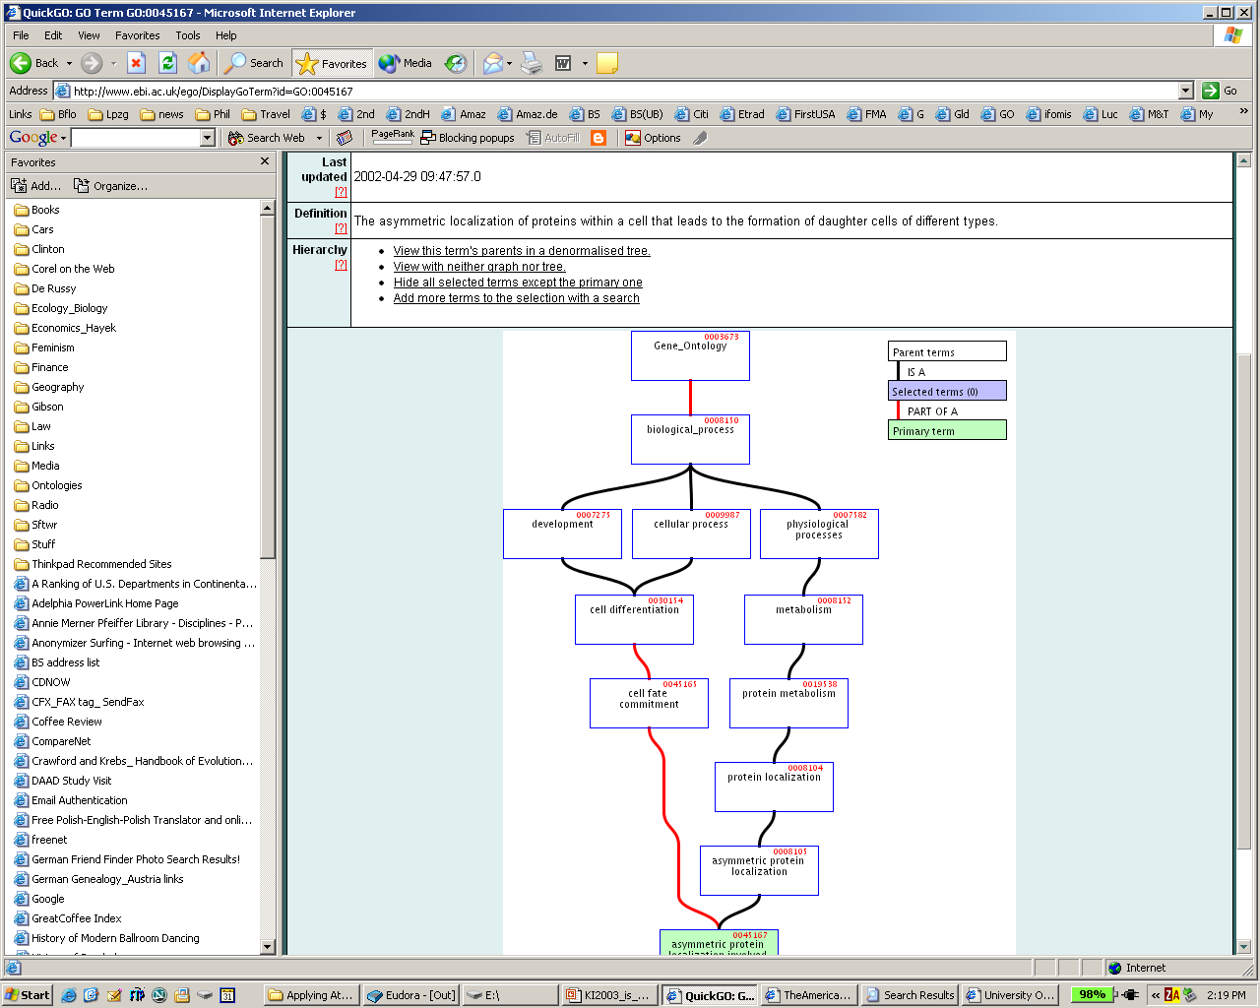
GO: asymmetric protein localization involved in cell fate commitment

Slide 7
Anatomical Space
Anatomical
Structure
is_a
Organ Cavity
Subdivision
Organ
Cavity
Organ
Organ Part
Serous Sac
Cavity
Subdivision
Serous Sac
Cavity
Serous Sac
Organ
Component
Organ
Subdivision
Tissue
Pleural Sac
Pleura(Wall
of Sac)
Pleural
Cavity
part_of
Parietal
Pleura
Visceral
Pleura
Interlobar
recess
Mediastinal
Pleura
Mesothelium
of Pleura

Slide 8
OBO
OBO Relation Ontology
OBO-UBO (Upper Biomedical Ontology)
From controlled vocabulary to reasoning tool
From single granularity to cross-granularity
From single-study to all biological experiments and all clinical trials
Smith B et al. Relations in biomedical ontologies. Genome Biology 2005, 6:R46

Slide 9
NIH Ontology Efforts
NCBO / NCBC Roadmap Centers
caBIG – NCI Thesaurus – Pre-NCIT
NECTAR (National Electronics Clinical Trials and Research Network)
BIRN (Biomedical Informatics Research Network)

Slide 10
BIRN Ontology Workshop (NIH)
Stanford, February 28-March 1
NIAID Immunology Ontology Workshop (NIH)
Gaithersburg, March 21-22 2006
Image Ontology Workshop
Stanford, March 24-25 2006
Gene Ontology Workshop
St. Croix, March 31-April 3 2006
Training Course in Biomedical Ontology
Dagstuhl, Germany, May 21-24 2006
Anatomy Ontology Workshop
Seattle, September 8-9 2006
Disease Ontology Workshop
Baltimore, November 6-7 2006
Interoperability of Biomedical Ontologies
Dagstuhl, Germany, March 27-30 2007

Slide 11
The Mouth

Slide 12
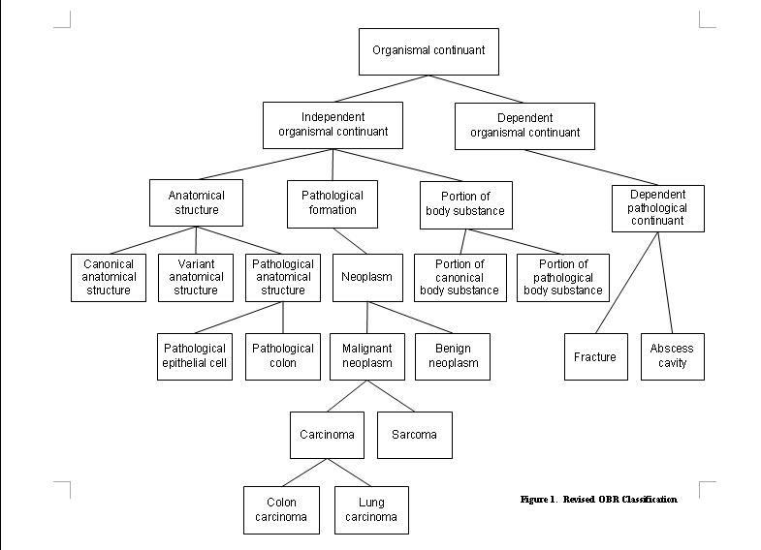
OBO-UBO

Slide 13
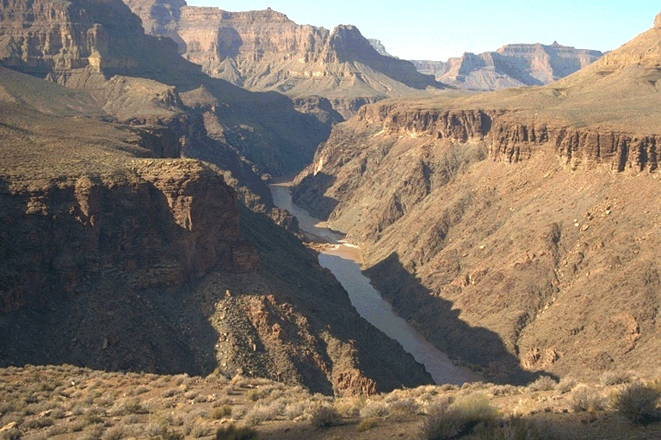
Places are holes
Notes:
Inner Gorge, Colorado River, Granite Rapids, looking west from Tonto Trail just west of Salt Creek
http//www.kaibab.org/gc/images/img0072.jpg

Slide 14
A hole in the ground
Solid physical boundaries at the floor and walls
but with a fiat lid:
hole

Slide 15
Holes involve two kinds of boundaries
bona fide boundaries which exist independently of our demarcating acts
fiat boundaries which exist only because we put them there

Slide 16
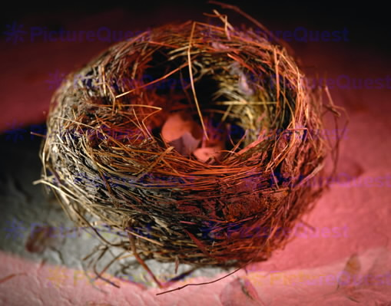
niches, environments are holes

Slide 17

Armchair Ontology

Slide 18
Positive and negative parts
negative
part
or hole
(not made
of matter)
positive
part
(made of matter)

Slide 19
niches, environments are holes

Slide 20
environment place niche habitat setting hole spatial region interior

Slide 21
Ecological Niche Concepts
niche as particular place or subdivision of an environment that an organism or population occupies
vs.
niche as function of an organism or population within an ecological community

Slide 22
Elton
the ‘niche’ of an animal means
its place in the biotic environment, its relations to food and enemies. [...]
When an ecologist says ‘there goes a badger’ he should include in his thoughts some definite idea of the animal’s place in the community to which it belongs,
just as if he had said ‘there goes the vicar’ (Elton 1927, pp. 63f.)

Slide 23
The Niche as Hypervolume
foliage density
humidity
temperature

Slide 24
The Niche as Hypervolume
foliage density
humidity
temperature

Slide 25
The Niche as Hypervolume
foliage density
humidity
temperature

Slide 26
The Niche as Hypervolume
foliage density
humidity
temperature

Slide 27
Hypervolume niche is a location in an attribute space
defined by a specific constellation of environmental variables such as degree of slope, exposure to sunlight, soil fertility, foliage density...
… John found his niche as a mid-level accounts manager in a small-town bank …

Slide 28
But every hypervolume niche must be realized in some specific spatial location
Niche type must be tokenized in space
Your mouth is a tokenized niche (or perhaps a constantly changing sum of tokenizations of different niche types)
→ niche topology:
Smith B, Varzi AC, The niche, Nous, 1999;33:198–222.

Slide 29
J. J. Gibson’s theory of surface layout
systems of barriers, doors, pathways to which the behavior of organisms of given types is specifically attuned,
temperature gradients, patterns of movement of air or water molecules or bacteria

Slide 30
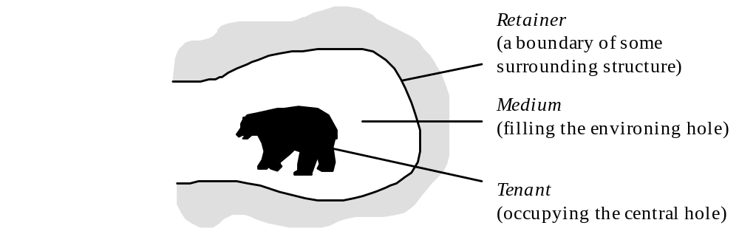
Double Hole Structure

Slide 31
The Structure of Niches
media and retainers
the medium of the bear’s niche is a
circumscribed body of air

Slide 32
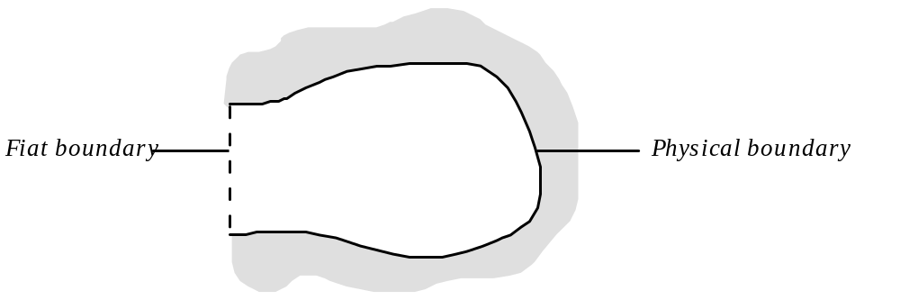
Two Types of Boundary

Slide 33
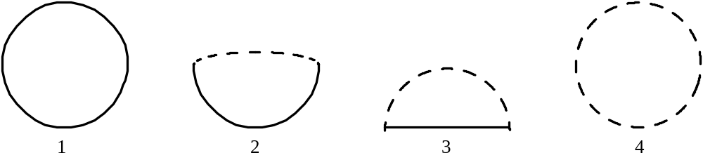
Four Basic Niche Types
1: a womb;
2: a snail’s shell;
3: the niche of a pasturing cow;
4: the niche around a buzzard

Slide 34
Types of Niches
a pond, a nest, a cave, a hut, an air-conditioned apartment building
the history of evolution as a history of the development of niches

Slide 35
Four Basic Niche Types
1: a house;
2: a snail’s shell;
3: the niche of a pasturing cow;
4: the earth’s atmosphere

Slide 36
stationary niches
1: your office when the door is closed; 2: a rabbit hole; 3: a seat at Yankee stadium; 4: the Klingon Empire

Slide 37
Four Basic Niche Types
1: a womb;
2: a snail’s shell;
3: the niche of a pasturing cow;
4: the niche around a buzzard

Slide 38
all vacant niches must have a retainer
generic dependence of niche on tenant(s)

Slide 39
Niche Construction
Lewontin: niches normally arise in symbiosis with the activities of organisms or groups of organisms;
they are not already there, like vacant rooms in a gigantic evolutionary hotel, awaiting organisms who would evolve into them.
“ecosystem engineering”
maintenance of niches (screwdrivers, paintings)

Slide 40
niches on different levels of the food chain
a. at the bottom of the hiearchy is the saprophytic chain, in which micro-organisms live on dead organic matter;
b. above this is the primary relation between animals and the plants they consume;
c. above this is the predator chain, in which animals of one sort eat smaller animals of another sort;
d. crosscutting all of these is the parasite chain, in which a smaller organism consumes part of a larger host organism.

Slide 41
Token Science
selection theory is concerned with phenomena at the level of populations; it is ‘concerned with what properties are selected for and against in a population.
We do not describe single organisms and their physical constituents one by one.’
genotypes vs. genotokens
niche theory and set theory

Slide 42
Fiat Boundaries
fish and bird niches as volumes of space
demarcatory vs. behavioral fiat boundaries

Slide 43
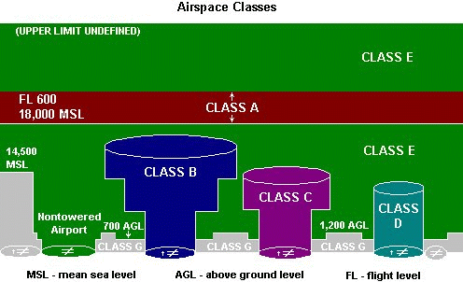
Varieties of Controlled Airspace

Slide 44
Apertures, Mouths, and Sphincters
security vs. freedom of movement
plants
barnacles and snails
fish and birds
skin or hide

Slide 45
Security vs. Freedom
the mouth of the bear, the mouth of the bear’s cave, the threshold of your office
freedom of movement and fiat boundaries (of niches and of organisms)
the alimentary canal: hole or part ?

Slide 46
Double Hole Structure

Slide 47
The Medium for Life
a medium is a medium only relative to a given type of niche
a medium requires either a retainer (in the case of a vacant niche) or a tenant (in the case of an occupied niche)
when a tenant leaves its niche the gap left by the tenant is filled immediately by the surrounding medium
Michelangelo’s David
examples of media: air, smoke, water

Slide 48
Mixed Media
mixed media (including radioactive impurities, as well as as bacterial films, vitamins, amino acids, salts, and sugars)
Scrooge, crowds, plastic balls
every medium is maximal

Slide 49
Towards an Environment Ontology
Substances (Anatomy, Cellular Components)
Qualities, Roles, Functions
Processes
Environments (of Organisms, of Populations, of Proteins, ...)
UN Assessment of Ecosystem Health
Gewin V (2005) Eco-Defense against Invasions. PLoS Biol 3(12): e429.

