Slide 1
Anatomical Information Science
Barry Smith
http://ontologist.com

Slide 2
with thanks to:
Jose L.V. Mejino Jr and Cornelius Rosse
Structural Informatics Group, University of Washington Medical School, Seattle
Stefan Schulz
Freiburg University Hospital, Germany
Anand Kumar
Institute for Formal Ontology and Medical Information Science, Saarbrücken, Germany

Slide 3
Earth = GIS
Human Body = AIS
Reference Objects

Slide 4
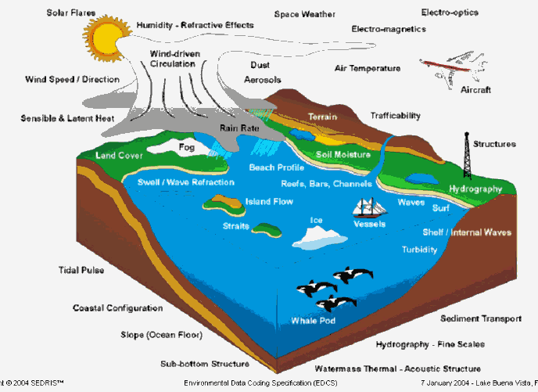
Layers of the Earth’s surface
http://www.sedris.org/stc/2004/tu/edcs/sld024.htm
http://www.sedris.org/stc/2004/tu/edcs/sld024.htm

Slide 5
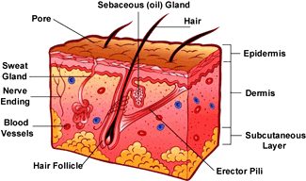
Layers of the body’s surface
kidshealth.org/kid/ body/skin_noSW.html

Slide 6
Two sides to SDTS
(Spatial Data Transfer Standard)
Quantitative: Spatial Object Definitions (Raster/Vector ...)
Qualitative: Standard Entities

Slide 7
Quantitative
Spatial Object Definitions
  0-, 1-, 2-dimensions
  elemental and aggregates
  some examples from SDTS
    Node: topological junction of two or more links or chains, or is at an end point of link or chain
    Chain: nonbranching sequence on non-intersecting line segments or arcs, bounded by nodes at each end
http://campus.fct.unl.pt/ama/tsig/slides/overview.ppt

Slide 8
Qualitative
Standard Entities
  Watercourse: a way or course through which water may or does flow (includes stream, river, anabranch, barranca, branch, brook, canal, channel, creek, culvert, ditch, drain, flume, fork, lode, narrows, ... wash)
Standard Attributes
  Intermittent/Perennial: occurring in interrupted sequence vs. present at all seasons of the year

Slide 9
Summary
GIS strong on quantitative side, weak on qualitative side
All the data means that GIS is in good shape
But no robust geospatial ontology = no theoretically grounded taxonomy of the types of entities and relations in the geospatial world

Slide 10
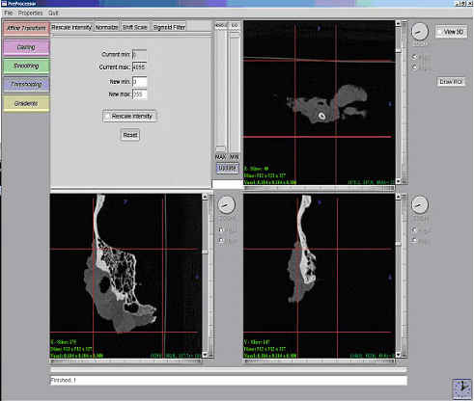
Weak treatment of quantities and instance data in AIS
– no fixed coordinates (flexible earth),
– need for 3-dimensional views

Slide 11
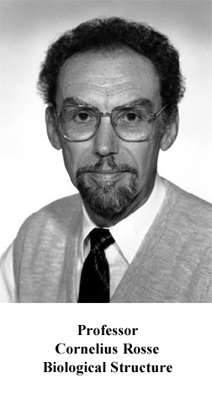
But very strong qualitative ontology: Foundational Model of Anatomy (FMA)
Department of Biological Structure, University of Washington, Seattle

Slide 12
Anatomical Space
Anatomical
Structure
Organ Cavity
Subdivision
Organ
Cavity
Organ
Organ Part
is_a
Serous Sac
Cavity
Subdivision
Serous Sac
Cavity
Serous Sac
Organ
Component
Organ
Subdivision
Tissue
Pleural Sac
Pleura(Wall
of Sac)
Pleural
Cavity
part_of
Parietal
Pleura
Visceral
Pleura
Interlobar
recess
Mediastinal
Pleura
Mesothelium
of Pleura

Slide 13
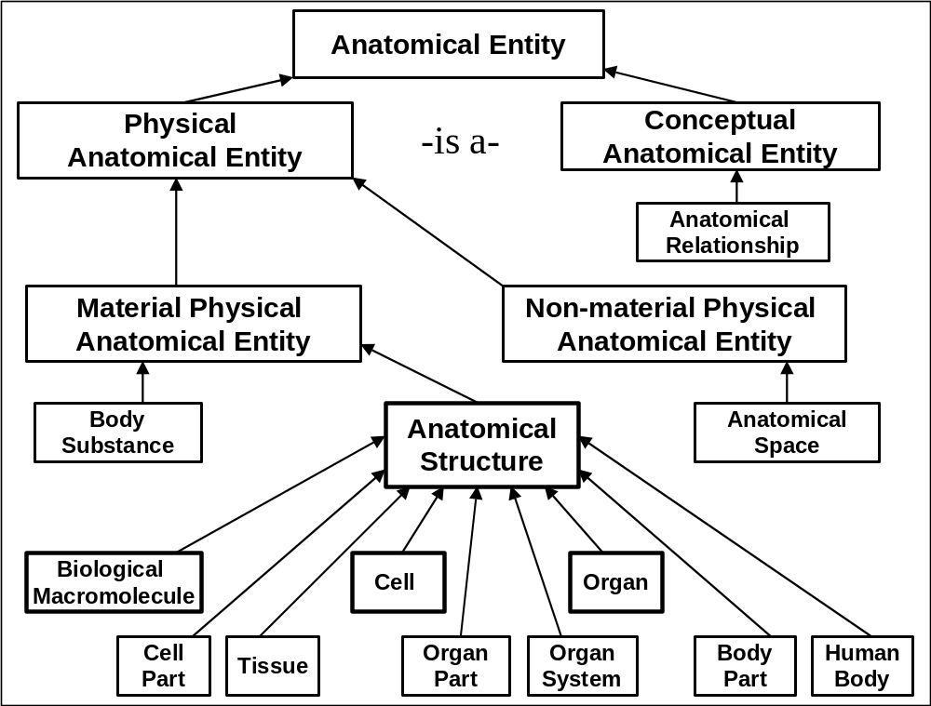

Slide 14
The Anatomy Reference Ontology
is organized in a graph-theoretical structure involving two sorts of links or edges:
is-a (= is a subtype of )
(pleural sac is-a serous sac)
part-of
(cervical vertebra part-of vertebral column)

Slide 15
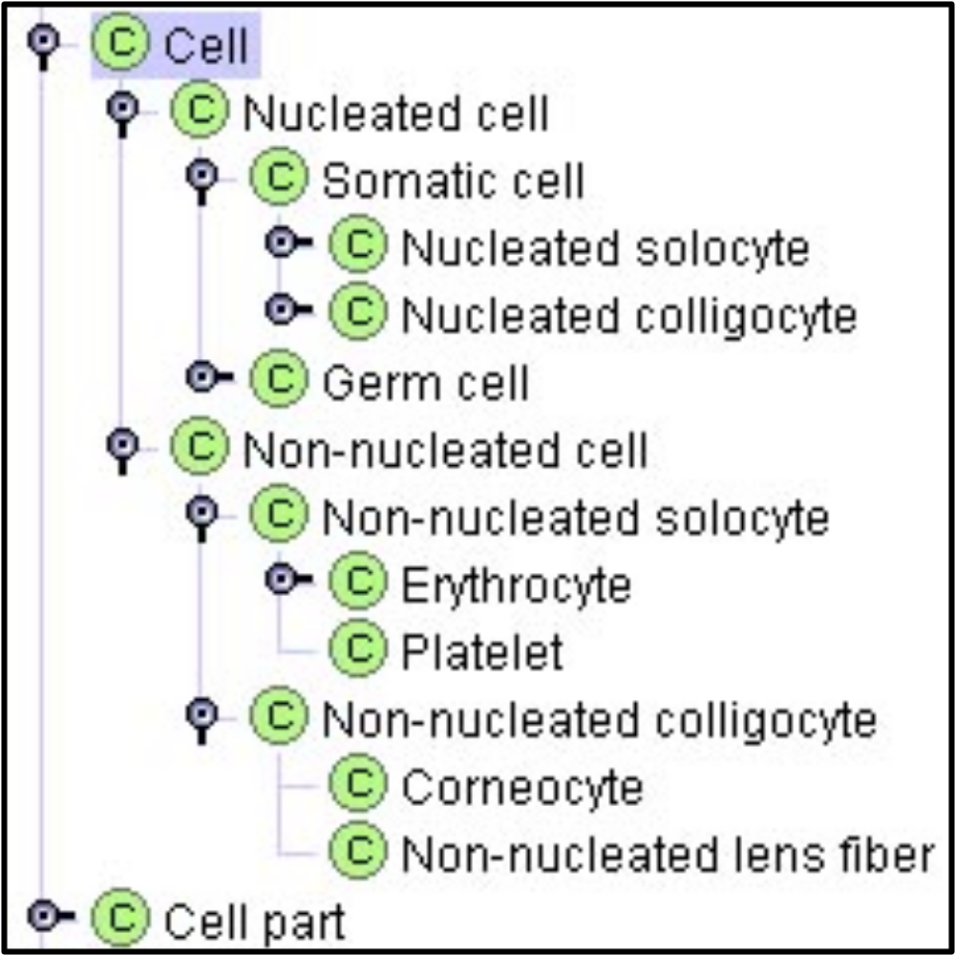
at every level of granularity

Slide 16
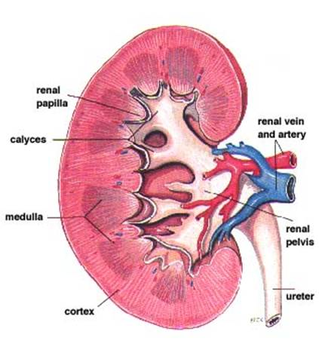
Modularity
What do the kidneys do?

Slide 17
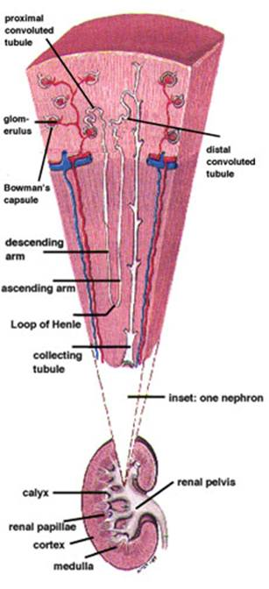
How does a kidney work?
NEPHRON

Slide 18
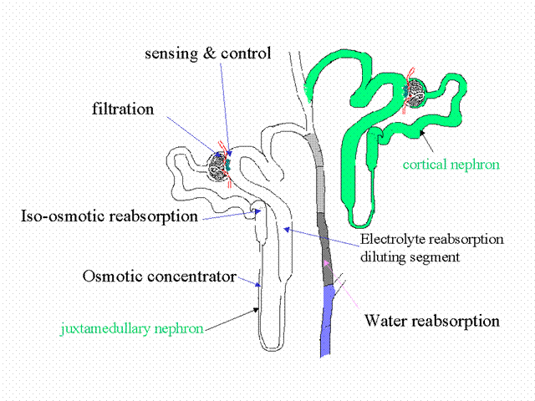
Nephron Functions
FUNCTIONAL SEGMENTS

Slide 19
Top-Level Categories in the FMA
anatomical
entity
physical
anatomical entity
non-physical
anatomical entity
material physical anatomical entity
non-material physical anatomical entity
anatomical structure
body
substance
body
space
boundary
anatomical attribute
anatomical relationship

Slide 20
anatomical structure (cell, lung, nerve, tooth)
result from the coordinated expression of structural genes
have their own 3-D shape

Slide 21
portion of body substance
inherits its shape from contained
urine
menstrual flood
blood ...

Slide 22
anatomical space
cavities, conduits

Slide 23
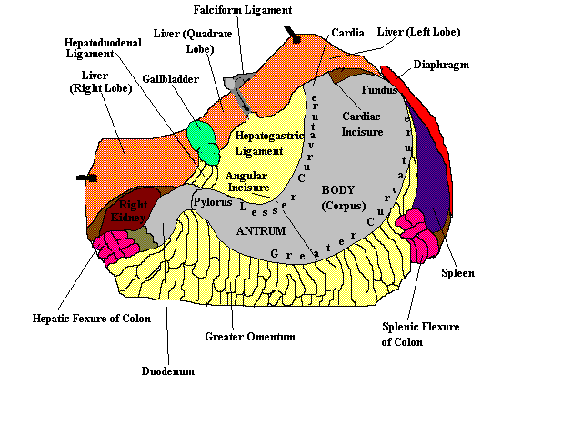
boundary
bona fide / fiat
www.enel.ucalgary.ca/ People/Mintchev/stomach.htm

Slide 24
anatomical attribute
mass
weight
temperature
your temperature
its value now

Slide 25
anatomical relationship
located_in
contained_in
adjacent_to
connected_to
surrounds
lateral_to (West_of)
anterior_to

Slide 26
Anatomical Space
Anatomical
Structure
Organ Cavity
Subdivision
Organ
Cavity
Organ
Organ Part
Serous Sac
Cavity
Subdivision
Serous Sac
Cavity
Serous Sac
Organ
Component
Organ
Subdivision
Tissue
Pleural Sac
Pleura(Wall
of Sac)
Pleural
Cavity
Parietal
Pleura
Visceral
Pleura
Interlobar
recess
Mediastinal
Pleura
Mesothelium
of Pleura

Slide 27
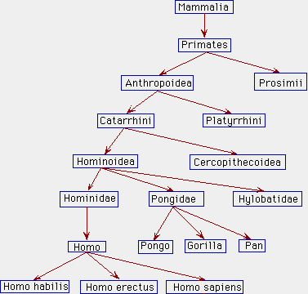
A Window on Reality
Notes:
http://www.kheper.auz.com/gaia/biosphere/systematics/Linnean.htm

Slide 28
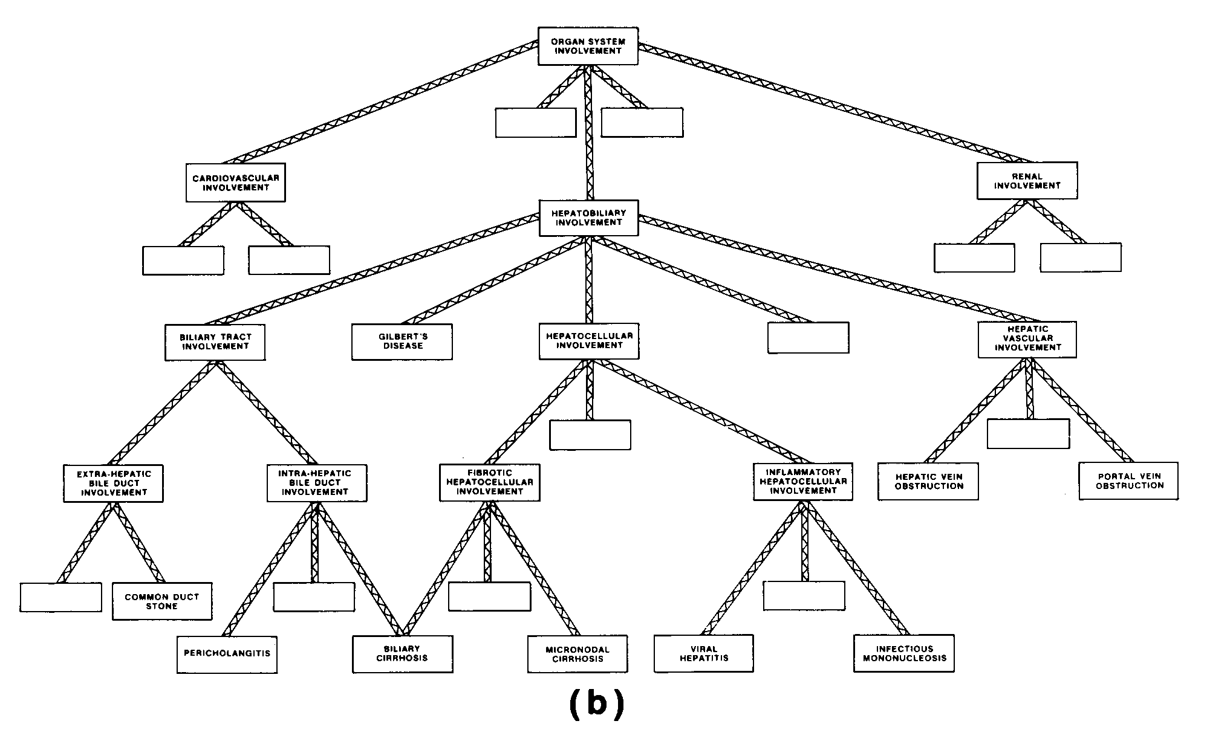
Dependence Relations
Organisms
Diseases
Notes:
http://www.kheper.auz.com/gaia/biosphere/systematics/Linnean.htm

Slide 29
A Window on Reality
Organisms
Diseases
Notes:
http://www.kheper.auz.com/gaia/biosphere/systematics/Linnean.htm

Slide 30
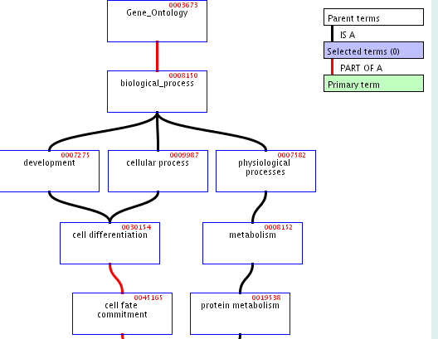
A Window on Reality
Notes:
http://www.kheper.auz.com/gaia/biosphere/systematics/Linnean.htm

Slide 31
We can reason across such hierarchies and combinations
but only if the top-level categories and associated formal-ontological relations are well-defined and used consistently

Slide 32
Formal-Ontological Relations
is_a part_of located_at depends_on is_boundary_of adjacent_to contained_in

Slide 33
To support integration of ontologies
relational expressions such as
is_a
part_of
...
should be used in the same way by all the ontologies to be integrated

Slide 34
to define these relations properly
we need to take account of both universals and instances in reality

Slide 35
is_a
human is_a mammal
all instances of the universal human are as a matter of necessity instances of the universal mammal

Slide 36
part_of
For instances:
part_of = instance-level parthood
(for example between Mary and her heart)
For universals:
A part_of B =def. given any instance a of A there is some instance b of B such that a part_of b

Slide 37
instance-level relations
part_of
is_located_at
has_participant
has_agent
earlier
. . .

Slide 38
Kinds of relations
<universal, universal>: is_a, part_of, ...
<instance, universal>: this explosion instance_of the universal explosion
<instance, instance>: Mary’s heart part_of Mary

Slide 39
From molecules to diseases
use the methodology of formally defined relations and a common top-level ontology to bridge the granularity gap between genomics and proteomics data and phenotype (clinical, pharmacological, patient-centered) data
“Relations in Biomedical Ontologies”, Genome Biology, April 2005

Slide 40
Part_of relations for continuants must be indexed by times
lobe of liver part_of liver
all-some structure: every instance of lobe of liver stands in an instance-level parthood relation to some instance of liver at some time

Slide 41
all-some structure
A part_of B =def. given any instance a of A there is some instance b of B such that a part_of b
See Maureen Donnelly, Thomas Bittner and Cornelius Rosse. “A Formal Theory for Spatial Representation and Reasoning in Biomedical Ontologies”, Artificial Intelligence in Medicine 2005

Slide 42
Connectedness and Continuity
The body is a highly connected entity.
Exceptions: cells floating free in blood
Connectedness in FMA =
continuous_with,
attached_to (muscle to bone)
synapsed_with (nerve to nerve and nerve to muscle)
Two continuants are continuous on the instance level if and only if they share a fiat boundary.

Slide 43
Continuity on the universal level is not symmetric
instance a continuous_with instance b
But consider the universals lymph node and lymphatic vessel.
Each lymph node is continuous with some lymphatic vessel, but there are lymphatic vessels (e.g. lymphs and lymphatic trunks) which are not continuous with any lymph nodes.

Slide 44
Adjacency as a relation between universals is not symmetric
nucleus adjacent_to cytoplasm
Not: cytoplasm adjacent_to nucleus
seminal vesicle adjacent_to urinary bladder
Not: urinary bladder adjacent_to seminal vesicle

Slide 45
The Moral of this Story
RELATIONS BETWEEN UNIVERSALS (AKA ‘CONCEPTS’) CAN BE COUNTERINTUITIVE
THE DISCIPLINE OF KNOWLEDGE REPRESENTATION IS BASED ON THE IDEA THAT WE CAN CAPTURE KNOWLEDGE BY APPEALING TO OUR INTUITIONS ABOUT THE RELATIONS BETWEEN CONCEPTS
CONCLUSION : ABOLISH THE DISCIPLINE OF ‘KNOWLEDGE REPRESENTATION’

