Slide 1
The thesis of “16 Days”

Slide 2
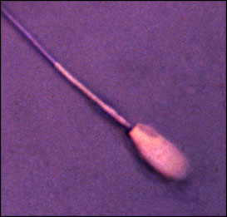
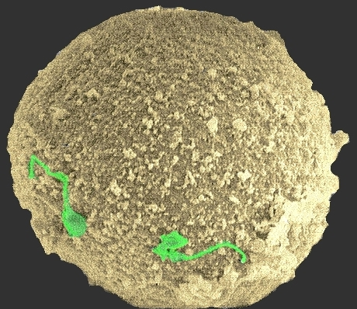
first there are two:
t₁

Slide 3
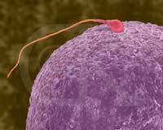
t₂

Slide 4
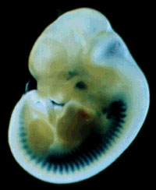
but somewhere along the way there is one
t₃

Slide 5
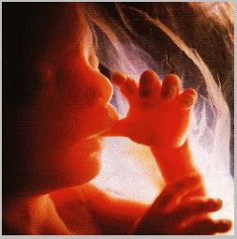
but somewhere along the way there is one
t₄

Slide 6
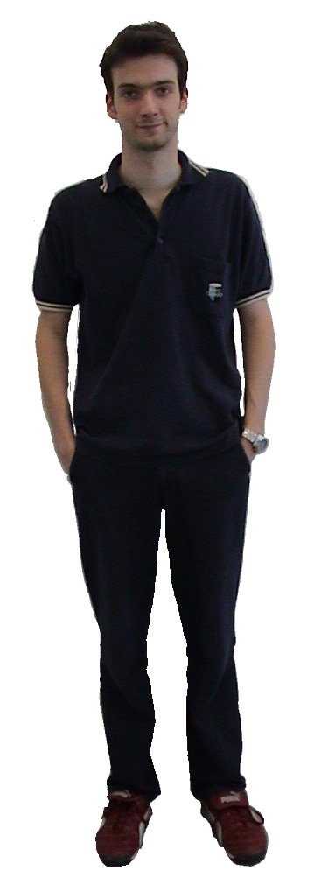
but somewhere along the way there is one
t₅

Slide 7
but somewhere along the way there is one
t₆

Slide 8
but somewhere along the way there is one
t₇

Slide 9
Daniel is a substance
The sum of sperm and egg from out of which Daniel was formed is not a substance
∴Somewhere along the way a substantial change occurred

Slide 10
What are the alternative candidate thresholds for substantial change?

Slide 11
a. single-cell zygote (day 0)
b: multi-cell zygote (days 0-3)
c. morula (day 3)
d. early blastocyst (day 4)
e. implantation (days 6-13)
f. gastrulation (days 14-16)
g. neurulation (from day 16)
h. formation of the brain stem (days 40-43)
i. end of first trimester (day 98)
j. viability (around day 130)
k. sentience (around day 140)
l. quickening (around day 150)
m. birth (day 266)
n. the development of self-consciousness (some time after birth)

Slide 12
a. single-cell zygote (day 0)
b: multi-cell zygote (days 0-3)
c. morula (day 3)
d. early blastocyst (day 4)
e. implantation (days 6-13)
f. gastrulation (days 14-16)
g. neurulation (from day 16)
h. formation of the brain stem (days 40-43)
i. end of first trimester (day 98)
j. viability (around day 130)
k. sentience (around day 140)
l. quickening (around day 150)
m. birth (day 266)
n. the development of self-consciousness (some time after birth)

Slide 13
a. single-cell zygote (day 0)
b: multi-cell zygote (days 0-3)
c. morula (day 3)
d. early blastocyst (day 4)
e. implantation (days 6-13)
f. gastrulation (days 14-16)
g. neurulation (from day 16)
h. formation of the brain stem (days 40-43)
i. end of first trimester (day 98)
j. viability (around day 130)
k. sentience (around day 140)
l. quickening (around day 150)
m. birth (day 266)
n. the development of self-consciousness (some time after birth)

Slide 14
The thesis of 16 days
the substantial change occurs at the latest at 16 days after fertilization
with the conclusion of the process of gastrulation,
which is also the initiation of the process of neurulation

Slide 15
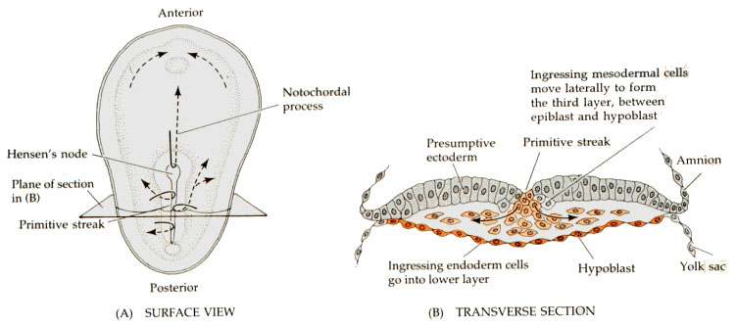
Gastrulation
eatworms.swmed.edu/~leon/med_neuro/neurogenesis.ppt

Slide 16
Perhaps the substantial change occurs much earlier
Helen Pearson,
“Your Destiny, From Day One”,
Nature 8 July 2002

Slide 17
Helen Pearson:
“the first division of the egg
influences the fate of each cell
and ultimately all the tissues of the body.
“There is a memory of the first cleavage
in the whole of the rest of our life.”

Slide 18
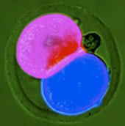
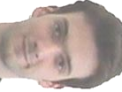
“What is clear
… is that developmental biologists
will no longer dismiss early mammalian
embryos as featureless bundles of cells.”

Slide 19
Speciecists say:
being human is a morally significant quality
human beings have a special moral status because they are members of the species homo sapiens sapiens

Slide 20
A less controversial view:
Existing is a morally significant quality
and human beings begin to exist,
at the latest, at 16 days after fertilization
here: human being = human organism = human individual

Slide 21
Daniel’s question:
what new morally significant feature is acquired at the stage of gastrulation
(or at some much earlier stage)?
Answer:
existing

Slide 22
Why is existing a morally significant quality?
If human beings have any morally significant qualities
then existing must be among them.
x has a morally significant quality means roughly: x is deserving of moral respect
Lemma: Only what exists is deserving of moral respect
Proof: Because ought implies can

Slide 23
Candidates for morally significant qualities mentioned by Daniel:
– being self-conscious
– having an interest in one's own future existence
These are both clearly qualities which only an existent being can possess
(Daniel’s second candidate is even such as to involve a double recognition of the moral significance of existing)

Slide 24
And if existing is a morally significant quality
then the question when an entity begins to exist, too, is a question with moral significance

Slide 25
A response to this argument
PETERSINGERISM: the ‘person’ caper

Slide 26
The philosophical tradition since Locke isn't really interested in the beginning of existence of human beings.
The interesting metaphysical problem is the problem when we, as persons, begin to exist.

Slide 27
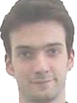
If, on the Petersingerist view
the question when human beings begin to exist is not morally significant,
then this must be because persons and human beings are two distinct entities
are they both substances?
Did Daniel begin to exist twice, once as human being, once as person?

Slide 28
of course not
‘person’, like ‘student’ is a phase sortal
If student x has a morally significant quality, then that is because x itself has a morally significant quality
And this means that x itself is the bearer of some sort of moral significance (thus x is deserving of respect and protection)
from the beginning to the end of its existence

Slide 29
END OF THE FIRST LESSON
Hence the moral significance of the question: when does a human being begin to exist

