Slide 1
Beyond Concepts
Barry Smith
http://ontologist.com

Slide 2
IFOMIS
Institute for Formal Ontology and Medical Information Science
Mission: to develop formal ontologies to support empirical research in biomedical informations and in the life sciences in general

Slide 3
Bioinformatics ontologies
currently manifest a very low degree of formal rigour
Gene Ontology
Heptolysis =def The causes of heptolysis

Slide 4
The reason for this lies in the concept orientation introduced by linguists

Slide 5
MeSH – Medical Subject Headings
UMLS – Unified Medical Language System
grew out of work on medical thesauri and nomenclatures

Slide 6
But the problem is widespread

Slide 7
An example
“Concepts, also known as classes, are used in a broad sense. They can be abstract or concrete, elementary or composite, real or fictious. In short, a concept can be anything about which something is said, and, therefore, could also be the description of a task, function, action, strategy, reasoning process, etc.”

Slide 8
Entities are the principal data object about which information is to be collected. Entities are usually recognizable concepts, either concrete or abstract, such as person, places, things, or events which have relevance to the database.

Slide 9
The Entity-Relationship Model
http://www.utexas.edu/its/windows/database/datamodeling/dm/erintro.html

Slide 10
Another example
... not all modifiers [on this list] express properties of noses:
for example, many express concepts that have noses as parts.

Slide 12
Three readings of ‘concept’
The linguistic reading
The engineering reading
The ontological reading

Slide 13
1) The linguistic reading
concept = the meaning that is shared in common by a collection of synonymous terms
concept = an idea shared in common in the minds of those who use synonymous terms (psycho-linguistic view)
concept = synset = a set of words which can be exchanged for each other salva veritate in given sentential contexts (WordNet)

Slide 14
The linguistic reading is bad
for work on ontologies in support of research in the natural sciences

Slide 15
Problem of evaluation
a good ontology = one which corresponds to reality as it exists beyond our concepts
if an ontology is a mere specification of a conceptualization, then the distinction between good and bad ontologies loses its foothold

Slide 16
angel or devil are perfectly good concepts
cancelled performance
avoided meeting
prevented pregnancy
imagined mammal ...

Slide 17
The ontologies of
alien implant removal
or
Chios energy healing
would be perfectly good ontologies on the linguistic reading

Slide 18
The linguistic reading
makes ontology too easy
draws ontology too far away from empirical science

Slide 19
UMLS
is_a =_{def.}
If one item ‘is_a’ another item then the first item is more specific in meaning than the second item. (Italics added)

Slide 20
Fruit
similarTo
Vegetable
NarrowerTerm
Orange
Apfelsine
synonymWith
Goble & Shadbolt

Slide 21
fish is_a vertebrate
copulation is_a biological process
both testes is_a testis
both uteri is_a uterus
plant parts is_a plant

Slide 22
the linguistic reading
yields a more or less coherent reading of relations like:
‘is_a’
‘synonymous_with’
‘associated_to’

Slide 23
but it fails miserably when it comes to relations of other types
Gene Ontology:
menopause part_of death

Slide 24
part_of
heart part_of human
human heart part_of human
testis part_of human
human testis part_of human

Slide 25
for how can concepts, on the linguistic reading, figure as relata of relations like:
part_of = def. composes, with one or more other physical units, some larger whole
contains =def. is the receptacle for fluids or other substances.

Slide 26
How can a set of synonymous terms serve as
a receptacle for fluids or other substances?

Slide 27
Three readings of ‘concept’
The linguistic reading
The engineering reading
The ontological reading

Slide 28
2) The engineering reading
SUO_concept =def.
a tuple (p, t, d), in which
p is a predicate defined by a definition or axioms in KIF;
t is an English term (word or multiword phrase);
d is an English documentation which attempts to precisely define the term;
[etc.]

Slide 29
connected_to =def.
Directly attached to another physical unit as tendons are connected to muscles.
How can a 3-tuple of predicate, term and documentation be directly attached to another physical unit as tendons are connected to muscles ?

Slide 30
On the engineering reading
Concepts are creatures of the computational realm
They exist through their representations in software code, in UML diagrams, XML representations, ...

Slide 31
2) The engineering reading
Not every collection of lines of code is interpretable as being associated with a conceptual model.
the code on execution must be such that there are relations between inputs and outputs which match relations between corresponding entities in reality

Slide 32
Therefore, to evaluate ontologies as conceptual models
we need ontologies of entities in reality as they are in themselves
(ontology is a scientific enterprise)

Slide 33
3) The ontological reading
concepts are not creatures of cognition or of computation
they are invariants out there in reality
= they are what philosophers call types, kinds, universals

Slide 34
is_a
human is_a mammal
all instances of the universal human are instances of the universal mammal

Slide 35
part_of
For instances:
part_of = instance-level parthood
(for example between Mary and her heart)
For universals:
A part_of B =def. given any instance a of A there is some instance b of B such that a part_of b

Slide 36
inverse relations
nucleus part_of cell
cell has_part nucleus

Slide 37
Evalation
Bad ontologies are (inter alia) those whose general terms lack the relation to corresponding universals in reality, and thereby also to corresponding instances.

Slide 38
Good ontologies
= representations of universals and particulars in reality

Slide 39
Use of ‘concept’
almost always involves a confusion in the understanding of the terms of ontologies as between invariants in reality and creatures of cognition
swimming is healthy
swimming has 8 letters

Slide 40
Recommendation
Simply avoid the words ‘concept’, ‘conceptual model’, ‘conceptual representation’, ‘conceptual entity’
They are sources of confusion
Conceive ontologies instead as representations of reality

Slide 41
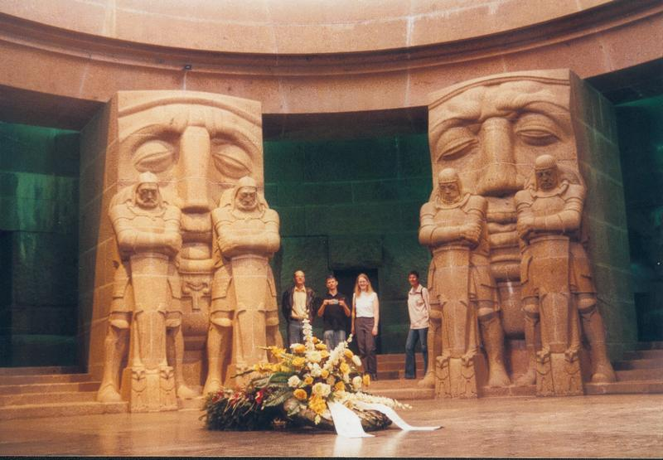
http://ontologist.com

