Slide 1
Granular Partitions and Vagueness
Thomas Bittner and Barry Smith
Northwestern University
NCGIA and SUNY Buffalo

Slide 2
Overview
Introduction
Context, granular partitions, and vagueness
Boundaries and contexts
Conclusions

Slide 3

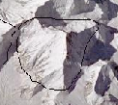


Three people and a mountain
J = ‘We will cross the boundary of Mount
Everest within the next hour’
Judging subject
wants to determine the truth of J in a context-free fashion
Semantic theorist
(the bad guy)
wants to determine the truth of J in a context-dependent fashion using granular partitions
Partition theorist
(the good guy)

Slide 4
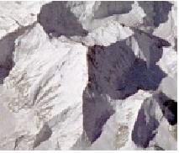
Vagueness
Where is the boundary of Everest?
This boundary is subject to vagueness
The boundary of Everest IS vague:
It is a broad or fuzzy boundary
Vague objects and boundaries
as ontological primitives
Vagueness is a semantic property
There is a multitude of equally
good crisp candidate referents
Extend semantics: supervaluation

Slide 5
Supervaluation (Fine 1975)
Extension of reference semantics to vagueness
Takes multiplicity of candidate referents of vague names into account
S = ‘X is a part of Mount Everest’
  Truth value of S is determined for all candidate referents of ‘Mount Everest’
  S is supertrue if it is true for all candidates
  S is superfalse if it is true for no candidate
  S is indeterminate otherwise

Slide 6
!
Truth value indeterminacy does NOT
occur if we analyze sentences
with vague names (like Everest) in a
context-dependent fashion !

Slide 7
Context, granular partitions, and vagueness

Slide 8
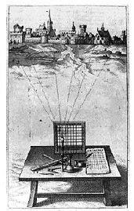
Theory of granular partitions
Major assumptions:
There is a projective relation between cognitive subjects and reality
Humans ‘see’ reality through a grid
The ‘grid’ is usually not regular and raster shaped

Slide 9
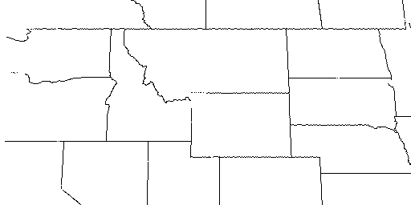
Projection of cells
Cognitive
subject
Grid
Projection
North America
…
Montana
Idaho
Wyoming
…
Foreground of attention

Slide 10
Features of granular partitions
Selectivity
  Only a few features are in the foreground of attention
Granularity
  Recognizing a whole without recognizing all of its parts

Slide 11
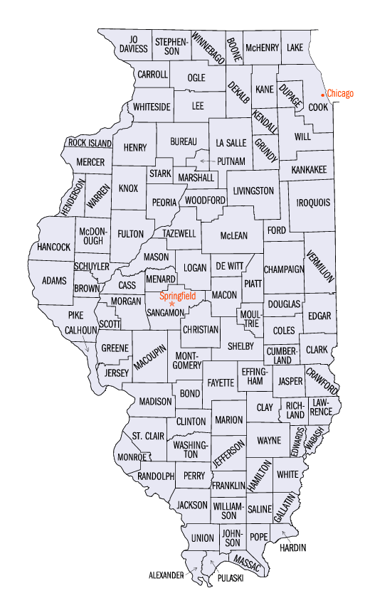
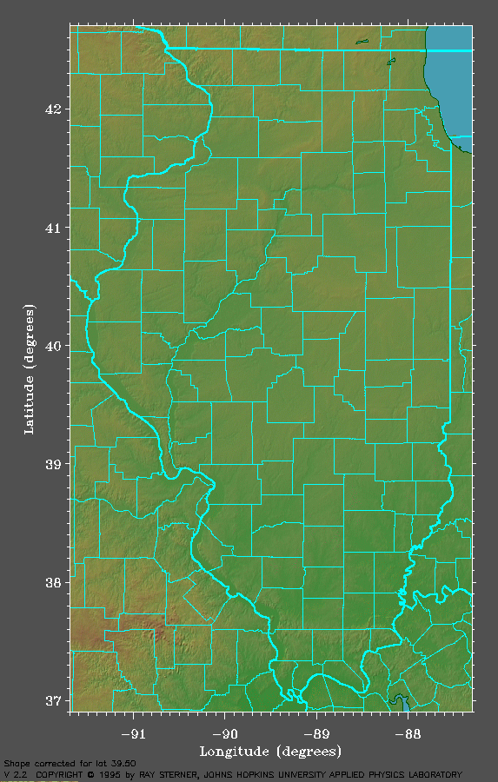
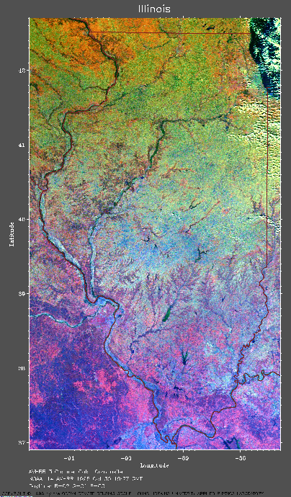
Projection establishes fiat boundaries
Part of the surface of the Earth
photographed from space
Cell structure
P
no counties
no county boundaries
Map =
Representation
of cell structure
County boundaries
in reality

Slide 12
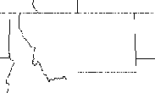
Crisp and vague projection
…
Montana
…
crisp
Himalayas
P1
vague
Everest
Pn
Every projection singles out one admissible candidate of reference

Slide 13
Vague judgments about mereological structure
‘X is part of Y’, X is a vague name
Judgment = Sentence + Context
Granular partition
J = (‘X is part of Y’, Pt^{V})

Slide 14
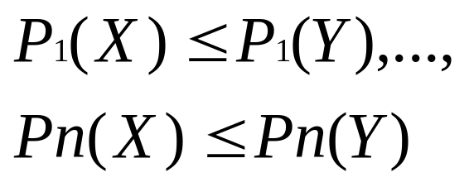
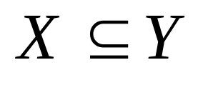
Vague judgments about mereological structure
J = (‘X is part of Y’, Pt^{V}) = supertrue
Labeling of
names in
S onto
cells in Pt
Y
P₁
X
P_{n}

Slide 15
Boundaries, contexts, and truth-value indeterminacy

Slide 16
Boundaries and contexts
  We distinguish:
  contexts in which our use of a vague term brings:
  a single crisp fiat boundary
  a multiplicity of crisp fiat boundaries
  into existence

Slide 17
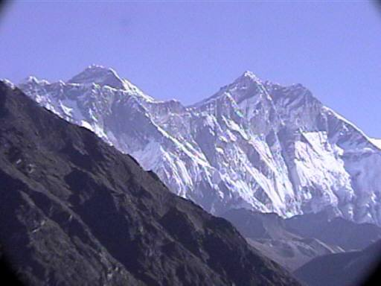
The single crisp boundary case
J = (‘This is the boundary of
Mount Everest’, Pt)
The judging subject must have the authority
(the partitioning power) to impose this boundary
e.g., because she is a member of some government agency
Vagueness is resolved. J has a determinate truth value

Slide 18
The multiple boundary case
The subject (restaurant owner) judges:
J = (‘The boundary of the smoking zone
goes here’, Pt^{V})
while vaguely pointing across the room.
Vague projection brings a multitude of boundary
candidates into existence
Truth-value indeterminacy can potentially arise
To show: naturally occurring contexts are such that
truth-value indeterminacy does not arise.

Slide 19
The multiple boundary case
The subject (restaurant owner) judges:
J = (‘The boundary of the smoking zone
goes here’, Pt)
while vaguely pointing across the room.
Claim:
The judgment can be uttered only in contexts
(1) Where it is precise enough to be (super)true
(2) but: not precise enough for indeterminacy to arise

Slide 20
The multiple boundary case
The subject (restaurant owner) judges:
J = (‘The boundary of the smoking zone goes here’, Pt)
while vaguely pointing across the room.
Context 1:
To advise the staff where
to put the ashtrays
Context 2:
To describe where nicotine
molecules are
The projection must be just
precise enough to determine
on which table to put an ashtray
truth-value indeterminacy
can potentially occur
But: nobody can seriously
utter such a judgment in
naturally occurring contexts
No truth-value
indeterminacy

Slide 21
Conclusions
Theory of granular partitions provides a tool to understand granularity, vagueness, and the relationships between them
Context is critical when analyzing truth-values of judgments
In naturally occurring contexts truth-value indeterminacy does not occur
Formalism – see paper
Partition-theoretic solution to the Sorites paradoxes – see paper

