Slide 1
Granular Partitions and Vagueness
Thomas Bittner and Barry Smith
Northwestern University
NCGIA and SUNY Buffalo

Slide 2
Overview
Introduction
Context, granular partitions, and vagueness
Boundaries and contexts
Conclusions

Slide 3

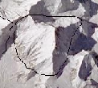


Three people and a mountain
J = ‘We will cross the boundary of Mount
Everest within the next hour’
Judging subject
wants to determine the truth of J in a context-free fashion
Semantic theorist
(the bad guy)
wants to determine the truth of J in a context-dependent fashion using granular partitions
Partition theorist
(the good guy)

Slide 4
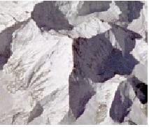
Vagueness
Where is the boundary of Everest?
This boundary is subject to vagueness
The boundary of Everest IS vague:
It is a broad or fuzzy boundary
Vague objects and boundaries
as ontological primitives
Vagueness is a semantic property
There is a multitude of equally
good crisp candidate referents
Extend semantics: supervaluation

Slide 5
Supervaluation (Fine 1975)
Extension of reference semantics to vagueness
Takes multiplicity of candidate referents of vague names into account
S = ‘X is a part of Mount Everest’
  Truth value of S is determined for all candidate referents of ‘Mount Everest’
  S is supertrue if it is true for all candidates
  S is superfalse if it is true for no candidate
  S is indeterminate otherwise

Slide 6
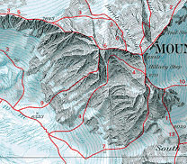
Vagueness and truth
S = ‘We will cross the boundary
of Everest within the next hour’
S is superfalse
S is indeterminate
S is supertrue
Notes:
The semantic theorist does not bother about context. In whatever situation S is uttered the machinery of supervaluation is used and yields supertrue, superfalse, or indeterminate

Slide 7
Vagueness and truth
S = ‘We will cross the boundary
of Everest within the next hour’
?
?
?
S is supertrue
Context is critical !

Slide 8
Context, granular partitions, and vagueness

Slide 9
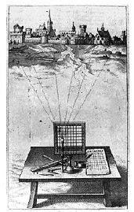
Theory of granular partitions
Major assumptions:
There is a projective relation between cognitive subjects and reality
Humans ‘see’ reality through a grid
The ‘grid’ is usually not regular and raster shaped

Slide 10
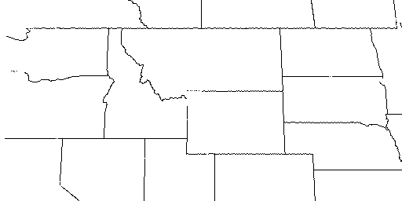
Projection of cells
Cell structure
Projection
North America
…
Montana
Idaho
Wyoming
…

Slide 11
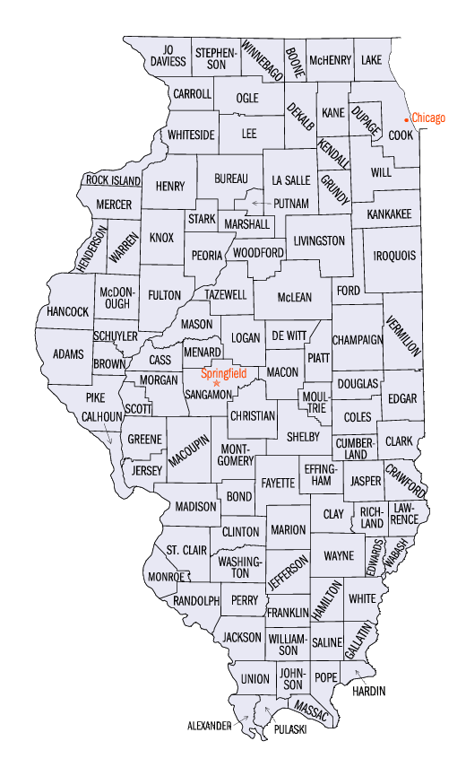
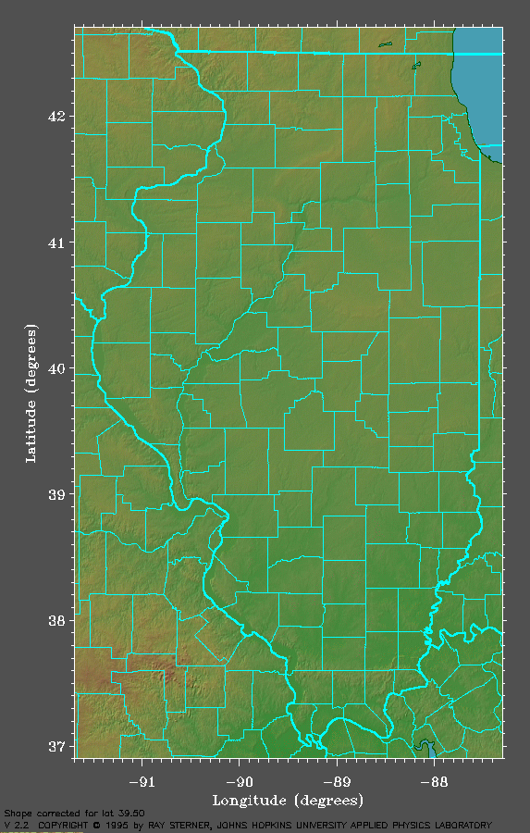
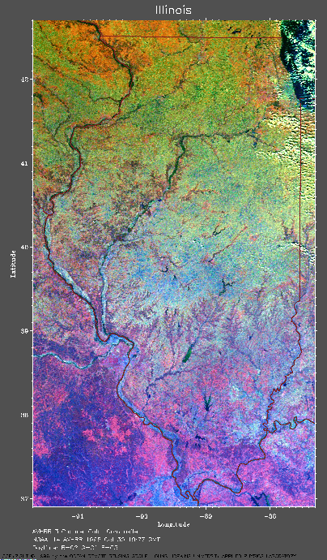
Projection establishes fiat boundaries
Part of the surface of the Earth
photographed from space
Cell structure
P
no counties
no county boundaries
Map =
Representation
of cell structure
County boundaries
in reality

Slide 12
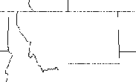
Crisp and vague projection
…
Montana
…
crisp
Himalayas
P1
vague
Everest
Pn
Vague reference is always reference to fiat boundaries!

Slide 13
Boundaries and contexts

Slide 14
Boundaries and contexts
  We distinguish:
  contexts in which our use of a vague term brings:
  a single crisp fiat boundary
  a multiplicity of crisp fiat boundaries
  into existence

Slide 15
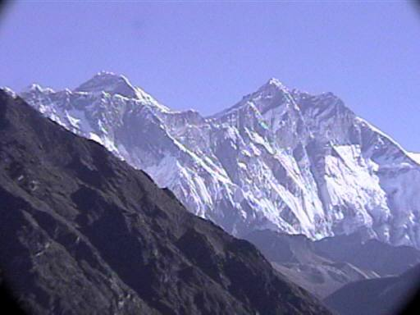
The single crisp boundary case
J = (‘This is the boundary of
Mount Everest’, Pt)
The judging subject must have the authority
(the partitioning power) to impose this boundary
e.g., because she is a member of some government agency
Vagueness is resolved. J has a determinate truth value

Slide 16
The multiple boundary case
The subject (restaurant owner) judges:
J = (‘The boundary of the smoking zone
goes here’, Pt)
while vaguely pointing across the room.
Vague projection brings a multitude of boundary
candidates into existence
Truth-value indeterminacy can potentially arise
To show: naturally occurring contexts are such that
truth-value indeterminacy does not arise.

Slide 17
The multiple boundary case
The subject (restaurant owner) judges:
J = (‘The boundary of the smoking zone
goes here’, Pt)
while vaguely pointing across the room.
Claim:
The judgment can be uttered only in contexts
(1) Where it is precise enough to be (super)true
(2) but: not precise enough for indeterminacy to arise

Slide 18
The multiple boundary case
The subject (restaurant owner) judges:
J = (‘The boundary of the smoking zone goes here’, Pt)
while vaguely pointing across the room.
Context 1:
To advise the staff where
to put the ashtrays
Context 2:
To describe where nicotine
molecules are
The projection must be just
precise enough to determine
on which table to put an ashtray
truth-value indeterminacy
can potentially occur
But: nobody can seriously
utter such a judgment in
naturally occurring contexts
No truth-value
indeterminacy

Slide 19
Conclusions
Theory of granular partitions provides a tool to understand granularity, vagueness, and the relationships between them
Context is critical when analyzing truth-values of judgments
In naturally occurring contexts truth-value indeterminacy does not occur
Formalism – see paper
Partition-theoretic solution to the Sorites paradoxes – see paper

