Slide 1
Need for a systematized approach to naming radiology procedures
Many different imaging modalities & vendors, varying names
  “radiography,” “X-ray,” US,” “sonogram,” etc.
Similar imaging protocols among institutions, but use different naming methods
How to identify similar imaging devices and procedures? Need ontology of imaging procedures.

Slide 2
RadLex ontology of imaging devices and procedures
A catalog of terms to describe the imaging devices, imaging procedures, and imaging sequences that are employed in radiology
Procedures identified according to distinguishing characteristics
  imaging device
  anatomic region imaged
  scanning parameters
  agent administered
Vendor-independent terms

Slide 3
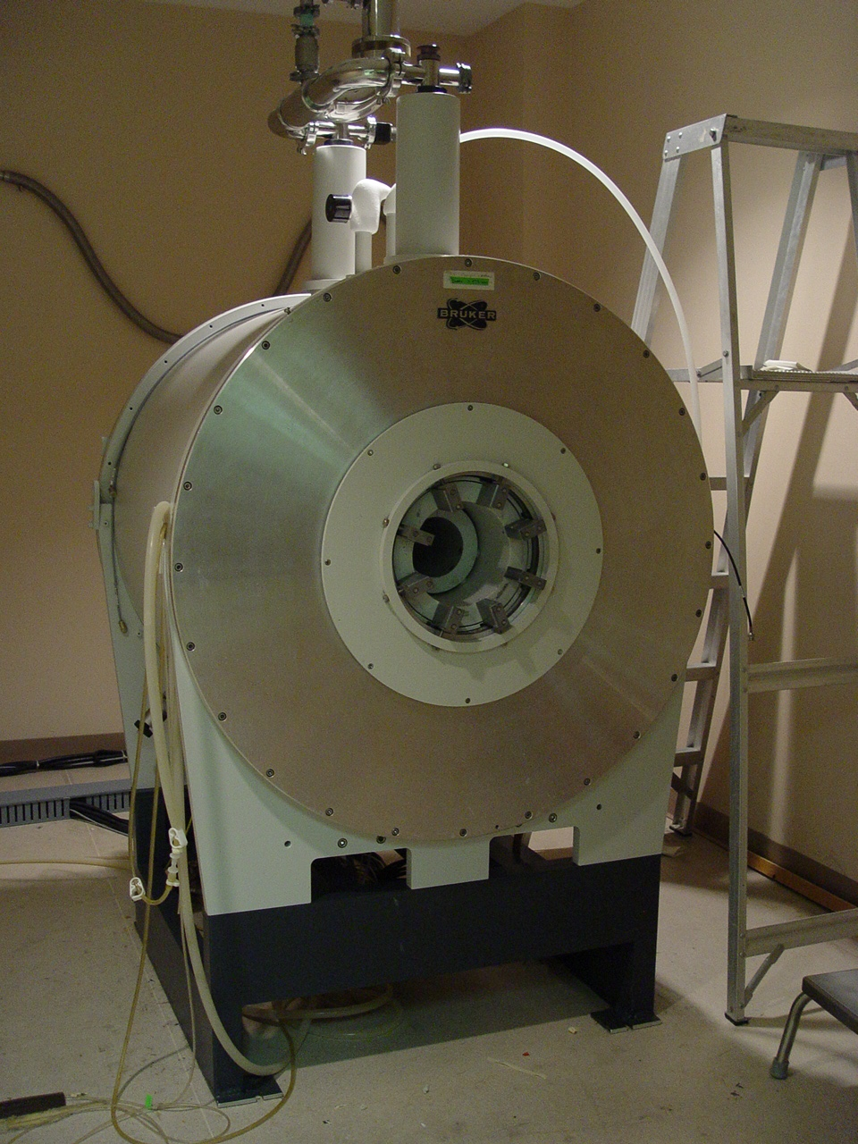
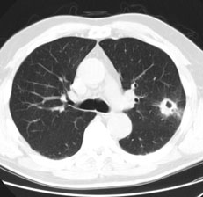
ontology of imaging devices and procedures
  “4.7T 33-cm bore magnet operating at 200 MHz”
“CT axial chest to rule out pulmonary embolism”
Modality: CT
Acquisition: axial
Anatomy: chest
Contrast agent: N
Scanning params: routine
Description: rule out PE

