Slide 1
Units in PATO and Investigation Ontology matters
Chris Mungall and Barry Smith
Notes:
NCORB
s/core4/core1

Slide 2
Reality has various measurable dimensions
length
weight
temperature
specific gravity
etc.

Slide 3
Fiat boundaries
The product of (our) gridding activity

Slide 4
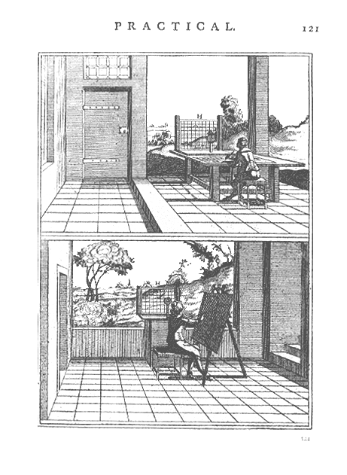
Artist’s Grid
Notes:
From: http://www.cinemedia.net/SFCV-RMIT-Annex/rnaughton/DRAWING_MACHINES.htm
from P. Le Dubreuil, La Perspective Pratique (Paris 1642)

Slide 5
Measurement belongs to the realm of partitions
... 0 ➢10 10 ➢ 20 20 ➢ 30 30 ➢ 40 ...
massively
increased
... normal increased
chronic ...

Slide 6
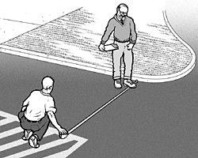
An Act of Measurement
portion of reality:
dependent magnitude (here: distance)
+ independent bearer

Slide 7
The Act of Measurement
tape measure (grid) projected onto reality with endpoints mapped to endpoints
l l l l l l l l l l l l l l l l l l l l l l l

Slide 8
Scalar qualities
A scalar quality can be partitioned on a linear scale
  fiat boundaries
Scalar qualities can be measured
Measurements involve units
  A unit is a fiat subtype of a scalar qualities
Measurements are the simplest sorts of experiments (depend on equipment ...)

Slide 9
fiat subtypes of scalar qualities
quality
spatial quality
length
weight
temperature
is_a
…
short
long
heavy
light
hot

Slide 10
fiat subtypes of scalar qualities
quality
spatial quality
length
weight
temperature
is_a
…
short [length]
light [weight]

Slide 11
Units are fiat subtypes of qualities
quality
spatial quality
length
weight
temperature
is_a
…
1mm
1cm
1g
1kg

Slide 12
Representation of measurements
quality
unit
spatial quality
mm
cm
length
weight
temperature
kg
is_a
measurement_of
g

Slide 13
Ontology of measurement types (units)
units are artifacts created through specific measurement practices

Slide 14
Measurement instances in OWL
Numbers are not part of the ontology; they are part of the data
MA
tail
PATO
length
UO
cm
has_
measurement
this-tail
has_quality
this-
length
this-cm-
measurement
has_magnitude
2.1

Slide 15
Investigation
Ontology
Functional
Genomic
Investigation
Ontology
Clinical Trial
Ontology
Imaging
Ontology
Measurement
Ontology
Phenotype
(Quality)
Ontology
Unit
Ontology
(List?)

Slide 16
scientific investigation
problem analysis
information gathering
objective (e.g. to test a hypothesis)
experimental design
experiment
optional:
result interpretation
result evaluation

Slide 17
Measurement
Ontology
Biomedical
Investigation
Ontology
Flow Cytometry Investigation
Ontology
Transcriptomics Investigation
Ontology
Metabolomics Investigation
Ontology
Nutrigenomics Investigation
Ontology
Clinical Trial
Ontology
Imaging
Ontology ?

