Slide 1
upper level ontologies
Barry Smith

Slide 2
Suggested Upper Merged Ontology
Adam Pease
apease@articulatesoftware.com
http://www.articulatesoftware.com

Slide 3
Imagine...your view of the web
Joe Smith
name
BS Case Western Reserve,
1982
MS UC Davis, 1984
education
CV
private
Married, 2 children
work
1985-1990 ACME Software,
programmer

Slide 4
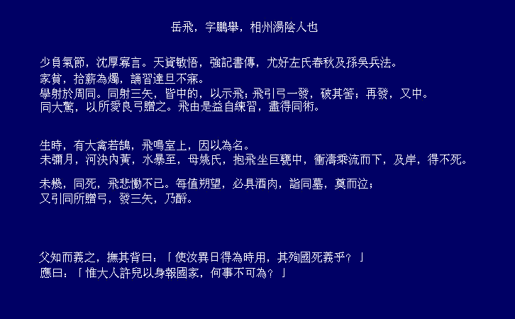
...and the Computer's View
name
education
CV
private
work
Slide inspired by Frank von Harmelan

Slide 5
Wait, we've got semantics -
Mammal
Mammal
subclass
Person
implies
instance
instance
JoeSmith
JoeSmith

Slide 6
Suggested Upper Merged Ontology
1000 terms, 4000 axioms, 750 rules
Associated domain ontologies totalling 20,000 terms and 60,000 axioms
[includes ontology of boundaries from BS]
www.ontologyportal.org

Slide 7
SUMO Structure
Structural Ontology
Base Ontology
Set/Class Theory
Numeric
Temporal
Mereotopology
Graph
Measure
Processes
Objects
Qualities

Slide 8
SUMO+Domain Ontology
Structural
Ontology
SUMO
Base
Ontology
Total Terms Total Axioms Rules
20399 67108 2500
Set/Class
Theory
Numeric
Temporal
Mereotopology
Graph
Measure
Processes
Objects
Qualities
Mid-Level
Transnational
Issues
WMD
Geography
Financial
Ontology
ECommerce
Services
Communications
Government
Distributed
Computing
People
Military
Transportation
Terrorist
Terrorist
Attack Types
Economy
Elements
NAICS
UnitedStates
Terrorist
Attacks
Biological
Viruses
Afghanistan
France
World
Airports
…

Slide 9
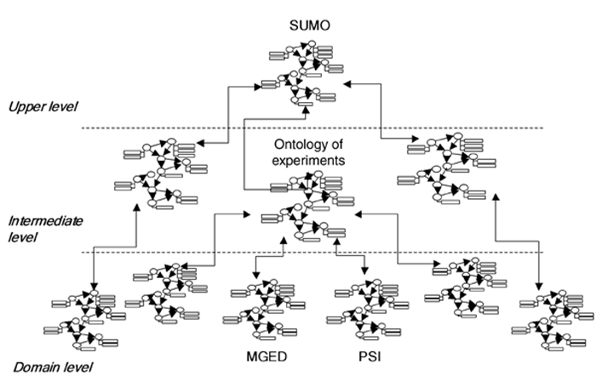

Slide 10
Subclass Hierarchy Tree
entity
physical
abstract
quantity
number
real number
rational number
irrational number
nonnegative real number
negative real number
binary number
imaginary number
complex number
physical quantity
attribute
set or class
relation
proposition
graph
graph element

Slide 11
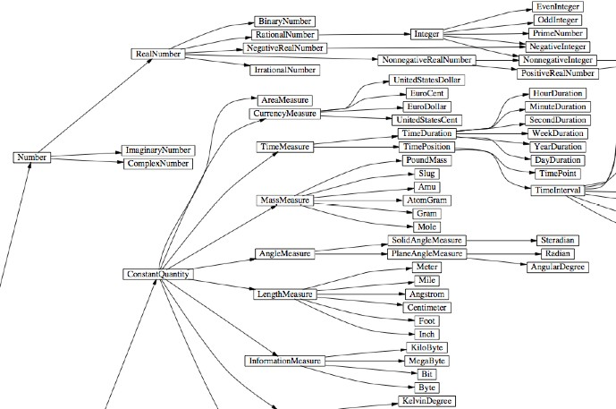

Slide 12
SUMO Subclass Hierarchy Tree
entity
physical
object
process
dual object process
intentional process
intentional psychological process
recreation or exercise
organizational process
guiding
keeping
maintaining
repairing
poking
content development
making
constructing
manufacture
publication
cooking
searching
social interaction
maneuver
motion
internal change
shape change
abstract

Slide 13
Subclass Hierarchy Tree
entity
physical
object
self connected object
substance
corpuscular object
organic object
organism
plant
flowering plant
non flowering plant
alga
fungus
moss
fern
animal
microorganism
toxic organism
anatomical structure
artifact
content bearing object
food
region
collection
agent
process
abstract

Slide 14
corpuscular object =def.
A SelfConnectedObject whose parts have properties that are not shared by the whole.
Superclass(es)
entity
physical object
self-connected object
Subclass(es)
organic object
artifact
Coordinate term(s)
    content bearing object
    food
    substance
Axiom: corpuscular object is disjoint from substance.
substance =def.
An Object in which every part is similar to every other in every relevant respect.

Slide 15
problems with SUMO as Upper-Level
it contains its own tiny biology (protein, crustacean, fruit-Or-vegetable ...)
it is overwhelmingly an ontology for abstract entities (sets, functions in the mathematical sense, ...)
no clear treatment of relations between instances vs. relations between types
[all of these problems can be fixed]

Slide 16
DOLCE a Descriptive Ontology for Linguistic and Cognitive Engineering from Nicola Guarino
Strong cognitive/linguistic bias:
  descriptive (as opposite to prescriptive) attitude
  Categories mirror cognition, common sense, and the lexical structure of natural language.
Categories as conceptual containers: no “deep” metaphysical implications
Rich axiomatization
  37 basic categories
  7 basic relations
  80 axioms, 100 definitions, 20 theorems
Rigorous quality criteria
Documentation

Slide 17
DOLCE’s basic taxonomy
Endurant (Continuant)
Physical
Amount of matter
Physical object
Feature
Non-Physical
Mental object
Social object
…
Perdurant (Occurrent)
Static
State
Process
Dynamic
Achievement
Accomplishment
Quality
Physical
Spatial location
…
Temporal
Temporal location
…
Abstract
Abstract
Quality region
Time region
Space region
Color region
…
…

Slide 18
1 - The physical view
Basic qualities ascribed to atomic spacetime regions (e.g., mass, electric charge…)
Fields (physical processes) are spatiotemporal distributions of qualities

Slide 19
2 - The cognitive view
Humans isolate relevant invariances on the basis of:
  Perception (as resulting from evolution)
  Cognition and cultural experience
  Language
A set of atomic percepts is associated to each situation

Slide 20
3 - The linguistic view and the multiplicative choice
substitutivity tests :
  I am talking here
  *This bunch of molecules is talking
  *What’s here now is talking
  This statue is looking at me
  *This piece of marble is looking at me
  This statue has a strange nose
  *This piece of marble has a strange nose

Slide 21
Qualities (EAV approach)
Quality attribution
Quality
Quality space
Color-space
Rose
Red-obj
Color
Has-part
Red-region
q-location
Has-part
Rose1
Color of rose1
Red421
Inheres
Has-quale

Slide 22
Abstract vs. Concrete Entities
Concrete:
  located (at least) in time
Abstract
- not located in space-time (no inherent spatial or temporal location)
  Examples: propositions, sets, symbols, regions, etc.
  Quality regions and quality spaces are abstract entities – time and space are abstract
  Mereological sums (of concrete entities) are concrete, the corresponding sets are abstract...

Slide 23
Physical vs. Non-physical Endurants
Physical endurants
  Inherent spatial localization
  Not necessarily dependent on other objects
Non-physical endurants
  No inherent spatial localization
  Dependent on agents
    mental (depending on singular agents)
    social (depending on communities of agents)
  Agentive: a company, an institution
  Non-agentive: a law, the Divine Comedy, a linguistic system

Slide 24
Advantages of DOLCE and SUMO
clear logical infrastructure (FOL) – beyond computability
much more coherent than e.g. CYC upper level
much more coherent than the upper level hard wired into OWL-DL (and a fortiori into OWL-FULL)

Slide 25
Basic Formal Ontology as alternative (as subset of DOLCE and SUMO)?
a true upper level ontology
no interference with domain ontologies
no interference with physics / cognition
no abstracta
no negative entities
a small subset of DOLCE plus more adequate treatment of instances, types and relations
no problem with mass terms (there are no homogeneous stuffs; but only portions of blood, portions of cytoplasm, etc.)

Slide 26
Three dichotomies
instance vs. type
continuant vs. occurrent
dependent vs. independent
everything in the ontology is a type
types exist in reality through their instances

Slide 27
BFO
Continuant
Occurrent
(Process)
Independent
Continuant
Dependent
Continuant
..... ..... ........

Slide 28
RELATION TO TIME GRANULARITY | CONTINUANT |  |  |  | OCCURRENT
 | INDEPENDENT |  | DEPENDENT
ORGAN AND ORGANISM | Organism (NCBI Taxonomy?) | Anatomical Entity (FMA, CARO) | Organ Function (FMP, CPRO) | Phenotypic Quality (PaTO) | Organism-Level Process (GO)
CELL AND CELLULAR COMPONENT | Cell (CL) | Cellular Component (FMA, GO) | Cellular Function (GO) |  | Cellular Process (GO)
MOLECULE | Molecule (ChEBI, SO, RnaO, PrO) |  | Molecular Function (GO) |  | Molecular Process (GO)

Slide 29
BFO
Continuant
Occurrent
(Process)
Independent
Continuant
(molecule,
cell, organ,
organism)
Dependent
Continuant
(quality,
function,
disease)
Functioning
Side-Effect,
Stochastic
Process, ...
..... ..... .... .....

