Slide 1
Biomedical Ontology in Saarbrücken
Barry Smith
http://ifomis.org

Slide 2
IFOMIS
Institute for Formal Ontology and
Medical Information Science
founded in Leipzig in April 2002
moved to Saarbrücken in August 2004

Slide 3
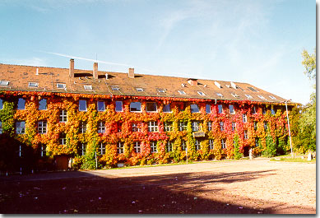

Slide 4
Funding
Humboldt Foundation
Volkswagen Foundation
EU FP6 NoE: Semantic Datamining
for Biomedical Informatics

Slide 5
Personnel by discipline
7 Philosophers
2 Logicians
1 Computer Scientist
3 MDs
1 Bioinformatician

Slide 6
Personnel by nationality
3 Americans
1 Belgian
1 Canadian
1 Czech
1 Frenchman
1 Indian
5 Germans
1 Swede

Slide 7
Partners
Digital Anatomist / Biological Structure Group, University of Seattle, Washington
Ontology Works, Baltimore, MD
NLM, Bethesda, MD
Gene Ontology (EBI)
Swiss Prot (SIB)
Open Biological Ontologies Consortium

Slide 8
Partners in Saarbrücken
DFKI: German Research Center for Artificial Intelligence
Center for Bioinformatics
Max Planck Institute for Computer Science
Institute for Human Genetics
ECOR

Slide 9
E
COR
European Center for
Ontological Research

Slide 10
ECOR
Affiliates:
Laboratory for Applied Ontology, Trento/Rome
Center for Theoretical and Applied Ontology, Turin
Foundational Ontology Group, University of Leeds

Slide 11
Pre-History
from Philosophical Ontology
to Information Systems Ontology
Introducing realist ontology (as a rigorous analytical philosophical discipline) to improve ontologies as representations

Slide 12
Goal
Apply philosophical ontology to improvement of biomedical information systems
Foundational Model of Anatomy
Gene Ontology
UMLS

Slide 13
Biomedicine
desperately needs to find a way
to enable the huge amounts of data
resulting from trials by different groups
to be (f)used together

Slide 14
How resolve incompatibilities?
“ONTOLOGY” = the solution of first resort
(compare: kicking a television set)
But what does ‘ontology’ mean?
Current most popular answer: a hierarchy of concepts (a thesaurus, a list of terms)

Slide 15
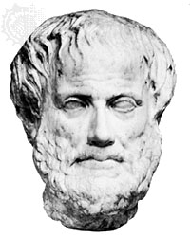
Aristotle
a better idea

Slide 16
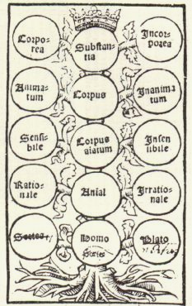
(from Porphyry’s Commentary on Aristotle’s Categories)
Notes:
Porphyry‘s Tree Ca. 1514

Slide 17
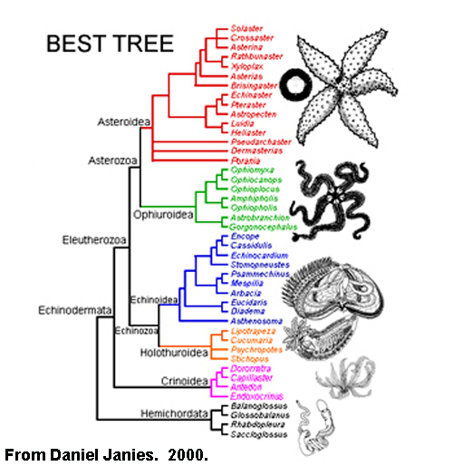
Linnaean Ontology

Slide 18
IFOMIS’s long-term goal
Build a robust high-level framework
BASIC FORMAL ONTOLOGY (BFO)
which can serve as the basis for an ontologically coherent unification of medical knowledge and terminology

Slide 19
Main axis of Basic Formal Ontology
Occurrents vs continuants

Slide 20
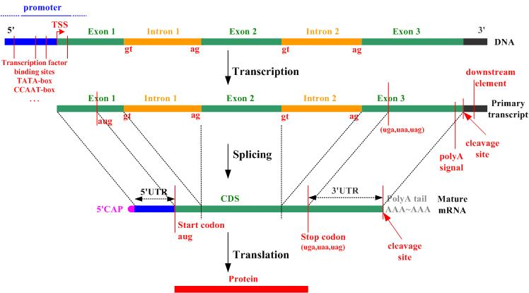
Occurrents and continuants
Picture by Vladimir Brajic

Slide 21
UMLS: blood is a tissue
SNOMED: blood is a fluid

Slide 22


different conceptual systems

Slide 23
need not interconnect at all

Slide 24
Concept hierarchy ontology cannot solve the data-integration problem
because of its roots in knowledge representation/knowledge mining

Slide 25
we cannot make incompatible concept-systems interconnect
just by looking at concepts,
or knowledge –
we need some tertium quid

Slide 26
What is needed
is not a Concept Hierarchy but
a Reference Ontology
(something like old-fashioned
realist metaphysics
or like the anatomy which used to be taught to medical students at the beginning of their studies)

Slide 27
The Problem
Standard medical informatics resources arose out of medical dictionaries
Concerned with concepts not with reality

Slide 28
The Unified Medical Language System (UMLS) Semantic Network
An illustration of the problem

Slide 29
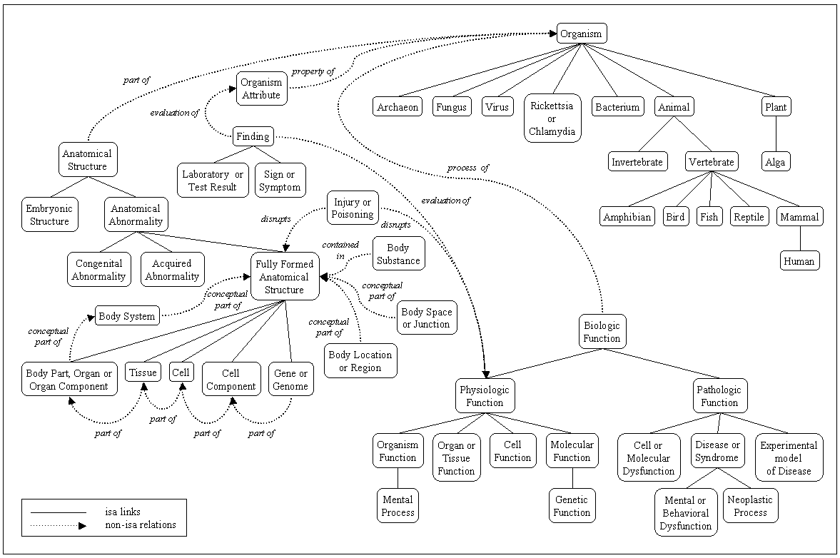
a pudding of ‘concepts’

Slide 30
location_of
Fungus location_of Vitamin
Tissue location_of Mental or Behavioral Dysfunction

Slide 31
Fungus location_of Vitamin
Every instance of fungus is located in some vitamin?
Some instances of fungus are located in some vitamins?
Some instances of vitamin have instances of fungi located in them?

Slide 32
what are the nodes in this graph?

Slide 34
linguistic entities
≈ meanings

Slide 35
UMLS SN
is_a =_{def.}
if one item ‘is_a’ another item then the first item is more specific in meaning than the second item

Slide 36
Fruit
SimilarTo
Vegetable
NarrowerThan
Orange
Apfelsine
SynonymWith
Goble & Shadbolt

Slide 38
How can concepts/meanings figure as relata of relations such as disrupts or contained in?

Slide 39
Injury or Poisoning
causes
Vitamin

Slide 40
Experimental Model of Disease
causes
Bacterium

Slide 41
Disease or Syndrome
causes
Manufactured Object

Slide 42
Mental or Behavioral Dysfunction
causes
Biomedical or Dental Material

Slide 43
Swimming is healthy and contains 8 letters

Slide 44
Reference Ontology
An ontology is a theory of a domain of entities in the world
Ontology is outside the computer
sacrifices computational tractability for the sake of representational adequacy

Slide 45
Basic Formal Ontology
  theory of universals and instances
  theory of part and whole
  theory of ontological dependence
  theory of boundary, continuity and contact/fusion
  theory of states, powers, qualities, roles, functions, systems
  theory of environments/niches

Slide 46
Methodology
working with biomedical content developers such as FMA and OBO to ensure rigorous conformity with good principles of classification and definition
developing software tools for automatic quality control and authoring of information systems ontologies

Slide 47
ontologies constructed in conformity with BFO principles
are based on tested principles
share a common suite of foundational relations
can be integrated together into a single ontological system

Slide 48
Institute for Formal Ontology and Medical Information Science
http://ifomis.org

