Slide 1
Mont Blanc, Lake Constance and Sakhalin Island:
Gaps, Gluts and Vagueness
Varzi: “Vagueness in Geography”
Smith and Brogaard: “A Unified
Theory of Truth and Reference”
http://philosophy.buffalo.edu/faculty/smith

Slide 2
Setting into Relief
You use the name ‘Mont Blanc’ to refer to a certain mountain
You see Mont Blanc from a distance
In either case your attentions serve to foreground a certain portion of reality

Slide 3
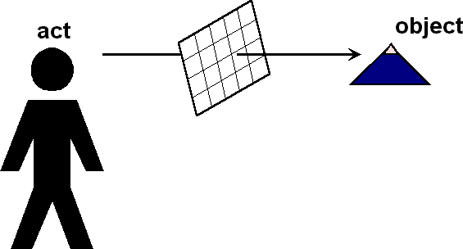
Foreground/Background

Slide 4
The theory of partitions is a theory of foregrounding, of setting into relief

Slide 5
Partitions in Language, etc.
Foregrounding occurs in:
  judging
  theorizing
  classifying
  mapping
  naming
  perceiving
}

Slide 6
The Problem of the Many
There is no single answer to the question as to what it is to which the term ‘Mont Blanc’ refers. Many parcels of reality are equally deserving of the name ‘Mont Blanc’
– Think of its foothills and glaciers, and the fragments of moistened rock gradually peeling away from its exterior; think of all the rabbits crawling over its surface

Slide 7
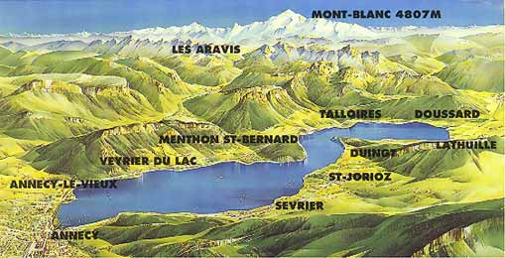
Mont Blanc from Lake Annecy

Slide 8
The world itself is not vague
Rather, many of the terms we use to refer to objects in reality are such that, when we use these terms, we stand to the corresponding parcels of reality in a relation that is one-to-many rather than one-to-one.
Something similar applies also when we perceive objects in reality.

Slide 9
Many but almost one
Lewis:
There are always outlying particles, questionable parts of things, not definitely included and not definitely not included. So there are always many aggregates, differing by a little bit here and a little bit there, with equal claim to be the thing. We have many things or we have none, but anyway not the thing we thought we had.

Slide 10
Granularity
Cognitive acts of Setting into Relief: the Source of Partitions
Partititions: the Source of Granularity
Granularity: the Source of Vagueness

Slide 11
Tracing Over
When you think of John cooking in the kitchen, then the cells in John’s arm and the fly next to his ear belong to the portion of the world that does not fall under the beam of your referential searchlight. They are traced over.

Slide 12
Beverly Hills
The way you partition (carve up) the world when you think of John cannot be understood along any simple geographical lines. It is not as if one connected, compact (hole-free) portion of reality is set into relief in relation to its surroundings, as Beverly Hills is set into relief within the wider surrounding territory of Los Angeles County.

Slide 13
Granularity the source of vagueness
This is because your partition does not recognize parts beneath a certain size.
This is why your partition is compatible with a range of possible views as to the ultimate constituents of the objects included in its foreground domain

Slide 14
Granularity the source of vagueness
It is the coarse-grainedness of our partitions which allows us to ignore questions as to the lower-level constituents of the objects foregrounded by our uses of singular terms.
This in its turn is what allows such objects to be specified vaguely
Our attentions are focused on those matters which lie above whatever is the pertinent granularity threshold.

Slide 15
Interlude on Fiat Vagueness

Slide 16
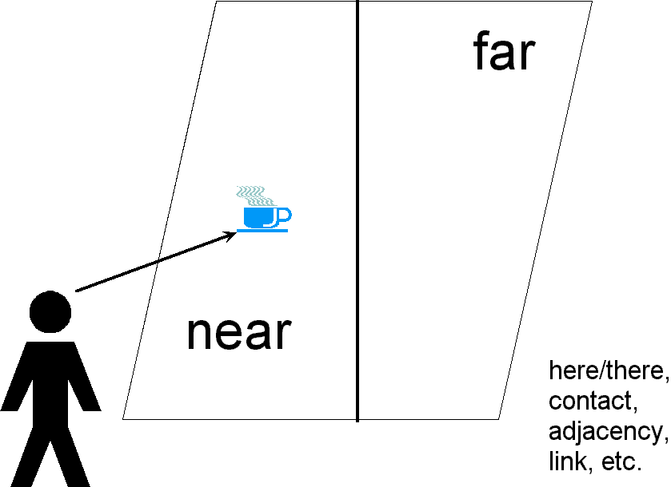
Vagueness in the Fiat Realm
Vagueness in the Fiat Realm

Slide 17
Crispness in the Fiat Realm
– some types of partitions determine their own fiat objects

Slide 18

Montana
Montana

Slide 19
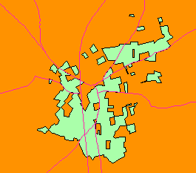
Baarle

Slide 20
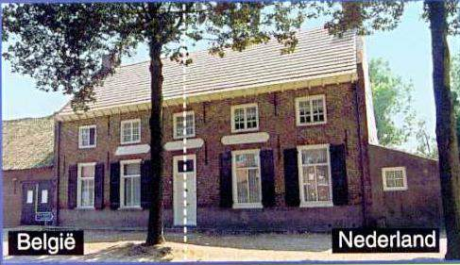
Baarle

Slide 21
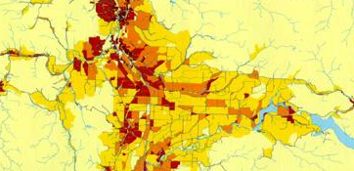
Population Density by Census Tract
Notes:
Population density of Lewis County according to Census Tracts

Slide 22
End of Interlude

Slide 23
In what follows we are interested in partitions relating to bona fide objects
– to objects which were there
before we came along

Slide 24
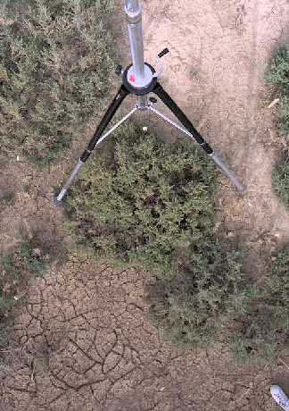
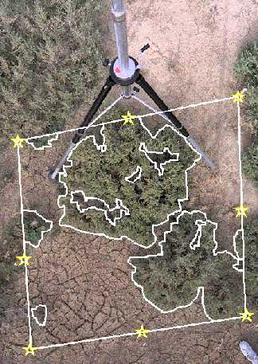
Ground Cover
Notes:
http://www.natgeo.lu.se/Publikationer/LERPG/1/1Article.htm

Slide 25
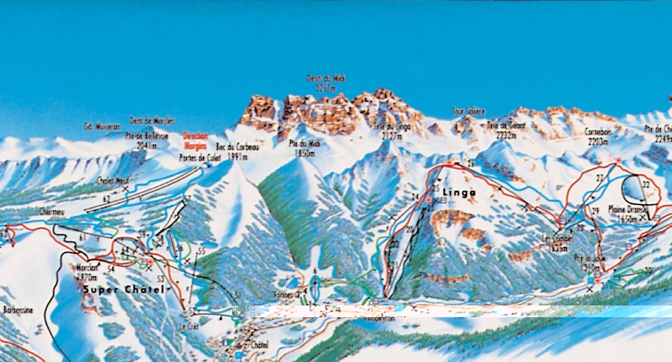
Mont Blanc from Chatel

Slide 26
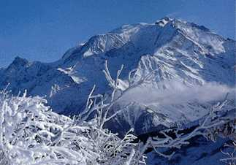
Mont Blanc (Tricot)

Slide 27
Mont Blanc is one mountain
Mont Blanc is one mountain
Max Egenhofer is one person
– these are both supertrue

Slide 28
Standard Supertruth
they are true no matter which of the many aggregates of matter you assign as precisified referent

Slide 29
Standard Supervaluationism
A sentence is supertrue if and only if it is true under all such precisifications.
A sentence is superfalse if and only if it is true under all such precisifications.
A sentence which is true under some ways of precisifying and false under others is said to fall down a supervaluational truth-value gap. Its truth-value is indeterminate.

Slide 30
Example of Gaps
On Standard Supervaluationism
Rabbits are part of Mont Blanc
falls down a supertruth-value gap

Slide 31
Different Contexts
In a perceptual context it is supertrue that these rabbits are part of Mont Blanc
In a (normal) context of explicit assertion it is superfalse that these rabbits are part of Mont Blanc
In a real estate context in a hunting community it might be supertrue that these rabbits are part of that mountain

Slide 32
So are there any contexts with gaps?

Slide 33
Supervaluationism Contextualized
Supervaluations depend on contexts
We pay attention in different ways and to different things in different contexts
The range of available precisified referents and the degree and the type of vagueness by which referring terms are affected will be dependent on context.

Slide 34
Some sentences are unjudgeable
The umbrella in your cocktail is part of your meal
The neutrino passing through your gullet is part of your body.
President Chirac’s hat is part of France
John is exactly bald.
The Morning Star is not a star
The Morning Star does not have magic powers and neither does the Evening Star

Slide 35
No gaps
The everyday judgments made in everyday contexts do not fall down supervaluational truth-value gaps
because the sentences which might serve as vehicles for such judgments are in normal contexts not judgeable (philosophers do not live in normal contexts)

Slide 36
Gaps and Gluts
Consider:
Rabbits are part of Mont Blanc
in a normal context inhabited by you or me
Compare:
Sakhalin Island is both Japanese and not Japanese
Just as sentences with truth-value gaps are unjudgeable, so also are sentences with truth-value gluts.

Slide 37
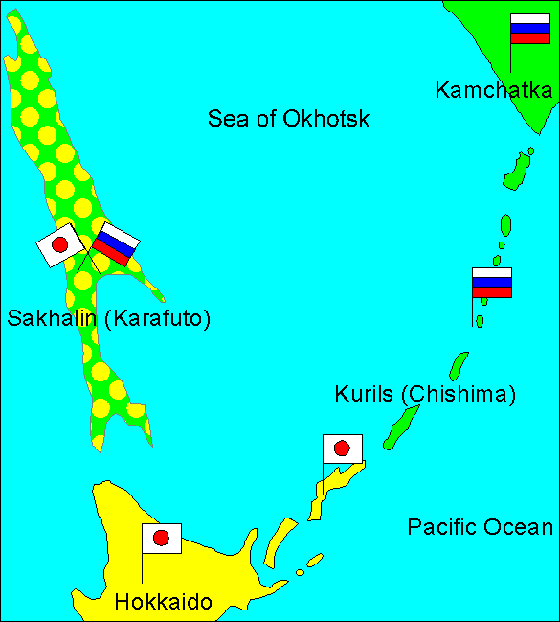
1855
1855

Slide 38
Contextualized Supervaluationism
A judgment p is supertrue if and only if:
(T1) it successfully imposes in its context C a partition of reality assigning to its constituent singular terms corresponding families of precisified aggregates, and
(T2) the corresponding families of aggregates are such that, however we select individual fi from the many Fi, ‘P(f1, …, fn)’ is true.

Slide 39
Supertruth and superfalsehood are not symmetrical:
A judgment p is superfalse if and only if
either:
(F0) it fails to impose in its context C a partition of reality in which families of aggregates corresponding to its constituent singular referring terms are recognized,

Slide 40
Falsehood
or both:
(F1) the judgment successfully imposes in its context C a partition of reality assigning to its constituent singular terms corresponding families of precisified aggregates, and
(F2) the corresponding families of aggregates are such that, however we select therefrom, p is false.
In case (F0), p fails to reach the starting gate for purposes of supervaluation

Slide 41
Lake Constance
No international treaty establishes where the borders of Switzerland, Germany, and Austria in or around Lake Constance lie.
Switzerland takes the view that the border runs through the middle of the Lake.
Austria takes the view that all three countries have shared sovereignty over the whole Lake.
Germany takes the view that Germany takes no view on the matter.

Slide 42
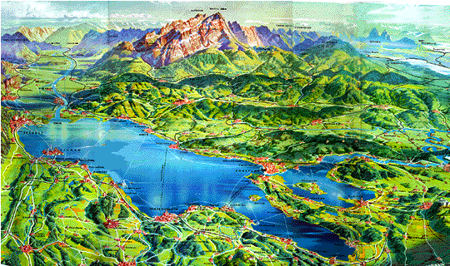
Lake Constance
Notes:
http://www.bodensee-info.com/bodensee/geographie/geograpie/bodensee.gif

Slide 43
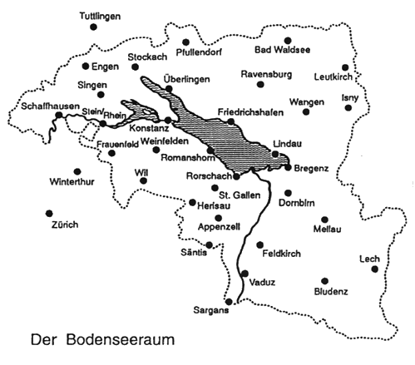
Lake Constance (D, CH, A)
Germany
Switzerland
Austria
Notes:
http://www.ub.uni-konstanz.de/boddb/bodkt.htm

Slide 44
That Water is in Switzerland
You point to a certain kilometer-wide volume of water in the center of the Lake, and you assert:
[Q] That water is in Switzerland.
Does [Q] assert a truth on some precisifications and a falsehood on others?

Slide 45
That Water is in Switzerland
No. By criterion (F0) above, [Q] is simply (super)false.
Whoever uses [Q] to make a judgment in the context of currently operative international law is making the same sort of radical mistake as is someone who judges that Karol Wojtya is more intelligent than the Pope.

Slide 46
Reaching the Starting Gate
  In both cases reality is not such as to sustain a partition of the needed sort.
  The relevant judgment does not even reach the starting gate as concerns our ability to evaluate its truth and falsehood via assignments of specific portions of reality to its constituent singular terms.

Slide 47
John is bald
This slurry is part of Mont Blanc
Geraldine died before midnight
John is bald
It is part of what we mean when we say that John is, as far as baldness is concerned, a borderline case that ‘John is bald’ is unjudgeable.

Slide 48
Partitions do not care
Our ordinary judgments, including our ordinary scientific judgments, have determinate truth-values
because the partitions they impose upon reality do not care about the small (molecule-sized differences between different precisified referents).

Slide 49
No Gaps
‘Bald’, ‘cat’, ‘mountain’, ‘island,’ ‘lake’, are all vague
But corresponding (normal) judgments nonetheless have determinate truth-values.

Slide 50
Partitions and Time
Sequences of partitions can be used to represent histories

Slide 51
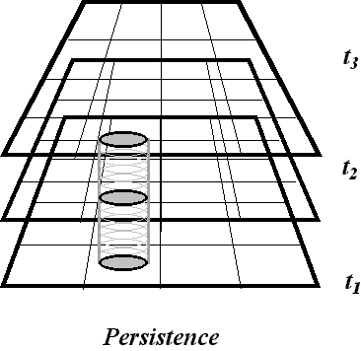
History (Time)

Slide 52
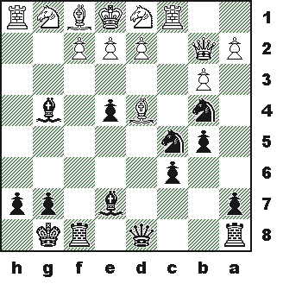
Chess

Slide 53
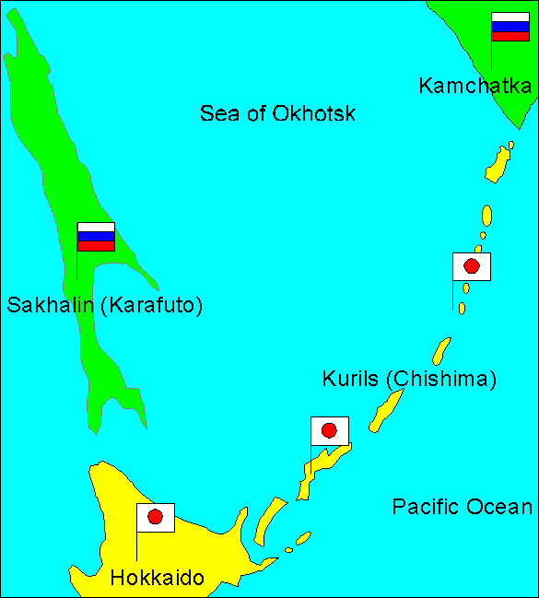
1875
1875

Slide 54
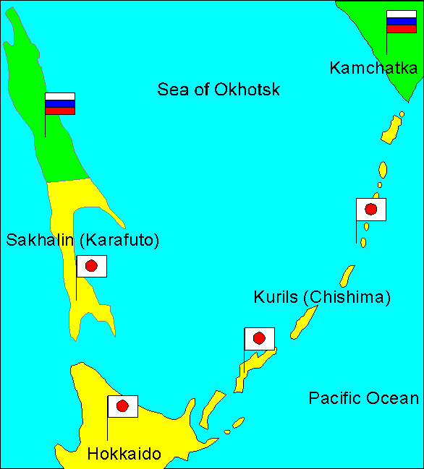
1905
1905

Slide 55
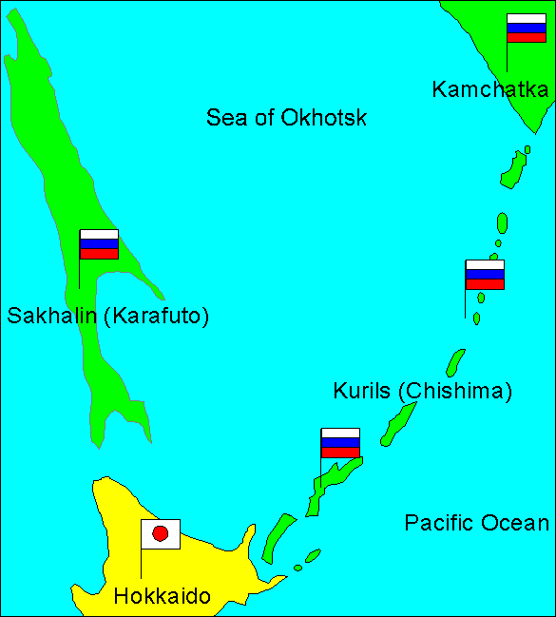
1945

Slide 56
Consistency of Partitions
Two partitions are consistent when there is some third partition which extends them both.

Slide 57
Union fails 3
We do not have:
If A and B are partitions, then there is some third partition C of which they are both sub-partitions
Call this the Axiom of Consistency

Slide 58
Granularity and QM
The Axiom of Consistency holds for all coarse-grained partitions (called by physicists ‘quasi-classical’)
For partitions of too fine a grain we may have the partition-theoretic equivalent of
L(x, P) and L(x, not-P)
Roland Omnès, The Interpretation
of Quantum Mechanics (Princeton 1994)

Slide 59
Distributivity
Distributive partitions satisfy:
if object x is a part of object y, where y is located at a complex z, then x is also located at that complex
All spatial partitions are distributive
A set is a simple example of a non-distributive partition

