Slide 1
VT

Slide 2
Austrian Economics and the Foundations of the Civil Law
Barry Smith

Slide 3
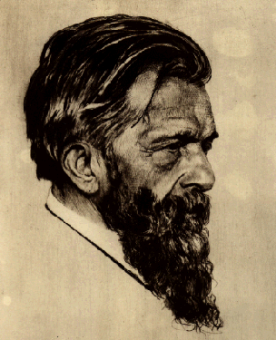
Carl Menger

Slide 4
Carl Menger and the Austrian School of Economics
Austrian Economics = study of the necessary dependence relations amongst the various constituent parts of the economic domain
apriorism – these dependence relations are intelligible
An exchange depends upon an exchanger and an exchangee

Slide 5
Carl Menger:
A good exists as such only if the following are simultaneously present:
1. A need on the part of some human being.
2. Properties of the object in question which render it capable of being brought into a causal connection with the satisfaction of this need.
3. Knowledge of this causal connection on the part of the person involved.
4. Command of the thing sufficient to direct it to the satisfaction of the need

Slide 6
Apriorism
Menger
Mises “Man Acts”
Rothbard “In Defence of Extreme Apriorism”
Hoppe

Slide 7
Some terminological background
Analytic = a truth of logic, a tautology
Synthetic = a truth with content – not reducible to any logical truth
A priori = known independently of experience
A posteriori = known via experience

Slide 8
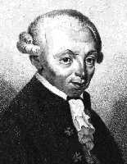
Kant

Slide 9
There exist synthetic a priori truths
But for Kant they are restricted to a small number of examples,
above all to the truths of Euclidean geometry and Newtonian physics

Slide 10
How can economics be based upon a priori truths?
Mises: confuses the a priori with the analytic – Austrian economics is based on certain axioms which are close to being truths of logic (praxeology = the logic of action)
Menger: there are a priori structures in reality = non-inductive intelligibilities

Slide 11
Menger:
“the goal of research in the field of theoretical economics can only be the determination of the general essence and the general connection of economic phenomena.”

Slide 12
The philosophical theory of the (non-Kantian) a priori
The philosophical theory of non-inductive intelligible structures in all domains of reality

Slide 13
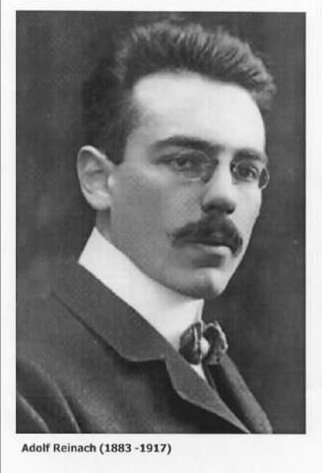

Slide 14
Adolf Reinach
The A Priori Foundations of the Civil Law – 1913
A study of the ontology of the promise and related social phenomena

Slide 15
From:
K. Mulligan (ed.),
Speech Act and Sachverhalt: Reinach and the Foundations of Realist Phenomenology, 1987

Slide 16
Speech Acts
Examples: requesting, questioning, answering, ordering, imparting information, promising, commanding, baptising
“‘acts of the mind’ which do not have in words and the like their accidental additional expression”
Social acts which “are performed in the very act of speaking”

Slide 17
Part of a “general ontology of social interaction”
Die apriorische Grundlagen des bürgerlichen Rechts
Reinach employs a theory of ontological structure
Austin, on the other hand, is concerned to combat a view of language
(the view of Aristotle, Frege)

Slide 18
Reinach: language, psychology, action (and ontological structure) (and law) all matter

Slide 19
Reinach’s typology of acts
spontaneous acts
= acts which consist in a subject’s bringing something about within his own psychic sphere,
as contrasted with passive experiences of feeling a pain or hearing a noise

Slide 20
Spontaneous acts and language
internal vs. external
internal = the act’s being brought to expression is non-essential
external = the act only exist in its being brought to expression

Slide 21
Self-directability
self-directable vs. non-self-directable
self-directable: love, hate, fear
non-self-directable: commanding, requesting

Slide 22
Non-self-directable external spontaneous acts
can be IN NEED OF UPTAKE:
the issuer of a command must not merely utter the command in public;
he must direct this utterance to its addressees in such a way that it is received and understood by them in an appropriate way.

Slide 23
Reinach:
A command is neither a purely external action nor is it a purely inner experience, nor is it the announcing (kundgebende Ausserung) to another person of such an experience.
Commanding … does not involve an experience which is expressed but which could have remained unexpressed,
…there is nothing about commanding which could rightly be taken as the pure announcing of an internal experience.

Slide 24
Reinach:
Commanding is rather an experience all its own, a doing of the subject to which in addition to its spontaneity, its intentionality and its other-directedness, the need to be grasped is also essential
Commanding, requesting, warning …
are all social acts, which by the one who performs them and in the performance itself, are cast towards another person in order to fasten themselves in his soul.

Slide 25
social acts have an inner and an outer side
‘If I say “I am afraid” or “I do not want to do that”, this is an utterance referring to experiences which would have occurred even without any such utterance.
‘But a social act, as it is performed between persons, does not divide into an independent performance of an act and an accidental statement about it;
‘it rather forms an inner unity of voluntary act and voluntary utterance.’

Slide 26
THE PARTS OF PROMISES AND OTHER SOCIAL ACTS
The linguistic component
Reinach: The same words, ‘I want to do this for you’, can … function both as the expression of a promise and as the informative expression of an intention.

Slide 27
THE PARTS OF PROMISES AND OTHER SOCIAL ACTS
The experiential component:
mental actions

Slide 28
THE PARTS OF PROMISES AND OTHER SOCIAL ACTS
Reinach: all social acts presuppose specific types of internal experiences
-- relation of one-sided ontological dependence
-- Brentano/Husserl descriptive psychology part of an ontology
(Theory of dependence originally introduced in context of psychology)

Slide 29
THE PARTS OF PROMISES AND OTHER SOCIAL ACTS
Social Act Experience
informing conviction
asking a question uncertainty
requesting wish
commanding will
promising will
enactment will

Slide 30
THE PARTS OF PROMISES AND OTHER SOCIAL ACTS
Social Act Experience
informing state conviction
asking a question state uncertainty
requesting wish
commanding will
promising will
enactment will

Slide 31
THE PARTS OF PROMISES AND OTHER SOCIAL ACTS
Social Act Experience
informing state conviction
asking a question state uncertainty
requesting event wish
commanding event will
promising event will
enactment event? will

Slide 32
CONTENT
Mental states and mental events can share the same content
Husserl: content vs. quality of an act
p
p!
p?

Slide 33
Reinach:
the intentional content of the underlying experience
the intentional content of the social act
the content of the action to be performed (in the case of promises, requests, commands …)

Slide 34
Social acts depend on uptake
(contrast: envy, forgiveness)
social acts must be both
addressed to other people
and
registered by their addressees

Slide 35
Some social acts not other-directed
and thus not in need of uptake:
waiving a claim
enacting a law
I promise you that p
I ask you whether p
(3) I order you to F
(4) I hereby enact that p

Slide 36
Enactments
BGB §1: “The ability of man to be a subject of rights begins with the completion of birth”
This is ‘not any sort of judgement’
Valid laws shape/create environments:
‘If a state of affairs stands for a group of subjects as objectively required in virtue of an enactment, then action realizing the state of affairs is consequently required of these subjects.’

Slide 37
FOUNDING RELATIONS FOR SOCIAL ACTS
Commands, marryings, baptisings
depend on
i. relations of authority
ii. appropriate attitudes
iii. appropriate environment
The simultaneous basis of the speech act

Slide 38
Grounding Social Acts
Reinach:
‘A question is grounded insofar as the state of affairs which it puts into question is objectively doubtful; an enactment is grounded insofar as the norm which is enacted, objectively ought to be.’

Slide 39
SUCCESSOR STATES FOR SOCIAL ACTS
Assertion gives rise to CONVICTION
Promise gives rise to
CLAIM and OBLIGATION
(not experiences)

Slide 40
Non-Physical Social Entities:
relations of authority …
(SIMULTANEOUS BASIS)
claims, obligations …
(SUCCESSOR STATES)
Compare: Searle’s deontic powers

Slide 41
The Structure of Social Acts
‘Insofar as philosophy is ontology or the a priori theory of objects, it has to do with the analysis of all kinds of objects as such.’ (GS 172).
The a priori theory of objects is formal ontology and not to be confused with the different material ontologies that result from applying the formal theory to the domain of mental acts or social acts (GS 431).

Slide 42
PARTS OF SOCIAL ACTS: Tendencies
Promising, commands, requests gives rise to a tendency to realization
Genes have a tendency to be expressed in the form of proteins
Bodies have a tendency to fall when dropped
Tendencies can be blocked …

Slide 43
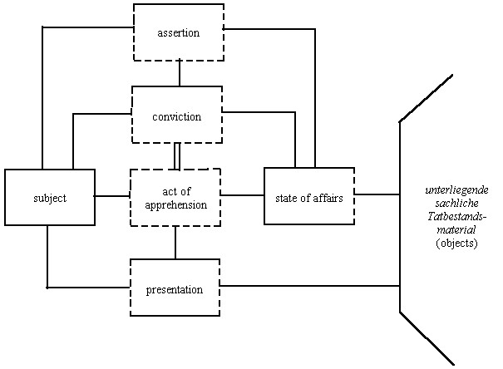
Assertion

Slide 44
event
state
event
process

Slide 45
Bunge-Wand-Weber (BWW) Ontology
Endurants created, destroyed, changed by events.
Record of a history is an endurant
Histories started stopped by events

Slide 46
event
state
?
?
event
?
process

Slide 47
THE BACKGROUND

Slide 48
Events give rise to states
Assertion gives rise to CONVICTION as its successor state
(if it does not, it is not an assertion)
John sees that Mary is swimming
Promising gives rise to CLAIM and OBLIGATION as its successor state

Slide 49
The Structure of the Promise
the promise
promiser
promisee
relations of one-sided
dependence

Slide 50
The Structure of the Promise
act of speaking
promiser
act of registering
promisee
content
three-sided mutual
dependence

Slide 51
The Structure of the Promise
act of speaking
promiser
act of registering
promisee
content
two-sided mutual dependence
oblig-ation
claim

Slide 52
The Structure of the Promise
action: do F
act of speaking
promiser
act of registering
promisee
content F
tendency towards realization
oblig-ation
claim

Slide 53
action: do F
act of speaking
promiser
act of registering
promisee
content F
oblig-ation
claim
sincere intention
The Background (Environment)

Slide 54
Modifications of Social Acts
Sham promises
Lies as sham assertions (cf. a forged signature); rhetorical questions
Social acts performed in someone else’s name (representation, delegation)
Social acts with multiple addresses
Conditional social acts

Slide 55
Collective social acts
Singing in a choir
Conversation
Dancing
Arguing
Religious rituals

Slide 56
action: do F
act of speaking
promiser
act of registering
promisee
content F
oblig-ation
claim
sincere intention
How modific-ations occur
The Background (Environment)

Slide 57
action: do F
act of speaking
promiser
act of registering
promisee
content F
oblig-ation
claim
sincere intention
How modific-ations occur
The Background (Environment)

Slide 58
action: do F
act of speaking
promiser
act of registering
promisee
content F
oblig-ation
claim
sincere intention
How modific-ations occur
The Background (Environment)

Slide 59
action: do F
act of speaking
promiser
act of registering
promisee
content F
oblig-ation
claim
sincere intention
How modific-ations occur
The Background (Environment)

Slide 60
action: do F
act of speaking
promiser
act of registering
promisee
content F
oblig-ation
claim
sincere intention
The Background (Environment, External Memory)
TRUST

Slide 61
The Ontology of Claims and Obligations (Endurants)
Debts
Offices, roles
Licenses
Prohibitions
Rights
Laws

Slide 62
Three sorts of history
1.
2.
3.

Slide 63
Three sorts of history
1.
2.
3.
The number 7
Bill Clinton
Clinton’s Presidency

Slide 64
Three sorts of objects
1. Necessary Objects (intelligible; timeless) – e.g. the number 7 (Plato)
2. Contingent Objects (knowable only through observation; historical; causal) – e.g. Bill Clinton (positivists)
3. Objects of the third kind (intelligible, but have a starting point in time) – e.g. my debts, Karl Popper’s knighthood (Adolf Reinach, Roman Ingarden)

Slide 65
A priori law vs. positive law
Positive law = historical modifications of a priori legal structures
A priori law: A promise gives rise to a claim and obligation
Positive law:
Signing a contract before witnesses counts as making a contract
Contracts signed by minors are not valid
Contracts not co-signed by a notary public are not valid

Slide 66
Apriorism
Reinach's a priori theory of law provides universal grammar of the (micro-)legal realm, or of human (micro-)institutions in general.
Austrian school of economics provides universal grammar of the micro-economic realm

Slide 67
Two sorts of social science
Micro vs. Macro
Micro deals with intelligible ontological structures
Macro deals with causal/historical regularities
Law and Ethics both Micro-Disciplines
foundations for Macro Disciplines (e.g. Legal History)
Austrian economics is Micro-Economics
Marxist economics is Macro-Economics
Apriorism applies only to the micro-social sciences

Slide 68
Other aprioristic micro-disciplines
a priori disciplines:
mereology
rational kinaesiology
geometry
chronometry mechanics

Slide 69
Other aprioristic micro-disciplines
aesthesiologies (theories of secondary qualities):
colourology
tone-theory
haptology (the theory of warmth and cold, textures)

Slide 70
Other aprioristic micro-disciplines
rational psychology:
theory of beliefs and desires
theory of feelings
theory of values and valuings
theory of will
theory of imperatives
theory of speech acts
theory of norms
aesthetics

Slide 71
Could the world of social entities (deontic powers) be entirely conventional ?
Oughtness a function of (collective) belief
Tokens – this obligation exists = people believe this obligation exists
Types – this type of obligation exists = people believe this type of obligation exists

Slide 72
Searle
The institutions of marriage, money, and promising are like the institutions of baseball and chess in that they are systems of …constitutive rules or conventions.

Slide 73
Reinach:
Some institutional concepts are purely conventional: endowment mortgage, junk bond derivatives trader, football team-manager
But not all of them can be
Consider the concept of convention

Slide 74
Reinach:
Basic institutional concepts: convention, ownership, obligation, uptake, agreement, sincerity,
rule, breaking a rule, authority, consent, jurisdiction
These are primitive = not capable of being defined in terms of more basic notions

Slide 75
The Basic Structures of Social Reality
Propositions about basic institutional concepts,
e.g.: an acknowledgement is different from an obligation
cannot be true purely as a matter of convention
For the very formulation and adoption of conventions presupposes concepts of the given sort.

Slide 76
The bonds
established by Reinach’s proto-structures of promise, claim and obligation …
can normally arise only within miniature civil societies,
within which special sorts of environmental conditions are satisfied

Slide 77
Already every single act of promising
manifests a tremendous transcategorial complexity, embracing constituents of a linguistic, psychological, quasi-legal and quasi-ethical sort, as well as more narrowly physical constituents of different types (including vibrations in the air and ear and associated electrical and chemical events in the brain).
How is this complexity possible?

Slide 78
This complex feat,
which is performed almost effortlessly dozens if not hundreds of times every day,
COULD NOT BE LEARNED
Therefore, there exist intrinsic intelligible structures in reality of which we have non-inductively acquired knowledge

Slide 79
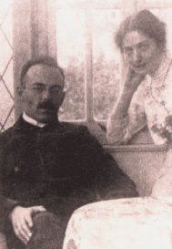
THE END

