Slide 1
VT

Slide 2

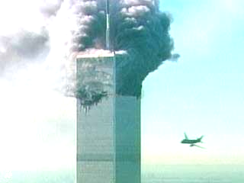
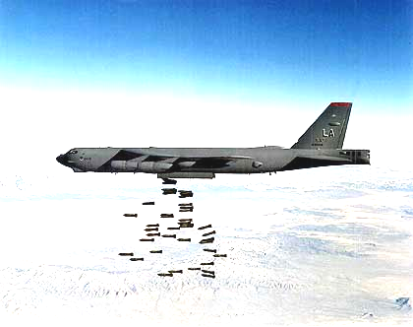
sommersemester 2002
dienstag, 23. april
18.30 uhr
hörsaalgebäude
hörsaal 18
universitäts-ringvorlesung
öffentliche
terror & der krieg gegen ihn
  barry smith (bufallo / leipzig)
  kamikaze – und der westen
leitung
georg meggle
mit unterstützung von
universität leipzig
hochschule für grafik und buchkunst
smwk-projekt kunst-kommunikation
studium universale
vereinigung von förderern und freunden
der universität leipzig e.v.
weitere informationen
link universitäts-ringvorlesung
www.uni-leipzig.de/~philos

Slide 3
  barry smith (bufallo / leipzig)
  kamikaze – und der westen
  http://ontology.buffalo.edu/smith

Slide 7
The Scorpion and the Frog
A scorpion meets a frog on the banks of the River Jordan
„Dear frog, will you take me over to the other bank on your back?"
„You think I‘m crazy?", answered the frog,
„As soon as we are on the water you will sting me and I‘ll drown"

Slide 8
The Scorpion and the Frog
„But then I‘ll go under too," said the scorpion.
„That‘s a good point", said the frog, and the scorpion climbed up onto his back.
But hardly had they swum a few meters before the frog felt a stinging pain.
„Damn!", said the frog, „Now you‘ve gone and stung me after all. Now we‘ll both die".

Slide 9
Version 1
"I know", answered the scorpion with a sigh.
„I‘m sorry.
" ... But I just am this way.
"We‘re not like you; we don‘t care at all about dying;
" … we don’t care about friends;
" ... We just lie and sting. That is our nature. But didn‘t you aready know that?"

Slide 10


Slide 11
Version 2
A scorpion meets a frog on the banks of the River Jordan
....
„Damn!", said the frog, „Now you‘ve gone and stung me after all. Now we‘ll both die".
„I‘m sorry.
... But we are after all in the Middle East."

Slide 12
Version 3
A scorpion meets a frog on the banks of the River Jordan
....
„Damn!", said the frog, „Now you‘ve gone and stung me after all. Now we‘ll both die".
„I‘m sorry.
... But we are after all in Quetzaltenango."

Slide 14
Question:
Why have all Western languages taken over the term Kamikaze from the Japanese?

Slide 15
Lemma 1
Loan words (like jokes) are often an important clue to the sources of cultural-historical innovations
  'Cuisine'
  'Schadenfreude'
  'Sex'

Slide 16
Lemma 2
There is something special in the history of the West
in virtue of which the term 'Kamikaze' has been adopted as a loan word in all major Western languages

Slide 17
Compare
the history of the word `assassino´, ‘assassin’, …

Slide 18
The Assassines
secret schiite-ismaili league founded by Hassan-I-Sabbah in 1090 on the territory of present-day Iran
first terrorist organisation in history

Slide 19
Die Assassinen (1090-1230)
Originally called by their enemies ‚Hashishin’
Influence extended from Pakistan to Europa.
It was counted by the assassines as especially honorable to die on an attack. In this way they arrive directly in paradise
»The soldier who dies in battle becomes god-like.«

Slide 20
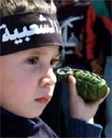

Slide 22
Kamikaze
the ‚Divine Wind’
13th century storm which saved Japan from the invasion of the Mongols under Kublai-Khan
Kamikaze-Pilots were not terrorists, but soldiers,
who attacked exclusively military targets
Notes:
http://www.heute.t-online.de/ZDFheute/artikel/0,1251,POL-8686-5917,00.html

Slide 23
Kamikaze: the religious question
The Shinto-Religion of Japan has no notion of paradise in the Christian-Islamic sense
But the soldier who dies in battle becomes god-like and becomes an object of reverence for all subsequent generations
Notes:
http://www.heute.t-online.de/ZDFheute/artikel/0,1251,POL-8686-5917,00.html
–

Slide 24
Question:
Were Kamikaze-Pilots in the Second World War volunteers?
In the final moment, yes

Slide 25
Much more important than paradise
is what happens if the kamikaze pilot is not successful in his mission
he must suffer shame
which will apply to his family for all generations to come

Slide 26
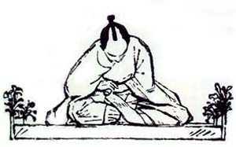

Slide 27
Notes:
http://www.heute.t-online.de/ZDFheute/artikel/0,1251,POL-8686-5917,00.html

Slide 28
Durkheim‘s taxonomy of suicides
1. Egoistic Suicide.
2. Altruistic Suicide.
3. Anomic Suicide.
4. Fatalistic Suicide.

Slide 29
Durkheim's taxonomy of suicides
1. Egoistic Suicide
arises where individuals suffer a sense of meaningless
In traditional societies strong collective consciousness gives people a broad sense of meaning to their lives.
Individuals strongly integrated into a family, a religious group, less likely to commit suicide

Slide 30
Durkheim's taxonomy of suicides
2. Altruistic Suicide
the individual forced into committing suicide; feels it is his duty to commit suicide
suicides of those who are old and sick
Jim Jones, Heavens Gate, hara kiri
Durkheim: may "spring from hope, for it depends on the belief in beautiful perspectives beyond this life."

Slide 31
Durkheim's taxonomy of suicides
3. Anomic Suicide
Anomie = lawlessness
suicide from social instability, breakdown of standards and values
in periods of stock market crash or over-rapid economic expansion
suicides of family members after the death of a husband or wife

Slide 32
Durkheim's taxonomy of suicides
4. Fatalistic Suicide
occurs when regulation is too strong
Durkheim: "persons with futures pitilessly blocked and passions violently choked by oppressive discipline" may see no way out.

Slide 33
A new form of "altruistic" suicide
5. Terroristic Suicide
the individual is forced into committing suicide
and into taking others with him
by terroristic groups appealing to his feelings of duty, hope and organizing his suicide by providing means and target

Slide 34
Two forms of terrorist operations
missions with planned withdrawals
"one-way" (voluntary) missions based on terroristic suicide
… the latter are not found in the West

Slide 35
Thesis:
Organized suicide bombers,
leagues/sects of assassins practising terroristic suicide
... are an exclusively non-Western phenomenon

Slide 36
Two sides to terroristic suicide:
hard men, suppliers of explosives, behind the scenes
the suicides themselves (mainly adolescents)

Slide 37
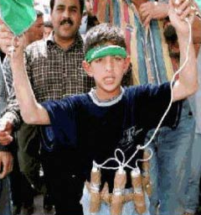

Slide 38
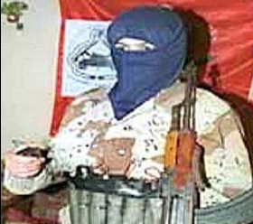

Slide 39
The logic of this thesis:
For all x, if x practices organized terroristic suicide, then x is non-Western
NOT:
For all x, if x is non-Western, then x practices organized terroristic suicide

Slide 40
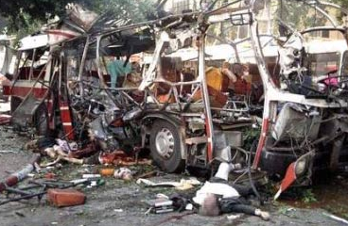

Slide 41
Logic again:
For all x, if x is a case of organized deliberate suicide designed to bring about the simultaneous deaths of others
then x is non-Western

Slide 42
Counter-Example
Luftwaffe Sturmstaffel 1
Notes:
http://members.aol.com/Panzrbaer2/ss1.html

Slide 43

Counter-Example
Luftwaffe Sturmstaffel 1
Motto: "Ich ramme!"
Notes:
http://members.aol.com/Panzrbaer2/ss1.html

Slide 44
Die Rammjäger
An experimental fighter unit formed to test new methods and equipment for attacking Allied bomber formations.
Notes:
http://members.aol.com/Panzrbaer2/ss1.html

Slide 45
Die Rammjäger
The Lightning Bolts and Clouded Sky represent the attack of Sturmstaffel 1 descending upon the enemy bombers
like a storm
Notes:
http://members.aol.com/Panzrbaer2/ss1.html

Slide 46
Sturmstaffel 1
From 3 to 5 April 1998, the surviving pilots
of Sturmstaffel 1 held a first-time reunion in Echterdingen, Germany.
http://members.aol.com/Panzrbaer2/ss1.html
... The reunion was initiated and organized by Barry Smith of Feldpost Amerika ...
Notes:
http://members.aol.com/Panzrbaer2/ss1.html

Slide 47
Sturmstaffel 1
Each pilot of Sturmstaffel 1 signed an oath that he would shoot down at least one bomber per mission or, as a last resort, ram an enemy bomber.
In practice, there may have been only one case in which a pilot intentionally rammed a bomber,
but due to their close-in tactics, many unintentional collisions did occur.
... some evidence suggests they may have inspired the Japanese to take this bold concept to the level of intentional self-sacrifice.
Notes:
http://members.aol.com/Panzrbaer2/ss1.html

Slide 48
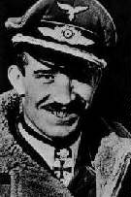
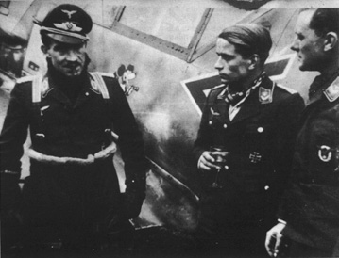
Adolf Galland (1912 - 1996)
Pilot, Ace, General of the Luftwaffe
Notes:
"IT IS MY DUTY TO RESPOND..."
COMMENTS ON THE THEME "RAMMJAEGER AND SELF-SACRIFICE MISSIONS" BY ADOLF GALLAND
- Jaegerblatt Vol. XL (2), p.17 (1991)

Slide 49
Did Rammjäger ever really exist?
Adolf Galland Jägerblatt, Vol. XL (2), p. 17 (1991):
“Rammjäger and Self-Sacrifice Missions”
Notes:
"IT IS MY DUTY TO RESPOND..."
COMMENTS ON THE THEME "RAMMJAEGER AND SELF-SACRIFICE MISSIONS" BY ADOLF GALLAND
- Jaegerblatt Vol. XL (2), p.17 (1991)

Slide 50
Galland:
In 1944 Major von Kornatzki proposed ramming tactics against American heavy bombers to me in my capacity as General der Jagdflieger. ... I was able to convince him that ramming was unnecessary
... fighters that were able to approach very near the bombers were certain to shoot them down, and then had a chance for their own survival.
Notes:
"IT IS MY DUTY TO RESPOND..."
COMMENTS ON THE THEME "RAMMJAEGER AND SELF-SACRIFICE MISSIONS" BY ADOLF GALLAND
- Jaegerblatt Vol. XL (2), p.17 (1991)

Slide 51
Galland:
In the second half of 1944 Oberst Hajo Herrmann raised the issue of ramming tactics with me once more.
To my question as to the role he would assign himself on such a ramming mission, he said that he had ruled out a personal role as leader of the ramming unit in the air.
Notes:
"IT IS MY DUTY TO RESPOND..."
COMMENTS ON THE THEME "RAMMJAEGER AND SELF-SACRIFICE MISSIONS" BY ADOLF GALLAND
- Jaegerblatt Vol. XL (2), p.17 (1991)

Slide 52
Did Rammjäger ever really exist?
I opposed the ramming, or "self-sacrifice" mission, using the same arguments ..., but I was duty bound to inform Goering, who shared my attitude. ... Goering confirmed that Hitler also opposed self-sacrifice missions for the German military.
For the rest of my period of service as General der Jagdflieger, talk of ramming, or self-sacrifice missions, was banished from the table.
Notes:
"IT IS MY DUTY TO RESPOND..."
COMMENTS ON THE THEME "RAMMJAEGER AND SELF-SACRIFICE MISSIONS" BY ADOLF GALLAND
- Jaegerblatt Vol. XL (2), p.17 (1991)

Slide 53
Thesis
Notes:
http://www.heute.t-online.de/ZDFheute/artikel/0,1251,POL-8686-5917,00.html

Slide 54
Two sorts of terrorist organization
IRA (Irish Republican Army)
ETA (Basque Fatherland and Liberty)
FARC (Revolutionary Armed Forces of Colombia)
Shining Path (Sendero Luminoso)
Animal Liberation Front
Baader-Meinhof Gang
...do not practice terroristic suicide

Slide 55
Two sorts of terrorist organization
Al Aqsa Martyrs Brigades
HAMAS (Islamic Resistance Movement)
Hizballah (Party of God)
PIJ (Palestinian Islamic Jihad)
PFLP (Popular Front for the Liberation of Palestine)
Notes:
Tanzim and Fatah and the Al Aqsa Martyrs Brigades, and the still harder men of Hamas and Hezbollah

Slide 56
Two sorts of terrorist organization
ANO (Abu Nidal Organization) a.k.a. Black September, the Fatah Revolutionary Council, the Arab Revolutionary Council, the Arab Revolutionary Brigades, the Revolutionary Organization of Socialist Muslims
Tanzim
Fatah
Notes:
Tanzim and Fatah and the Al Aqsa Martyrs Brigades, and the still harder men of Hamas and Hezbollah

Slide 57
Thesis
organized leagues of assassins practising terroristic suicide
... are an exclusively non-Western phenomenon

Slide 58
Why?
What does ‘the West’ mean ?

Slide 59
Possible explanations:
Courage (vs. Comfort)
Poverty
Totalitarianism (vs. Democracy)
Humiliation (Demutigung)
Hopelessness
Military weakness
Religion

Slide 60
Possible explanations:
Courage (vs. Comfort)
where does this courage come from?

Slide 61
Possible explanations:
Poverty
– empirically false

Slide 62
Possible explanations:
Totalitarianism (vs. Democracy)
– why so few democracies in the Islamic world?

Slide 63
Possible explanations:
Humiliation
– only under very special conditions can humiliation be thought to justify killing
– what are these conditions?

Slide 64
Possible explanations:
Hopelessness
– conditions of hopelessness created in part through terroristic suicide

Slide 65
Possible explanations:
Military weakness
– why not apply to IRA, ETA, etc.?

Slide 66
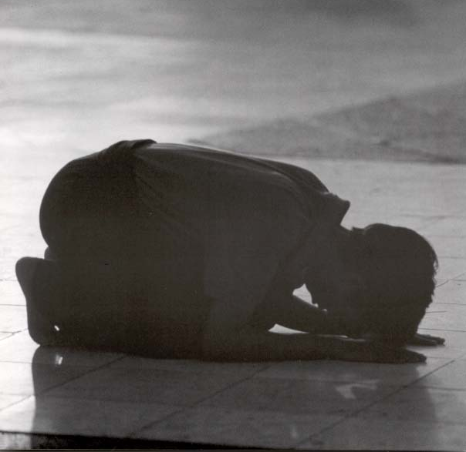
Possible explanations:
Religion
Only religion can provide the very special sort of background conditions needed to make possible the extreme phenomenon of terroristic suicide

Slide 67
The Essence of the West
Harold J. Berman: Law and Revolution. The Formation of the Western Legal Tradition, Harvard, 1983
Philippe Nemo: “The Invention of Western Reason”, Kirchberg, 2000

Slide 68
The Gregorian Reform
The Y1K Problem
Pope Gregory VII
“Dictatus papæ” (1076)

Slide 69
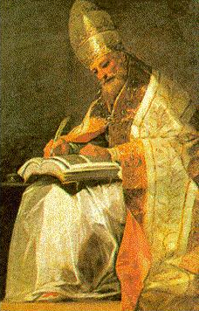
Gregory VII

Slide 70
Gregory VII
Ameliorism vs. Apocalypse
A new philosophy of man:
… what you do here on earth is of importance for your salvation

Slide 71
What are we here for?
to make the world a better place
a place worthy of Christ's return
... importance of reason, free choice, will, action, science ...

Slide 72
Elements of the Papal Revolution 1
Adoption of Roman Law
a new universal legislation – the “Corpus juris canonici” – organises the whole of Christian society
with the aim of rationally organising economic, social, and even private lives

Slide 73
Elements of the Papal Revolution 2
Birth of the idea of Rechtsstaat
Law as basis for a new kind of politics
Law as basis for a new kind of economics

Slide 74
Elements of the Papal Revolution 3
use legal proceedings to decide disputes, instead of violence or the whim of the king
Law as impersonal
… a system of known, abstract rules
... slowly but surely, a more structured, ordered society is constructed

Slide 75
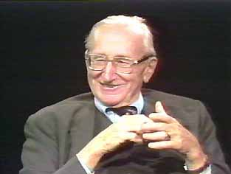

Slide 76
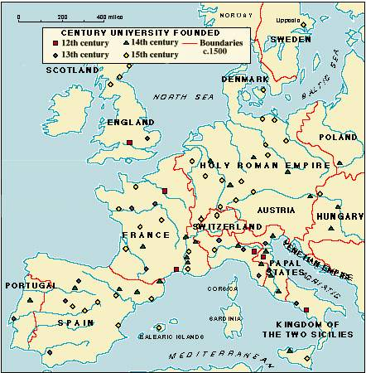
Elements of the Papal Revolution 4
universities established throughout Europe
Bologna 1088
Oxford 1167
Leipzig 1409

Slide 77
Science
in the sense of the search for knowledge for its own sake
deriving from the Greeks
preserved and fostered by the Arabs
disseminated systematically in the West

Slide 78
Monasteries
spread knowledge, writing
spread new forms of agriculture, viticulture, hygiene, medicine
...all as part of the new project to solve the Y1K problem

Slide 79
The Church, through its monasteries and universities,
creates new systems of communication
world’s first postal service between Oxford University and Prague University in the 14th century

Slide 80
Communication systems
… the Medieval equivalent of the internet

Slide 81
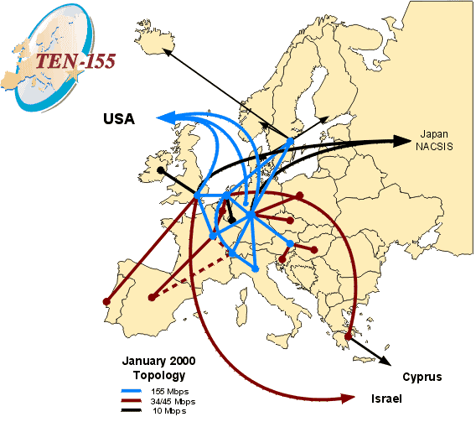

Slide 82
Exploration and Conquest
the Crusades
the Reconquista in Spain
the German Drang nach Osten
Marco Polo
Columbus ...
resting on science and reason and made possible by the new forms of socio-economic organization

Slide 83
a new world
a new philosophy of geography: a world for exploration, a world for understanding
... to be improved
not through prayer or apocalypse
but through good works and sound institutions

Slide 84
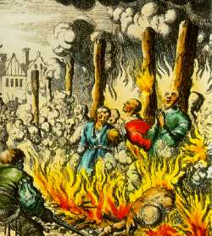
What came before?

Slide 85
The Problem of Original Sin
Augustine: after original sin, man deserves nothing but death
–∞
+a, +b, +c …
Human action has no value
moral order is arbitrary and subject to the whim of the gods

Slide 86
There is no measure on earth

Slide 87
Hence
abstain from acting altogether:
isolate yourself from the world
appeal to supernatural forces:
prayers, pilgrimages, the worship of relics
in a magical, enchanted (pre-Western) world reason is not required

Slide 88
Notes:
http://www.heute.t-online.de/ZDFheute/artikel/0,1251,POL-8686-5917,00.html

Slide 89
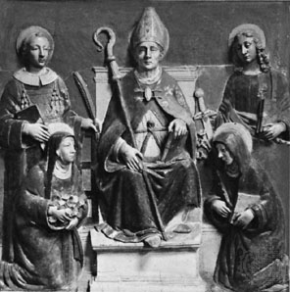
St. Anselm of Canterbury (died 1109)

Slide 90
Anselm
"Credo, ut intelligam"
("I believe in order to know")
Anselm’s philosophy the expression of ameliorism, the desire to make the world better via reason

Slide 91
Solving the Problem of Original Sin
The Anselmian Doctrine of Atonement
Christ‘s death on the Cross is the way of atonement for the sins of the world

Slide 92
Human action recovers its meaning
It is up to the individual to be saved,
not by magic, but by good works
Human life, here on earth, matters

Slide 93
Anselm‘s New Balance Sheet
PASSIVA ACTIVA
–∞ –a –b –c +∞ +a +b +c
Original_sin actual_sins Christ’s_sacrifice good_works

Slide 94
Anselm‘s New Balance Sheet
crimes | paying your debt to society by serving time in jail There is a measure on earth

Slide 95
Doctrine of purgatory (Fegefeuer)
never too late to start performing good works
purgatory gives you the chance to atone for your sins even after death

Slide 96
Going to jail
gives you a chance to atone for your sins before death
to wipe the slate clean
idea of “criminal justice”
→ culture of guilt

Slide 97
Culture of shame
if you do something wrong
(for example refusing to obey an order)
the shame will affect your whole family and all your descendants for all eternity
… suicide is the only solution
suicide is the honorable solution

Slide 98
Notes:
http://www.heute.t-online.de/ZDFheute/artikel/0,1251,POL-8686-5917,00.html

Slide 99
Paths to Salvation
Heaven
Earth
Heaven
Earth

Slide 100
Salvation
is no longer an “all-or-nothing” issue,
but one in which man has to measure and make use of his reason
Nemo: The West is a scientific and legal civilization based on the principle that life here on Earth matters

Slide 101
What does ‘the West’ mean?
The West = those societies which fell, during one thousand years of cultural development, within the influence of the Gregorian reforms
Thus Quetzaltenango
and Guadaloupe, and Silicon Valley
but not Japan, not Russia,
and not the Islamic world

Slide 103
If life here on earth is meaningful
this implies a separability of spheres:
above all the separation of state and church
a materially successful society can also be a moral and religious society

Slide 104
If life here on earth is insignificant
God and society cannot be separated
Universal theocratic totalitarianism is the only moral form of social order

Slide 105
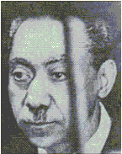
Sayyad Qutb (1906-1966)
the brains of Al Quaeda
to go from jahiliyyah (the “primitive savagery” of pre-Islamic days)
to a universal theocratic society based on Divine Governance

Slide 106
The Meaning of Life
Not happiness
But free action
Why is freedom important?
Mill’s answer
Why is it important not merely to do the right thing, but to do the right thing of your own free will?
Because only free action contributes to the meaningfulness of your life

Slide 107
The Meaning of Life
The failed mountaineer and the failed artist

Slide 108
The Measure of Civilizations
Happiness
Morality
Welfare (riches ...)
Meaningfulness – the West is best
at least in this: that the West is a civilization more conducive to the living of meaningful lives on the part of its citizens

