Slide 1
VT

Slide 2
Searle and De Soto
The New Ontology of the Social World
Barry Smith

Slide 3
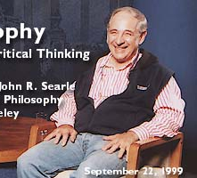
Searle

Slide 4
Searle’s Speech Acts (1969)
    Regulative vs. Constitutive Rules
    The former merely regulate antecedently existing forms of behaviour, as rules of polite table behaviour regulate eating
    The latter create new forms of behaviour, as the rules of chess create the very possibility of our engaging in the type of activity we call playing chess.

Slide 5
Constitutive rules
  have the basic form:
    X counts as Y in context C
    Examples:
    signaling to turn left
    bidding in an auction house

Slide 6
Constitutive rules
    An utterance of the form ‘I promise to mow the lawn’ counts as putting oneself under a corresponding obligation.
    The Y term in a constitutive rule characteristically marks something that has consequences in the form of rewards, penalties, obligations to act.

Slide 7
Constitutive rules
  form systems:
    acting in accordance with all, or a sufficiently large subset of, these and those rules by individuals of these and those sorts
    counts as
    playing basketball.

Slide 8
Searle: there is only one level of brute facts
    – constituted by the facts of natural science
    From out of this there arises a hierarchy of institutional facts at successively higher levels.

Slide 9
Brute facts
    are independent of all human institutions, including the institution of language.

Slide 10
Searle:
When you perform a speech act then you create certain institutional facts
(you create a miniature ‘civil society’).

Slide 11
Institutional facts
    exist because we are here to treat the world and each other in certain, very special (cognitive) ways
    Institutions are systems of constitutive rules.
    Examples of institutions:
    money
    property
    marriage
    government

Slide 12
Problem
    how can a mere utterance give rise to a mutually correlated obligation and claim?
    Searle will explain how these consequences arise by means of his theory of constitutive rules.

Slide 13
Every institutional fact
  is underlain by a (system of) rule(s) of the form “X counts as Y in context C”. (Searle 1969)

Slide 14
Constitutive rules
  create new forms of behavior
  as the rules of chess create the very possibility of our engaging in the type of activity we call playing chess

Slide 15
Promises
    are utterances which count as falling under the institutional concept act of promise,
    The latter is itself logically tied to further concepts such as claim and obligation.
    THEREFORE WE CAN DERIVE AN OUGHT FROM AN IS:
    John promised to do p
    John ought to do p

Slide 16
Constitutive rules
  have the basic form:
    X counts as Y in context C

Slide 17
Examples
X = a certain arm movement
Y = signalling to turn left
bidding in an auction house
threatening your opponent’s bishop
signing a debt agreement

Slide 18
Constitutive rules
    X = a certain utterance of the form
    ‘I promise to mow the lawn’
    Y = putting yourself under a corresponding obligation
    The Y term in a constitutive rule characteristically marks something that has consequences in the form of rewards, penalties, obligations to act.

Slide 19
Problem
    how can a mere utterance give rise to a mutually correlated obligation and claim?
    Recall: The Y term in a constitutive rule characteristically marks something that has consequences in the form of rewards, penalties, obligations to act.

Slide 20
Constitutive rules
    affect our behavior in the following way:
    where such rules obtain we can perform certain special types of activities
    (e.g. playing chess)
    in virtue of this our behavior can be interpreted by ourselves and by others in terms of certain very special types of institutional concepts.

Slide 21

Searle’s Ontology of Social Reality

Slide 22
Social Reality
  I go into a café in Paris and sit in a chair at a table.
  The waiter comes and I utter a fragment of a French sentence.
  I say, ‘un demi, Munich, pression, s’il vous plaît.’
  The waiter brings the beer and I drink it.
  I leave some money on the table and leave.
  ^{THIS SCENE HAS A ‘HUGE} ^{INVISIBLE ONTOLOGY’}

Slide 23
Social Reality
    the waiter did not actually own the beer he gave me, but he is employed by the restaurant which owned it.
    The restaurant is required to post a list of the prices of all the boissons.
    The owner of the restaurant is licensed by the French government to operate it.
    As such, he is subject to a thousand rules and regulations I know nothing about.
    I am entitled to be there in the first place only because I am a citizen of the United States, the bearer of a valid passport, and I have entered France legally.

Slide 24
Searle’s Challenge
To develop an ontology of social reality that is both realist and naturalistic

Slide 25
Realism
social reality exists
it is not a mere fiction

Slide 26
Searle’s axiom of naturalism
    There is one world, and everything in it is governed by the laws of physics (sometimes also by the laws of biology, neurology, …)

Slide 27
Social Reality
  By acting in accordance with constitutive rules
  we are able to impose certain special rights,
  ^{duties, obligations}
  ^{– ‘deontic powers’ –}
  on our fellow human beings and on the reality
  ^{around us.}
  ^{Searle:}
  this ‘involves a kind of magic’

Slide 28
Collective Intentionality
    How to understand social reality in naturalistic terms?
    Human beings are biological beasts. Like other higher mammals they enjoy the capacity for ‘collective intentionality’
    … they are able to engage with others in cooperative behavior in such a way as to share the special types of beliefs, desires and intentions involved in such behavior.

Slide 29
^{The Ontology of Social Reality}
    Social facts = facts involving collective intentionality
    ^{(manifested} ^{already among higher mammals)}
    Institutional facts = special kinds of social facts involving in addition a deontic component;
    … they are facts which arise when human beings collectively award status functions to parts of reality,
    which means: functions those parts of reality could not perform exclusively in virtue of their physical properties.

Slide 30
This works
via constitutive rules
X counts as Y in context C

Slide 31
The X Counts As Y Theory of Institutional Reality
  Naturalism implies (?) that both the X and the Y terms in Searle’s formula range in every case over token physical entities
  Recall: There is one world, and everything in it is governed by the laws of physics (sometimes also by the laws of biology, neurology, …)

Slide 32
Status functions
    A line of yellow paint performs the function of a barrier
    A piece of green-printed paper performs the function of a medium of exchange
    A human being in a black suit performs the function of a magistrate
    A tall sandstone building performs the function of a house of god

Slide 33
Social Reality
    By exchanging vows before witnesses
    a man and a woman bring a husband and a wife into being
    (out of X terms are created Y terms with new status and powers).

Slide 34
The Problem
    How can Searle’s naturalism allow a realistic ontology of social reality
    = an ontology which takes prices, licenses, debts and corporations to exist in the very same reality that is described by physics and biology?

Slide 35
X counts as Y, Y counts as Z
  … a Y term can itself play the role of a new X term in iterations of the formula:
    status functions can be imposed upon physical reality as it has been shaped by earlier impositions of function

Slide 36
but, because of naturalism,
  this imposition of function
  gives us nothing ontologically new
    Bill Clinton is still Bill Clinton even when he counts as President

Slide 37
Social Objects
    While each Y term is in a sense a new entity – President Clinton did not, after all, exist before his Inauguaration – this new entity is from the physical perspective the same old entity as before.
    What has changed is the way the entity is treated in given contexts and the descriptions under which it falls.

Slide 38
Turtles
    Searle: wherever a status-function is imposed there has to be something it is imposed upon
    Eventually the hierarchy must bottom out in phenomena whose existence is not a matter of human agreement.

Slide 39
Turtles
    It could not be that the world consists of institutional facts all the way down, with no brute reality to serve as their foundation.

Slide 40
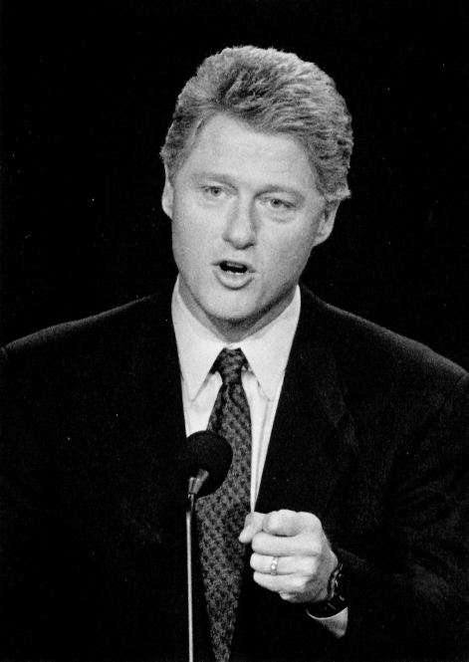
A President

Slide 41
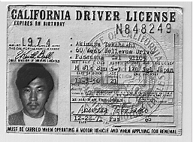
A California Driving License

Slide 42
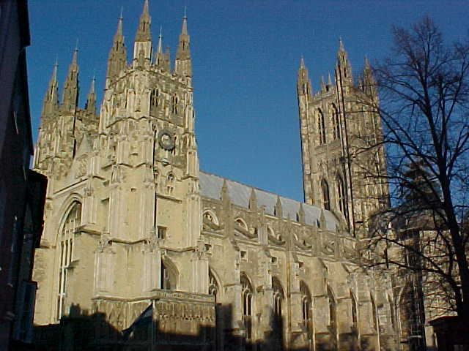
A Cathedral

Slide 43
Objects and events
    The range of X and Y terms includes not only individual substances (objects, things) such as you and me but also events
    as when an act of uttering counts as the making of a promise.

Slide 44
Naturalism:
    when a given event counts as the making of a promise, then the event itself does not physically change; no new event comes into being,
    rather the event with which we start is treated in a special way.

Slide 45
Naturalism:
    This works when the Y term exists simultaneously with the corresponding X term
    (as when an audioacoustic blast counts as an utterance of English)
    – the two are, after all, identical

Slide 46
Naturalism:
    but how can an event which lasts 2 seconds be the bearer, the ontological support, the physical foundation,
    of deontic powers (e.g. claims, obligations) which continue to exist for several months?

Slide 47
Here, there is no piece of green-printed paper, no organism, no building, is available to serve as X term in the future.

Slide 48
Searle:
    “I promise something on Tuesday, and the act of uttering ceases on Tuesday, but the obligation of the promise continues to exist over Wednesday, Thursday, Friday, etc.

Slide 49
Searle’s response:
    “that is not just an odd feature of speech acts, it is characteristic of the deontic structure of institutional reality.
    “So, think for example, of creating a corporation. Once the act of creation of the corporation is completed, the corporation exists.
    “It need have no physical realization,
    it may be just a set of status functions.”

Slide 50
Searle’s response:
    “The whole point of institutional facts is that once created they continue to exist as long as they are recognized.
    “You do not need the X term once you have created the Y status function.
    “At least you do not need it for such abstract entities as obligations, responsibilities, rights, duties, and other deontic phenomena, and these are, or so I maintain, the heart of the ontology of institutional reality.”

Slide 51
Searle’s social ontology
    is thus committed to free-standing Y terms
    entities which do not coincide ontologically with any part of physical reality
    entities which are not subject to the laws of physics or biology or neurology

Slide 52
Institutional reality
includes not only physical objects and events but also certain abstract entities:
    corporations
    obligations
    rights
    legal systems
    debts
    (blind chess games)
  which have no physical realization.

Slide 53
The Construction of Social Reality:
    all sorts of things can be money, but there has to be some physical realization, some brute fact
    – even if it is only a bit of paper or a blip on a computer disk –
    on which we can impose our institutional form of status function.
    Thus there are no institutional facts without brute facts.

Slide 54
But
    Does a blip on a computer disk really count as money?
    Do we truly impose status functions on blips in computers?
    Can we use blips in computers to buy things with?

Slide 55
Searle confesses his error
    On at least one point … Smith has shown that the account I gave in [The Construction of Social Reality] is mistaken.
    I say that one form that money takes is magnetic traces on computer disks, and another form is credit cards.

Slide 56
Strictly speaking neither of these is money, rather, both are different representations of money.

Slide 57
Blips in computers merely represent money.
    Title deeds merely record or register the existence of a property right.
    An IOU note records the existence of a debt; it does not count as the debt.

Slide 58
Objects vs. Representations
    Mental acts do not count as obligations, any more than blips in computers count as money.
    Rather, all of these things belong to the domain of records and registrations

Slide 59
The Credit Card
    “can be used in a way that is in many respects functionally equivalent to money, but even so it is not itself money.
    “It is a fascinating project to work out the role of these different sorts of representations of institutional facts, and I hope at some point to do it.”

Slide 60
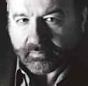
Hernando De Soto

Slide 61
The Mystery of Capital
    Why Capitalism Triumphs in the West
    and Fails Everywhere Else
    (Basic Books, 2000)
    It is the ‘invisible infrastructure of asset management’ upon which the astonishing fecundity of Western capitalism rests

Slide 62
This invisible infrastructure
    consists precisely of representations, of property records and titles
    These capture what is economically meaningful about the corresponding assets
    “The formal property system that breaks down assets into capital is extremely difficult to visualize”

Slide 63
The domain of free-standing Y terms
    = the domain of what exists in virtue of representations
    “Capital is born by representing in writing—in a title, a security, a contract, and other such records—the most economically and socially useful qualities [of a given asset].
    “The moment you focus your attention on the title of a house, for example, and not on the house itself, you have automatically stepped from the material world into the [non-pnysical] universe where capital lives.”

Slide 64
The Mystery of Capital
    We often take advantage of the abstract (non-physical) status of free-standing Y terms
    in order to manipulate them in quasi-mathematical ways:

Slide 65
      we pool and collateralize assets
      we securitize loans
      we consolidate debt
      shareholders can buy and sell their property rights in a factory without affecting the integrity of the physical asset

Slide 66
The mathematical divisibility of capital
means that capital is no longer the privilege of the few

Slide 67
What serves as security in credit transactions
    is not physical dwellings, but rather the equity that is associated therewith.
    This equity is something abstract that is represented in a legal record or title in such a way that it can be used to provide security to lenders in the form of liens, mortgages, easements, or other covenants.

Slide 68
Records and Representations
bring a new domain of reality into existence
– and this can have positive effects on the lives of human beings
Recall: the institution of chess masters
Compare: the institution of credit-worthiness records, insurance

Slide 69
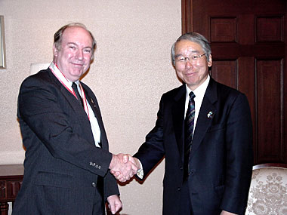
A Debt
thoughts,
worries
thoughts
an abstract pattern tied to specific parties and to a specific initiating event
records
representations

Slide 70
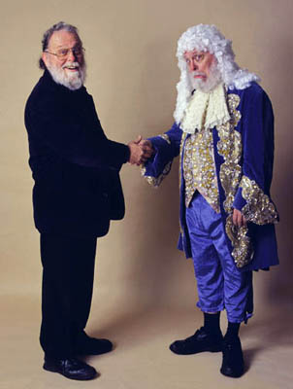
An Informal Debt
thoughts,
worries
thoughts, worries
does not have the
chance to shape for
good the lives of
the parties involved

Slide 71
Against Concepts
“The proof that property is pure concept comes when a house changes hands; nothing physically changes.”
Concepts belong to the realm of records and registrations.
The relation of property is out there on the side of the objects (not in people’s heads)
but it is non-physical

Slide 72
the key to modern development:
= a reliable means to discover, with great facility and on on ongoing basis, the most potentially productive qualities of resources.
“As Aristotle discovered 2,300 years ago, what you can do with things increases infinitely when you focus your thinking on their potential.
“Formal property became the staircase to the … realm where the economic meaning of things can be discovered and where capital is born.”

Slide 73
The West
= a common system of enforceable formal property registrations, which made knowledge functional by depositing all the information and rules governing accumulated wealth and its potentialities into one knowledge base
AND MADE PEOPLE ACCOUNTABLE ACROSS THE ENTIRE PROPERTY JURISDICTION

Slide 74

First Axiom of Ontological Realism:
Nothing is certain except

Slide 75
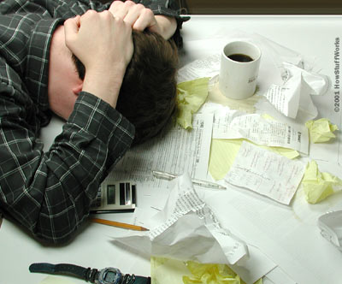

Slide 76
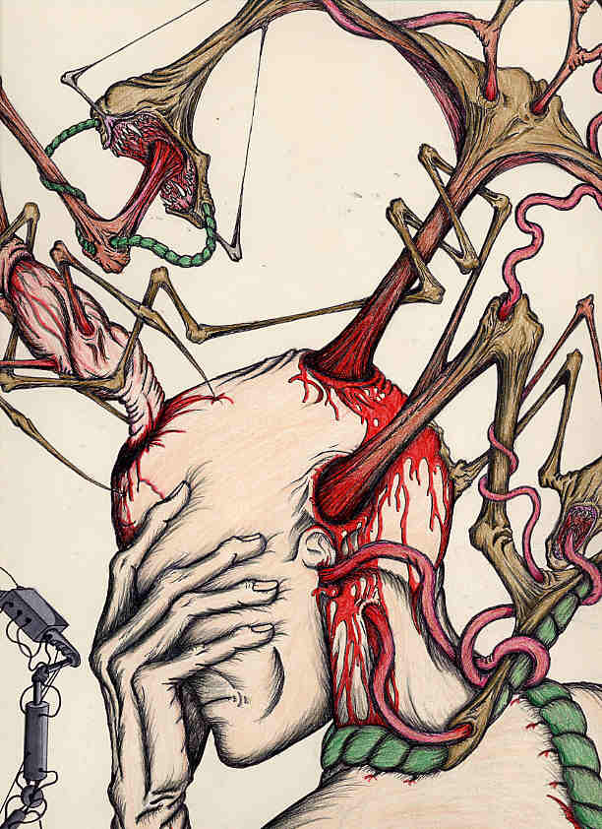
THE END

