Slide 1
VT

Slide 2
The Ontology of Commodities and Services, or:
Why You Can Rent a Car but Cannot Rent a Person):
Barry Smith
http://ontologist.com

Slide 3
Nouns and verbs
Substances and processes
Endurants and perdurents
In preparing an inventory of reality
we keep track of these two different categories of entities in two different ways

Slide 4

Snapshot vs. Video
t i m e
process
substance

Slide 5
SNAP vs SPAN
t i m e
process
substance

Slide 6
SNAP and SPAN
SNAP entities
- have continuous existence in time
- preserve their identity through change
- exist in toto if they exist at all
SPAN entities
- have temporal parts
- unfold themselves phase by phase
- exist only in their phases/stages

Slide 7
SNAP vs. SPAN
Substances vs. their lives

Slide 8
You are a substance
Your life is a process
You are 3-dimensional
Your life is 4-dimensional

Slide 9
Substances
Mesoscopic reality is
divided at its natural joints
into substances:
animals, bones, rocks, potatoes

Slide 10
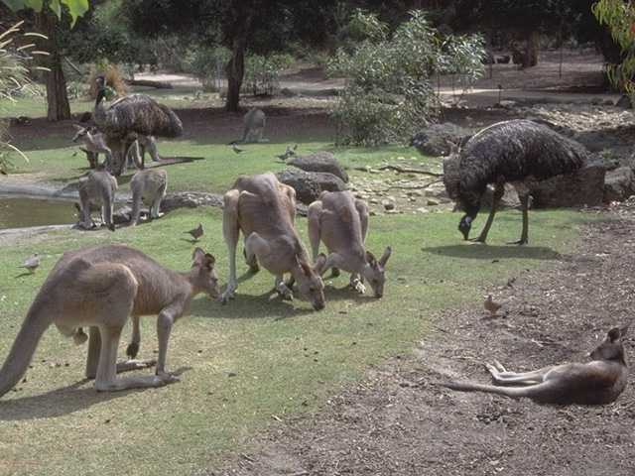

Slide 11
Processes
Processes merge into one another
Process kinds merge into one another
… few clean joints either between instances or between types

Slide 12
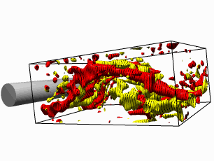
Processes
t i m e

Slide 13
In the world of flux
everything is flux

Slide 14
Processes have temporal parts
The first 5 minutes of my headache is a temporal part of my headache
The first game of the match is a temporal part of the whole match

Slide 15
Substances do not have temporal parts
The first 5-minute phase of my existence is not a temporal part of me
It is a temporal part of that complex process which is my life

Slide 16
Need for different perspectives
Not one ontology, but a multiplicity of complementary ontologies
Cf. anatomy vs. physiology in medicine
Cf. particle vs. wave ontologies in quantum mechanics

Slide 17
Two Orthogonal and Complementary Perspectives
SNAP and SPAN

Slide 18
Realization (SNAP-SPAN)
the execution of a plan, algorithm
the expression of a function
the exercise of a role
the realization of a disposition

Slide 19
SNAP entities and their SPAN realizations
plan
function
role
disposition
algorithm
SNAP

Slide 20
SNAP entities and their SPAN realizations
execution
expression
exercise
realization
application
course
SPAN

Slide 21
Material examples:
performance of a symphony
projection of a film
expression of an emotion
utterance of a sentence
application of a therapy
course of a disease
increase of temperature

Slide 22
SNAP and SPAN in the Ontology of Production and Consumption
stocks and flows
products and processes
commodities and services

Slide 23
National Income Statistics
sub-categorized according to whether provided by Government, Private Enterprise, Charities, etc.
Commodities (Manufacturing)
Services
Other

Slide 24
APPLICATION
The Ontology of National Income Statistics (with thanks to Wolfgang Grassl):
from the Producer’s Perspective
from the Government’s Perspective
from the Consumer’s Perspective
from a Neutral, Ontological Perspective

Slide 25
What is a commodity?
A SNAP entity
An apple
A book
A car
An overhead projector

Slide 26
What is a service?
A SPAN entity -- a movement
a cutting (of hair)
an installation
a repair
an act of programming
an act of singing
an act of lecturing

Slide 27
What are you paying for
when you buy a railway ticket?
A commodity?
A service?
Something else? (A license/permission)
→ ontology of records and representations

Slide 28
Music
What is the CD, which you buy in a shop?

Slide 29
Is it a commodity?
Or is it a service?
Producer’s perspective
Government’s perspective
Consumer’s perspective

Slide 30
US Government
treat music CDs as belonging to the service industry of music
[music a Fine Art; music is after all much “finer” than mere manufacturing]
thus CD sales are reckoned on the service side of National Income Statistics
(product of producers’ lobbying)

Slide 31
Confusion
“Services industries are areas of high economic growth in modern economies”
Service industries include manufacture of CDs, CD-Roms, shrink-wrapped software …

Slide 32
→ Two kinds of services
Embodied =
tied directly to specific human actions
Disembodied/Splintered =
floating free from the human actions which initiated them

Slide 33
Embodied Services
haircutting | LPs, CDs
consulting | books, newspapers
nursing | paintings
prostitution | advertising
teaching | television, telephone <?>
transport | software on the net <?>

Slide 34
Disembodied/Splintered Services
haircutting | LPs, CDs
consulting | books, newspapers
nursing | paintings
prostitution | advertising
teaching | television, telephone <?>
transport | software on the net <?>

Slide 35
Embodied and Splintered Services
Embodied | Disembodied/Splintered
haircutting | LPs, CDs
consulting | books, newspapers
nursing | paintings
prostitution | advertising
teaching | television, telephone <?>
transport | software on the net <?>

Slide 36
A Better Definition
Service = an economic good for which production and consumption spatiotemporally coincide (hairdressing)
∴Since all consumption is SPAN, all services (= all token deliveries of services) are SPAN entities, too

Slide 37
Service =
an economic good for which production and consumption spatiotemporally coincide
… but

Slide 38
... but surely ‘coincidence’ can be shifted in time
there is live television (services)
but there is taped television
But note: the tapes, videos, DVDs are then commodities (SNAP)
Services are in every case time-perishable

Slide 39
‘Splintered’ (‘disembodied’) services (CDs, books …)
are wrongly classified
they are not services at all because, their production and consumption do not coincide

Slide 40
Embodied and Splintered Services
Embodied | Disembodied/Splintered
haircutting | LPs, CDs
consulting | books, newspapers
nursing | paintings
prostitution | advertising = advertisements
teaching | television, telephone <?>
transport | software on the net <?>

Slide 41
Two Kinds of Commodities
consumable (bananas)
and non-consumable (roads, telephone lines) SNAP
The latter afford services SPAN
as an ocean affords swimming

Slide 42
When you sign a contract with the telephone country
you are renting the whole telephone net
(whether this is made of wires or radio-transmitters)
what you rent is a SNAP entity
therefore: IT IS NOT A SERVICE
as contrasted with telephone sex

Slide 43
Strict, independent services | Dependent Services (Meta-services) | Selling manufactured goods | Renting manufactured goods
haircutting | advertising | LPs, CDs | car rental
consulting | selling, transport | books, newspapers | tele-communications
nursing | input service (typing) | painting | road networks wired networks
prostitution | advertising
teaching
live television and theatre performances | television and theatre technical services |  | software on the net

Slide 44
Television and telecommunications
are similar ontologically: each has two components: the network and the utilization of the network
= continuants plus occurrents
SNAP plus SPAN

Slide 45
From the consumer’s perspective
Television IS A SERVICE:
we watch television in order to enjoy the services of the actors
Here the network and delivery mechanism are secondary.
Not so for telephone ‘service’: We want to use the actual physical mechanical network object
Telephone is NOT A SERVICE

Slide 46
Telecommunications
is an industry analogous to car rental
When we rent a car we rent the whole car (not a temporal part of the car, since cars are SNAP entities and do not have temporal parts)
When we sign a contract with a telephone company we rent the whole network …

Slide 47
The Ontology of Renting

Slide 48
Car rental is like home rental
it is the purchase of a SNAP entity for a certain time

Slide 49
Phone sex,
like other stuff which comes down the phone line for payment, is a service.
But the telecommunication system itself is a commodity, which we rent
Proof: You still pay for your telephone connection even when no one is using the line.
You still pay for your rental car even when you are not driving it

Slide 50
It is a necessary feature of renting
that the object you rent can in principle exist before and after the period of your rental contract
∴what you rent must be a SNAP entity
You can’t rent a service: this is ontologically incoherent

Slide 51
The category of services
– where production and consumption coincide both spatially and temporally
– is characterized by the fact that rental is impossible.
Services can only be purchased outright.

Slide 52
Dependent services
(meta-services)
What of:
Transport and shipping services (taxi services)?
Insurance services ?
Protection services?

Slide 53
What of sales and marketing?

Slide 54
An adequate ontology of marketing
must include three categories:
Things (commodities)
Processes (production, consumption, sale):
of services
of commodities
Settings (environments, niches, contexts):
for production, consumption and sale

Slide 55
Settings
the ensemble of environmental features within which a purchase is made (environmental features which are relevant to the purchase).
WHEN BUYING A CAR
WHEN BUYING A HAIRCUT

Slide 56
Settings
When you buy a service you also buy a delivery setting.
And the delivery setting has the same temporal extent as the service itself. (Hairdressers)
The delivery setting for commodities is transient. They bring you the car and leave.

Slide 57
The value of a commodity
is dependent upon the setting in which it exists at the moment of purchase
(luxurious BMW car showroom)
The value of a service is dependent upon the setting in which it exists at the moment of delivery
(luxurious hairdressing salon)

Slide 58
More on the ontology of services
The service is the action, not the result
It is the haircutting, not the resulting pattern in the hair on your head

Slide 59
A CD is a commodity
because one can either buy it or rent it.

Slide 60
Definition of renting
x rents y to z : x owns y and x allows z to use y for a limited time in exchange for recompense proportionate to the length of time involved.
(There is an assumption that y will be available for multiple time periods.)
(Sub-letting as an iteration thereof)

Slide 61
Theorem: There is nothing which can only be rented
Proof: From the definition of renting

Slide 62
You cannot rent people
What is involved in employing people? Do you buy their labour or do you rent their labour.
Marx: the commonsensical view according to which we can rent or hire bodyguards is mistaken. We do not rent bodyguards; we buy the services of bodyguards for given time periods.

Slide 63

The Story with Bodyguards

Slide 64
Counter-argument
Surely you can rent a bodyguard, because the bodyguard exists for a longer period of time than the time in which you rent him.
No: you buy the services (the actions) of the bodyguard

Slide 65
If you could rent the bodyguard
this would be tantamount to slavery (indentured servitude) for the time of the rental period

Slide 66
An Ontology of Prostitution and Slavery
A1 x is a commodity iff x is necessarily of such a sort that it can either be bought or rented.
A2 x is a service → x is necessarily of such a sort that it can only be bought.

Slide 67
An Ontology of Prostitution and Slavery
A4 Anything which can be rented can also be bought
A5 In legal systems like ours people cannot be bought
∴ People cannot be rented.

