Slide 1
BFO and Information Artifacts
Barry Smith

Slide 2
Mission Command Comments
Bill Mandrick
09 May 2013

Slide 3
Towards Definitions
Label | Parent Class | Ontology Definition
Actor | AgentRole | An AgentRole wherein an Agent takes part in some intentional behavior
Organization | Continuant Entity (Agent) | An organization is a continuant entity which can play roles, has members, and has a set of organization rules. Members of organizations are either organizations themselves or individual people. Members can bear specific organization member roles that are determined in the organization rules. The organization rules also determine how decisions are made on behalf of the organization by the organization members. http://purl.obolibrary.org/obo/OBI_0000245
Person | Continuant Entity (Agent) | An Object that is a human being (homo spaiens)
Facility | ArtifactRole | An ArtifactRole wherein some object facilitates an action, operation, or course of conduct
Materiel (Object) | Artifact | An Artifact which is the bearer of some EquipmentRole for some Organization
Area | Spatial Region | A Spatial Region which is serving a special function (Role)
Event | Entity | An Entity that has temporal parts and that happens, unfolds, or develops through time
Action | Process | A Process in which at least one Agent plays a causative role.
Feature | Quality | A Quality which is any prominent characteristic of some Object or Event

Slide 4
Event
Area
is_a
has_location
has_location
Action
Site
participates_in
designates
Actor
Grid Coordinate
has_role
Agent
is_a
is_a
is_a
is_a
MGRS Coordinates
Latitude Longitude
Organization
Person
has_member

Slide 5
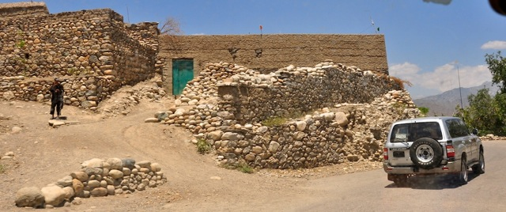
Production Facility Role
is_a
Mosque Role
is_a
Facility Role
Area
is_a
School Role
has_role
is_a
has_location
Safe House Role
Building
has_location
Site
instance_of

Slide 6
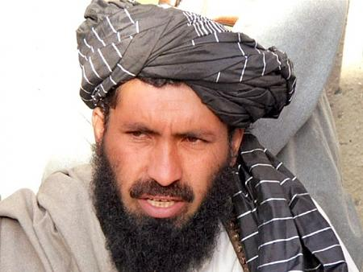
Brother Role
is_a
Mullah Role
is_a
Person Role
is_a
Husband
has_role
is_a
Insurgent Role
Person
instance_of

Slide 7
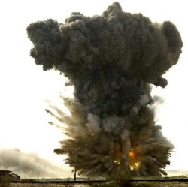
Military Grid Reference System Coordinates
designates
Event
instance_of
Site
is_a
has_part
VT 3394 8472
IED Detonation
Area
has_role
instance_of
has_role
has_role
has_role
Area of Interest
Area of Operations
Area Target
Area of Influence

